Slide 1

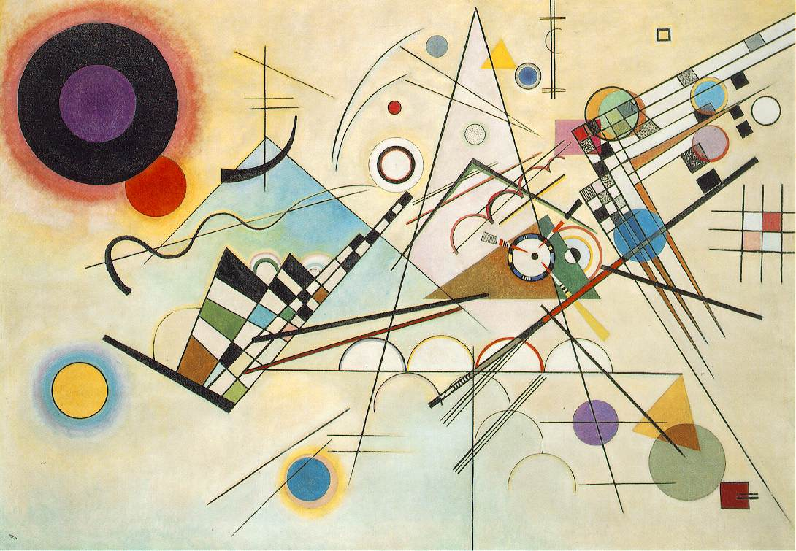
Year 3 Autumn Art Knowledge Mat Expressive drawing to music
Subject Specific Vocabulary |  | Sticky Knowledge | Key Moments in Sketchbooks
tempo | the speed of a musical piece | Wassily Kandinsky To know how to interpret music into visual imagery. To know the name of the artist Wassily Kandinsky. To know that Kandinsky was a Russian painter born in 1866 and died in 1944. To know that Kandinsky was an abstract artist. To know how to combine materials effectively in one drawing. | Artist research pages. Exploring mark-making with pencils, coloured pencils and fine liners. Drawings to different types of music. Exploring expressive mark-making. Photos of collaborative drawings with objects on the floor in response to music. Exploring different combinations of materials in one artwork. NB – Annotation should feature throughout the sketchbooks to show the pupils’ reflections on their work and that of others.
pace | the rhythm or speed of a musical piece | To know that Elizabeth Catlett was an American and Mexican graphic artist and sculptor born in 1915 and died in 2012.
rhythm | the regular repeated pattern of sound
emotion | a strong feeling deriving from your mood | To recognise the artwork ‘The Sharecropper’.
 |  |  | Skills
 |  |  | How to make marks on paper in response to music. How to use the whole of the paper to create an expressive drawing. How to combine pencil, coloured pencil and ink in a drawing.

Slide 2
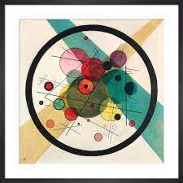
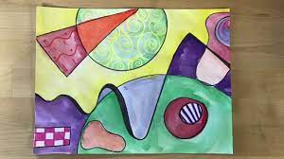
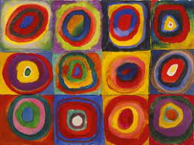
Prior Knowledge | Prior Vocabulary | Curriculum Links
To know how to hold a pencil. To know how to draw an enclosed shape with a pencil. To know how to make a representation of a subject using a pencil. To know a variety of marks that can be made with a pencil. T be able to select appropriate techniques for different parts of a drawing. | Draw, line, shape, mark, pencil, hold, size, round, straight, curved, soft, hard, light, dark, group, fluid, continuous line, angle, drawn, accurate, combine, inspire, research, abstract, features, characteristics. | Music – key words

