Slide 1

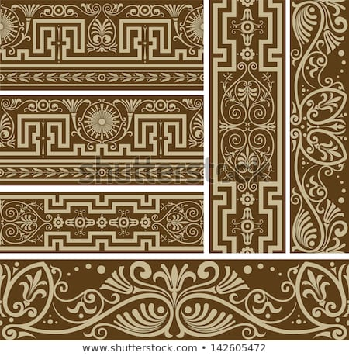
Year 3 Summer Art Knowledge Mat Printing – Roman pattern & design
Subject Specific Vocabulary |  | Sticky Knowledge | Key Moments in Sketchbooks
Roman | Relating to ancient Rome, its empire or its people. | ROMAN PATTERN To know a variety of patterns used in Roman artwork and architecture. To know how to create a relief block using a variety of materials. To know how to create a pattern by printing a design multiple times. | Research pages exploring Roman patterns. Exploring different materials to create a relief printing block. Drawings of different designs. Exploring different compositions and combinations. Experimenting with printing. NB – Annotation should feature throughout the sketchbooks to show the pupils’ reflections on their work and that of others.
border | A physical boundary designed to stop flow across it. | To know that Elizabeth Catlett was an American and Mexican graphic artist and sculptor born in 1915 and died in 2012.
decorative | To make something look more attractive.
pattern | A design in which shapes, lines, forms, or colours are repeated. | To recognise the artwork ‘The Sharecropper’.
 |  |  | Skills
 |  |  | -How to recreate a Roman pattern in a piece of artwork. How to create a relief printing block by sticking objects and materials to a board. How to print a relief block multiple times to create a pattern.

Slide 2
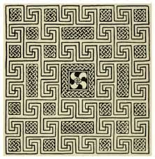
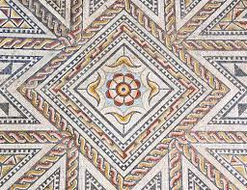
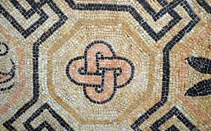
Prior Knowledge | Prior Vocabulary | Curriculum Links
To know how to create a relief print by drawing in foam. To understand that the print will be a mirror image of the design. To understand that printing is a great way to create multiples of the same image. | Print, printing, mirror-image, colour, primary, secondary, paint, mix, complementary, design, multiple, relief print, mark-making, mixing, experiment. | History - Romans

