Slide 1

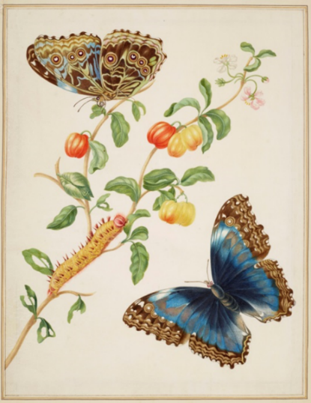
Year 4 Autumn Art Knowledge Mat Colour – exploring nature
Subject Specific Vocabulary |  | Sticky Knowledge | Key Moments in Sketchbooks
Direct observation | drawing what you see in front of you as realistically as possible | Maria Sybilla Merian To understand pattern and symmetry. To use their observational skills in relation to drawing a subject. To begin to be able to more accurately represent a subject using colour. To be able to select appropriate mark-making techniques for different aspects of a drawing. To know the name of the artist Maria Sibylla Merian. To know that Maria Sibylla Merian was born in Germany in 1647 and was an artist, scientist and adventurer. To know that Sibylla was a pioneer in her field and discovered many new facts about the insects she studied. To know that at a time when superstition and lack of education was common, Maria courageously tried to find new ways to live. Women then did not often travel and few received an education. She challenged old ideas about both nature and women’s roles. To recognise and be able to express key features in their own and others artwork. | Artist research pages. Exploring mark-making with pencils, coloured pencils and fine liners. Drawing of insects from photographs. Drawings of plants through direct observation. Exploring different combinations of materials in one artwork.
pioneer | someone who is the first to do something | To know that Elizabeth Catlett was an American and Mexican graphic artist and sculptor born in 1915 and died in 2012.
aspect | the shape or appearance of something
superstition | a belief that is based on fear of the unknown and faith in good or bad luck | To recognise the artwork ‘The Sharecropper’.
 |  |  | Skills
 |  |  | How to use observational skills to create an accurate drawing. How to refine artwork in order to improve it. How to blend colours to create a desired effect. How to combine different elements to create an effective composition. How to accurately recreate patterns in nature. Experimenting with different compositions. NB – Annotation should feature throughout the sketchbooks to show the pupils’ reflections on their work and that of others.

Slide 2
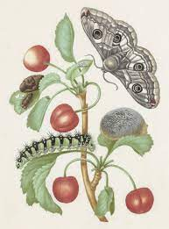
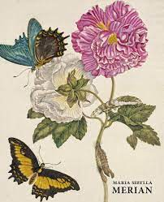
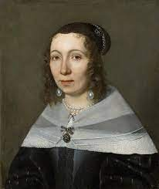
Prior Knowledge | Prior Vocabulary | Curriculum Links
To know how to hold a pencil. To know how to draw an enclosed shape with a pencil. To know how to make a representation of a subject using a pencil. To know a variety of marks that can be made with a pencil. To be able to select appropriate techniques for different parts of a drawing. To know how to combine pencil, coloured pencil and ink in a drawing. To know how to select key features for a picture. To know about a variety of animals and their habitats. To know the visual characteristics of different animals and their habitats. | Draw, line, shape, mark, pencil, hold, size, round, straight, curved, soft, hard, light, dark, group, fluid, continuous line, angle, drawn, accurate, combine, inspire, research, abstract, features, characteristics. | Science – plants, animals, and their habitats

