Slide 1



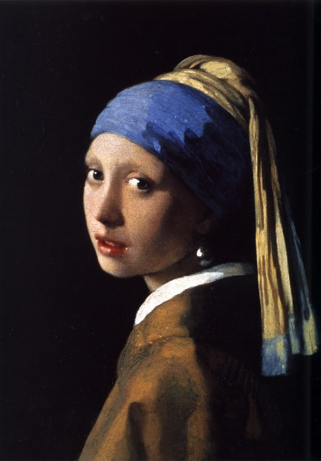
Year 4 Spring Art Knowledge Mat Drawing – Light and Tone
Subject Specific Vocabulary |  | Sticky Knowledge | Key Moments in Sketchbooks
directional light | light that enters from a specific location | Johannes Vermeer To know how to observe light and tone in a subject. To understand where the shadows will fall on a subject considering the direction of the light source. To know how to recreate light and tone in a drawing. To know that Johannes Vermeer (1632 – 1675) was one of the great Dutch masters, though only about 35 paintings by him are known. To know that Vermeer is particularly renowned for his masterly treatment and use of light in his work. | Artist pages – exploring the work of Johannes Vermeer. Exploring light and tone through observational drawings of a group of still life objects. Exploring the use of different materials and techniques to express light and tone. Exploring light and tone on different drawing surfaces. Exploring different compositions for a final composition.
shadow | the area where the light is blocked | To know that Elizabeth Catlett was an American and Mexican graphic artist and sculptor born in 1915 and died in 2012.
tone | the lightness or darkness of a colour
3D | art with all dimensions of height, width and depth | To recognise the artwork ‘The Sharecropper’.
 |  |  | Skills
 |  |  | How to accurately recreate light and tone in a drawing. How to express 3 dimensions in a drawing using light and tone. How to use charcoal, graphite and chalk in combination to show light and tone.

Slide 2
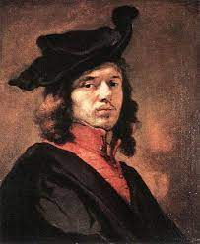
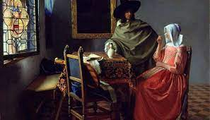
Prior Knowledge | Prior Vocabulary | Curriculum Links
To know how to hold a pencil. To know how to draw an enclosed shape with a pencil. To know how to make a representation of a subject using a pencil. To know a variety of marks that can be made with a pencil. To be able to select appropriate techniques for different parts of a drawing. To know how to combine pencil, coloured pencil and ink in a drawing. To know how to select key features for a picture. | Draw, line, shape, mark, pencil, hold, size, round, straight, curved, soft, hard, light, dark, group, fluid, continuous line, angle, drawn, accurate, combine, inspire, research, abstract, features, characteristics, direct observation. | Science – Light and shadow.

