Slide 1

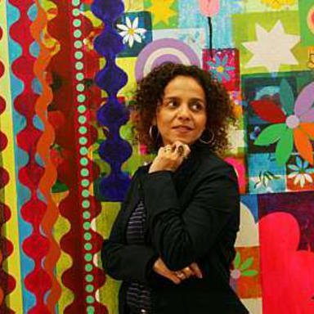
Year 4 Summer Art Knowledge Mat Printing – colour & collage
Subject Specific Vocabulary |  | Sticky Knowledge | Key Moments in Sketchbooks
collage | A piece of art made by sticking various different materials such as photographs and pieces of paper or fabric on to a backing. | ARTIST To know that Beatriz Milhazes is a Brazillian artist born in 1960. To know that Milhazes uses collage and colour in her work. To know how to combine collage and print in an artwork. To know how to use pattern and colour effectively in an abstract composition. | Artist pages exploring Beatriz Milhazes. Exploring different print designs using drawings on foam. Drawings of different designs. Exploring different compositions and combinations of pattern and colour. Experimenting with printing onto collage. NB – Annotation should feature throughout the sketchbooks to show the pupils’ reflections on their work and that of others.
vibrant | Bright, exciting, full of life and colour and energy. | To know that Elizabeth Catlett was an American and Mexican graphic artist and sculptor born in 1915 and died in 2012.
collaborative | Two or more parties working together.
detailed | Work produced with many patterns and intricacies. | To recognise the artwork ‘The Sharecropper’.
 |  |  | Skills
 |  |  | How to create a 2-colour print. How to combine print and collage effectively in one artwork. How to explore and experiment with pattern, shape and texture in an artwork.

Slide 2
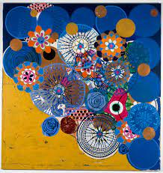
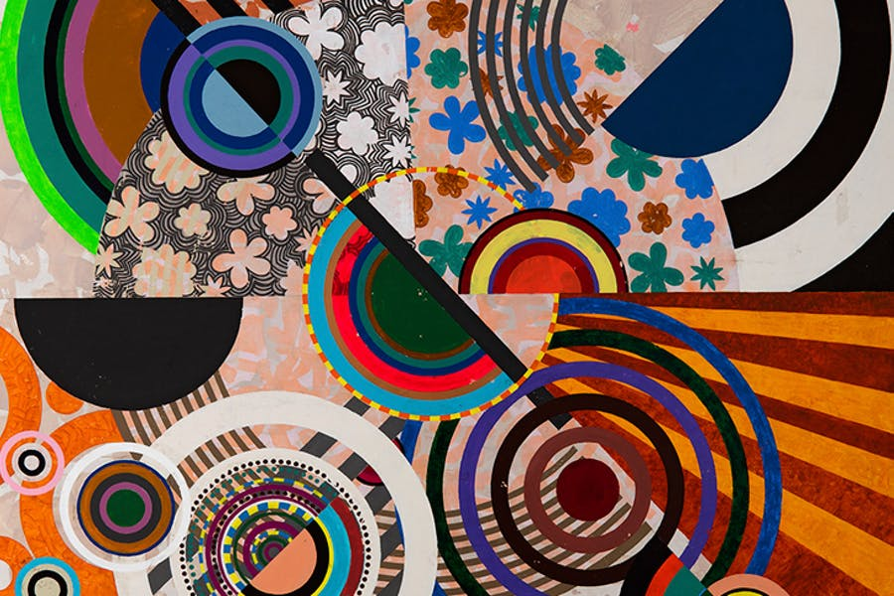
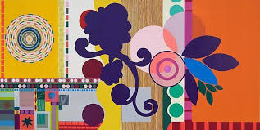
Prior Knowledge | Prior Vocabulary | Curriculum Links
To know the difference between primary and secondary colours. To know how to mix secondary colours. To know which colours complement each other. To know how to create different tones of a colour, from the darkest to the lightest. To know how to create a relief print by drawing in foam. To understand that the print will be a mirror image of the design. To understand that printing is a great way to create multiples of the same image. | Print, printing, mirror-image, colour, primary, secondary, tertiary, paint, mix, complementary, design, multiple, relief print, mark-making, mixing, experiment, decorative, pattern. | Jigsaw – team work

