Slide 1

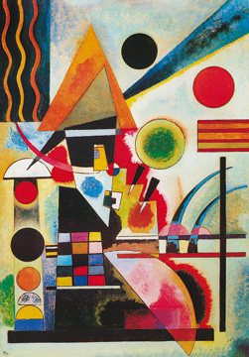
Year 5 Autumn Art Knowledge Mat Mood – vibrancy, light and tone
Subject Specific Vocabulary |  | Sticky Knowledge | Key Moments in Sketchbooks
hue | a colour or shade | Wassily Kandinski To be able to lighten the tone of a colour using white. To be able to darken the tone of a colour without using black. To be able to select appropriate colours with reference to mood. To be able to select appropriate tools for making different marks and effects with paint. | Artist research pages. Exploring mark-making with pencils and paint. Drawings and paintings to different types of music. Exploring expressive mark-making. Exploring colour in relation to mood. NB – Annotation should feature throughout the sketchbooks to show the pupils’ reflections on their work and that of others.
vibrancy | striking brightness of colour | To know that Elizabeth Catlett was an American and Mexican graphic artist and sculptor born in 1915 and died in 2012.
staccato | a series of sounds that are each sharply separated from the others
crescendo | a gradually increasing sound | To recognise the artwork ‘The Sharecropper’.
 |  |  | Skills
 |  |  | How to interpret music and sound into visual imagery, considering colour in relation to mood. How to explain colour choices in artwork.

Slide 2
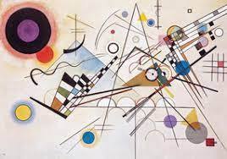
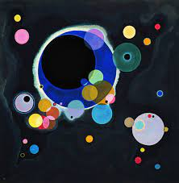
Prior Knowledge | Prior Vocabulary | Curriculum Links
To know how to hold a pencil. To know how to draw an enclosed shape with a pencil. To know a variety of marks that can be made with a pencil. To be able to select appropriate techniques for different parts of a drawing. To know how to interpret music into visual imagery. To know the name of the artist Wassily Kandinsky. To know that Kandinsky was a Russian painter born in 1866 and died in 1944. To know that Kandinsky was an abstract artist. | Draw, line, shape, mark, pencil, hold, size, round, straight, curved, soft, hard, light, dark, group, fluid, continuous line, angle, drawn, accurate, combine, inspire, research, abstract, features, characteristics, response, interpret, tempo, pace, rhythm, quick, feelings, emotion. | Music – key words

