Slide 1


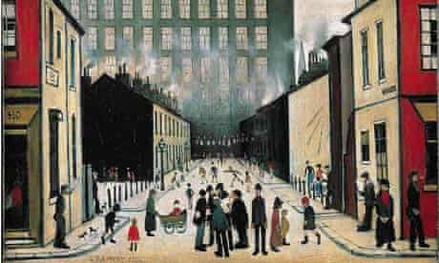
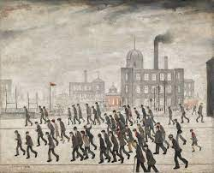
Year 5 Spring Art Knowledge Mat Drawing-perspective
Subject Specific Vocabulary |  | Sticky Knowledge | Key Moments in Sketchbooks
perspective | the representation of 3D and 2D objects showing depth | LS Lowry Key information about artists studied. The fundamental rules in perspective. | Artist pages – exploring the work of L S Lowry Exploring perspective through observational drawings of buildings. Exploring different compositions for a final artwork. Experimenting with materials NB – Annotation should feature throughout the sketchbooks to show the pupils’ reflections on their work and that of others.
industrial | relating to manufacturing and trade | To know that Elizabeth Catlett was an American and Mexican graphic artist and sculptor born in 1915 and died in 2012.
urban | characteristic of a town or city
composition | the way in which different elements of artwork are combined or arranged | To recognise the artwork ‘The Sharecropper’.
 |  |  | Skills
 |  |  | How to show simple perspective in a drawing. How to capture a street scene.

Slide 2
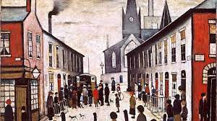
Prior Knowledge | Prior Vocabulary | Curriculum Links
To know how to hold a pencil. To know how to draw an enclosed shape with a pencil. To know how to make a representation of a subject using a pencil. To know a variety of marks that can be made with a pencil. To be able to select appropriate techniques for different parts of a drawing. To know how to combine pencil, coloured pencil and ink in a drawing. To know how to select key features for a picture. | Draw, line, shape, mark, pencil, hold, size, round, straight, curved, soft, hard, light, dark, group, fluid, continuous line, angle, drawn, accurate, combine, inspire, research, abstract, features, characteristics, direct observation. | History - Victorians

