Slide 1

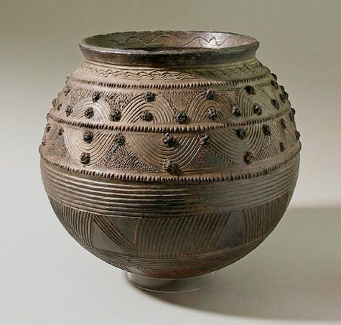
Year 5 Summer Art Knowledge Mat Sculpture – Coil pots
Subject Specific Vocabulary |  | Sticky Knowledge | Key Moments in Sketchbooks
ceramics | Decorative objects made out of clay or similar natural materials. | AFRICAN CERAMIC DESIGN Research pages exploring African patterns. Research pages about clay as a material. Exploring clay and the different ways of moulding and shaping it (photos). Drawings of different designs for a coil pot. Experimenting pattern and decoration. | Research pages exploring African patterns. Research pages about clay as a material. Exploring clay and the different ways of moulding and shaping it (photos). Drawings of different designs for a coil pot. Experimenting pattern and decoration. NB – Annotation should feature throughout the sketchbooks to show the pupils’ reflections on their work and that of others.
border | A physical boundary designed to stop flow across it. | To know that Elizabeth Catlett was an American and Mexican graphic artist and sculptor born in 1915 and died in 2012.
coil | A shape made with the clay from rolling.
 |  |  | Skills
decorative | To make something look more attractive. | To recognise the artwork ‘The Sharecropper’. | Skills: How to create a basic coil pot out of clay. How to decorate a coil pot using patterns and designs inspired by African ceramics. How to select appropriate tools to create a pattern in clay.

Slide 2

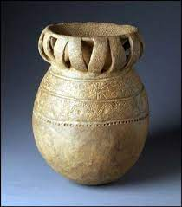
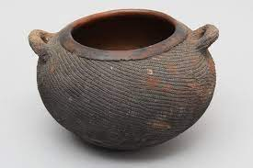
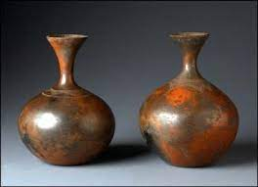
Prior Knowledge | Prior Vocabulary | Curriculum Links
To know how to use your hands to mould a material into different simple shapes. To know how to create a representation of a subject using a mouldable material. | Mould, shape, mark, line, press, roll, squeeze, experiment, inspired. | Geography - Africa

