Slide 1

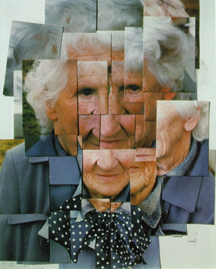
Year 6 Autumn Art Knowledge Mat Colour –Self portraits
Subject Specific Vocabulary |  | Sticky Knowledge | Key Moments in Sketchbooks
combined | to join or merge | David Hockney To know that David Hockney is an influential British artist born in Bradford in 1937. To be able to recognise the painting ‘Mother’ and to know that this technique was created through experimentation with materials and processes. To know how to match colours by mixing paint. To know how to combine photographs and paint in one piece of artwork. | Artist research pages. Colour mixing. Exploring combining collage and paint in an artwork. Experimenting with composition. NB – Annotation should feature throughout the sketchbooks to show the pupils’ reflections on their work and that of others.
match | to resemble or correspond | To know that Elizabeth Catlett was an American and Mexican graphic artist and sculptor born in 1915 and died in 2012.
photography | the practice of taking photographs
 |  | To recognise the artwork ‘The Sharecropper’.
 |  |  | Skills
 |  |  | How to match colours by mixing paint. How to paint with control and accuracy. How to combine photographs with paint in a final artwork. .

Slide 2
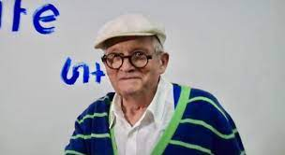
Prior Knowledge | Prior Vocabulary | Curriculum Links
To know the difference between primary and secondary colours. To know how to mix secondary colours. To know which colours complement each other. To know how to create different tones of a colour, from the darkest to the lightest. To be able to lighten the tone of a colour using white. To be able to darken the tone of a colour without using black. To be able to select appropriate colours with reference to mood. To be able to select appropriate tools for making different marks and effects with paint. | Colour, primary, secondary, tertiary, paint, mix, complementary, hue, vibrancy. | Music – key words

