Slide 1


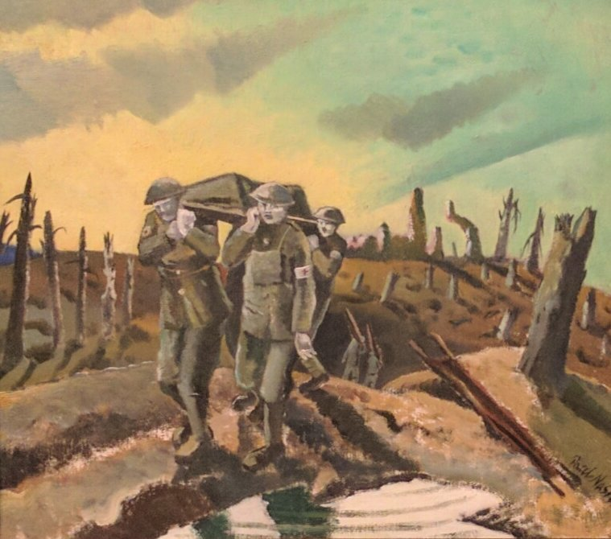
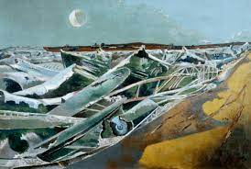
Year 6 Spring Art Knowledge Mat Drawing: Narrative and Illustration WW2
Subject Specific Vocabulary |  | Sticky Knowledge | Key Moments in Sketchbooks
interpretation | The action of explaining the meaning of something | Paul Nash To know the name of the war artist Paul Nash. To know that Paul Nash was a British artist born in 1889 and died in 1946. To recognise the Paul Nash painting ‘Ashen faced medics stretcher a wounded colleague, framed by a bright sky’. | Artist pages – exploring the work of Paul Nash. Exploring drawing techniques and combinations of materials. Exploring key themes in Wilfred Owen Poetry through visual imagery. Exploring narrative in artwork. Experimenting with composition.
Visual imagery | The sense of having pictures in our mind | To know that Elizabeth Catlett was an American and Mexican graphic artist and sculptor born in 1915 and died in 2012.
narrative | The story
 |  |  | Skills
Story telling | The sharing of stories through art
 |  |  | How to express a narrative in a piece of artwork. How to consider narrative in relation to composition. How to interpret written stimulus into visual imagery..
 |  | To recognise the artwork ‘The Sharecropper’.

Slide 2
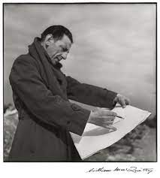
Prior Knowledge | Prior Vocabulary | Curriculum Links
To know how to hold a pencil. To know how to draw an enclosed shape with a pencil. To know how to make a representation of a subject using a pencil. To know a variety of marks that can be made with a pencil. To be able to select appropriate techniques for different parts of a drawing. To know how to combine pencil, coloured pencil and ink in a drawing. To know how to select key features for a picture. | Draw, line, shape, mark, pencil, hold, size, round, straight, curved, soft, hard, light, dark, group, fluid, continuous line, angle, drawn, accurate, combine, inspire, research, abstract, features, characteristics. | History – World War 1 and 2

