Slide 1

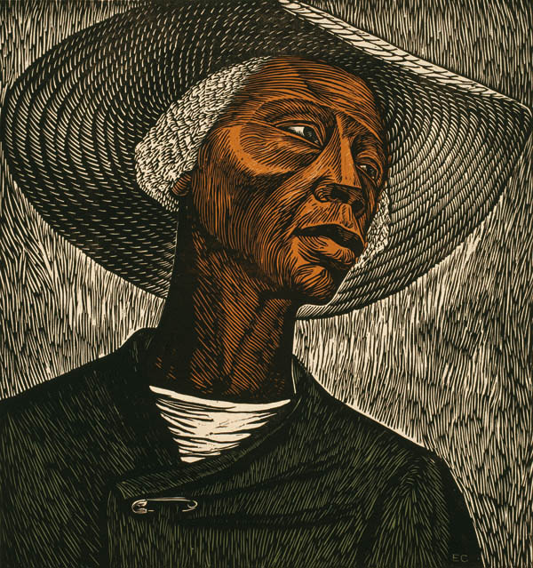
Year 6 Summer Art Knowledge Mat Printing – Mono-print
Subject Specific Vocabulary |  | Sticky Knowledge | Key Moments in Sketchbooks
mono -print | Mono-printing is a form of printmaking that has lines or images that can only be made once, unlike most printmaking, which allows for multiple originals. There are many techniques of mono-printing. | ARTIST To know the name of the artist Elizabeth Catlett. To know that Elizabeth Catlett was an American and Mexican graphic artist and sculptor born in 1915 and died in 2012. To know that Catlett was famous for political art, depicting race, feminism and injustice. To recognise the artwork ‘The Sharecropper’. | Research pages exploring Elizabeth Catlett’s artwork. Experiments with mono-printing. Drawings of different designs. Exploring different compositions and combinations. Experimenting with printing, drawing and painting in the same artwork. NB – Annotation should feature throughout the sketchbooks to show the pupils’ reflections on their work and that of others.
sculptor | An artist who makes sculptures – an artistic form in which materials are worked into 3D objects. | To know that Elizabeth Catlett was an American and Mexican graphic artist and sculptor born in 1915 and died in 2012.
composition | Organising or putting together different elements of art
graphic artist | Someone who uses visual art to create images (painting, drawing, printing) | To recognise the artwork ‘The Sharecropper’.
 |  |  | Skills
 |  |  | -How to mono-print - How to combine mono-printing and drawing or painting in order to introduce colour.

Slide 2
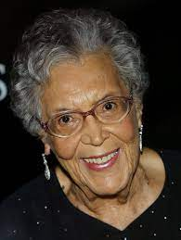
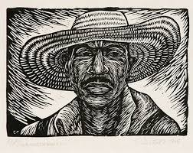
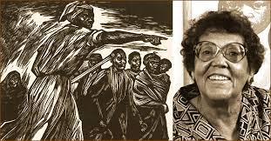
Prior Knowledge | Prior Vocabulary | Curriculum Links
To know how to create a relief print by drawing in foam. To understand that the print will be a mirror image of the design. To understand that printing is a great way to create multiples of the same image. | Print, printing, mirror-image, colour, primary, secondary, paint, mix, complementary, design, multiple, relief print, mark-making, mixing, experiment. | Social History.

