Slide 1


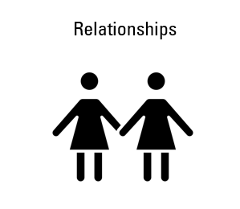
Year R PSHE Knowledge Mat Relationships
Subject Specific Vocabulary |  | Knowledge | Key Questions
Relationship | The way in which two or more people or groups regard and behave towards each other and are connected. | Relationships | Who is in your family? What jobs do mummy / daddy do around the house? Who are your friends? How do they make you feel? What do you do if your friend makes you upset? How does Jigsaw Jenie help you stay calm?
Feelings | An experience created after the physical sensation or emotional experience. | Know what Family is. Know that different people in families have different responsibilities (jobs) Know some of the characteristics of a healthy and safe relationship. Know that friends sometimes fall out. Knows some ways to mend a friendship. Know that unkind words can never be taken back and they can hurt. Know how to use Jigsaw Calm Me time to help when feeling angry. Know some reasons why others get angry.
Angry | Feeling or showing strong annoyance, displeasure, or hostility; full of anger.
Upset | To feel or make someone feel unhappy, disappointed, or worried.
Family, Jobs,Calm, Relationship, Friend, Lonely, Argue, Fall-out, |  | Children are introduced to the key relationships in their lives. They learn about families and the different roles people can have in a family. They explore the friendships they have and what makes a good friend. They are introduced to simple strategies they can use to mend friendships. The children also learn about Jigsaw’s Calm Me and how they can use this when feeling upset or angry. | Skills
 |  |  | Can identify what jobs they do in their family and those carried out by parents/carers and siblings Can suggest ways to make a friend or help someone who is lonely. Can use different ways to mend a friendship. Can recognise what being angry feels like. Can use Calm Me when angry or upset.

Slide 2
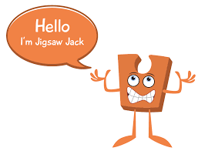
Year 1 PSHE Knowledge Mat Relationships
Subject Specific Vocabulary |  | Relationships | Key Questions
Relationship | The way in which two or more people. | Knowledge | Who is in our family? Do any of your friends have a family that is different? What does ‘being a good friend’ mean? Who are your good friends? Who do you/don’t you hug? Who can you ask for help at school?
Feelings | An experience created after the physical sensation or emotional experience. | Know that everyone’s family is different. Know that there are lots of different types of families. Know that families are founded on belonging, love and care. Know how to make a friend. Know the characteristics of healthy and safe friends. Know that physical contact can be used as a greeting. Know about different people in the school community and how they help. Know who to ask for help in the school community.
Argue | Exchange or express diverging or opposite views, typically in a heated or angry way.
Friend | A person with whom one has a bond of mutual affection.
Family, Jobs, Lonely, Fall-out, Words, Angry, Upset, Calm me, Breathing. |  | Children’s breadth of relationships is widened to include people they may ﬁnd in their school community. They consider their own signiﬁcant relationships (family, friends and school community) and why these are special and important. As part of the learning on healthy and safe relationships, children learn that touch can be used in kind and unkind ways. This supports later work on safeguarding. Pupils also consider their own personal attributes as a friend, family member and as part of a community, and are encouraged to celebrate these. | Skills
 |  |  | Can express how it feels to be part of a family. Can say what being a good friend means. Can show skills of friendship. Can identify forms of physical contact they prefer. Can say no when they receive touch they don’t like. Can praise themselves and others. Can recognise some of their personal qualities.

Slide 3

Prior Learning | Local /National | Unit Objective YR
Know what Family is. Know that different people in families have different responsibilities (jobs) Know some of the characteristics of a healthy and safe relationship. Know that friends sometimes fall out. Knows some ways to mend a friendship. Know that unkind words can never be taken back and they can hurt. Know how to use Jigsaw Calm Me time to help when feeling angry. Know some reasons why others get angry. | People who help us in the community. | Children are introduced to the key relationships in their lives. They learn about families and the different roles people can have in a family. They explore the friendships they have and what makes a good friend. They are introduced to simple strategies they can use to mend friendships. The children also learn about Jigsaw’s Calm Me and how they can use this when feeling upset or angry.

Slide 4
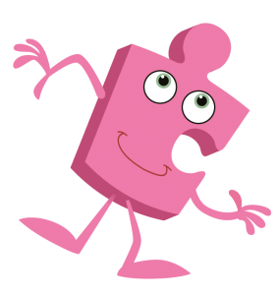
Year 2 PSHE Knowledge Mat Relationships
Subject Specific Vocabulary |  | Relationships | Key Questions
Relationship | The way in which two or more people. | Knowledge | What’s the same / different from our family to your friend’s family? What would you do if someone was hurting you at school? Who would you go to for help at school? Why do people fall out with each other? What can you do if you don’t agree with your friend? Can we share what we are grateful for in our family? Can you explain to me what ‘Mending Friendships’ is about?
Acceptable | Able to be agreed on; suitable, allowed. | Know that everyone's family is different. Know that families function well when there is trust, respect, care, love and cooperation. Know that there are lots of forms of physical contact within family. Know how to say stop if someone is hurting them. Know some reasons why friend have conflict. Know that friendships have ups and downs and some change with time. Know how to use the Mending Friendships or Solve-it-together problem-solving methods. Know there are good secrets and worry secrets and why it is important to share worry secrets. Learning about family relationships widens to include roles and responsibilities in a family and the importance of co-operation, appreciation and trust. Friendships are also revisited with a focus on falling out and mending friendships. This becomes more formalised and the children learn and practise two different strategies for conflict resolution (Solve-it-together and Mending Friendships). Children consider the importance of trust in relationships and what this feels like. They also learn about two types of secret, and why ‘worry secrets’ should always be shared with a trusted adult. Children reflect upon different types of physical contact in relationships, which are acceptable and which ones are not. They practise strategies for being assertive when someone is hurting them or being unkind. The children also discuss people who can help them if they are worried or scared.
Trust | Firm belief in the reliability, truth, or ability of someone or something.
Secret | Not known or seen or not meant to be known or seen by others.
Different, Similarities, Relationship, Important, Co-operate, Touch, Physical contact, Communication, Like, Dislike, Not acceptable, Friends, Conflict, Point of view, Positive problem solving, Secret, Surprise, Good secret, Worry secret, Telling, Adult, Trust, Happy, Sad, Frightened, Trust, Trustworthy, Honesty, Reliability, Compliments, Celebrate, Appreciate.
Family, Jobs, Lonely, Fall-out, Words, Angry, Upset, Calm me, Breathing. |  | Learning about family relationships widens to include roles and responsibilities in a family and the importance of co-operation, appreciation and trust. Friendships are also revisited with a focus on falling out and mending friendships. This becomes more formalised and the children learn and practise two different strategies for conflict resolution (Solve-it-together and Mending Friendships). Children consider the importance of trust in relationships and what this feels like. They also learn about two types of secret, and why ‘worry secrets’ should always be shared with a trusted adult. Children reflect upon different types of physical contact in relationships, which are acceptable and which ones are not. They practise strategies for being assertive when someone is hurting them or being unkind. The children also discuss people who can help them if they are worried or scared. | Skills
 |  |  | Can identify the different roles and responsibilities in their family. Can recognise and talk about the types of physical contact that is acceptable or unacceptable. Can use positive problem-solving techniques (Mending Friendships or Solve-it-together) to resolve a friendship conflict Can identify the negative feelings associated with keeping a worry secret Can identify who they trust in their own relationships Can give and receive compliments Can say who they would go to for help if they were worried or scared

Slide 5

Prior Learning | Local /National | Unit Objective Y1
Know that everyone’s family is different. Know that there are lots of different types of families. Know that families are founded on belonging, love and care. Know how to make a friend. Know the characteristics of healthy and safe friends. Know that physical contact can be used as a greeting. Know about different people in the school community and how they help. Know who to ask for help in the school community. | People who help us in the community. Friendships. School values. | Children’s breadth of relationships is widened to include people they may ﬁnd in their school community. They consider their own signiﬁcant relationships (family, friends and school community) and why these are special and important. As part of the learning on healthy and safe relationships, children learn that touch can be used in kind and unkind ways. This supports later work on safeguarding. Pupils also consider their own personal attributes as a friend, family member and as part of a community, and are encouraged to celebrate these.

Slide 6
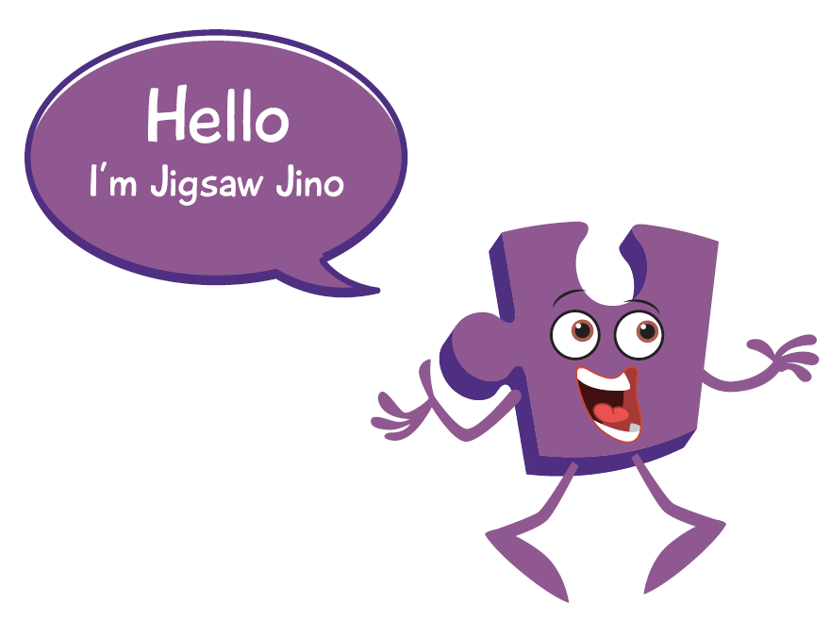
Year 3 PSHE Knowledge Mat Relationships
Subject Specific Vocabulary |  | Relationships | Key Questions
Relationship | The way in which two or more people. | Knowledge | What jobs does everyone do in the house? What makes a good friend? Can you tell me about a time when you were really good at sharing / taking turns / listening? How can you stay safe online? What should our rules be? What would you do if you saw or heard something online that made you feel worried? What rights do children have? How could we use the Solve-it-together technique at home?
Unisex | Designed to be suitable for both sexes | Know that different family members carry out different roles or have different responsibilities within the family Know that gender stereotypes can be unfair e.g. Mum is always the carer, Know some of the skills of friendship, e.g. taking turns, being a good listener Know some strategies for keeping themselves safe online Know how some of the actions and work of people around the world help and influence my life Know that they and all children have rights (UNCRC) Know the lives of children around the world can be different from their own Children revisit family relationships and identify the different expectations and roles that exist within the family home. They identify stereotypes. They also look at careers and why stereotypes can be unfair in this context. They learn that families should be founded on love, respect, appreciation, trust and cooperation. Children are reminded about the solve-it-together technique for negotiating conflict situations and the concept of a win-win outcome is introduced. Online relationships through gaming and Apps is explored and children are introduced to some rules for staying safe online.
Stereotype | A widely held but fixed and oversimplified image or idea of a particular type of person or thing.
Rights | A moral or legal entitlement to have or do something.
Male, Female, Career, Job, Responsibilities, Respect, Differences, Similarities, Conflict, Win-win, Solution,, Internet, Social media, Online, Risky, Gaming, Safe, Unsafe, Private messaging, Direct messaging, Global, Communication, Fair trade, Inequality, Food journey, Climate, Transport, Exploitation, Needs, Wants, Justice, United Nations, Equality, Deprivation, Hardship, Appreciation, Gratitude, Celebrate.
Family, Jobs, Lonely, Fall-out, Words, Angry, Upset, Calm me, Breathing. |  | Learning about family relationships widens to include roles and responsibilities in a family and the importance of co-operation, appreciation and trust. Friendships are also revisited with a focus on falling out and mending friendships. This becomes more formalised and the children learn and practise two different strategies for conflict resolution (Solve-it-together and Mending Friendships). Children consider the importance of trust in relationships and what this feels like. They also learn about two types of secret, and why ‘worry secrets’ should always be shared with a trusted adult. Children reflect upon different types of physical contact in relationships, which are acceptable and which ones are not. They practise strategies for being assertive when someone is hurting them or being unkind. The children also discuss people who can help them if they are worried or scared. | Skills
 |  |  | Can identify the responsibilities they have within their family Can use Solve-it-together in a conflict scenario and find a win-win outcome Know how to access help if they are concerned about anything on social media or the internet Can empathise with people from other countries who may not have a fair job/ less fortunate Understand that they are connected to the global community in many different ways Can identify similarities in children’s rights around the world
Children also learn that they are part of a global community and they are connected others in many ways e.g. through global trade. They investigate the wants and needs of others. Children’s universal rights are also revisited.

Slide 7

Prior Learning | Local /National | Unit Objective Y2
Know that everyone's family is different. Know that families function well when there is trust, respect, care, love and cooperation. Know that there are lots of forms of physical contact within family. Know how to say stop if someone is hurting them. Know some reasons why friend have conflict. Know that friendships have ups and downs and some change with time. Know how to use the Mending Friendships or Solve-it-together problem-solving methods. Know there are good secrets and worry secrets and why it is important to share worry secrets. | People who help us in the community. Conflict at home, school and in the community. School values. | Learning about family relationships widens to include roles and responsibilities in a family and the importance of co-operation, appreciation and trust. Friendships are also revisited with a focus on falling out and mending friendships. This becomes more formalised and the children learn and practise two different strategies for conflict resolution (Solve-it-together and Mending Friendships). Children consider the importance of trust in relationships and what this feels like. They also learn about two types of secret, and why ‘worry secrets’ should always be shared with a trusted adult. Children reflect upon different types of physical contact in relationships, which are acceptable and which ones are not. They practise strategies for being assertive when someone is hurting them or being unkind. The children also discuss people who can help them if they are worried or scared.

Slide 8

Year 4 PSHE Knowledge Mat Relationships
Subject Specific Vocabulary |  | Relationships | Key Questions
Relationship | The way in which two or more people. | Knowledge | Can you tell me about a time when you felt jealous? Did it affect how you behaved? Can we tell each other about the people we love? Do you miss seeing anyone? Who could we make a memory box for? Have you ever fallen out with any of your friends? What happened? How did you resolve it? Do you have any friends that you fall out with a lot? Does Calm Me time help you stay calm?
Jealousy | Feeling or showing an envious resentment of someone or their achievements, possessions, or advantages. | Know some reasons why people feel jealousy Know that jealousy can be damaging to relationships Know that loss is a normal part of relationships Know that negative feelings are a normal part of loss Know that memories can support us when we lose a special person or animal Know that change is a natural part of relationships/ friendship Know that sometimes it is better for a friendship/ relationship to end if it is causing negative feelings or is unsafe Children are focussing on the emotional aspects of relationships and friendships. With this in mind, children explore jealousy and loss/ bereavement. They identify the emotions associated with these relationship changes, the possible reasons for the change and strategies for coping with the change. The children learn that change is natural in relationships and they will experience (or may have already experienced) some of these changes. Children revisit skills of negotiation particularly to help manage a change in a relationship. They also learn that sometimes it is better if relationships end, especially if they are causing negative feelings or they are unsafe. Children are taught that relationship endings can be amicable.
Empathy | The ability to understand and share the feelings of another.
Compromise | An agreement or settlement of a dispute that is reached by each side
Close, Problem-solve, Emotions, Positive, Negative, Loss, Shock, Disbelief, Numb, Denial, Anger, Guilt, Sadness, Pain, Despair, Hope, Souvenir, Memento, Memorial, Acceptance, Relief, Remember, Negotiate, Trust, Loyal, Betrayal, Amicable, Appreciation, Love. |  |  | Skills
 |  |  | Can identify feelings and emotions that accompany jealousy Can suggest positive strategies for managing jealousy Can identify people who are special to them and express why Can identify the feelings and emotions that accompany loss Can suggest strategies for managing loss Can tell you about someone they no longer see Can suggest ways to manage relationship changes including how to negotiate

Slide 9

Prior Learning | Local /National | Unit Objective Y3
Know that different family members carry out different roles or have different responsibilities within the family Know that gender stereotypes can be unfair e.g. Mum is always the carer, Know some of the skills of friendship, e.g. taking turns, being a good listener Know some strategies for keeping themselves safe online Know how some of the actions and work of people around the world help and influence my life Know that they and all children have rights (UNCRC) Know the lives of children around the world can be different from their own | People who help us in the community. Right respecting- Children's rights Globally. | Revisit family relationships and identify the different expectations and roles that exist within the family home. They identify stereotypes. They also look at careers and why stereotypes can be unfair in this context. They learn that families should be founded on love, respect, appreciation, trust and cooperation. Children are reminded about the solve-it-together technique for negotiating conflict situations and the concept of a win-win outcome is introduced. Online relationships through gaming and Apps is explored and children are introduced to some rules for staying safe online.

Slide 10
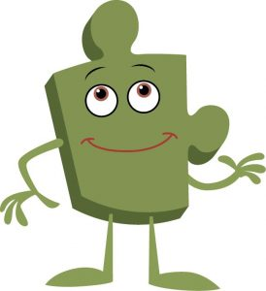
Year 5 PSHE Knowledge Mat Relationships
Subject Specific Vocabulary |  | Relationships | Key Questions
Relationship | The way in which two or more people. | Knowledge | What online games do you like to play? Who do you play them with? Do you ever talk to people you don’t know online? How do you know if people you talk to online are really who they say they are? What would you do if you saw or heard something online that made you feel uncomfortable? How much screen time do you think you should have every day? How shall we spend some special family time?
SMART | Safe, Meeting, Accepting, Reliability and Tell. | Know that a personality is made up of many different characteristics, qualities and attributes Know that belonging to an online community can have positive and negative consequences Know that there are rights and responsibilities in an online community or social network Know that there are rights and responsibilities when playing a game online Know that too much screen time isn’t healthy Know how to stay safe when using technology to communicate with friends Children learn about the importance of self-esteem and ways this can be boosted. They investigate and reflect upon a variety of positive and negative online/ social media contexts including gaming and social networking. They learn about age -limits and also age-appropriateness. Within these lessons, children are taught the SMARRT internet safety rules and they apply these in different situations. Risk, pressure and influences are revisited with a focus on the physical and emotional aspects of identifying when something online or in social media feels uncomfortable or unsafe. Children are taught about grooming and how people online can pretend to be whoever they want. Rights, responsibilities and respect are revisited with an angle on technology use. Screen time is also discussed and children find ways to reduce their own screen time.
Personal Attribute | a quality or feature regarded as a characteristic or inherent part of someone or something.
Gambling | Wagering something of value ("the stakes") on an event with an uncertain outcome with the intent of winning something else of value.
Qualities, Characteristics, Self-esteem, Unique, Comparison, Negative self-talk, Social media, Online, Community, Risky, Positive, Negative, Safe, Unsafe, Rights, Responsibilities, Social network, Gaming, Violence, Grooming, Troll, Betting, Trustworthy, Appropriate, Screen time, Physical health, Mental health, Off-line, Social, Peer pressure, Influences, Personal information, Passwords, Privacy, Settings, Profile.
Qualities, Characteristics, Self-esteem, Unique, Comparison, Negative self-talk, Social media, Online, Community, Risky, Positive, Negative, Safe, Unsafe, Rights, Responsibilities, Social network, Gaming, Violence, Grooming, Troll, Betting, Trustworthy, Appropriate, Screen time, Physical health, Mental health, Off-line, Social, Peer pressure, Influences, Personal information, Passwords, Privacy, Settings, Profile, SMARRT rules |  |  | Skills
 |  |  | Can suggest strategies for building self-esteem of themselves and others Can identify when an online community / social media group feels risky, uncomfortable, or unsafe Can suggest strategies for staying safe online/ social media Can say how to report unsafe online / social network activity Can identify when an online game is safe or unsafe Can suggest ways to monitor and reduce screen time Can suggest strategies for managing unhelpful pressures online/ social media

Slide 11

Prior Learning | Local /National | Unit Objective Y4
Know some reasons why people feel jealousy Know that jealousy can be damaging to relationships Know that loss is a normal part of relationships Know that negative feelings are a normal part of loss Know that memories can support us when we lose a special person or animal Know that change is a natural part of relationships/ friendship Know that sometimes it is better for a friendship/ relationship to end if it is causing negative feelings or is unsafe | People who help us in the community. Right respecting- Children's rights Globally. Internet safety at home and school. | Children are focussing on the emotional aspects of relationships and friendships. With this in mind, children explore jealousy and loss/ bereavement. They identify the emotions associated with these relationship changes, the possible reasons for the change and strategies for coping with the change. The children learn that change is natural in relationships and they will experience (or may have already experienced) some of these changes. Children revisit skills of negotiation particularly to help manage a change in a relationship. They also learn that sometimes it is better if relationships end, especially if they are causing negative feelings or they are unsafe. Children are taught that relationship endings can be amicable.

Slide 12
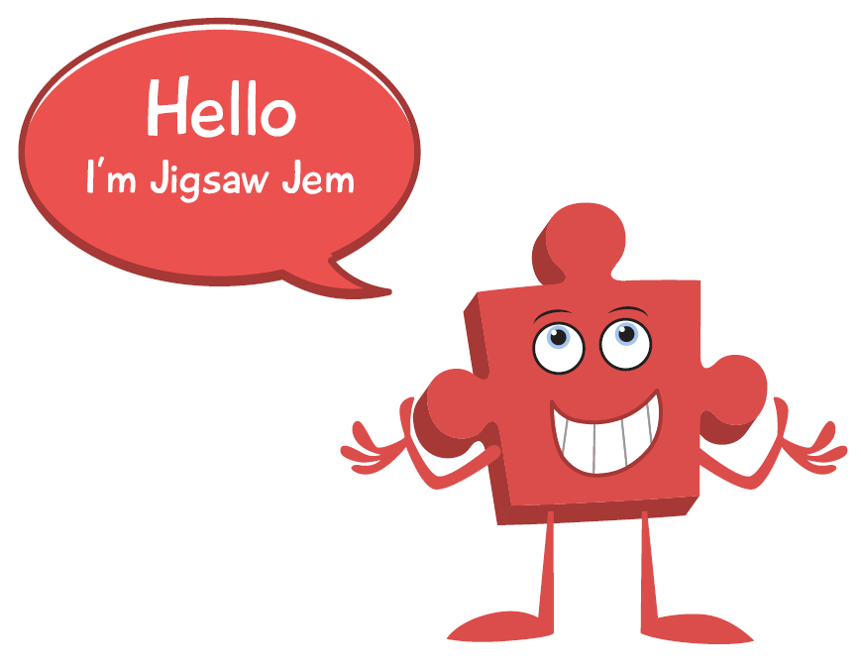
Year 6 PSHE Knowledge Mat Relationships
Subject Specific Vocabulary |  | Relationships | Key Questions
Relationship | The way in which two or more people. | Knowledge | What is mindfulness? What tips can you give me for taking care of my own mental health? What is the grief cycle? Do you have any tips for dealing with grief? Who do you talk to online? What would you do if they said something that you didn’t like? How do you know if a website is genuine?
Mindfulness | The basic human ability to be fully present, aware of where we are and what we're doing, and not overly reactive or overwhelmed | Know that it is important to take care of their own mental health Know ways that they can take care of their own mental health Know the stages of grief and that there are different types of loss that cause people to grieve Know that sometimes people can try to gain power or control them Know some of the dangers of being ‘online’ Know how to use technology safely and positively to communicate with their friends and family. The class look at mental health and how to take care of their own mental well-being. They talk about the grief cycle and its various stages, they also discuss the different causes of grief and loss. The children talk about people who can try to control them or have power over them. They look at online safety, learning how to judge if something is safe and helpful as well as talking about communicating with friends and family in a positive and safe way.
Cyber bullying | Sending, posting, or sharing negative, harmful, false, or mean content about someone else.
 |  |  | Skills
Stigma | A mark of disgrace associated with a particular circumstance, quality, or person.
 |  |  | Recognise that people can get problems with their mental health and that it is nothing to be ashamed of Can help themselves and others when worried about a mental health problem Recognise when they are feeling grief and have strategies to manage them Demonstrate ways they could stand up for themselves and their friends in situations where others are trying to gain power or control Can resist pressure to do something online that might hurt themselves or others Can take responsibility for their own safety and well-being
 |  |  | Skills
Ashamed, Stress, Anxiety, Worried, Warning, Self-harm, Emotions, Feelings, Sadness, Loss, Grief, Denial, Despair, Guilt, Shock, Hopelessness, Anger, Acceptance, Coping strategies, Power, Control, Authority, Bullying, Script, Assertive, Risks, Pressure, Influences, Self-control, Real / fake, Assertiveness, Judgement, Communication, Technology, Power, Abuse, Safety.

Slide 13

Prior Learning | Local /National | Unit Objective Y5
Know that a personality is made up of many different characteristics, qualities and attributes Know that belonging to an online community can have positive and negative consequences Know that there are rights and responsibilities in an online community or social network Know that there are rights and responsibilities when playing a game online Know that too much screen time isn’t healthy Know how to stay safe when using technology to communicate with friends | People who can help us in the community. Right respecting- Children's rights Globally. Internet safety at home and school. The online community. | Children learn about the importance of self-esteem and ways this can be boosted. They investigate and reflect upon a variety of positive and negative online/ social media contexts including gaming and social networking. They learn about age -limits and also age-appropriateness. Within these lessons, children are taught the SMARRT internet safety rules and they apply these in different situations. Risk, pressure and influences are revisited with a focus on the physical and emotional aspects of identifying when something online or in social media feels uncomfortable or unsafe. Children are taught about grooming and how people online can pretend to be whoever they want. Rights, responsibilities and respect are revisited with an angle on technology use. Screen time is also discussed and children find ways to reduce their own screen time.

