Slide 1



Year R PSHE Knowledge Mat Changing Me
Subject Specific Vocabulary |  | Changing Me | Key Questions
Change | An act or process through which something becomes different. | Knowledge | • Which parts of your body do you know the same of? • Who can you talk to if you ever feel worried or frightened? (at school / at home) • Can you tell me about a time when you felt really happy?
Worry | Feel anxious or troubled about actual or potential problems, or change. | Know the names and functions of some parts of the body • Know that we grow from baby to adult • Know who to talk to if they are feeling worried • Know that sharing how they feel can help solve a worry • Know that remembering happy times can help us move on
Adult | A person who is fully grown or developed.
Memories | Something remembered from the past
Eye, Foot, Eyebrow, Forehead, Ear, Mouth, Arm, Leg, Chest, Knee, Nose, Tongue, Finger, Toe, Stomach, Hand, Baby, Grown-up, |  | Children are encouraged to think about how they have changed from being a baby and what may change for them in the future. They consolidate the names and functions of some of the main parts of the body and discuss how these have changed. They learn that our bodies change as we get older in lots of different ways. Children understand that change can bring about positive and negative feelings, and that sharing these can help. They also consider the role that memories can have in managing change. | Skills
 |  |  | . Can identify how they have changed from a baby Can say what might change for them they get older Recognise that changing class can elicit happy and/or sad emotions Can say how they feel about changing class/growing up Can identify positive memories from the past year in school/ home

Slide 2
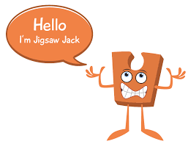

Year 1 PSHE Knowledge Mat Changing Me
Subject Specific Vocabulary |  | Changing Me | Key Questions
Changes | An act or process through which something becomes different. | Knowledge | • What is a life cycle? • How will you change as you grow up? • Which parts of your body are private? • Who is allowed to see your private body parts? • What should you do if you don’t like the way someone is touching you? • Who can you talk to if you ever feel worried or frightened? ( • What is the best part about being your age?
Life cycle | A series of stages through which something passes during its lifetime. | • Know that animals including humans have a life cycle • Know that changes happen when we grow up • Know that people grow up at different rates and that is normal • Know the names of male and female private body parts • Know that there are correct names for private body parts and nicknames, and when to use them • Know which parts of the body are private and that they belong to that person • Know who to ask for help if they are worried or frightened • Know that learning brings about change
Baby | a very young child
Adult | A person who is fully grown or developed.
Adulthood, Grown-up, Mature, Male, Female, Vagina, Penis, Testicles, Vulva, Anus, Learn, New, Grow, Feelings, Anxious, Worried, Excited, Coping. |  | Children are introduced to life cycles e.g. that of a frog and identify the different stages. They compare this with a human life cycle and look at simple changes from baby to adult e.g. getting taller, learning to walk etc. Pupils are taught the correct words for private parts of the body (those kept private by underwear: vagina, anus, penis, testicles, vulva). They are also taught that nobody has the right to hurt these parts of the body. Change is discussed as a natural and normal part of getting older which can bring about happy and sad feelings. Children practise a range of skills to help manage their feelings and ask for help. | Skills
 |  |  | Understand and accepts that change is a natural part of getting older Can identify some things that have changed and some things that have stayed the same since being a baby (including the body) Can express why they enjoy learning Can suggest ways to manage change e.g. Moving to a new class

Slide 3

Prior Learning | Local /National | Unit Objective YR
Know the names and functions of some parts of the body Know that we grow from baby to adult Know who to talk to if they are feeling worried Know that sharing how they feel can help solve a worry Know that remembering happy times can help us move on | Family history, family trees. Change in our local area. Aspirations week-parent’s occupations. My rights. (UNICEF) | Children are encouraged to think about how they have changed from being a baby and what may change for them in the future. They consolidate the names and functions of some of the main parts of the body and discuss how these have changed. They learn that our bodies change as we get older in lots of different ways. Children understand that change can bring about positive and negative feelings, and that sharing these can help. They also consider the role that memories can have in managing change.

Slide 4

Year 2 PSHE Knowledge Mat Changing Me
Subject Specific Vocabulary |  | Changing Me | Key Questions
Change | An act or process through which something becomes different. | Knowledge | What is a life cycle? How have you changed since you were a baby? How will you change over the next year / 5 years / 20 years? What changes cant/can you / control? Which parts are your private parts? Who is allowed to see them? What would you do if someone was touching you and you didn’t like it? Who can you talk to if you ever feel worried or frightened?
Grow | Increasing in size and changing physically | Know that life cycles exist in nature Know that aging is a natural process including old-age Know that some changes are out of an individual’s control Know how their bodies have changed from when they were a baby and that they will continue to change as they age Know the physical differences between male and female bodies Know the correct names for private body parts Know that private body parts are special and that no one has the right to hurt these Know who to ask for help if they are worried or frightened Know there are different types of touch and that some are acceptable and some are unacceptable Children look at different life cycles in nature including that of humans. They reflect on the changes that occur between baby, toddler, child, teenager, adult and old -age. We discuss how independence, freedoms and responsibility can increase with age. pupils are re-taught the correct words for private parts of the body (those kept private by underwear: vagina, anus, penis, testicle, vulva). Children practise a range of strategies for managing feelings and emotions and are taught where they can get help if worried or frightened.
Control | The power to influence or direct people's behaviour or events
Life cycle | A series of stages through which something passes during its lifetime.
Baby, Adult, Fully grown, Growing up, Old, Young, Change, Respect, Appearance, Physical, Baby, Toddler, Child, Teenager, Independent, Timeline, Freedom, Responsibilities, Male, Female, Vagina, Penis, Testicles, Vulva, Anus, Public, Private, Touch, Texture, Cuddle, Hug, Squeeze, Like, Dislike, Acceptable, Unacceptable, Comfortable, Uncomfortable , Excited, Nervous, Anxious.
Family, Jobs, Lonely, Fall-out, Words, Angry, Upset, Calm me, Breathing. |  | Learning about family relationships widens to include roles and responsibilities in a family and the importance of co-operation, appreciation and trust. Friendships are also revisited with a focus on falling out and mending friendships. This becomes more formalised and the children learn and practise two different strategies for conflict resolution (Solve-it-together and Mending Friendships). Children consider the importance of trust in relationships and what this feels like. They also learn about two types of secret, and why ‘worry secrets’ should always be shared with a trusted adult. Children reflect upon different types of physical contact in relationships, which are acceptable and which ones are not. They practise strategies for being assertive when someone is hurting them or being unkind. The children also discuss people who can help them if they are worried or scared. | Skills
 |  |  | Be able to express how they feel about changes Can recognise the independence and responsibilities they have now compared to being a baby or toddler Can say what greater responsibilities and freedoms they may have in the future Can say who they would go to for help if worried or scared Can say what types of touch they find comfortable/ uncomfortable Be able to confidently ask someone to stop if they are being hurt Can say what they are looking forward to next year

Slide 5

Prior Learning | Local /National | Unit Objective Y1
Know that animals including humans have a life cycle Know that changes happen when we grow up Know that people grow up at different rates and that is normal Know the names of male and female private body parts Know that there are correct names for private body parts and nicknames, and when to use them Know which parts of the body are private and that they belong to that person Know who to ask for help if they are worried or frightened Know that learning brings about change | Family history, family trees. Change in our local area. Aspirations week-parent’s occupations. My rights. (UNICEF) | Children are introduced to life cycles e.g. that of a frog and identify the different stages. They compare this with a human life cycle and look at simple changes from baby to adult e.g. getting taller, learning to walk etc. Pupils are taught the correct words for private parts of the body (those kept private by underwear: vagina, anus, penis, testicles, vulva). They are also taught that nobody has the right to hurt these parts of the body. Change is discussed as a natural and normal part of getting older which can bring about happy and sad feelings. Children practise a range of skills to help manage their feelings and ask for help.

Slide 6
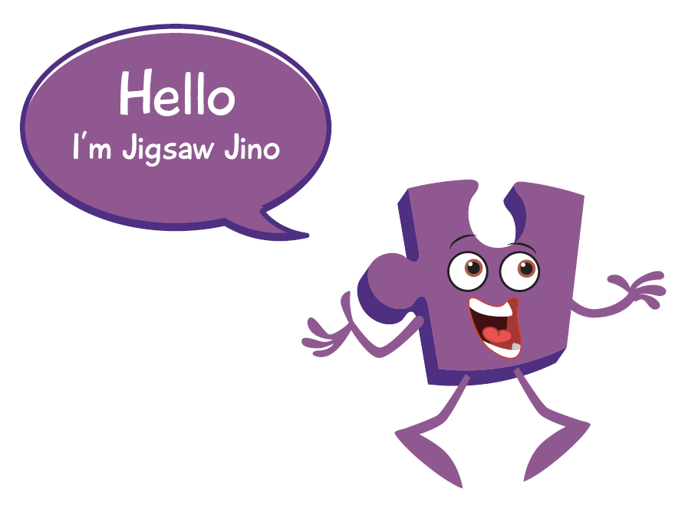

Year 3 PSHE Knowledge Mat Changing Me
Subject Specific Vocabulary |  | Changing Me | Key Questions
Changes | An act or process through which something becomes different. | Knowledge | Can you tell me about some of the changes that happen to a puppy / kitten / baby as they grow up? Can we talk about some of the changes that are going to happen to you as you grow up? How do you feel about these changes? Do you have any questions about the changes that are going to happen to you as you grow up?
Birth | emergence of a baby or other young from the body of its mother; | Know that in animals and humans lots of changes happen between conception and growing up Know that in nature it is usually the female that carries the baby Know that in humans a mother carries the baby in her uterus (womb) and this is where it develops Know that babies need love and care from their parents/carers Know some of the changes that happen between being a baby and a child Know that the male and female body needs to change at puberty so their bodies can make babies when they are adults Know some of the outside body changes that happen during puberty Know some of the changes on the inside that happen during puberty Children explore babies and what they need to grow and develop including parenting. Children learn that it is usually the female that carries the baby in nature. This leads onto lessons where puberty is briefly introduced. Children first discuss outside body changes in males and females, delving further into this un year 4. They learn that puberty is a natural part of growing up and that it is a process for getting their bodies ready to make a baby when grown up. Children discuss how they feel about puberty and growing up and there are opportunities for them to seek reassurance if anything is worrying them.
Animal | a living thing that can move and eat and react to the world through its senses
Babies | a very young child.
Mother, Growing up, Baby, Grow, Uterus, Womb, Nutrients, Survive, Love, Affection, Care, Puberty, Control, Male, Female,, Womb / uterus, Vagina, Stereotypes, Task, Roles, Challenge, Looking forward, Excited, Nervous, Anxious.
Family, Jobs, Lonely, Fall-out, Words, Angry, Upset, Calm me, Breathing. |  | Learning about family relationships widens to include roles and responsibilities in a family and the importance of co-operation, appreciation and trust. Friendships are also revisited with a focus on falling out and mending friendships. This becomes more formalised and the children learn and practise two different strategies for conflict resolution (Solve-it-together and Mending Friendships). Children consider the importance of trust in relationships and what this feels like. They also learn about two types of secret, and why ‘worry secrets’ should always be shared with a trusted adult. Children reflect upon different types of physical contact in relationships, which are acceptable and which ones are not. They practise strategies for being assertive when someone is hurting them or being unkind. The children also discuss people who can help them if they are worried or scared. | Skills
 |  |  | Can express how they feel about babies Can describe the emotions that a new baby can bring to a family Can express how they feel about puberty Can say who they can talk to about puberty if they have any worries Can identify stereotypical family roles and challenge these ideas e.g. it may not always be Mum who does the laundry Can identify changes they are looking forward to in the next year Can suggest ways to help them manage feelings during changes they are more anxious about

Slide 7

Prior Learning | Local /National | Unit Objective Y2
Know that life cycles exist in nature Know that aging is a natural process including old-age Know that some changes are out of an individual’s control Know how their bodies have changed from when they were a baby and that they will continue to change as they age Know the physical differences between male and female bodies Know the correct names for private body parts Know that private body parts are special and that no one has the right to hurt these Know who to ask for help if they are worried or frightened Know there are different types of touch and that some are acceptable and some are unacceptable | Family history, family trees. Change in our local area. Aspirations week-parent’s occupations. My rights. (UNICEF) | Children look at different life cycles in nature including that of humans. They reflect on the changes that occur between baby, toddler, child, teenager, adult and old -age. We discuss how independence, freedoms and responsibility can increase with age. pupils are re-taught the correct words for private parts of the body (those kept private by underwear: vagina, anus, penis, testicle, vulva). Children practise a range of strategies for managing feelings and emotions and are taught where they can get help if worried or frightened.

Slide 8


Year 4 PSHE Knowledge Mat Changing Me
Subject Specific Vocabulary |  | Changing Me | Key Questions
Change | An act or process through which something becomes different. | Knowledge | Which of your characteristics did you get from your birth parents? Do you have any questions about the changes that happen to a girl when they grow up? How do you feel about the changes that will happen to you as you grow?
Personal | belonging to or affecting a particular person rather than anyone else. | • Know that personal characteristics are inherited from birth parents and this is brought about by an ovum joining with a sperm • Know that babies are made by a sperm joining with an ovum • Know how the female and male body change at puberty-girls • Know that personal hygiene is important during puberty and as an adult • Know that change is a normal part of life and that some cannot be controlled and have to be accepted • Know that change can bring about a range of different emotions Bodily changes at puberty are visited with some additional vocabulary, particularly around menstruation. Sanitary health is taught to girls, including introducing pupils to different sanitary and personal hygiene products. Children understand that a baby is formed by the joining of an ovum and sperm. They also learn that the ovum and sperm carry genetic information that carry personal characteristics. The unit ends by looking at the feelings associated with change and how to manage these. Children are introduced to Jigsaw’s Circle of change model as a strategy for managing future changes.
Unique | being the only one of its kind; unlike anything else.
Parents, Sperm, Egg / ovum, Penis, Testicles, Vagina / vulva, Womb / uterus, Ovaries,, Puberty, Menstruation, Periods, Circle, Seasons, Change, Control, Emotions, Acceptance, Looking forward, Excited, Nervous, Anxious, Happy, Menstruation. |  |  | Skills
 |  |  | Can appreciate their own uniqueness and that of others Can express how they feel about having children when they are grown up Can express any concerns they have about puberty Can say who they can talk to about puberty if they are worried Can apply the circle of change model to themselves to have strategies for managing change Have strategies for managing emotions relating to change

Slide 9

Prior Learning | Local /National | Unit Objective Y3
Know that in animals and humans lots of changes happen between conception and growing up Know that in nature it is usually the female that carries the baby Know that in humans a mother carries the baby in her uterus (womb) and this is where it develops Know that babies need love and care from their parents/carers Know some of the changes that happen between being a baby and a child Know that the male and female body needs to change at puberty so their bodies can make babies when they are adults Know some of the outside body changes that happen during puberty | Family history, family trees. Change in our local area. Aspirations week-parent’s occupations. My rights. (UNICEF) | Children explore babies and what they need to grow and develop including parenting. Children learn that it is usually the female that carries the baby in nature. This leads onto lessons where puberty is briefly introduced. Children first discuss outside body changes in males and females, delving further into this un year 4. They learn that puberty is a natural part of growing up and that it is a process for getting their bodies ready to make a baby when grown up. Children discuss how they feel about puberty and growing up and there are opportunities for them to seek reassurance if anything is worrying them.

Slide 10
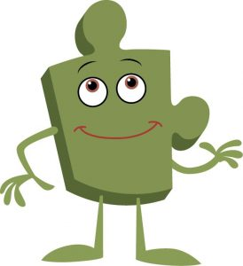

Year 5 PSHE Knowledge Mat Changing Me
Subject Specific Vocabulary |  | Changing Me | Key Questions
Change | An act or process through which something becomes different. | Knowledge | Can you tell me how you feel about yourself? What can people do if they don’t feel great about themselves? Can I share with you how I see you and how I care about you? Do you have any worries about puberty? What do you think it will be like when you are a teenager? What kinds of things do you think you will be allowed to do when you are a teenager that you’re not allowed to do now? What do you enjoy about being your age now?
Body image | picture of one's own physical appearance made by both by self-observation and by noting the reactions of others. | • Know what perception means and that perceptions can be right or wrong • Know how girls’ and boys’ bodies change during puberty and understand the importance of looking after themselves physically and emotionally • Know that becoming a teenager involves various changes and also brings growing responsibility Children revisit self-esteem and self/body-image. They learn that we all have perceptions about ourselves and others, and these may be right or wrong. They also reflect on how social media and the media can promote unhelpful comparison and how to manage this. Puberty is revisited with further detail explaining bodily changes in males and females. Further details about pregnancy are introduced including some facts about the development of the foetus. Children learn that having a baby is a personal choice. Children look at what becoming a teenager means for them with an increase in freedom, rights and responsibilities. They also look at the perceptions that surround teenagers and reflect whether they are always accurate e.g. teenagers are always moody; all teenagers have a boyfriend/girlfriend etc.
Self image | he way a person feels about his or her personality, achievements and value to society:
Characteristics, Looks, Personality, Perception, Comparison, Uterus, Womb,, Puberty, Breasts, Vagina, Vulva, Hips, Penis, Testicles, Adam’s Apple, Scrotum, Genitals, Hair, Broader, Wider, Growth spurt, Facial hair, Pubic hair, Hormones, Ovaries, Egg ,Pregnancy, Menstruation, Teenager, Responsibilities, Rights
Qualities, Characteristics, Self-esteem, Unique, Comparison, Negative self-talk, Social media, Online, Community, Risky, Positive, Negative, Safe, Unsafe, Rights, Responsibilities, Social network, Gaming, Violence, Grooming, Troll, Betting, Trustworthy, Appropriate, Screen time, Physical health, Mental health, Off-line, Social, Peer pressure, Influences, Personal information, Passwords, Privacy, Settings, Profile, SMARRT rules |  |  | Skills
 |  |  | Can celebrate what they like about their own and others’ self- image and body-image Can suggest ways to boost self-esteem of self and others Recognise that puberty is a natural process that happens to everybody and that it will be OK for them Can express how they feel about having children when they are an adult Can express how they feel about becoming a teenager

Slide 11

Prior Learning | Local /National | Unit Objective Y4
• Know that personal characteristics are inherited from birth parents and this is brought about by an ovum joining with a sperm • Know that babies are made by a sperm joining with an ovum • Know how the female and male body change at puberty • Know that personal hygiene is important during puberty and as an adult • Know that change is a normal part of life and that some cannot be controlled and have to be accepted • Know that change can bring about a range of different emotions | Family history, family trees. Change in our local area. Aspirations week-parent’s occupations. My rights. (UNICEF) My value in the world. My Future. | Bodily changes at puberty are visited with some additional vocabulary, particularly around menstruation. Sanitary health is taught to girls, including introducing pupils to different sanitary and personal hygiene products. Children understand that a baby is formed by the joining of an ovum and sperm. They also learn that the ovum and sperm carry genetic information that carry personal characteristics. The unit ends by looking at the feelings associated with change and how to manage these. Children are introduced to Jigsaw’s Circle of change model as a strategy for managing future changes.

Slide 12
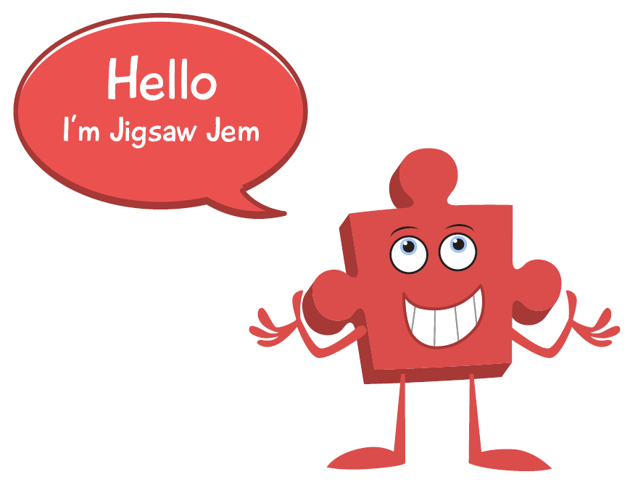

Year 6 PSHE Knowledge Mat Changing Me
Subject Specific Vocabulary |  | Changing Me | Key Questions
Change | An act or process through which something becomes different. | Knowledge | Can we talk about the changes that will happen to your body over the next few years? How do you feel about these changes? What does mutual respect mean? Why is that important in a relationship? What are you excited about in secondary school? What are you worried about in secondary school? What can we do with these worries?
Body Image | picture of one's own physical appearance made by both by self-observation and by noting the reactions of others. | • Know how girls’ and boys’ bodies change during puberty and understand the importance of looking after themselves physically and emotionally • Know how a baby develops from conception through the nine months of pregnancy and how it is born • Know how being physically attracted to someone changes the nature of the relationship • Know the importance of self-esteem and what they can do to develop it • Know what they are looking forward to and what they are worried about when thinking about transition to secondary school / moving to their next class The class learn about puberty in boys and girls and the changes that will happen – they reflect on how they feel about these changes. The children also learn about childbirth and the stages of development of a baby, starting at conception. They talk about being physically attracted to someone and the effect this can have upon the relationship. They discuss relationships and the importance of mutual respect and not pressuring / being pressured into doing something that they don’t want to. The children also learn about self-esteem, why it is important and ways to develop it. Finally, they look at the transition to secondary school (or next class) and what they are looking forward to / are worried about and how they can prepare themselves mentally.
Self Image | he way a person feels about his or her personality, achievements and value to society:
Characteristics, Looks, Personality, Perception, Self-esteem, Affirmation, Comparison, negative body-talk, mental health, Body and genital names. ,Hormones, Hygiene, Responsible, Teenager, Responsibilities, Rights, opportunities, freedoms, responsibilities, attraction, relationship, love, sexting, transition, secondary, looking forward, journey, worries, anxiety, excitement |  |  | Skills
 |  |  | Recognise ways they can develop their own self-esteem Can express how they feel about the changes that will happen to them during puberty Recognise how they feel when they reflect on the development and birth of a baby Understand that mutual respect is essential in a boyfriend / girlfriend relationship Can celebrate what they like about their own and others’ self- image and body-image Use strategies to prepare themselves emotionally for the transition (changes) to secondary school

Slide 13

Prior Learning | Local /National | Unit Objective Y5
• Know what perception means and that perceptions can be right or wrong • Know how girls’ and boys’ bodies change during puberty and understand the importance of looking after themselves physically and emotionally • Know that becoming a teenager involves various changes and also brings growing responsibility | Family history, family trees. Change in our local area. Aspirations week-parent’s occupations. My rights. (UNICEF) My value in the world- my future. | Children revisit self-esteem and self/body-image. They learn that we all have perceptions about ourselves and others, and these may be right or wrong. They also reflect on how social media and the media can promote unhelpful comparison and how to manage this. Puberty is revisited with further detail explaining bodily changes in males and females. Further details about pregnancy are introduced including some facts about the development of the foetus. Children learn that having a baby is a personal choice. Children look at what becoming a teenager means for them with an increase in freedom, rights and responsibilities. They also look at the perceptions that surround teenagers and reflect whether they are always accurate e.g. teenagers are always moody; all teenagers have a boyfriend/girlfriend etc.

