Slide 1



Year R PSHE Knowledge Mat Healthy Me
Subject Specific Vocabulary |  | Knowledge | Key Questions
Healthy Exercise Stranger Trust | In good health, body, mind and spirit. Activity that needs lots of effort. A person that you do not know. To believe someone or believe the truth. | Healthy Me Know the names for some parts of their body • Know what the word ‘healthy’ means • Know some things that they need to do to keep healthy • Know that they need to exercise to keep healthy • Know how to help themselves go to sleep and that sleep is good for them • Know when and how to wash their hands properly • Know what to do if they get lost • Know how to say No to strangers | • Can you tell me which parts of the body you know the names for • What do we need to do to be healthy? • What food do we eat that is healthy? • What can you do to help yourself get to sleep? • What would you do if a stranger approached you? (discuss a few different locations, park, shop etc) • How does Jigsaw Jenie help you at school?
 |  | Children learn about their bodies; the names of some key parts as well as how to stay healthy. They talk about food and that some foods are healthier than others. They discuss the importance of sleep and what they can do to help themselves get to sleep. They talk about hand washing and why it is important. The class also discuss stranger danger and what they should do if approached by someone they don’t know.
Head, Shoulders, Knees, Toes, Sleep, Wash, Clean, Stranger, Scared, |  |  | Skills
 |  |  | • Recognise how exercise makes them feel • Recognise how different foods can make them feel • Can explain what they need to do to stay healthy • Can give examples of healthy food • Can explain how they might feel if they don’t get enough sleep • Can explain what to do if a stranger approaches them

Slide 2
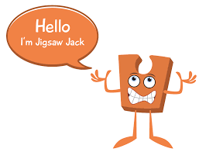

Year 1 PSHE Knowledge Mat Healthy Me
Subject Specific Vocabulary |  | Healthy Me | Key Questions
Healthy | In good health, body, mind and spirit. | Knowledge | • Can you give me an example of a healthy / unhealthy choice? • How do you feel when you make a healthy choice? • Can you tell me something that is special about you? • Can I tell you something I think is special about you? • What can you do when you feel poorly? • Can you talk about a time when you felt frightened? • Who can you ask for help when you feel frightened?
Unhealthy | Not having or showing good health. | • Know the difference between being healthy and unhealthy • Know some ways to keep healthy • Know how to make healthy lifestyle choices • Know how to keep themselves clean and healthy • Know that germs cause disease / illness • Know that all household products, including medicines, can be harmful if not used properly • Know that medicines can help them if they feel poorly • Know how to keep safe when crossing the road • Know about people who can keep them safe
Balanced | Having things in good proportions.
Exercise | Activity that needs a lot of effort.
Sleep, Choices, Clean, Body parts, Keeping clean, Toiletry items (e.g. toothbrush, shampoo, soap), Hygienic, Safe Medicines, Trust, Safe, Safety, Green Cross Code, Eyes, Ears, Look, Listen, Wait. |  | The class talk healthy and unhealthy choices and how these choices make them feel. They talk about hygiene, keeping themselves clean and that germs can make you unwell. The children learn about road safety as well as people who can help them to stay safe. | Skills
 |  |  | • Feel good about themselves when they make healthy choices • Realise that they are special • Recognise ways to look after themselves if they feel poorly • Recognise when they feel frightened and know how to ask for help and keep themselves safe • Recognise how being healthy helps them to feel happy

Slide 3

Prior Learning | Local /National | Unit Objective YR
Know the names for some parts of their body • Know what the word ‘healthy’ means • Know some things that they need to do to keep healthy • Know that they need to exercise to keep healthy • Know how to help themselves go to sleep and that sleep is good for them • Know when and how to wash their hands properly • Know what to do if they get lost • Know how to say No to strangers | Link to UNICEF rights. Safeguarding in school and the community. Science- my body and my senses. ICT- Keeping myself safe- cyber safety. | Children learn about their bodies; the names of some key parts as well as how to stay healthy. They talk about food and that some foods are healthier than others. They discuss the importance of sleep and what they can do to help themselves get to sleep. They talk about hand washing and why it is important. The class also discuss stranger danger and what they should do if approached by someone they don’t know.

Slide 4
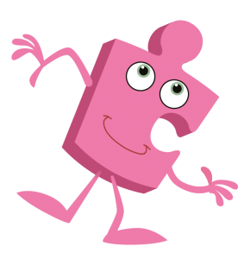

Year 2 PSHE Knowledge Mat Healthy Me
Subject Specific Vocabulary |  | Healthy Me | Key Questions
Healthy choices | Making choices that will help the health of your body, mind and spirit. | Knowledge | • What does your body need to stay healthy? • What does relaxed mean? • What makes you feel relaxed / stressed? • What types of medicine have I given you? What are they for? • What healthy snack shall we make and eat together? • What snacks could you eat before exercise? • How can Calm Me time help you stay healthy?
Lifestyle | The way a person lives. | Know what their body needs to stay healthy • Know what relaxed means • Know what makes them feel relaxed / stressed • Know how medicines work in their bodies • Know that it is important to use medicines safely • Know how to make some healthy snacks • Know why healthy snacks are good for their bodies • Know which foods given their bodies energy The class learn about healthy food; they talk about having a healthy relationship with food and making healthy choices. The children talk about things that make them feel relaxed and stressed. They talk about medicines, how they work and how to use them safely. The children have a go at making healthy snacks and also discuss why they are good for their bodies.
Motivation | The reason to do something.
Nutritious | Food nourishing, good for you.
Relax, Relaxation, Tense, Calm, Healthy, Unhealthy, Dangerous, Medicines, Safe, Body, Balanced diet, Portion, Proportion, Energy, Fuel,
Family, Jobs, Lonely, Fall-out, Words, Angry, Upset, Calm me, Breathing. |  | Learning about family relationships widens to include roles and responsibilities in a family and the importance of co-operation, appreciation and trust. Friendships are also revisited with a focus on falling out and mending friendships. This becomes more formalised and the children learn and practise two different strategies for conflict resolution (Solve-it-together and Mending Friendships). Children consider the importance of trust in relationships and what this feels like. They also learn about two types of secret, and why ‘worry secrets’ should always be shared with a trusted adult. Children reflect upon different types of physical contact in relationships, which are acceptable and which ones are not. They practise strategies for being assertive when someone is hurting them or being unkind. The children also discuss people who can help them if they are worried or scared. | Skills
 |  |  | • Desire to make healthy lifestyle choices • Identify when a feeling is weak and when a feeling is strong • Feel positive about caring for their bodies and keeping it healthy • Have a healthy relationship with food • Express how it feels

Slide 5

Prior Learning | Local /National | Unit Objective Y1
• Know the difference between being healthy and unhealthy • Know some ways to keep healthy • Know how to make healthy lifestyle choices • Know how to keep themselves clean and healthy • Know that germs cause disease / illness • Know that all household products, including medicines, can be harmful if not used properly • Know that medicines can help them if they feel poorly • Know how to keep safe when crossing the road • Know about people who can keep them safe | Link to UNICEF rights. Safeguarding in school and the community. Science- my body and my senses. ICT- Keeping myself safe- cyber safety. | The class talk healthy and unhealthy choices and how these choices make them feel. They talk about hygiene, keeping themselves clean and that germs can make you unwell. The children learn about road safety as well as people who can help them to stay safe.

Slide 6

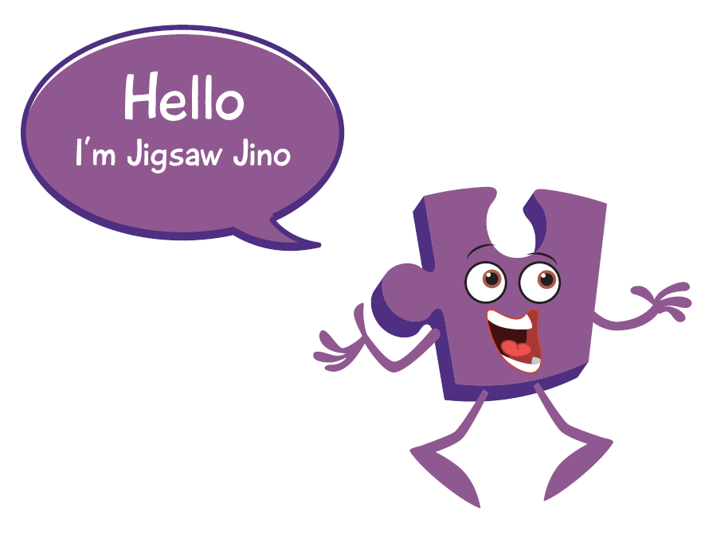
Year 3 PSHE Knowledge Mat Healthy Me
Subject Specific Vocabulary |  | Healthy Me | Key Questions
Oxygen | The gas that we need in order to live. | Knowledge | • How does exercise affect your body? • What do your heart and lungs do? • What drugs do you know about? How do you feel about drugs? • Tell me about some things / places / people that you think might be dangerous. How can you keep yourself safe from these? • Can you tell me about a time when you felt unsafe? • Can we talk about how we keep each other safe in our family? • Can we share a Calm me time to feel peaceful together? • Shall we try an exercise session together?
Energy | Physical and mental power. Produced by the body. | Know how exercise affects their bodies • Know why their hearts and lungs are such important organs • Know that the amount of calories, fat and sugar that they put into their bodies will affect their health • Know that there are different types of drugs • Know that there are things, places and people that can be dangerous • Know a range of strategies to keep themselves safe • Know when something feels safe or unsafe • Know that their bodies are complex and need taking care of The class talk about the importance of exercise and how it helps your body to stay healthy. They also talk about their heart and lungs, discuss what they do and that they are very important. The children talk about calories, fat and sugar; they discuss what each of these are and how the amount they consume can affect their health. The class talk about different types of drugs, the ones you take to make you better as well as other drugs. The children think about things, places and people that are dangerous and link this to strategies for keeping themselves safe.
Calories | A unit of energy.
Strategy | A plan of action.
kilojoules, Heartbeat, Lungs, Heart, Fitness, Labels, Sugar, Fat, Saturated fat, Healthy, Drugs, Attitude, Safe, Anxious, Scared, Advice, Harmful, Risk, Feelings, Complex, Appreciate, Body, Choice.
Family, Jobs, Lonely, Fall-out, Words, Angry, Upset, Calm me, Breathing. |  | Learning about family relationships widens to include roles and responsibilities in a family and the importance of co-operation, appreciation and trust. Friendships are also revisited with a focus on falling out and mending friendships. This becomes more formalised and the children learn and practise two different strategies for conflict resolution (Solve-it-together and Mending Friendships). Children consider the importance of trust in relationships and what this feels like. They also learn about two types of secret, and why ‘worry secrets’ should always be shared with a trusted adult. Children reflect upon different types of physical contact in relationships, which are acceptable and which ones are not. They practise strategies for being assertive when someone is hurting them or being unkind. The children also discuss people who can help them if they are worried or scared. | Skills
 |  |  | • Able to set themselves a fitness challenge • Recognise what it feels like to make a healthy choice • Identify how they feel about drugs • Can express how being anxious or scared feels • Can take responsibility for keeping themselves and others safe • Respect their own bodies and appreciate what they do

Slide 7

Prior Learning | Local /National | Unit Objective Y2
Know what their body needs to stay healthy • Know what relaxed means • Know what makes them feel relaxed / stressed • Know how medicines work in their bodies • Know that it is important to use medicines safely • Know how to make some healthy snacks • Know why healthy snacks are good for their bodies • Know which foods given their bodies energy | Link to UNICEF rights. Safeguarding in school and the community. Science- my body and my senses. ICT- Keeping myself safe- cyber safety. | The class learn about healthy food; they talk about having a healthy relationship with food and making healthy choices. The children talk about things that make them feel relaxed and stressed. They talk about medicines, how they work and how to use them safely. The children have a go at making healthy snacks and also discuss why they are good for their bodies.

Slide 8


Year 4 PSHE Knowledge Mat Healthy Me
Subject Specific Vocabulary |  | Healthy Me | Key Questions
Friendships | A relationship between friends. | Knowledge | Who are your friends? How do they make you feel? • Which groups do you spend time with? How do you feel when you are with the different groups? • Can you tell me about a time when you were the leader / follower in the group? • How can smoking affect people’s health? • How can drinking affect people’s health? • What can you do if a group of children are trying to convince you to do something you don’t want to do or know you shouldn’t do? • How can you build your inner strength? • Does Calm me time help you feel stronger inside?
Emotions | Feelings or mood that can change. | Know how different friendship groups are formed and how they fit into them • Know which friends they value most • Know that there are leaders and followers in groups • Know that they can take on different roles according to the situation • Know the facts about smoking and its effects on health • Know some of the reasons some people start to smoke • Know the facts about alcohol and its effects on health, particularly the liver • Know some of the reasons some people drink alcohol • Know ways to resist when people are putting pressure on them • Know what they think is right and wrong. The class look at the friendship groups that they are part of, how they are formed, how they have leaders and followers and how they fit into them. The children are asked to reflect on their friendships, how different people make them feel and which friends they value the most. The class also look at smoking and its effects on health, they do the same with alcohol and then look at the reasons why people might drink or smoke. Finally, they talk about peer pressure and how to deal with it.
Healthy | Being in good health in body, mind and spirit.
Relationships | The ways people or thins are connected.
Friendship groups, Value, Roles, Leader, Follower, Assertive, Agree, Disagree, Smoking, Pressure, Peers, Guilt, Advice, Alcohol, Liver, Disease, Anxiety, Fear, Believe, Assertive, Opinion, Right, Wrong |  |  | Skills
 |  |  | Can identify the feelings that they have about their friends and different friendship groups • Recognise how different people and groups they interact with impact on them • Identify which people they most want to be friends with • Recognise negative feelings in peer pressure situations • Can identify the feelings of anxiety and fear associated with peer pressure • Can tap into their inner strength and know of how to be assertive

Slide 9

Prior Learning | Local /National | Unit Objective Y3
Know how exercise affects their bodies • Know why their hearts and lungs are such important organs • Know that the amount of calories, fat and sugar that they put into their bodies will affect their health • Know that there are different types of drugs • Know that there are things, places and people that can be dangerous • Know a range of strategies to keep themselves safe • Know when something feels safe or unsafe • Know that their bodies are complex and need taking care of | Link to UNICEF rights. Safeguarding in school and the community. Science- my body and my senses. ICT- Keeping myself safe- cyber safety. | The class talk about the importance of exercise and how it helps your body to stay healthy. They also talk about their heart and lungs, discuss what they do and that they are very important. The children talk about calories, fat and sugar; they discuss what each of these are and how the amount they consume can affect their health. The class talk about different types of drugs, the ones you take to make you better as well as other drugs. The children think about things, places and people that are dangerous and link this to strategies for keeping themselves safe.

Slide 10

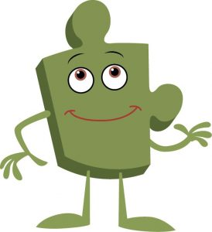
Year 5 PSHE Knowledge Mat Healthy Me
Subject Specific Vocabulary |  | Healthy Me | Key Questions
Choices | Act of choosing between one or more possibilities. | Knowledge | • What are the risks of smoking / misusing alcohol? • What emergency procedures have you learnt? • How do you contact the police / ambulance service / fire department? • Why do some people have eating problems? • Can you tell me about a time when someone tried to make you do something you didn’t want to? • What can you do if a group of children are trying to convince you to do something you don’t want to do or know you shouldn’t do? • What do you enjoy about how we try to keep healthy in our family? • Are there ways we could be healthier? •
Healthy Behaviour | Actions we take to improve our health. | Know the health risks of smoking • Know how smoking tobacco affects the lungs, liver and heart • Know some of the risks linked to misusing alcohol, including antisocial behaviour • Know basic emergency procedures including the recovery position • Know how to get help in emergency situations • Know that the media, social media and celebrity culture promotes certain body types • Know the different roles food can play in people’s lives and know that people can develop eating problems / disorders related to body image pressure • Know what makes a healthy lifestyle The class look at the risks linked to smoking and how this affects the lungs, liver and heart. They do the same with the risks associated with alcohol misuse. They are taught a range of basic emergency procedures (including the recovery position) and learn how to contact the emergency services when needed. The children look at how body types are portrayed in the media, social media and celebrity culture. They also talk about eating disorders and people’s relationships with food and how this can be linked to negative body image pressures.
Unhealthy Behaviour | Actions we take that will harm our health.
Informed decision | Deciding based on facts and information.
Pressure, Media, Influence, Emergency, Procedure, Recovery position, Calm, Level headed, Body image, Media, Social media, Celebrity, Altered, Self-respect, Comparison, Eating problem, Eating disorder, Respect, Debate, Opinion, Fact, Motivation
Qualities, Characteristics, Self-esteem, Unique, Comparison, Negative self-talk, Social media, Online, Community, Risky, Positive, Negative, Safe, Unsafe, Rights, Responsibilities, Social network, Gaming, Violence, Grooming, Troll, Betting, Trustworthy, Appropriate, Screen time, Physical health, Mental health, Off-line, Social, Peer pressure, Influences, Personal information, Passwords, Privacy, Settings, Profile, SMARRT rules |  |  | Skills
 |  |  | Can make informed decisions about whether or not they choose to smoke or drink when they are older • Can identify ways to keep themselves calm in an emergency • Can reflect on their own body image and know how important it is that this is positive • Accept and respect themselves for who they are • Respect and value their own bodies • Be motivated to keep themselves healthy and happy

Slide 11

Prior Learning | Local /National | Unit Objective Y4
Know how different friendship groups are formed and how they fit into them • Know which friends they value most • Know that there are leaders and followers in groups • Know that they can take on different roles according to the situation • Know the facts about smoking and its effects on health • Know some of the reasons some people start to smoke • Know the facts about alcohol and its effects on health, particularly the liver • Know some of the reasons some people drink alcohol • Know ways to resist when people are putting pressure on them • Know what they think is right and wrong. | Link to UNICEF rights. Safeguarding in school and the community. Science- my body and my senses. ICT- Keeping myself safe- cyber safety. | The class look at the friendship groups that they are part of, how they are formed, how they have leaders and followers and how they fit into them. The children are asked to reflect on their friendships, how different people make them feel and which friends they value the most. The class also look at smoking and its effects on health, they do the same with alcohol and then look at the reasons why people might drink or smoke. Finally, they talk about peer pressure and how to deal with it.

Slide 12
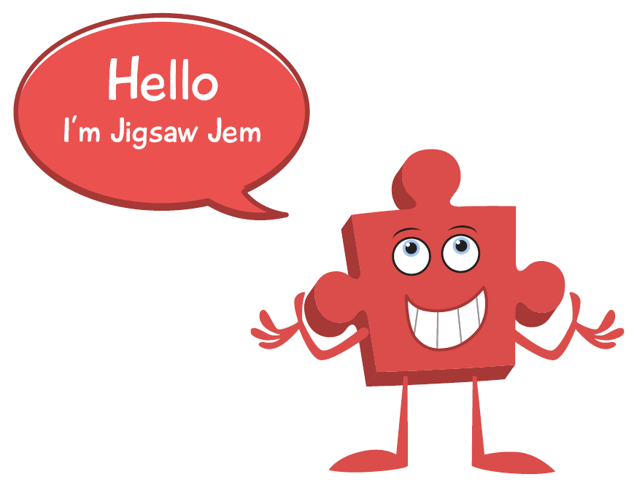
Year 6 PSHE Knowledge Mat Healthy Me
Subject Specific Vocabulary |  | Healthy Me | Key Questions
Responsibility | Having a duty, role or job. | Knowledge | What can you do to keep yourself physically / mentally well? • What types of drugs do you know about? • What makes you feel stressed? • What helps you when you feel stressed? • Can we share a Calm me time together? • Does Calm Me time help you stay calm and manage stress? • Can you recognise when anyone in our family is stressed? • What can you do if someone is putting pressure on you? • Does Jigsaw Jerrie Cat factor in your lessons?
Choice | An act of choosing between two or more possibilities. | Know how to take responsibility for their own health • Know how to make choices that benefit their own health and well-being • Know about different types of drugs and their uses • Know how these different types of drugs can affect people’s bodies, especially their liver and heart • Know that some people can be exploited and made to do things that are against the law • Know why some people join gangs and the risk that this can involve • Know what it means to be emotionally well • Know that stress can be triggered by a range of things • Know that being stressed can cause drug and alcohol misuse The children discuss taking responsibility for their own physical and emotional health and the choices linked to this. They talk about different types of drugs and the effects these can have on people’s bodies. The class discuss exploitation as well as gang culture and the associated risks. They also talk about mental health / illness and that people have different attitudes towards this. They learn to recognise the triggers for and feelings of being stressed and that there are strategies they can use when they are feeling stressed.
Immunisation | Protection against some infectious diseases.
 |  |  | Skills
Prevention | Stopping something from happening.
 |  |  | Are motivated to care for their own physical and emotional health • Are motivated to find ways to be happy • Identify ways that someone who is being exploited could help themselves • Suggest strategies someone could use to avoid being pressured • Recognise that people have different attitudes towards mental health / illness • Can use different strategies to manage stress and pressure
Drugs, Effects, Motivation, Prescribed, Unrestricted, Over-the-counter, Restricted, Illegal, Volatile substances, ‘Legal highs’, Exploited, Vulnerable, Criminal, Gangs, Pressure, Strategies, Reputation, Anti-social behaviour, Crime, Mental health, Emotional health, Mental illness, Symptoms, Stress, Triggers, Strategies, Managing stress, Pressure |  |  | Skills

Slide 13

Prior Learning | Local /National | Unit Objective Y5
Know the health risks of smoking • Know how smoking tobacco affects the lungs, liver and heart • Know some of the risks linked to misusing alcohol, including antisocial behaviour • Know basic emergency procedures including the recovery position • Know how to get help in emergency situations • Know that the media, social media and celebrity culture promotes certain body types • Know the different roles food can play in people’s lives and know that people can develop eating problems / disorders related to body image pressure • Know what makes a healthy lifestyle | Link to UNICEF rights. Safeguarding in school and the community. Science- my body and my senses. ICT- Keeping myself safe- cyber safety. First Aid. | The class look at the risks linked to smoking and how this affects the lungs, liver and heart. They do the same with the risks associated with alcohol misuse. They are taught a range of basic emergency procedures (including the recovery position) and learn how to contact the emergency services when needed. The children look at how body types are portrayed in the media, social media and celebrity culture. They also talk about eating disorders and people’s relationships with food and how this can be linked to negative body image pressures.

