Slide 1



Year R PSHE Knowledge Mat Dreams and Goals
Subject Specific Vocabulary |  | Celebrating Difference | Key Questions
Dream | Something you really want. | Knowledge | What is a challenge? • How does it feel when you think you can’t do something? • What job would you like when you are older? • What goals have you set? • Why is it important to keep trying? • Tell me about a time when something was hard but you kept trying. • How do you like to celebrate when you achieve something? • How can we celebrate together? • How does Jigsaw Jenie help you in lessons? • Can you tell me about Calm Me time?
Goal | An aim or desire. | Know what a challenge is • Know that it is important to keep trying • Know what a goal is • Know how to set goals and work towards them • Know which words are kind • Know some jobs that they might like to do when they are older • Know that they must work hard now in order to be able to achieve the job they want when they are older • Know when they have achieved a goal
Job | A task you do to get paid for.
Challenge | Something that is difficult to achieve.
Ambition, Perseverance, Achievement, Happy, Kind, Encourage |  | Children talk about challenges and facing up to them. They discuss not giving up and trying until they have achieved their goal. The children are encouraged to think about jobs that they might like to have when they are older and are taught to associate what they learn now with being able to have the job they want. They also talk about achieving goals and the feelings linked to this. | SKILLS
 |  |  | • Understand that challenges can be difficult • Recognise some of the feelings linked to perseverance • Talk about a time that they kept on trying and achieved a goal • Be ambitious • Resilience • Recognise how kind words can encourage people • Feel proud • Celebrate success

Slide 2
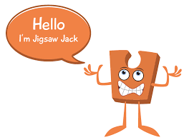

Year 1 PSHE Knowledge Mat Dreams and Goals
Subject Specific Vocabulary |  | Celebrating Difference | Key Questions
Proud | Feeling deep pleasure. | Knowledge | • What goals have you set at school? • What goal would you like to set for home? • What do you need to do achieve your goal? • How do you feel when something is difficult? • How do you feel when you have achieved a goal? • How can we celebrate your achievements together? • How does Jigsaw Jack help you in lessons? • Can you tell me about Calm Me time?
Success | To achieve an aim. | Know how to set simple goals • Know how to achieve a goal • Know how to work well with a partner • Know that tackling a challenge can stretch their learning • Know how to identify obstacles which make achieving their goals difficult and work out how to overcome them • Know when a goal has been achieved
Achievement | Something done successfully.
Goal | An aim or desire.
Learning, Stepping-stones, Process, Working together, Team work, Celebrate, Learning, Stretchy, Challenge, Feelings, Obstacle, Overcome, Achieve, Dreams, Goals |  | The class talk about setting simple goals, how to achieve them as well as overcoming difficulties when they try. The children learn to recognise the feelings associated with facing obstacles to achieving their goals as well as when they achieve them. They discuss partner working and how to do this well. | Skills
 |  |  | • Recognise things that they do well • Explain how they learn best • Celebrate an achievement with a friend • Recognise their own feelings when faced with a challenge • Recognise their own feelings when they are faced with an obstacle • Recognise how they feel when they overcome an obstacle • Can store feelings of success so that they can be used in the future

Slide 3

Prior Learning | Local /National | Unit Objective YR
Know what a challenge is • Know that it is important to keep trying • Know what a goal is • Know how to set goals and work towards them • Know which words are kind • Know some jobs that they might like to do when they are older • Know that they must work hard now in order to be able to achieve the job they want when they are older • Know when they have achieved a goal | Growth mindset, resilience and perseverance. My rights and responsibilities. (UNICEF) Setting challenges in provision and meeting them. Friendships. | Children talk about challenges and facing up to them. They discuss not giving up and trying until they have achieved their goal. The children are encouraged to think about jobs that they might like to have when they are older and are taught to associate what they learn now with being able to have the job they want. They also talk about achieving goals and the feelings linked to this.

Slide 4

Year 2 PSHE Knowledge Mat Dreams and Goals
Subject Specific Vocabulary |  | Celebrating Difference | Key Questions
Realistic | A sensible or practical idea. | Knowledge | • What goals have you set at school? • What goal would you like to set for home? • What do you need to do achieve your goal? • How do you feel when something is difficult? • How do you feel when you have achieved a goal? • How do you like to celebrate when you achieve something you are proud of? • How can we celebrate each other’s achievements at home? • Does Jigsaw Jo help you learn? • Do you have Pause Points with Jigsaw Jerrie Cat? Do these help you?
Proud | Feeling deep pleasure. | • Know how to choose a realistic goal and think about how to achieve it • Know that it is important to persevere • Know how to recognise what working together well looks like • Know what good group working looks like • Know how to share success with other people The class talk about setting realistic goals and how they can achieve them. They discuss perseverance when they find things difficult as well as recognising their strengths as a learner. The children talk about group work and reflect on who they work well with and who they don’t. They also talk about sharing success with other people.
Success | To achieve an aim.
Celebrate | Have a social gathering for a happy event.
Achievement, Goal, Strength, Persevere, Challenge, Difficult, Easy, Learning Together, Partner, Team work, Product.
Family, Jobs, Lonely, Fall-out, Words, Angry, Upset, Calm me, Breathing. |  | Learning about family relationships widens to include roles and responsibilities in a family and the importance of co-operation, appreciation and trust. Friendships are also revisited with a focus on falling out and mending friendships. This becomes more formalised and the children learn and practise two different strategies for conflict resolution (Solve-it-together and Mending Friendships). Children consider the importance of trust in relationships and what this feels like. They also learn about two types of secret, and why ‘worry secrets’ should always be shared with a trusted adult. Children reflect upon different types of physical contact in relationships, which are acceptable and which ones are not. They practise strategies for being assertive when someone is hurting them or being unkind. The children also discuss people who can help them if they are worried or scared. | Skills
 |  |  | • Be able to describe their own achievements and the feelings linked to this • Recognise their own strengths as a learner • Recognise how working with others can be helpful • Be able to work effectively with a partner • Be able to choose a partner with whom they work well • Be able to work as part of a group • Recognise how it feels to be part of a group that succeeds and store this feeling

Slide 5

Prior Learning | Local /National | Unit Objective Y1
Know how to set simple goals • Know how to achieve a goal • Know how to work well with a partner • Know that tackling a challenge can stretch their learning • Know how to identify obstacles which make achieving their goals difficult and work out how to overcome them • Know when a goal has been achieved | Inspiration week. Team work and group work skills. Emotions linked to achievement. Extra curricular achievements. Link to St Peters award scheme. Growth mindset. | The class talk about setting simple goals, how to achieve them as well as overcoming difficulties when they try. The children learn to recognise the feelings associated with facing obstacles to achieving their goals as well as when they achieve them. They discuss partner working and how to do this well.

Slide 6
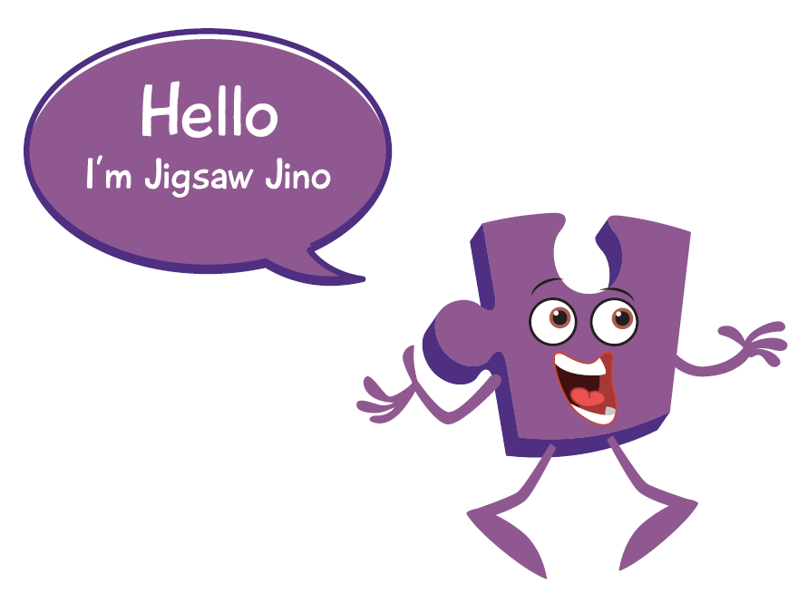
Year 3 PSHE Knowledge Mat Dreams and Goals
Subject Specific Vocabulary |  | Celebrating Difference | Key Questions
Perseverance | Doing something despite difficulty. | Knowledge | • Can you tell me about someone who overcame an obstacle to achieve their goal. • What ambition is important to you? • What can you do if something is difficult? • How does it feel to be stuck? • How can I help you to achieve your goal? • What might it feel like when you achieve your goal? • Describe how it felt when you achieved your goal? • How can you use this feeling the next time you are stuck? • How does Jigsaw Jino help your Jigsaw work? • Do you enjoy Calm Me time?
Challenges | Something that is difficult to achieve. | • Know about specific people who have overcome difficult challenges to achieve success • Know what dreams and ambitions are important to them • Know how they can best overcome learning challenges • Know that they are responsible for their own learning • Know what their own strengths are as a learner • Know what an obstacle is and how they can hinder achievement • Know how to take steps to overcome obstacles • Know how to evaluate their own learning progress and identify how it can be better next Time The class look at examples of people who have overcome challenges to achieve success and discuss what they can learn from these stories. The children identify their own dreams and ambitions and discuss how it will feel when they achieve them. They talk about facing learning challenges and identify their own strategies for overcoming these. The children talk about obstacles which might stop them from achieving their goals and how to overcome these. They reflect on their progress and successes and identify what they could do better next time.
Success | To achieve an aim.
Obstacles | A thing that blocks ones way.
Dreams, Goals, Ambitions, Future, Aspirations, Garden, Decorate, Team work, Enterprise, Design, Cooperation, Product, Strengths, Motivated, Enthusiastic, Excited, Efficient, Responsible, Frustration, ‘Solve It Together’ Technique, Solutions, Review, Learning, Celebrate, Evaluate.
Family, Jobs, Lonely, Fall-out, Words, Angry, Upset, Calm me, Breathing. |  | Learning about family relationships widens to include roles and responsibilities in a family and the importance of co-operation, appreciation and trust. Friendships are also revisited with a focus on falling out and mending friendships. This becomes more formalised and the children learn and practise two different strategies for conflict resolution (Solve-it-together and Mending Friendships). Children consider the importance of trust in relationships and what this feels like. They also learn about two types of secret, and why ‘worry secrets’ should always be shared with a trusted adult. Children reflect upon different types of physical contact in relationships, which are acceptable and which ones are not. They practise strategies for being assertive when someone is hurting them or being unkind. The children also discuss people who can help them if they are worried or scared. | Skills
 |  |  | • Recognise other people’s achievements in overcoming difficulties • Imagine how it will feel when they achieve their dream / ambition • Can break down a goal into small steps • Recognise how other people can help them to achieve their goals • Can manage feelings of frustration linked to facing obstacles • Can share their success with others • Can store feelings of success (in their internal treasure chest) to be used at another time

Slide 7

Prior Learning | Local /National | Unit Objective Y2
• Know how to choose a realistic goal and think about how to achieve it • Know that it is important to persevere • Know how to recognise what working together well looks like • Know what good group working looks like • Know how to share success with other people . | My rights and responsibilities. (UNICEF) Team work, communication, group work. Own aspirations. Growth mindset. | The class talk about setting realistic goals and how they can achieve them. They discuss perseverance when they find things difficult as well as recognising their strengths as a learner. The children talk about group work and reflect on who they work well with and who they don’t. They also talk about sharing success with other people.

Slide 8

Year 4 PSHE Knowledge Mat Dreams and Goals
Subject Specific Vocabulary |  | Celebrating Difference | Key Questions
Dream | Something you really want. | Knowledge | • What are your hopes and dreams? • Can you tell me about a time that one of your dreams didn’t come true? • What can we do when we feel disappointed? • What is resilience? • Describe how it felt when you achieved your goal? • Can I tell you what my dreams and goals were when I was your age? • How can you use this feeling the next time you are stuck? • Does Calm Me time help you when you are feeling stuck? • How does Jigsaw Jaz help you learn?
Hope | A desire to make something happen. | • Know what their own hopes and dreams are • Know that hopes and dreams don’t always come true • Know that reflecting on positive and happy experiences can help them to counteract disappointment • Know how to make a new plan and set new goals even if they have been disappointed • Know how to work out the steps they need to take to achieve a goal • Know how to work as part of a successful group • Know how to share in the success of a group The children talk about their hopes and dreams. They discuss how it feels when dreams don’t come true and how to cope with / overcome feelings of disappointment. The children talk about making new plans and setting new goals even if they have been disappointed. The class talk about group work and overcoming challenges together. They reflect on their successes and the feelings associated with overcoming a challenge.
Goal | An aim or desire.
Determination | Being determined, trying your best.
Perseverance, Resilience, Positive attitude, Disappointment, Fears, Hurts, Positive experiences, Plans, Cope, Help, Self-belief, Motivation, Commitment, Enterprise, Design, Cooperation, Success, Celebrate, Evaluate. |  |  | Skills
 |  |  | • Can talk about their hopes and dreams and the feelings associated with these • Can identify the feeling of disappointment • Can identify a time when they have felt disappointed • Be able to cope with disappointment • Help others to cope with disappointment • Can identify what resilience is • Have a positive attitude • Enjoy being part of a group challenge • Can share their success with others

Slide 9

Prior Learning | Local /National | Unit Objective Y3
• Know about specific people who have overcome difficult challenges to achieve success • Know what dreams and ambitions are important to them • Know how they can best overcome learning challenges • Know that they are responsible for their own learning • Know what their own strengths are as a learner • Know what an obstacle is and how they can hinder achievement • Know how to take steps to overcome obstacles • Know how to evaluate their own learning progress and identify how it can be better next time | Aspirations. My rights. (UNICEF) Growth mindset. Personal development, St Peters award. | the class look at examples of people who have overcome challenges to achieve success and discuss what they can learn from these stories. The children identify their own dreams and ambitions and discuss how it will feel when they achieve them. They talk about facing learning challenges and identify their own strategies for overcoming these. The children talk about obstacles which might stop them from achieving their goals and how to overcome these. They reflect on their progress and successes and identify what they could do better next time.

Slide 10
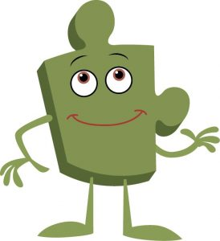
Year 5 PSHE Knowledge Mat Dreams and Goals
Subject Specific Vocabulary |  | Celebrating Difference | Key Questions
Dream | Something you really want. | Knowledge | • What are your dreams and goals? • Why might you need money to help you achieve your dreams and goals? • What jobs are you interested in doing when you are a grown-up? • How much do each of these jobs pay? • Tell me about the hopes and dreams of someone from a different culture? What are the similarities and differences form your own? • Shall I share with you what my dreams and goals were when I was at school? • What are the differences and similarities between you and someone from a different culture? • How does Jigsaw Jerrie Cat help you pause and reflect? • Does Calm Me time have a positive effect on you?
Hope | A desire to make something happen. | • Know that they will need money to help them to achieve some of their dreams • Know about a range of jobs that are carried out by people I know • Know that different jobs pay more money than others • Know the types of job they might like to do when they are older • Know that young people from different cultures may have different dreams and goals • Know that communicating with someone from a different culture means that they can learn from them and vice versa • Know ways that they can support young people in their own culture and abroad. The class talk about their dreams and goals and how they might need money to help them achieve them. They look at jobs that people they know do, they look at the fact that some jobs pay more money than others and reflect on what types of jobs they might like to do when they are older. The children look as the similarities and differences between themselves (and their dreams and goals) and someone from a different culture.
Goal | An aim or desire.
Feeling, Achievement, Money, Grown Up, Adult, Lifestyle, Job, Career, Profession, Money, Salary, Contribution, Society, Determination, Perseverance, Motivation, Aspiration, Culture, Country, Sponsorship, Communication, Support, Rallying, Team Work, Cooperation, Difference.
Qualities, Characteristics, Self-esteem, Unique, Comparison, Negative self-talk, Social media, Online, Community, Risky, Positive, Negative, Safe, Unsafe, Rights, Responsibilities, Social network, Gaming, Violence, Grooming, Troll, Betting, Trustworthy, Appropriate, Screen time, Physical health, Mental health, Off-line, Social, Peer pressure, Influences, Personal information, Passwords, Privacy, Settings, Profile, SMARRT rules |  |  | Skills
 |  |  | • Verbalise what they would like their life to be like when they are grown up • Appreciate the contributions made by people in different jobs • Appreciate the opportunities learning and education can give them • Reflect on the differences between their own learning goals and those of someone from a different culture • Appreciate the differences between themselves and someone from a different culture • Understand why they are motivated to make a positive contribution to supporting others

Slide 11

Prior Learning | Local /National | Unit Objective Y4
• Know what their own hopes and dreams are • Know that hopes and dreams don’t always come true • Know that reflecting on positive and happy experiences can help them to counteract disappointment • Know how to make a new plan and set new goals even if they have been disappointed • Know how to work out the steps they need to take to achieve a goal • Know how to work as part of a successful group • Know how to share in the success of a group | My rights. (UNICEF) My value in the world. Faith week. Growth mind-set. Aspirations. Diversity in the community and around the world. | The children talk about their hopes and dreams. They discuss how it feels when dreams don’t come true and how to cope with / overcome feelings of disappointment. The children talk about making new plans and setting new goals even if they have been disappointed. The class talk about group work and overcoming challenges together. They reflect on their successes and the feelings associated with overcoming a challenge.

Slide 12
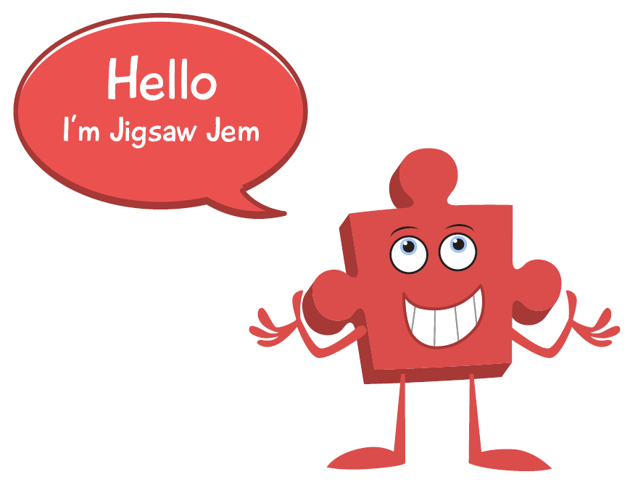
Year 6 PSHE Knowledge Mat Dreams and Goals
Subject Specific Vocabulary |  | Celebrating Difference | Key Questions
Dream | Something you really want. | Knowledge | • What are your learning strengths? • What goal have you set at school? • What goal have you set for home? • How can I help you achieve your goals? • What problems in the world are you worried about? Is there anything we can do to help? • What do you think your classmates admire and like about you? • What do you think your family admire and like about you? • What do you admire about other people? • Do you have any role models? • Does calm Me time help you regulate your emotions?
Hope | A desire to make something happen. | • Know their own learning strengths • Know how to set realistic and challenging goals • Know what the learning steps are they need to take to achieve their goal • Know a variety of problems that the world is facing • Know how to work with other people to make the world a better place • Know some ways in which they could work with others to make the world a better place • Know what their classmates like and admire about them The class talk about their own strengths and further stretching themselves by setting challenging and realistic goals. They discuss the learning steps they’ll need to take as well as talking about how to stay motivated. The children explore various global issues and explore places where people may be suffering or living in difficult situations – whilst doing this they reflect on their own emotions linked to this learning. The class also talk about what they think their classmates like and admire about them as well as working on giving others praise and compliments.
Goal | An aim or desire.
Learning, Strengths, Stretch, Achievement, Personal, Realistic, Unrealistic, Feeling, Success, Criteria, Learning steps, Money, Global issue, Suffering, Concern, Hardship, Sponsorship, Empathy, Motivation, Admire, Respect, Praise, Compliment, Contribution, Recognition
Value, Welcome, Choice, Ghana, West Africa, Cocoa Plantation, Cocoa Pods, Machete, Rights, Community, Education, Wants, Needs, Maslow, Empathy, Comparison, Opportunities, Education, Choices, Behaviour, Responsibilities, Rewards, Consequences, Empathise, Learning Charter, Obstacles, Cooperation, Collaboration, Legal, Illegal, Lawful, Laws, Participation, Motivation, Democracy, Decision, Proud. |  |  | Skills
 |  |  | • Understand why it is important to stretch the boundaries of their current learning • Set success criteria so that they know when they have achieved their goal • Recognise the emotions they experience when they consider people in the world who are suffering or living in difficult circumstances • Empathise with people who are suffering or living in difficult situations • Be able to give praise and compliments to other people when they recognise that person’s achievements

Slide 13

Prior Learning | Local /National | Unit Objective Y5
• Know that they will need money to help them to achieve some of their dreams • Know about a range of jobs that are carried out by people I know • Know that different jobs pay more money than others • Know the types of job they might like to do when they are older • Know that young people from different cultures may have different dreams and goals • Know that communicating with someone from a different culture means that they can learn from them and vice versa • Know ways that they can support young people in their own culture and abroad | Democracy- British Values. Aspirations. My rights. (UNICEF) E safety. Anti bullying week. Faith week. RE- other faiths. Diversity in my community. Growth mindset. Courage curriculum. | The class talk about their dreams and goals and how they might need money to help them achieve them. They look at jobs that people they know do, they look at the fact that some jobs pay more money than others and reflect on what types of jobs they might like to do when they are older. The children look at the similarities and differences between themselves (and their dreams and goals) and someone from a different culture.

