Slide 1



Year R PSHE Knowledge Mat Celebrating Difference
Subject Specific Vocabulary |  | Celebrating Difference | Key Questions
Different | Not the same as another, not like something. | Knowledge | • Can you say how you are different from a friend? • Can you say how you are the same as a friend? • What makes a family? • What makes you proud? • What are you good at doing? • Are all families the same? • What can you do to make a friend? • How can you tell when someone is feeling sad, angry or upset? • If someone is making you feel sad or upset what can you do about it? • Shall we share a Calm Me time?
Special | Better, greater or different from usual. | • Know what being proud means and that people can be proud of different things • Know that people can be good at different things • Know what being unique means • Know that families can be different • Know that people have different homes and why they are important to them • Know different ways of making friends • Know different ways to stand up for myself • Know the names of some emotions such as happy, sad, frightened, angry • Know that they don’t have to be ‘the same as’ to be a friend • Know why having friends is important • Know some qualities of a positive friendship
Proud | Feeling deep happiness because of your own achievements
Friends | Someone with a close bond. Someone to care for.
Kind, Same, Similar, Happy, Sad, Frightened, Angry, Family. |  | Children are encouraged to think about things that they are good at whilst understanding that everyone is good at different things. They talk about being different and how that makes everyone special but also recognising that we are the same in some ways. The children talk about their homes and are asked to explain why it is special to them. They talk about friendship and how to be a kind friend and how to stand up for themselves if someone says or does something unkind to them. | SKILLS
 |  |  | • Identify feelings associated with being proud, upset, frightened or angry • Identify things they are good at and vocalise their successes and others successes • Identify some ways they can be different and the same as others, including families • Identify and use skills to make a friend and stand up for themselves.

Slide 2
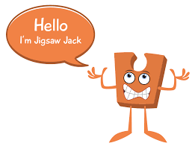
Year 1 PSHE Knowledge Mat Celebrating Difference
Subject Specific Vocabulary |  | Celebrating Difference | Key Questions
Similarity | Being similar but not the same | Knowledge | • Can you say how you are different from a friend? • Can you say how you are the same as a friend? • What can you do to make a friend? • How can you tell when someone is feeling sad, angry or upset? • If someone is making you feel sad or upset what can you do about it?
Same as | Identical, not different | • Know that people have differences and similarities • Know what bullying means • Know who to tell if they or someone else is being bullied or is feeling unhappy • Know skills to make friendships • Know that people are unique and that it is OK to be different
Different from | Not the same
Difference | When two things are compared and are not the same.
Bullying, Bullying behaviour, Deliberate, On purpose, Unfair, Included, Bully, Bullied, Celebrations, Special, Unique. |  | The class talk about the similarities and differences between people and that these make us unique and special. The children learn what bullying is and what it isn’t. They talk about how it might feel to be bullied and when and who to ask for help. The children talk about friendship, how to make friends and that it is OK to have differences from their friends. The children also talk about being nice to and looking after other children you might be being bullied. | Skills
 |  |  | • Recognise ways in which they are the same as their friends and ways they are different • Identify what is bullying and what isn’t • Understand how being bullied might feel • Know ways to help a person who is being bullied • Identify emotions associated with making a new friend • Verbalise some of the attributes that make them unique and special

Slide 3

Prior Learning | Local /National | Unit Objective YR
• Know what being proud means and that people can be proud of different things • Know that people can be good at different things • Know what being unique means • Know that families can be different • Know that people have different homes and why they are important to them • Know different ways of making friends • Know different ways to stand up for myself • Know the names of some emotions such as happy, sad, frightened, angry • Know that they don’t have to be ‘the same as’ to be a friend • Know why having friends is important • Know some qualities of a positive friendship | Myself and my friends, families, the class charter. Celebrating different families and faiths. My rights and responsibilities. (UNICEF) | Children are encouraged to think about things that they are good at whilst understanding that everyone is good at different things. They talk about being different and how that makes everyone special but also recognising that we are the same in some ways. The children talk about their homes and are asked to explain why it is special to them. They talk about friendship and how to be a kind friend and how to stand up for themselves if someone says or does something unkind to them.

Slide 4


Year 2 PSHE Knowledge Mat Celebrating Difference
Subject Specific Vocabulary |  | Celebrating Difference | Key Questions
Similarities | Being similar but not the same | Knowledge | • What is bullying? • Do all boys have to be the same, and all girls have to be the same? How do you feel about this? • Are stereotypes fair? • Can a person be friends with someone who is different from them? • Can we choose how we treat other people? • Can being different be used as a reason for bullying? How do you feel about that? • If you were worried about bullying what could you do? • Does Calm Me time help you feel peaceful?
Assumptions, | Something that is accepted as true, without proof | • Know there are stereotypes about boys and girls • Know that it is OK not to conform to gender stereotypes • Know it is good to be yourself • Know that sometimes people get bullied because of difference • Know the difference between right and wrong and the role that choice has to play in this • Know that friends can be different and still be friends • Know where to get help if being bullied • Know the difference between a one-off incident and bullying The class talk about gender stereotypes, that boys and girls can have differences and similarities and that is OK. They talk about children being bullied because they are different, that this shouldn’t happen and how to support a classmate who is being bullied. The children talk about feelings associated with bullying and how and where to get help. They talk about similarities and differences and that it is OK for friends to have differences without it affecting their friendship.
Shield | To protect
Stereotypes | An idea or image of a person or group of people.
Boys, Girls, Special, Differences, Bully, Purpose, Kind, Unkind, Feelings, Sad, Lonely, Help, Stand up for, Male, Female, Diversity, Fairness, Kindness, Friends, Unique, Value.
Family, Jobs, Lonely, Fall-out, Words, Angry, Upset, Calm me, Breathing. |  | Learning about family relationships widens to include roles and responsibilities in a family and the importance of co-operation, appreciation and trust. Friendships are also revisited with a focus on falling out and mending friendships. This becomes more formalised and the children learn and practise two different strategies for conflict resolution (Solve-it-together and Mending Friendships). Children consider the importance of trust in relationships and what this feels like. They also learn about two types of secret, and why ‘worry secrets’ should always be shared with a trusted adult. Children reflect upon different types of physical contact in relationships, which are acceptable and which ones are not. They practise strategies for being assertive when someone is hurting them or being unkind. The children also discuss people who can help them if they are worried or scared. | Skills
 |  |  | • Understand that boys and girls can be similar in lots of ways and that is OK • Understand that boys and girls can be different in lots of ways and that is OK • Explain how being bullied can make someone feel • Can choose to be kind to someone who is being bullied • Know how to stand up for themselves when they need to • Recognise that they shouldn’t judge people because they are different • Understand that everyone’s differences make them special and unique

Slide 5

Prior Learning | Local /National | Unit Objective Y1
• Know that people have differences and similarities • Know what bullying means • Know who to tell if they or someone else is being bullied or is feeling unhappy • Know skills to make friendships • Know that people are unique and that it is OK to be different | My rights and responsibilities. (UNICEF) Link to faith week. Link to RE- other faiths Growth mindset. Anti bullying week. | The class talk about the similarities and differences between people and that these make us unique and special. The children learn what bullying is and what it isn’t. They talk about how it might feel to be bullied and when and who to ask for help. The children talk about friendship, how to make friends and that it is OK to have differences from their friends. The children also talk about being nice to and looking after other children you might be being bullied.

Slide 6
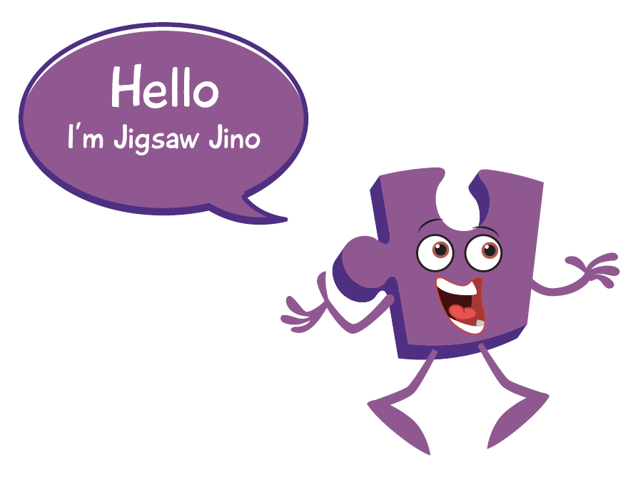

Year 3 PSHE Knowledge Mat Celebrating Difference
Subject Specific Vocabulary |  | Celebrating Difference | Key Questions
Family | A group of one or more parents living with children/a child | Knowledge | • What is the ‘Solve it together’ technique? How can it help solve a disagreement between two people? • What is a bystander in a bullying situation? (A bystander is a witness not directly involved). • How could a bystander make a bullying situation worse or better? • What types of bullying do you know about? • Where can someone get help if they were being bullied or witnessed bullying? • How does it feel to give and receive a compliment?
Loving | Feeling or showing great love or care | Know why families are important • Know that everybody’s family is different • Know that sometimes family members don’t get along and some reasons for this • Know that conflict is a normal part of relationships • Know what it means to be a witness to bullying and that a witness can make the situation worse or better by what they do • Know that some words are used in hurtful ways and that this can have consequences The class learn about families, that they are all different and that sometimes they fall out with each other. The children talk about techniques to calm themselves down and discuss a technique called ‘solve it together.’ The children revisit the topic of bullying and talk about being a witness (bystander), they took about how a witness has choices and how these choices can affect the bullying that is taking place. The children also talk about using problem-solving techniques in bullying situations. They talk about name-calling and choosing not to use hurtful words. They also talk about giving and receiving compliments and the feelings associated with this
Caring | To show kindness or care for others
Safe | To protect or be protected. Not likely to be harmful or risky.
Connected, Difference, Special, Conflict, Solve It Together, Solutions, Resolve, Witness, Bystander, Bullying, Gay, Unkind, Feelings, Tell, Consequences, Hurtful, Compliment, Unique
Family, Jobs, Lonely, Fall-out, Words, Angry, Upset, Calm me, Breathing. |  | Learning about family relationships widens to include roles and responsibilities in a family and the importance of co-operation, appreciation and trust. Friendships are also revisited with a focus on falling out and mending friendships. This becomes more formalised and the children learn and practise two different strategies for conflict resolution (Solve-it-together and Mending Friendships). Children consider the importance of trust in relationships and what this feels like. They also learn about two types of secret, and why ‘worry secrets’ should always be shared with a trusted adult. Children reflect upon different types of physical contact in relationships, which are acceptable and which ones are not. They practise strategies for being assertive when someone is hurting them or being unkind. The children also discuss people who can help them if they are worried or scared. | Skills
 |  |  | • Be able to show appreciation for their families, parents and carers • Use the ‘Solve it together’ technique to calm and resolve conflicts with friends and family • Empathise with people who are bullied • Employ skills to support someone who is bullied • Be able to ‘problem-solve’ a bullying situation accessing appropriate support if necessary • Be able to recognise, accept and give compliments

Slide 7

Prior Learning | Local /National | Unit Objective Y2
• Know there are stereotypes about boys and girls • Know that it is OK not to conform to gender stereotypes • Know it is good to be yourself • Know that sometimes people get bullied because of difference • Know the difference between right and wrong and the role that choice has to play in this • Know that friends can be different and still be friends • Know where to get help if being bullied • Know the difference between a one-off incident and bullying . | My rights and responsibilities. (UNICEF) My family and other families. Anti bullying week. E safety. Faith week. | The class talk about gender stereotypes, that boys and girls can have differences and similarities and that is OK. They talk about children being bullied because they are different, that this shouldn’t happen and how to support a classmate who is being bullied. The children talk about feelings associated with bullying and how and where to get help. They talk about similarities and differences and that it is OK for friends to have differences without it affecting their friendship.

Slide 8


Year 4 PSHE Knowledge Mat Celebrating Difference
Subject Specific Vocabulary |  | Celebrating Difference | Key Questions
Character | Qualities that make a person unique | Knowledge | • What is an assumption? Are assumptions always right? • What can influence us to make an unfair judgement about someone else? • Is social media always helpful? • What’s good/ bad about social media? • What is a stereotype? What stereotypes do you see on social media, in the movies or on TV? • Are stereotypes fair? • Do you know any rules for staying safe with technology? • What could you do if you were worried about something online or in social media e.g. cyber-bullying?
Assumption | Something that is accepted as true, without proof | Know that sometimes people make assumptions about a person because of the way they look or act • Know there are influences that can affect how we judge a person or situation • Know that some forms of bullying are harder to identify e.g. tactical ignoring, cyber-bullying • Know what to do if they think bullying is, or might be taking place • Know the reasons why witnesses sometimes join in with bullying and don’t tell anyone • Know that first impressions can change The children talk about judging people by their appearance, first impressions and what influences their thinking on what is normal. They talk about bullying, including online bullying and what to do if they suspect or know that it is taking place. They discuss the pressures of being a witness and why some people choose to join in or choose to not tell anyone about what they have seen. The children talk about their own uniqueness and what is special about themselves. They talk about first impressions and when their own first impressions of someone have changed
Judgement | Forming an opinion or evaluation
Different | Not the same as another, not like something.
Appearance, Accept, Influence, Opinion, Attitude, Bullying, Friend, Secret, Deliberate, On purpose, Bystander, Witness, Bully, Problem solve, Cyber bullying, Text message, Website, Troll, Special, Unique, Physical features, Impression, Changed |  |  | Skills
 |  |  | • Try to accept people for who they are, being non judgemental • Identify influences that have made them think or feel positively/negatively about a situation • Identify feelings that a bystander might feel in a bullying situation • Identify reasons why a bystander might join in with bullying • Revisit the ‘Solve it together’ technique to practise conflict and bullying scenarios • Identify when a first impression they had was right or wrong

Slide 9

Prior Learning | Local /National | Unit Objective Y3
Know why families are important • Know that everybody’s family is different • Know that sometimes family members don’t get along and some reasons for this • Know that conflict is a normal part of relationships • Know what it means to be a witness to bullying and that a witness can make the situation worse or better by what they do • Know that some words are used in hurtful ways and that this can have consequences | Aspirations. My rights. (UNICEF) Antibullying. Faith week. E safety. My family and families in the community. Growth mindset. | The class learn about families, that they are all different and that sometimes they fall out with each other. The children talk about techniques to calm themselves down and discuss a technique called ‘solve it together.’ The children revisit the topic of bullying and talk about being a witness (bystander), they took about how a witness has choices and how these choices can affect the bullying that is taking place. The children also talk about using problem-solving techniques in bullying situations. They talk about name-calling and choosing not to use hurtful words. They also talk about giving and receiving compliments and the feelings associated with this.

Slide 10
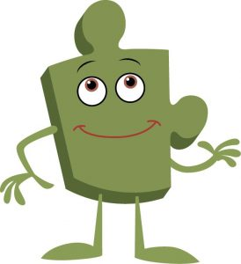

Year 5 PSHE Knowledge Mat Celebrating Difference
Subject Specific Vocabulary |  | Celebrating Difference | Key Questions
Culture | Ideas and social behaviour of people or group of people. | Knowledge | • What is our culture? • Can people with different cultures be friends? • How can differences in culture cause conflict? • What is racism? • Why is racism unfair? • What are your feelings about racism? • How can bullying affect how a person feels about themselves? Is this fair? • Is money more important than happiness? • What can we do to help people who are less fortunate than us? • Can you show me how to do a Calm me time?
Conflict | A serious disagreement or argument. To be different. | • Know what culture means • Know that differences in culture can sometimes be a source of conflict • Know what racism is and why it is unacceptable • Know that rumour spreading is a form of bullying on and offline • Know external forms of support in regard to bullying e.g. Childline • Know that bullying can be direct and indirect • Know how their life is different from the lives of children in the developing world The class explore culture and cultural differences. They link this to racism, talking about what it is and how to be aware of their own feelings towards people from different cultures. They revisit the topic of bullying and discuss rumour spreading and name-calling. The children talk about direct and indirect bullying as well as ways to encourage children to not using bullying behaviours. The class talk about happiness regardless of material wealth and respecting other people’s cultures.
Difference | Being similar but not the same.
Similarity Belong, Culture Wheel, Racism, Colour, Race, Discrimination, Ribbon, Bullying, Rumour, Name-calling, Racist, Homophobic, Cyber bullying, Texting, Problem solving, Indirect, Direct, Happiness, Developing World, Celebration, Artefacts, Display, Presentation | When two things are compared and are not the same.
Qualities, Characteristics, Self-esteem, Unique, Comparison, Negative self-talk, Social media, Online, Community, Risky, Positive, Negative, Safe, Unsafe, Rights, Responsibilities, Social network, Gaming, Violence, Grooming, Troll, Betting, Trustworthy, Appropriate, Screen time, Physical health, Mental health, Off-line, Social, Peer pressure, Influences, Personal information, Passwords, Privacy, Settings, Profile, SMARRT rules |  |  | Skills
 |  |  | • Identify their own culture and different cultures within their class community • Identify their own attitudes about people from different faith and cultural backgrounds-develop respect • Identify a range of strategies for managing their own feelings in bullying situations • Identify some strategies to encourage children who use bullying behaviours to make other choices • Be able to support children who are being bullied • Appreciate the value of happiness regardless of material wealth

Slide 11

Prior Learning | Local /National | Unit Objective Y4
Know that sometimes people make assumptions about a person because of the way they look or act • Know there are influences that can affect how we judge a person or situation • Know that some forms of bullying are harder to identify e.g. tactical ignoring, cyber-bullying • Know what to do if they think bullying is, or might be taking place • Know the reasons why witnesses sometimes join in with bullying and don’t tell anyone • Know that first impressions can change | My rights. (UNICEF) My value in the world. Faith week. Growth mindset. Diversity in the community. Anti bullying week. | The children talk about judging people by their appearance, first impressions and what influences their thinking on what is normal. They talk about bullying, including online bullying and what to do if they suspect or know that it is taking place. They discuss the pressures of being a witness and why some people choose to join in or choose to not tell anyone about what they have seen. The children talk about their own uniqueness and what is special about themselves. They talk about first impressions and when their own first impressions of someone have changed

Slide 12
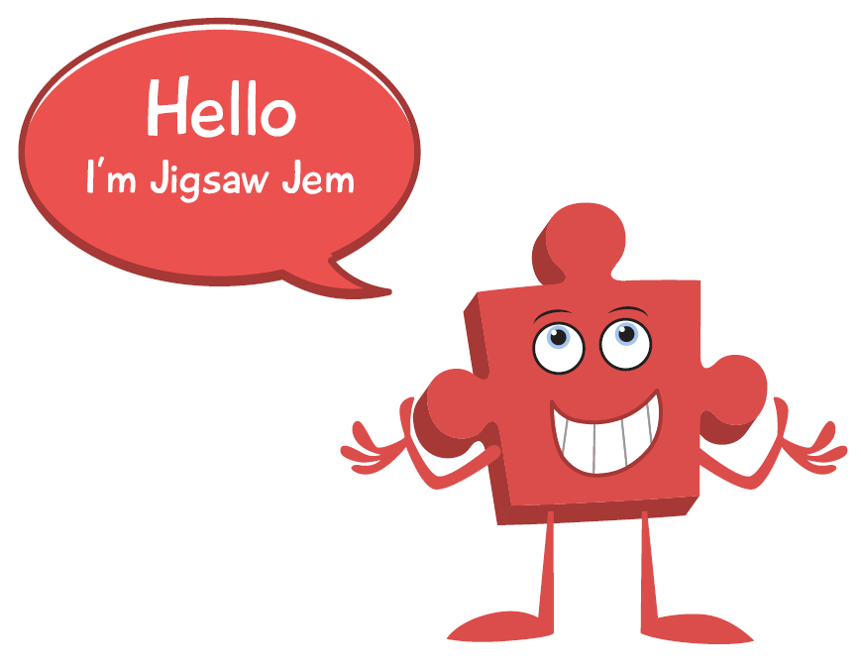

Year 6 PSHE Knowledge Mat Celebrating Difference
Subject Specific Vocabulary |  | Celebrating Difference | Key Questions
Normal | Standard, typical, usual or expected | Knowledge | • What is prejudice and discrimination, can you give an example? • Why is there an Equality Act in the UK? Who does it protect and why? • What role does power play in a bullying situation? Who has the power and why? • Why do some people choose to bully? • Can difference be a source of celebration? Can you give an example? • Does having Pause Points during lessons help you concentrate? • How does being able to do Calm me time help you regulate your emotions?
Ability | The skill to do something, a talent in a particular area. | Know that there are different perceptions of ‘being normal’ and where these might come from • Know that being different could affect someone’s life • Know that power can play a part in a bullying or conflict situation • Know that people can hold power over others individually or in a group • Know why some people choose to bully others • Know that people with disabilities can lead amazing lives • Know that difference can be a source of celebration as well as conflict The class talk about differences and similarities and that for some people, being different is hard. The children talk about bullying and how people can have power over others in a group. They talk about strategies for dealing with this as well as wider bullying issues. The class talk about people with disabilities and look at specific examples of disabled people who have amazing lives and achievements.
Disability | A physical or mental condition that limits or changes a persons movements, senses or activities.
Empathy Visual impairment, Perception, Medication, Vision, Blind, Male, Female, Diversity, Transgender, Gender Diversity, Courage, Fairness, Rights, Responsibilities, Power, Struggle, Imbalance, Harassment, Bullying, Bullying behaviour, Direct, Indirect, Argument, Recipient, Para-Olympian, Achievement, Accolade, Perseverance, Sport, Admiration, Stamina, Celebration, Conflict | The ability to understand and share the feelings of another.
Value, Welcome, Choice, Ghana, West Africa, Cocoa Plantation, Cocoa Pods, Machete, Rights, Community, Education, Wants, Needs, Maslow, Empathy, Comparison, Opportunities, Education, Choices, Behaviour, Responsibilities, Rewards, Consequences, Empathise, Learning Charter, Obstacles, Cooperation, Collaboration, Legal, Illegal, Lawful, Laws, Participation, Motivation, Democracy, Decision, Proud. |  |  | Skills
 |  |  | • Empathise with people who are different and be aware of my own feelings towards them • Be able to recognise when someone is exerting power negatively in a relationship • Use a range of strategies when involved in a bullying situation or in situations where difference is a source of conflict • Identify different feelings of the bully, bullied and bystanders in a bullying scenario • Be able to vocalise their thoughts and feelings about prejudice and discrimination and why it happens • Appreciate people for who they are and show empathy.

Slide 13

Prior Learning | Local /National | Unit Objective Y5
• Know what culture means • Know that differences in culture can sometimes be a source of conflict • Know what racism is and why it is unacceptable • Know that rumour spreading is a form of bullying on and offline • Know external forms of support in regard to bullying e.g. Childline • Know that bullying can be direct and indirect • Know how their life is different from the lives of children in the developing world | Democracy- British Values. Aspirations. My rights. (UNICEF) E safety. Anti bullying week. Faith week. RE- other faiths. Diversity in my community. Growth mindset. Courage curriculum. | The class explore culture and cultural differences. They link this to racism, talking about what it is and how to be aware of their own feelings towards people from different cultures. They revisit the topic of bullying and discuss rumour spreading and name-calling. The children talk about direct and indirect bullying as well as ways to encourage children to not using bullying behaviours. The class talk about happiness regardless of material wealth and respecting other people’s cultures.

