Slide 1
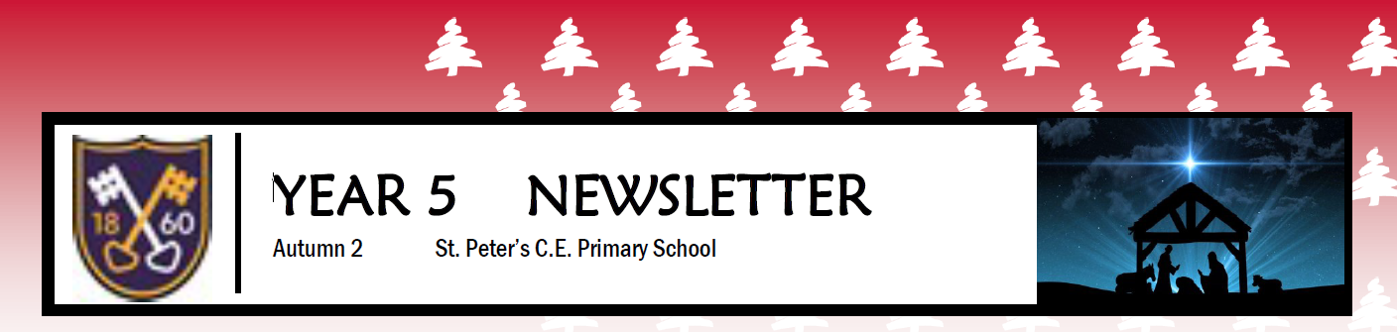
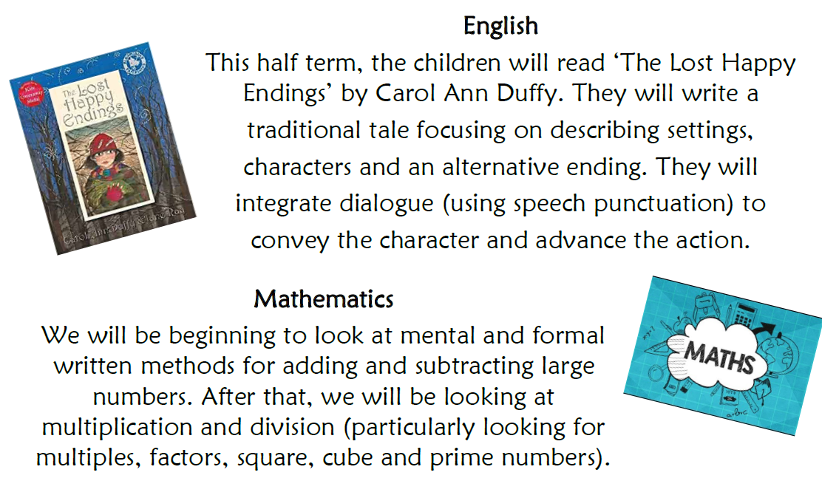
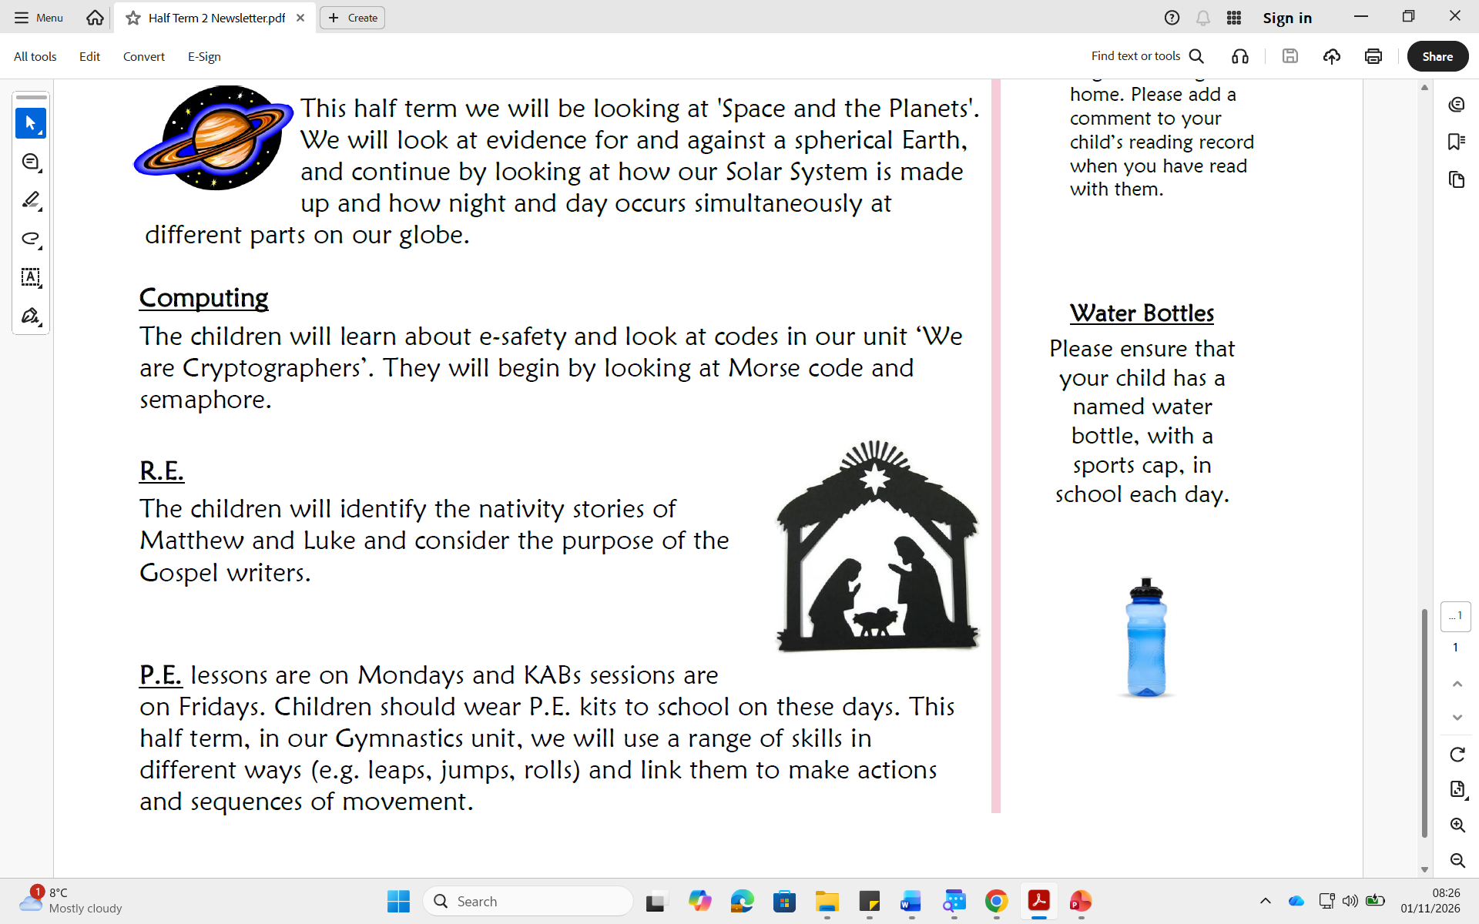
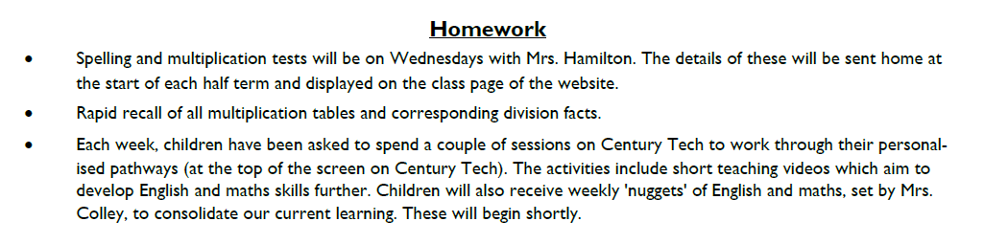
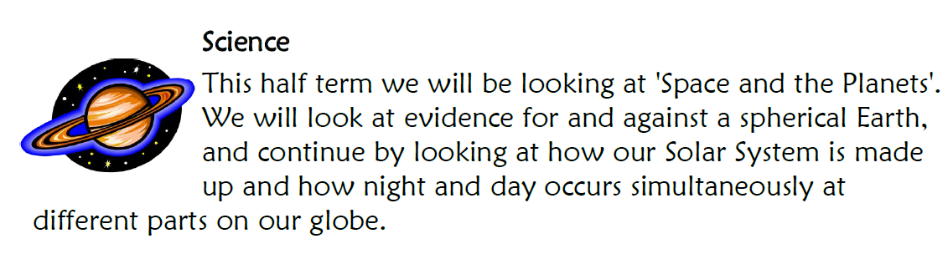

P.E.
This half term, P.E. lessons will take place on Mondays as we take part in rugby activities with coaches from Saints R.L.F.C. Children should wear a warm P.E. kit to school each Monday.

