Slide 1




Maths in the Early Years
Mrs Harrison 1.12.25

Slide 2
The Curriculum
z
Mathematics will have greater clarity to counting and comparing quantities in the Numerical Patterns ELG. The Government will proceed with its focus on number and numerical patterns within the mathematics ELGs as the strongest predictor for later maths outcomes.
This also reflects government’s continued commitment to strengthen the teaching of early numeracy so that all children are able to start year 1 with a strong and confident foundation in number.
Practitioners and teachers will still be required to teach children about shape, space and measures, as part of a well-rounded curriculum.

Slide 3
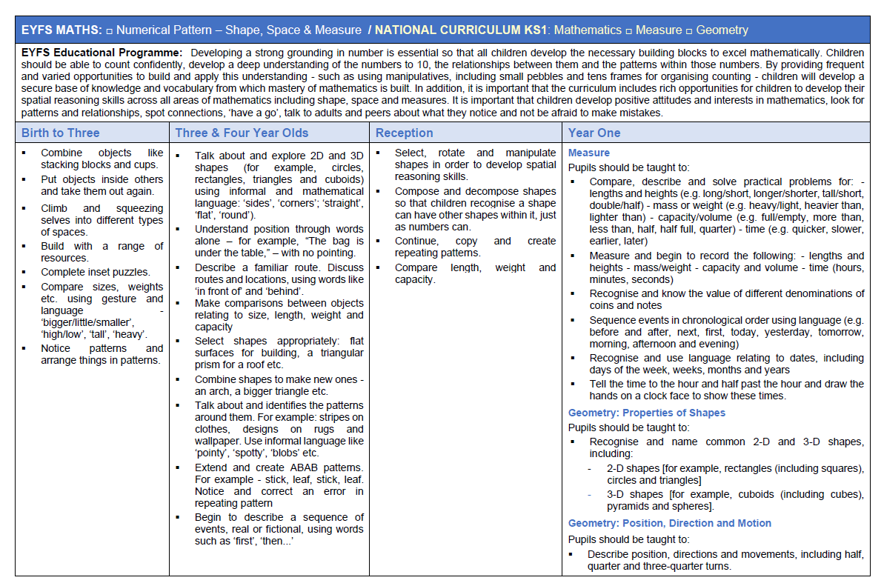
Development Matters and the EYFS Profile

Slide 4
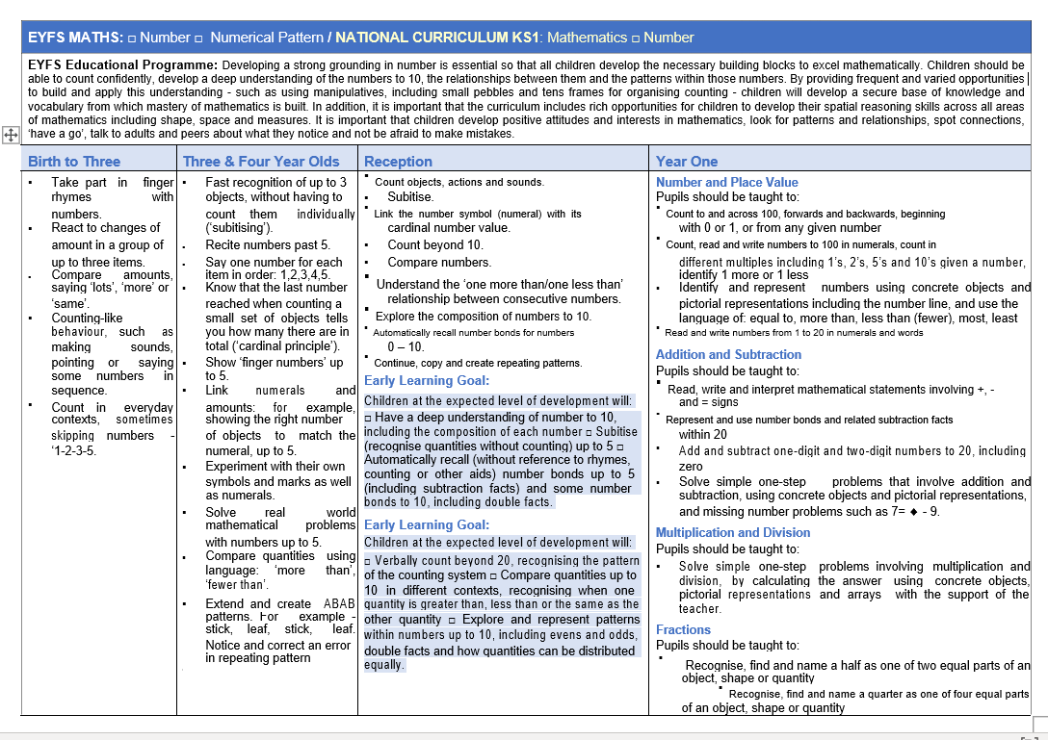

Slide 5
Reception
z
Select, rotate and manipulate shapes in order to develop spatial reasoning skills. ▪ Compose and decompose shapes so that children recognise a shape can have other shapes within it, just as numbers can. ▪ Continue, copy and create repeating patterns. ▪ Compare length, weight and capacity
Count objects, actions and sounds. ▪ Subitise. ▪ Link the number symbol (numeral) with its cardinal number value. ▪ Count beyond 10. ▪ Compare numbers. ▪ Understand the ‘one more than/one less than’ relationship between consecutive numbers. ▪ Explore the composition of numbers to 10. ▪ Automatically recall number bonds for numbers 0 – 10. ▪ Continue, copy and create repeating patterns.

Slide 6
The Early Learning Goals- ELG’s
z
Early Learning Goal: Children at the expected level of development will: □ Have a deep understanding of number to 10, including the composition of each number □ Subitise (recognise quantities without counting) up to 5 □ Automatically recall (without reference to rhymes, counting or other aids) number bonds up to 5 (including subtraction facts) and some number bonds to 10, including double facts.
Early Learning Goal: Children at the expected level of development will: □ Verbally count beyond 20, recognising the pattern of the counting system □ Compare quantities up to 10 in different contexts, recognising when one quantity is greater than, less than or the same as the other quantity □ Explore and represent patterns within numbers up to 10, including evens and odds, double facts and how quantities can be distributed equally.

Slide 7
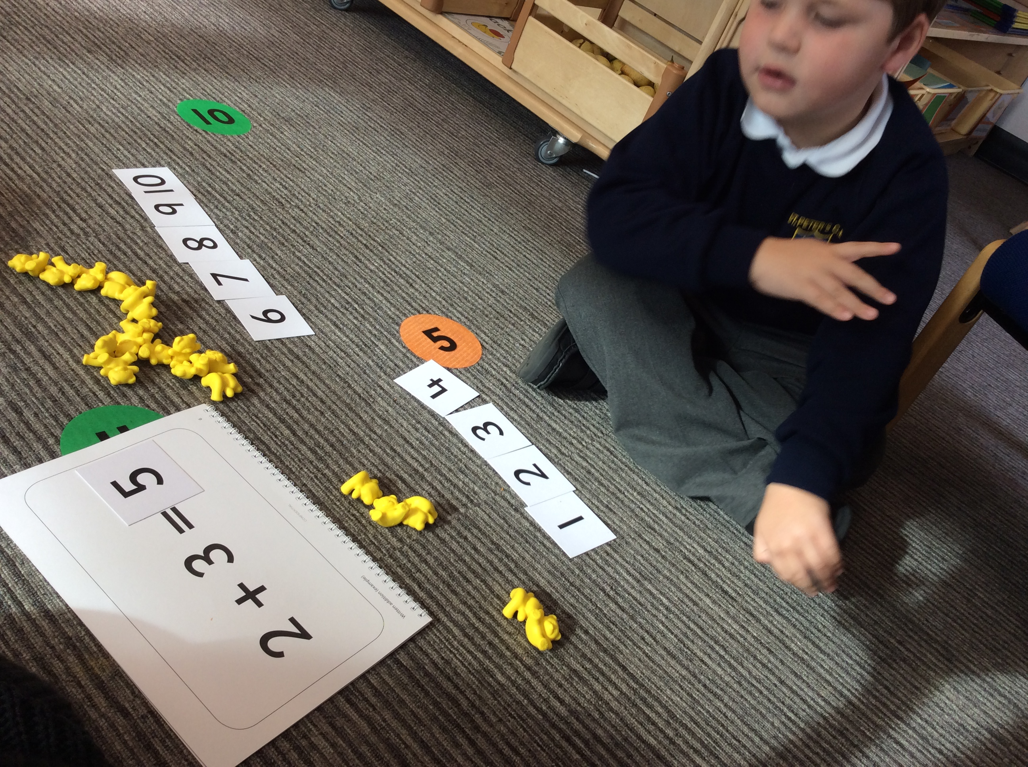
Maths in Reception
z
Every single day as a whole class lesson – 20 minutes approx.
Supported by teaching assistants
Maths challenges in the classroom (play provision)
Groups of children complete Maths activities with Mrs Harrison/ Miss Haeford throughout the week.
Recorded on Tapestry
Children will have a Maths book in late Spring term/Summer term
Indoors and outdoors

Slide 8

1.Stable Order 2. One to one correspondence 3.Cardinality 4.Abstract counting 5.Order irrelevance https://youtu.be/SG0jzpZtfgs
The 5 Principles of Counting
z

Slide 9
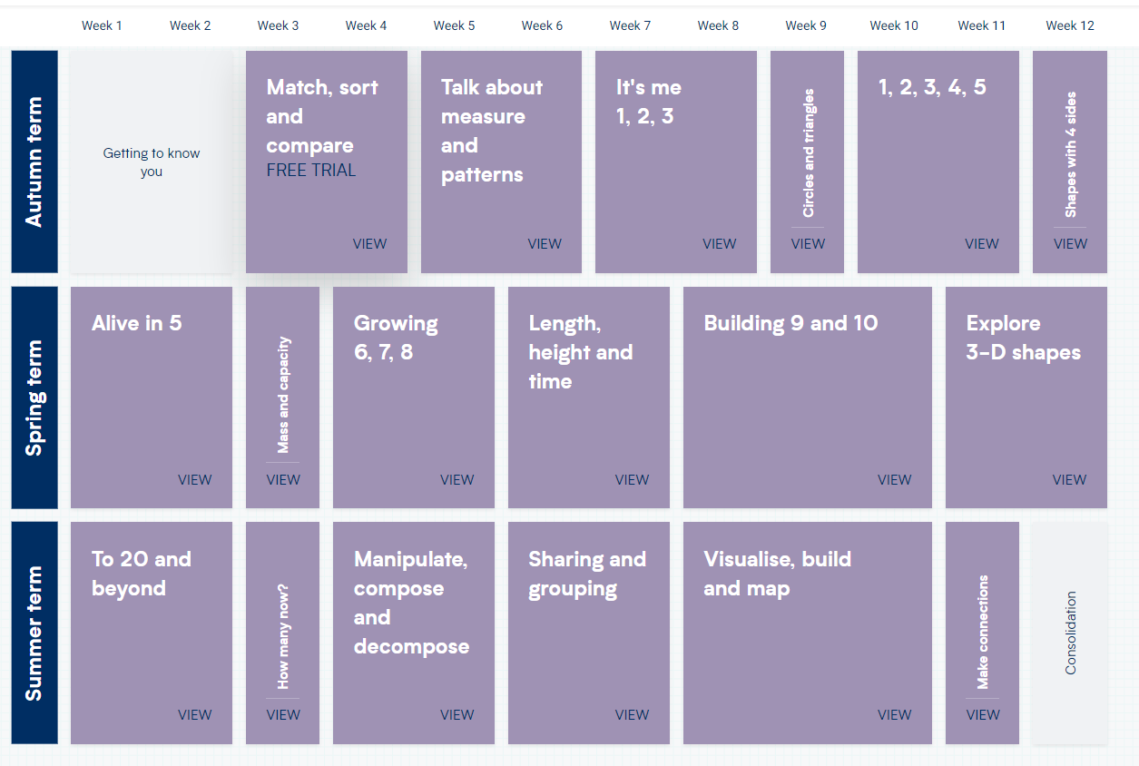

Slide 10
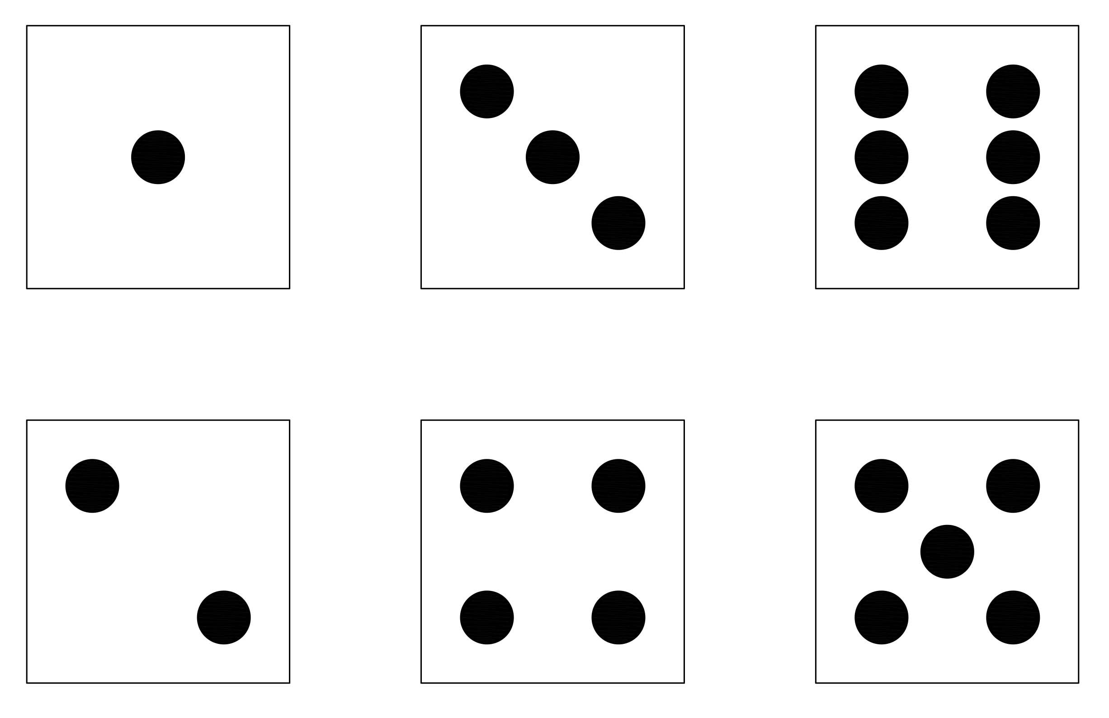
Subitising
z
• It is the ability to quickly recognise how many
objects are in a group without actually counting
• Reinforces principles of counting and beyond.
What numbers are represented here?

Slide 11
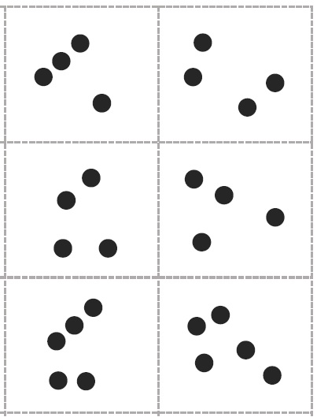
How do you see the number?
I know 1 and 3 makes 4.
4 is one more than 3.
z

Slide 12
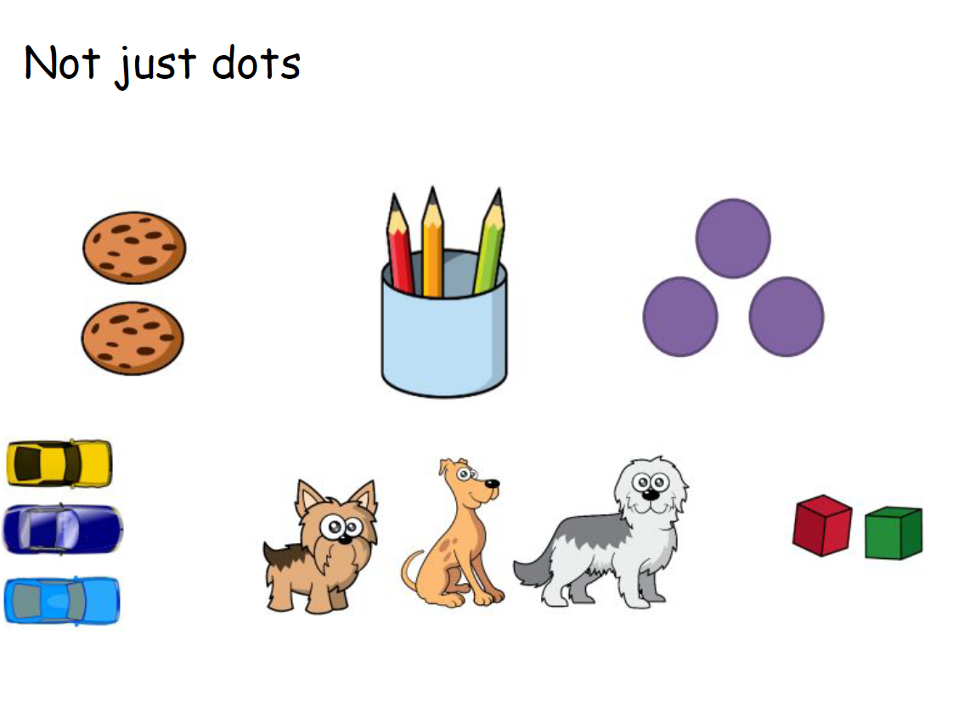

Slide 13
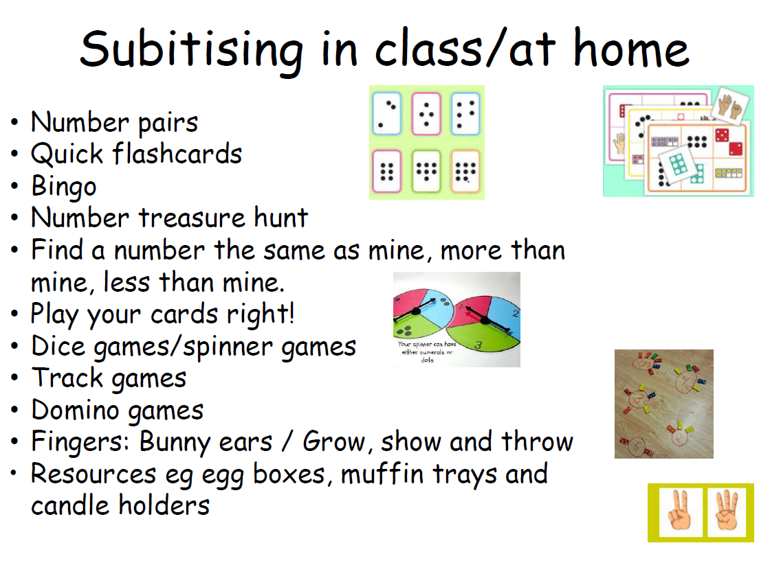

Slide 14
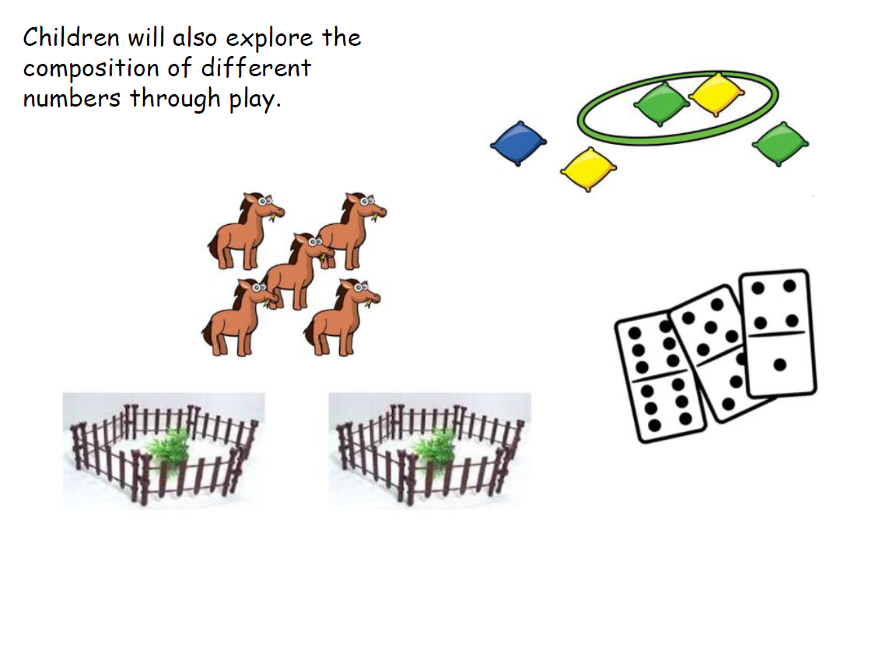

Slide 15
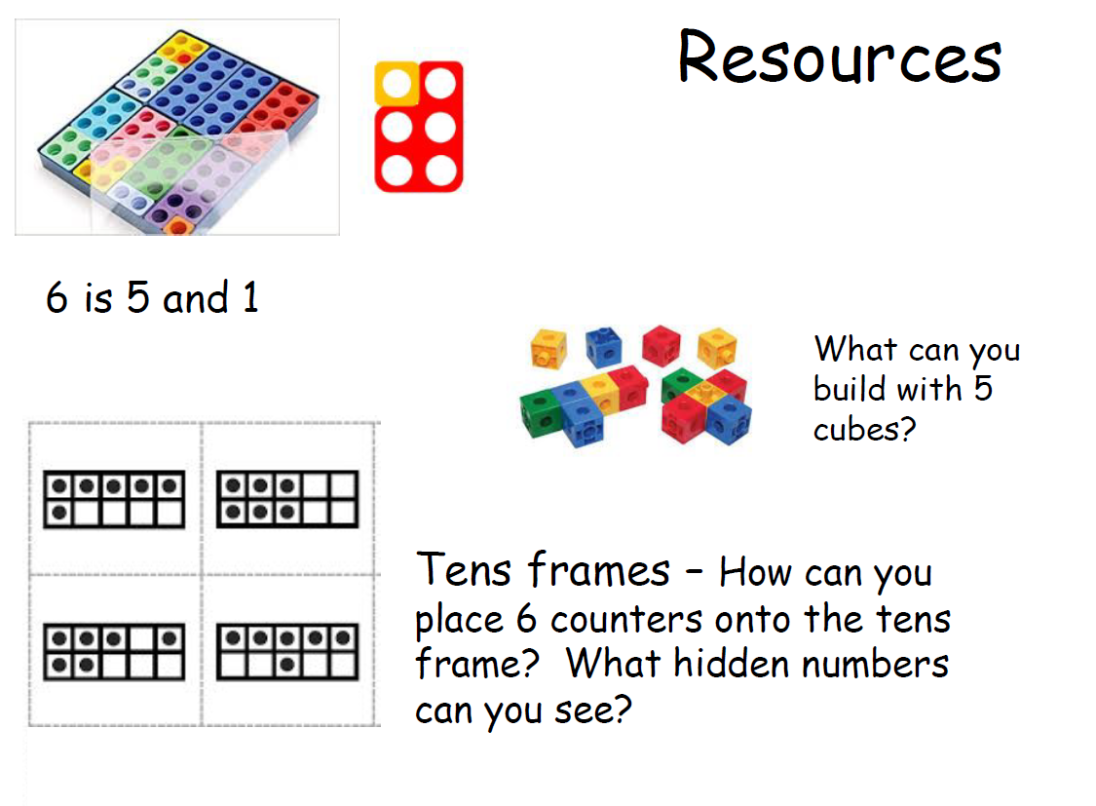

Slide 16
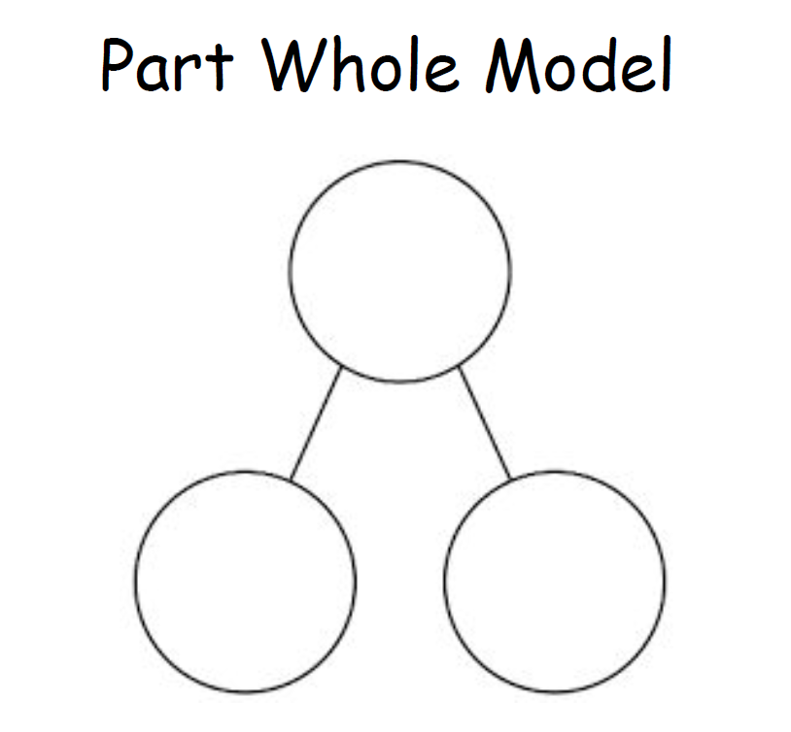

Slide 17
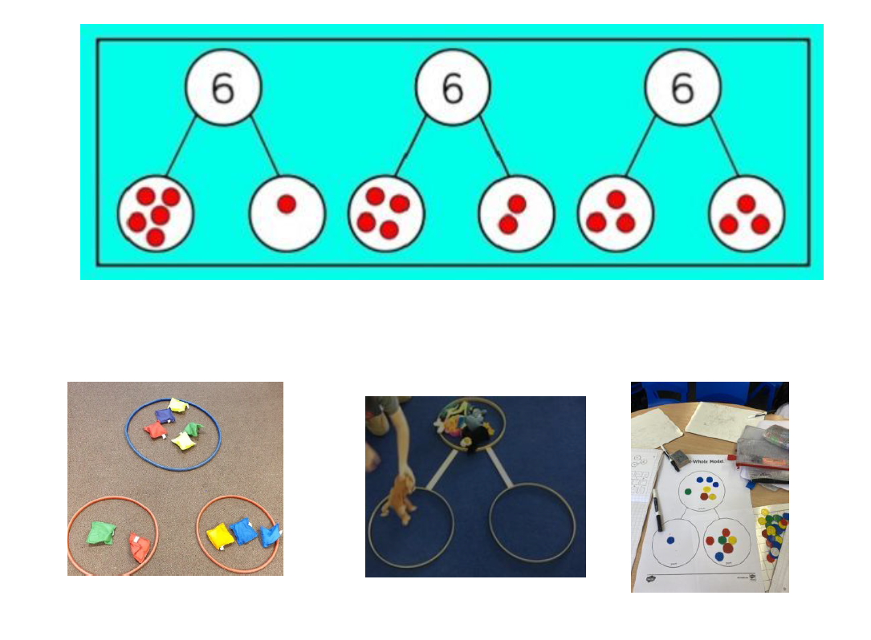

Slide 18

Vocabulary
Number; zero; numbers to 20; count, forwards, backwards; how many, more, fewer, equal, group; order, largest, smallest, less; even, odd, answer, share, sort, pattern, rule, same, different, least, most, estimate, part, whole
z

Slide 19
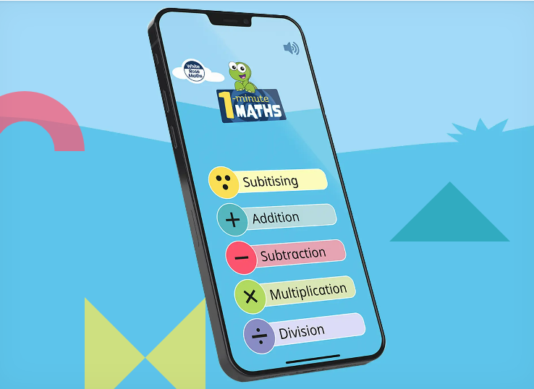

Slide 20
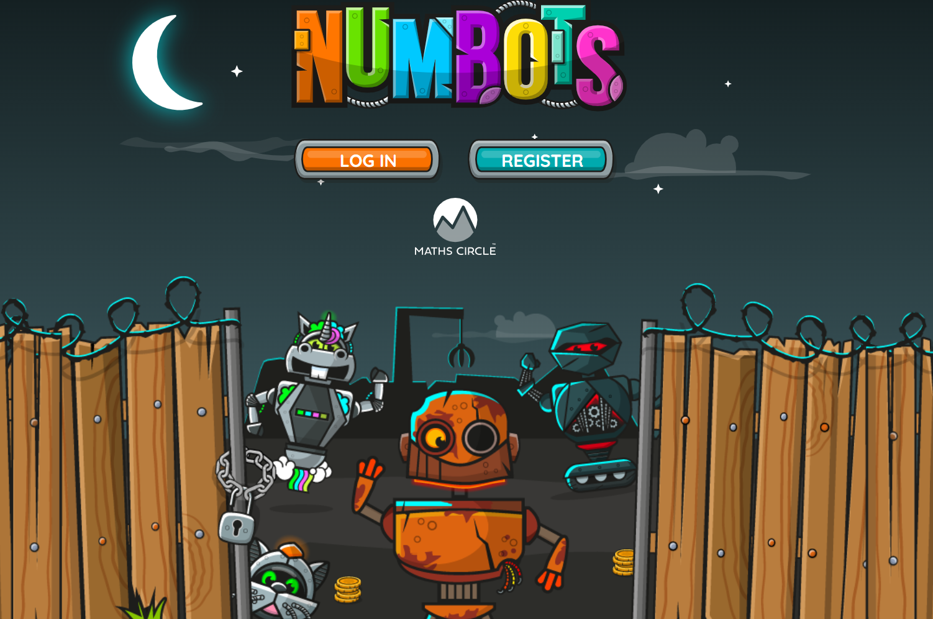

Slide 21
Useful websites
https://www.bbc.co.uk/cbeebies/shows/numberblocks
https://www.ncetm.org.uk/in-the-classroom/early-years/
https://whiterosemaths.com/resources?year=early-years
https://www.topmarks.co.uk/Search.aspx?Subject=37
http://www.crickweb.co.uk/Early-Years.html
https://www.youtube.com/watch?v=SG0jzpZtfgs
www.mathsbot.com

Slide 22


