Slide 1


Your child in the Early years
Mrs Harrison

Slide 2
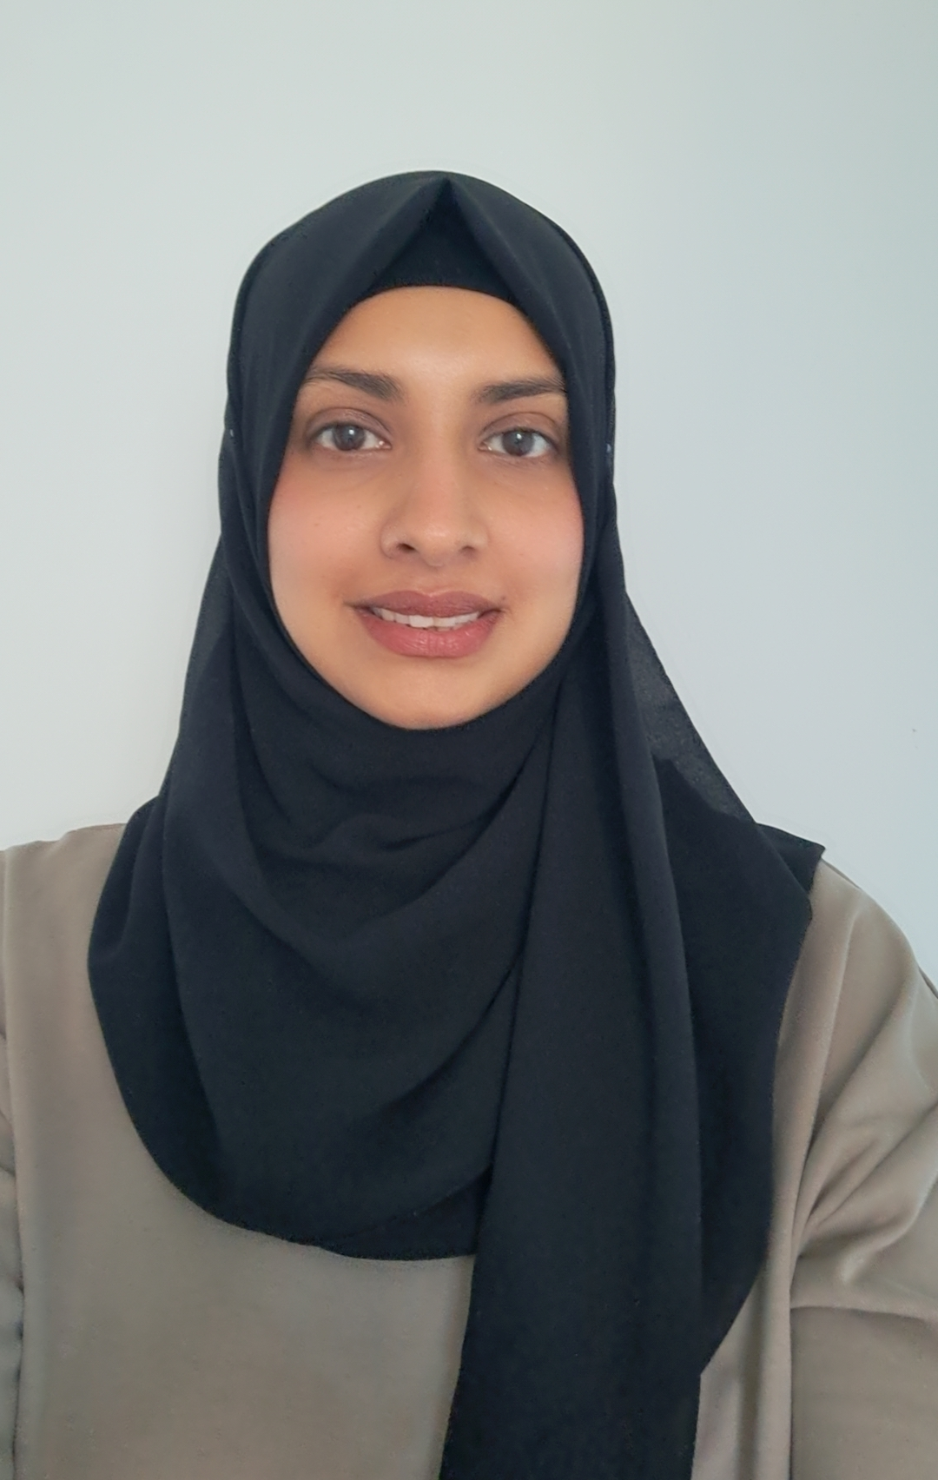
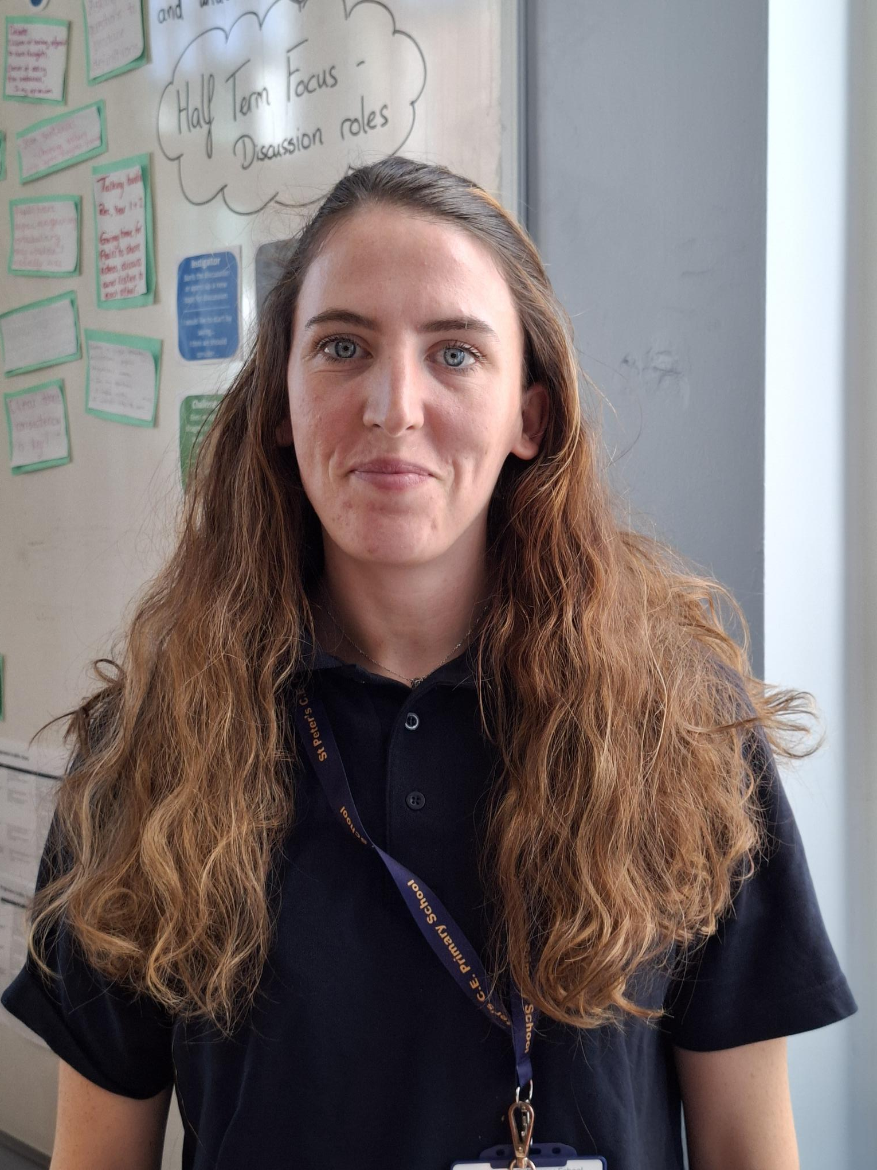
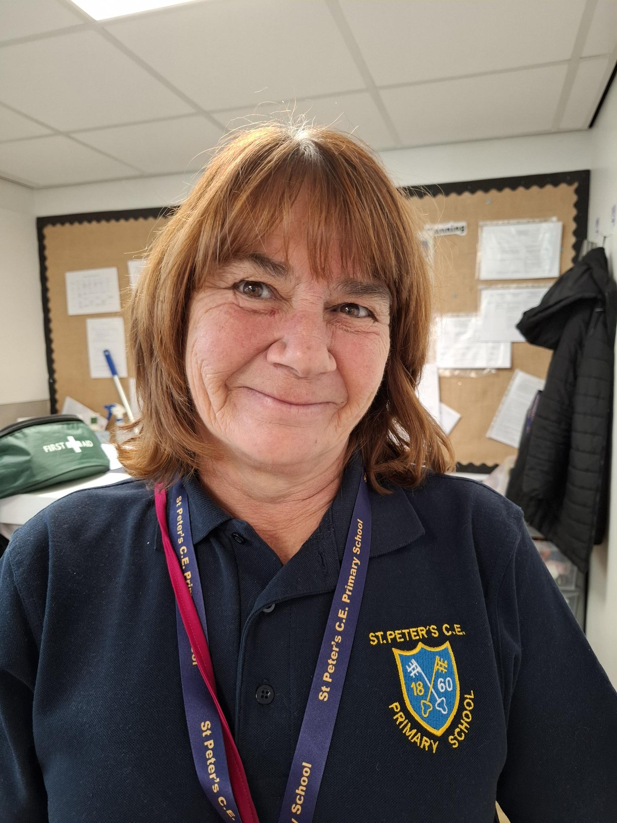
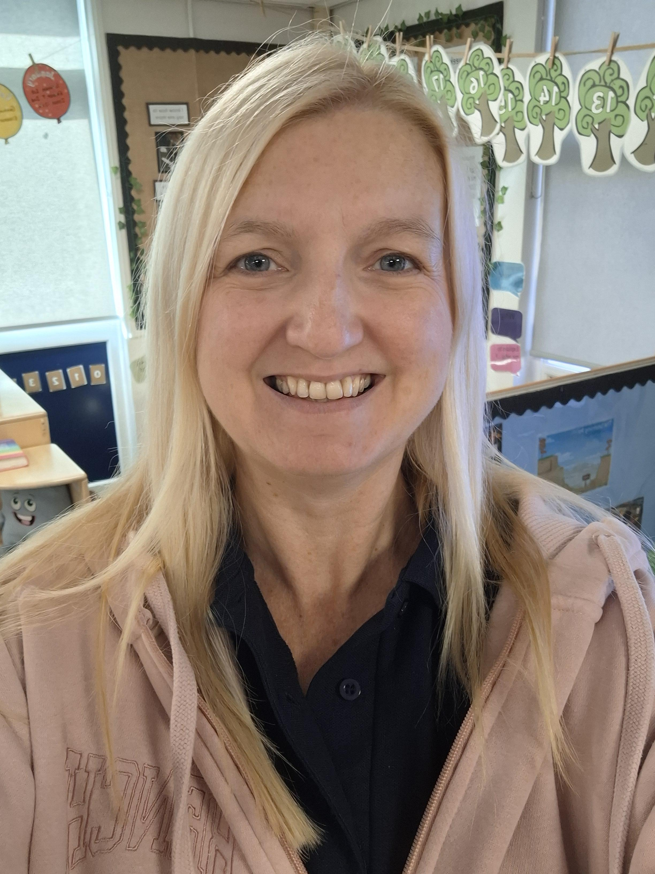
Staffing…
Mrs Harrison
Class Teacher
Miss Haeford
Teaching Assistant
Mrs Khanom
Teaching Assistant
Mrs Bourne
LSA
Miss Harrison (curly) HLTA
Tuesdays in class and Thurs morning interventions/group work with us

Slide 3
How my child will be learning…
The EYFS Framework explains how and what your child will learn to support
their healthy development.
Your child will be learning skills, acquiring new knowledge and demonstrating their
understanding through 7 areas of learning and development.
Children develop skills across 3 prime areas. These are:
• Communication and language;
• Physical development;
• Personal, social and emotional development.
These prime areas are essential for your child’s healthy development and
future learning.
As children grow and develop, the prime areas will help them to develop skills in 4 specific areas.
These are:
• Literacy;
• Mathematics;
• Understanding the world;
• Expressive arts and design.

Slide 4

Development Matters - GOV.UK (www.gov.uk)

Slide 5
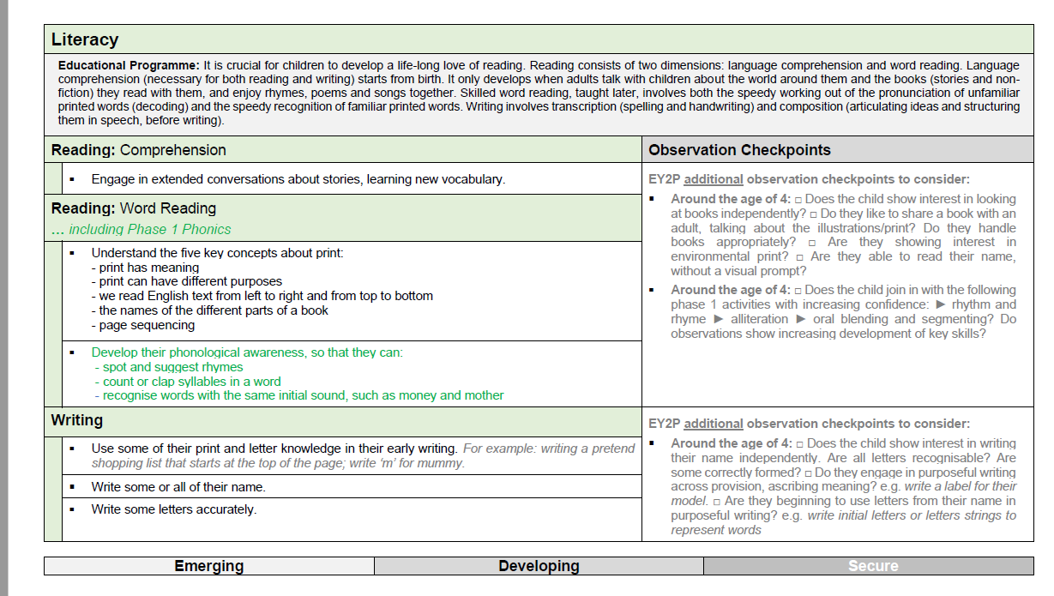

Slide 6
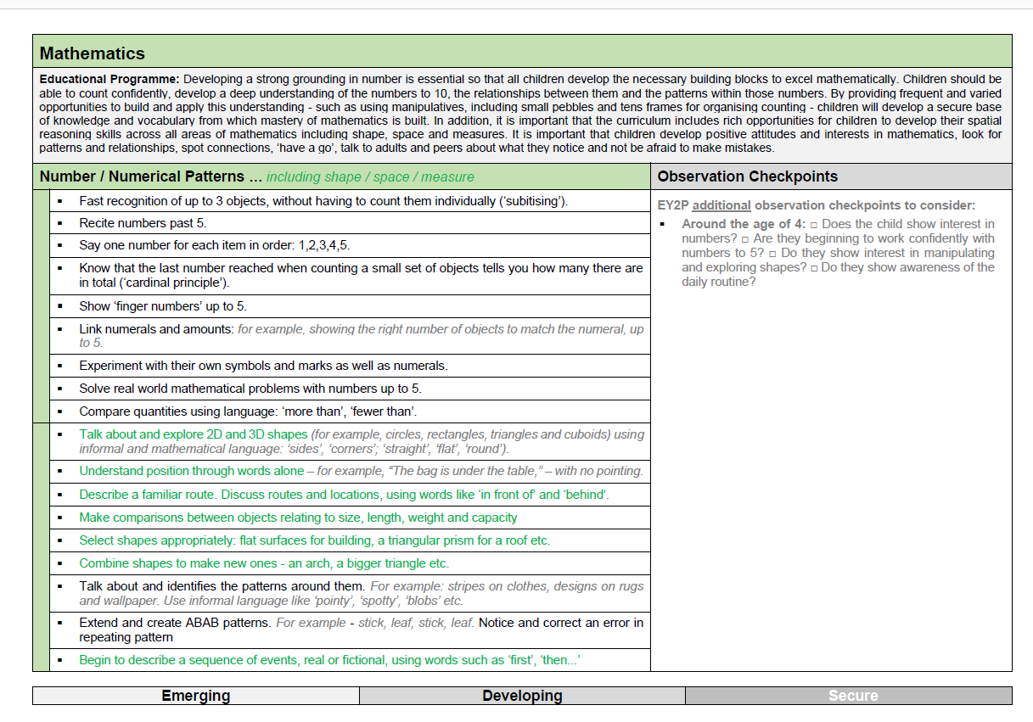

Slide 7
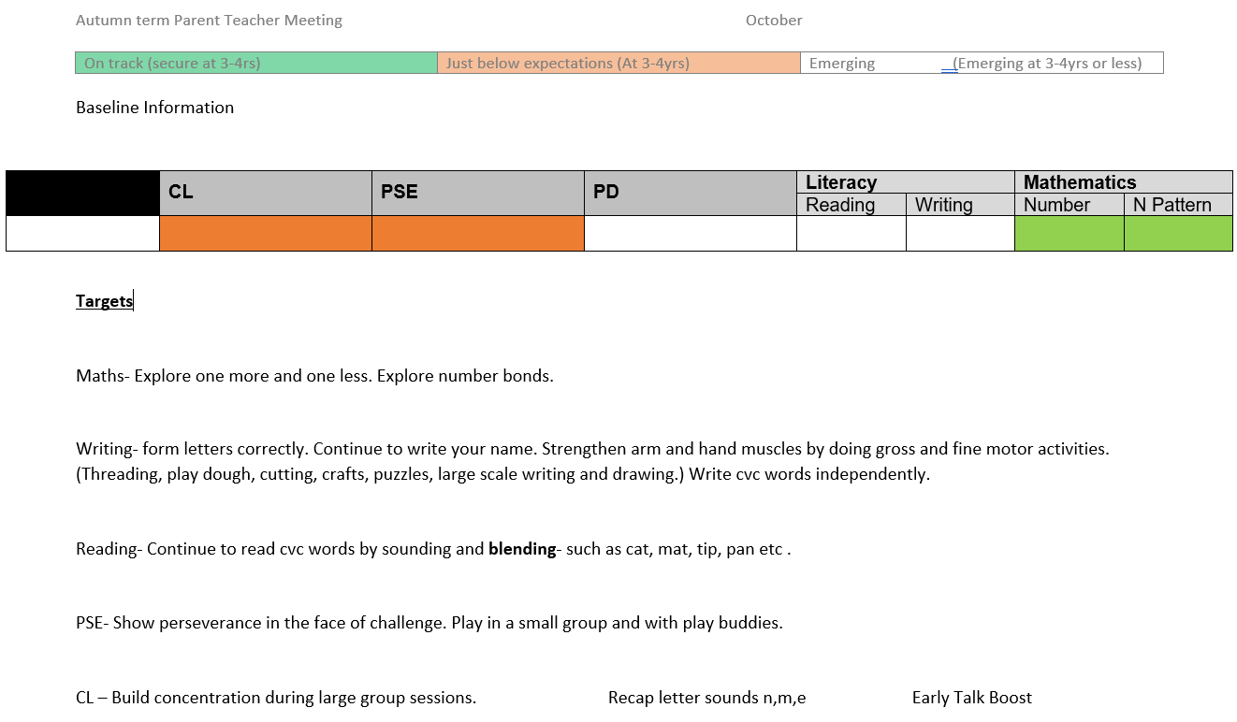
Letting you know…
Parent teacher meetings
Share info and targets.
Share celebrations and discuss concerns.
Interventions
Quick chat

Slide 8

Early Years Foundation stage Profile
The Reception teacher will use this profile to assess your child against the 17 Early Learning Goals across the 7 areas of learning, AT THE END OF THE YEAR.
They will be given a level in each;
Working at
Working towards/emerging
There is no exceeding level.
Children will also learn different characteristics of effective learning.

Slide 9
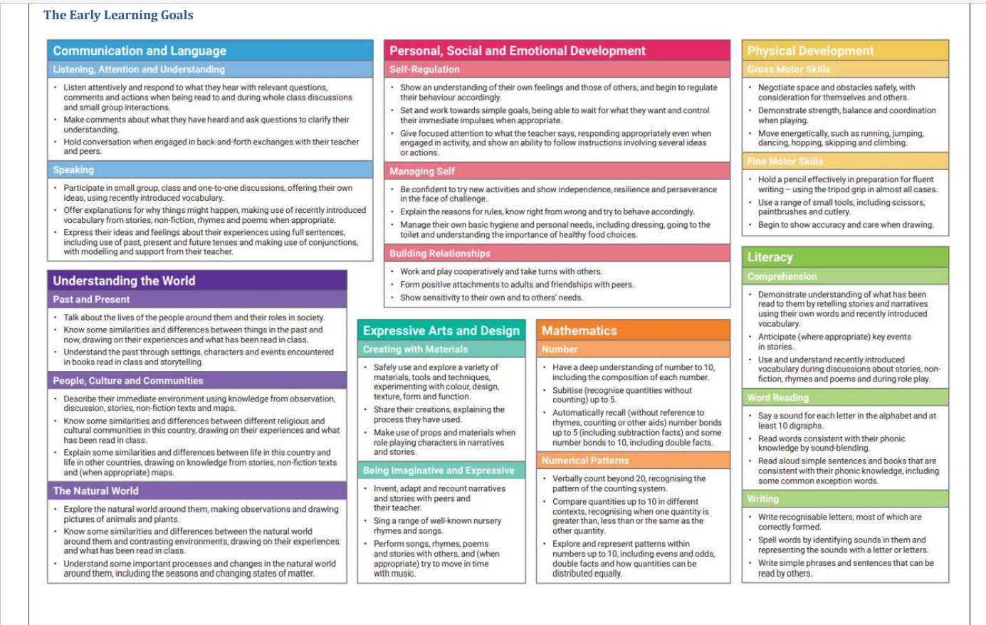

Slide 10
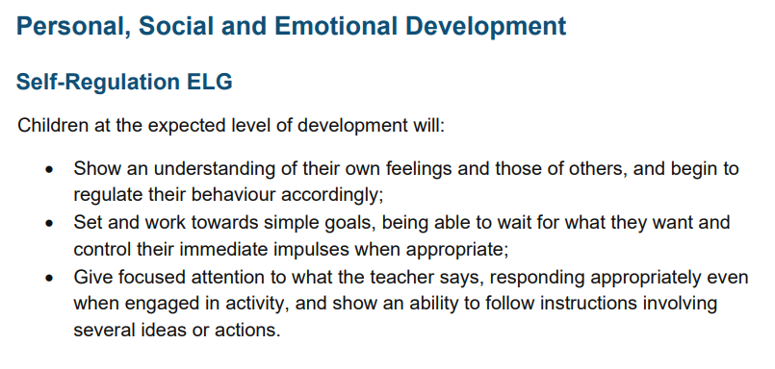

Slide 11


As a Parent or carer, how can I help with my child’s
learning?
All the fun activities that you do with your child at home are important in supporting
their learning and development, and have a really long-lasting effect on your child’s
learning as they progress through school.
Reading- 3 times each week at least, write in the diary. Make it fun!
Home activities- do them in the book, physically, take pics for Tapestry.
Tapestry- any observations are so valuable to us.
Make learning fun! If your child is struggling to hold a pencil at the moment, use chunky chalk, water, glue, cars dipped in paint, white board and marker, felt tip….anything! Count conkers, lego bricks, fruit, food on plate, play games to take turns.

Slide 12

Reception baseline assessment: information for parents - GOV.UK

Slide 13


Slide 14
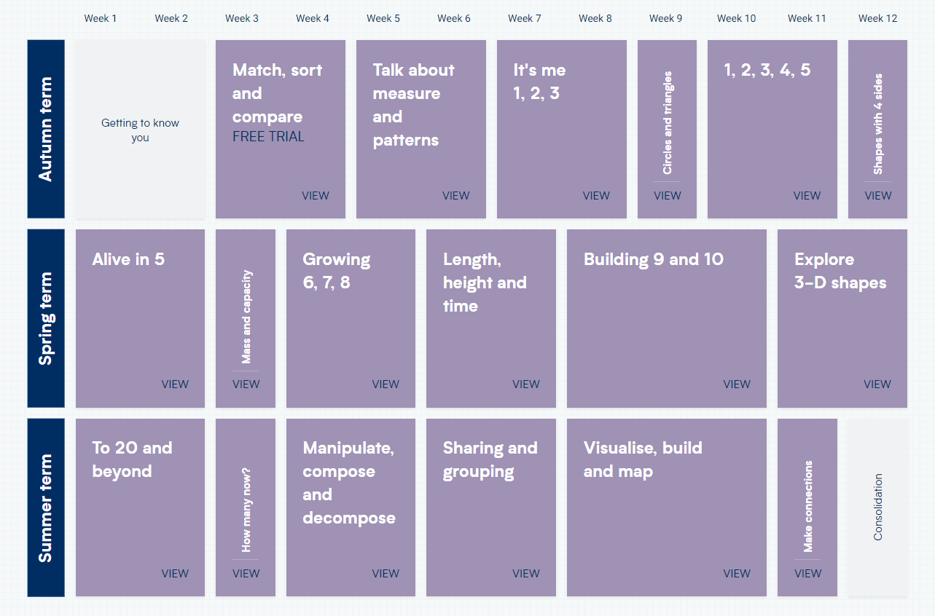

Slide 15
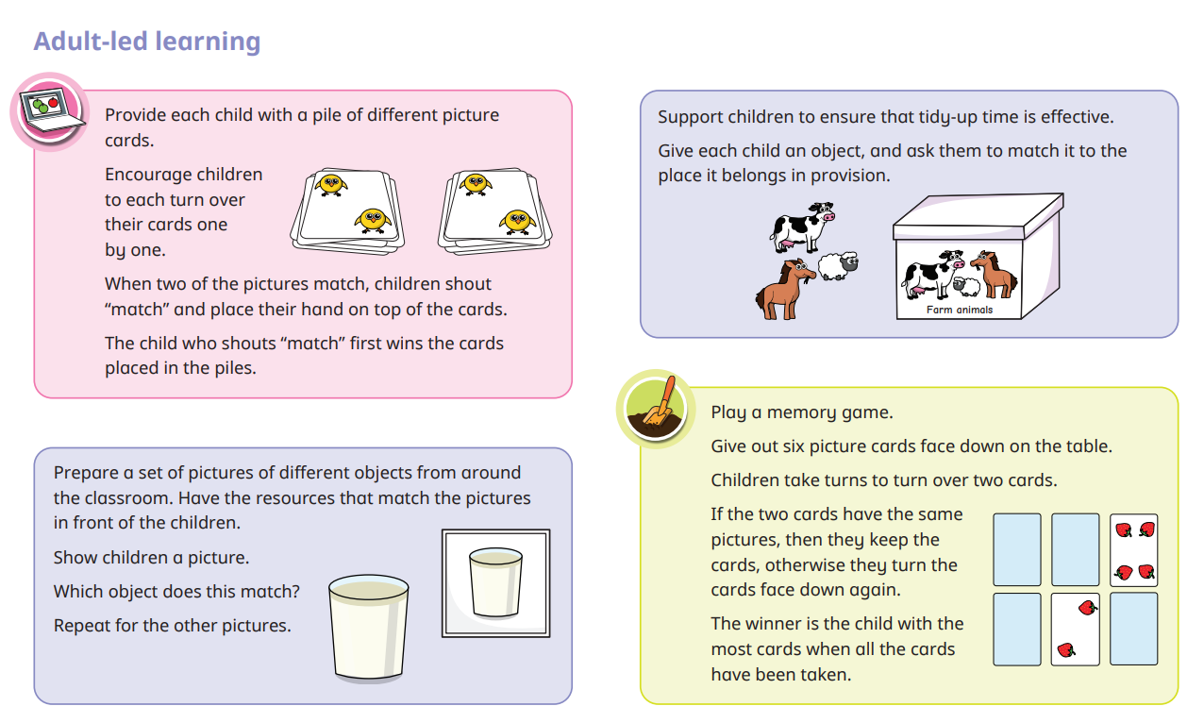

Slide 16



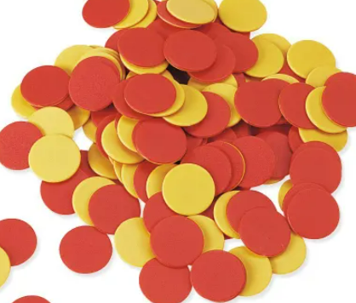

Behaviour Praise Rewards Behaviour policy- systems and sanctions

Slide 17
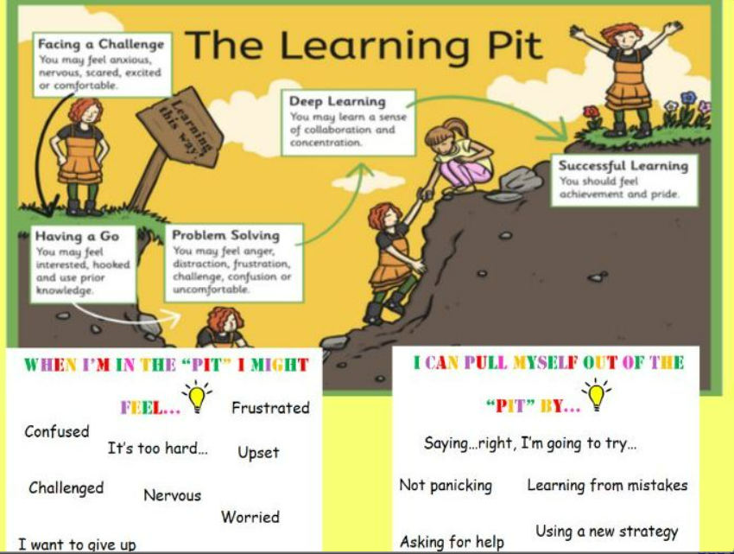
Growth mindset…

Slide 18
Self regulation in the EYFS…
Broadly speaking, self-regulation includes these 10 attributes:
Controlling own feelings and behaviours
Applying personalised strategies to return to a state of calm
Being able to curb impulsive behaviours
Being able to concentrate on a task
Being able to ignore distractions
Behaving in social ways
Thinking before acting
Delaying gratification- being patient
Persisting in the face of difficulty.

Slide 19
Independence
Coat on peg
Recognise name
Put belongings away
Toileting
Look after own items
Choose activities and challenges

Slide 20
How can you help?
“They’re only little.
She’s only 4.’
High expectations- if we expect they can, they usually will.
Little jobs, responsibilities around the house e.g. put your shoes away, tidy your toys.
Wait for their turn to talk?
Can they take their jumper off/put it back on?
The message at school is- try yourself, try again, then ask a grown up.
Toileting- keep trying with the wiping.
Can they carry their own drink to the table? Clear away their plate and cup?
Food- can they peel their own fruit?

Slide 21


