Slide 1
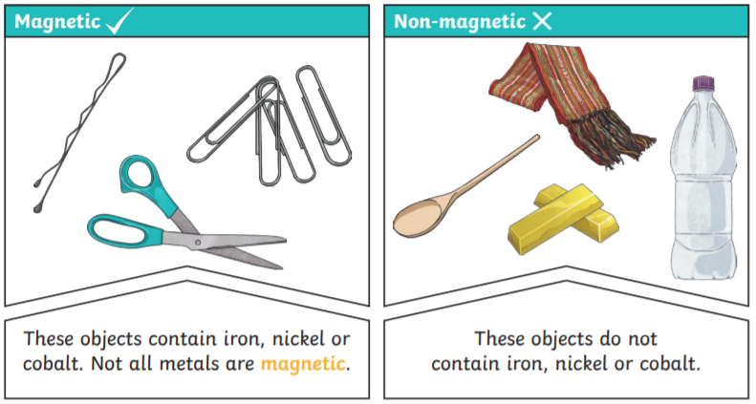
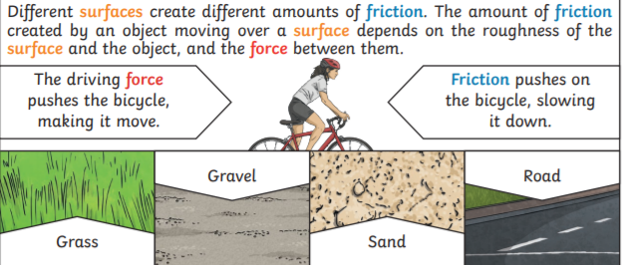
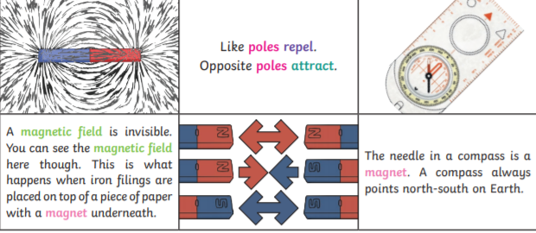

Can forces be useful? What can magnets do? (Year 3)
Key vocabulary
Forces | Pushes or pulls
Friction | A force that acts between two surfaces of objects that are moving, or trying to move, across each other.
Surface | To top layer of something.
Magnet | An object which produces a magnetic force.
Magnetic | Objects which are attracted to a magnet are magnetic.
Magnetic field | The area around a magnet where there is a magnetic force.
Poles | North and south poles are found at different ends of a magnet.
Repel | Repulsion is a force that pushes objects away.
Attract | Attraction is a force that pulls objects together.
How do magnets allow us to create and use compasses?

Slide 2

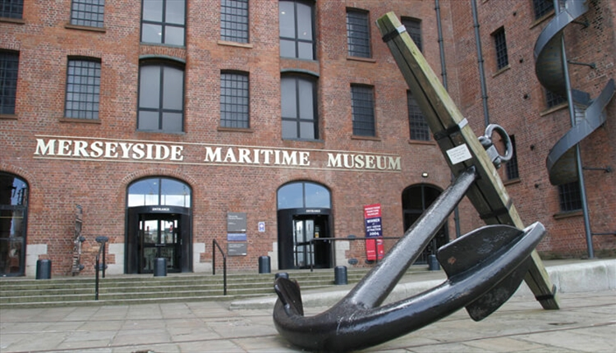
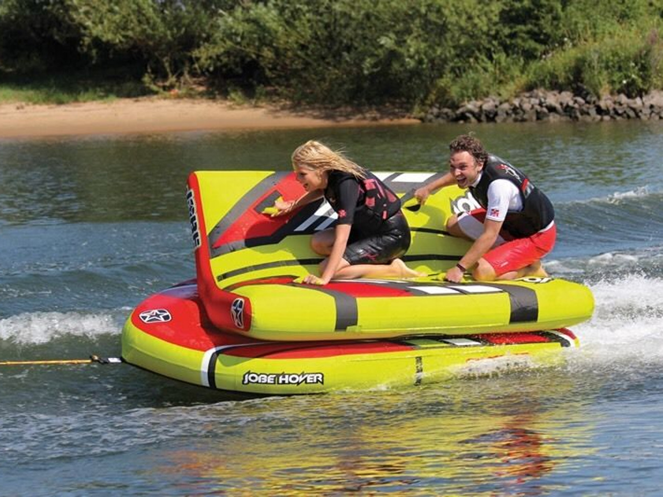

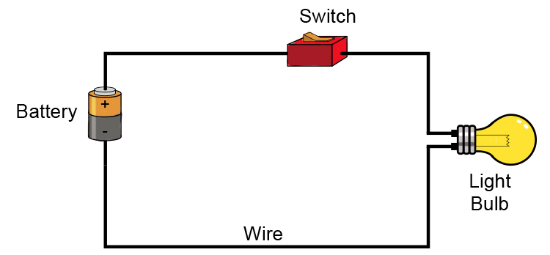
Prior Learning (Development matters) | Local links | Unit Objectives
I can talk about and explore the different forces I can feel (for example, how water pushes up when I push a boat down into it, and how magnets attract and repel different objects) | How did magnets shape navigation, and so Merseyside? Merseyside Maritime Museum | Pupils should be taught to: compare how things move on different surfaces notice that some forces need contact between two objects, but magnetic forces can act at a distance observe how magnets attract or repel each other and attract some materials and not others compare and group together a variety of everyday materials on the basis of whether they are attracted to a magnet, and identify some magnetic materials describe magnets as having two poles predict whether two magnets will attract or repel each other, depending on which poles are facing.
 |  | Where next? Can we control electricity? (Year 4)

