Slide 1

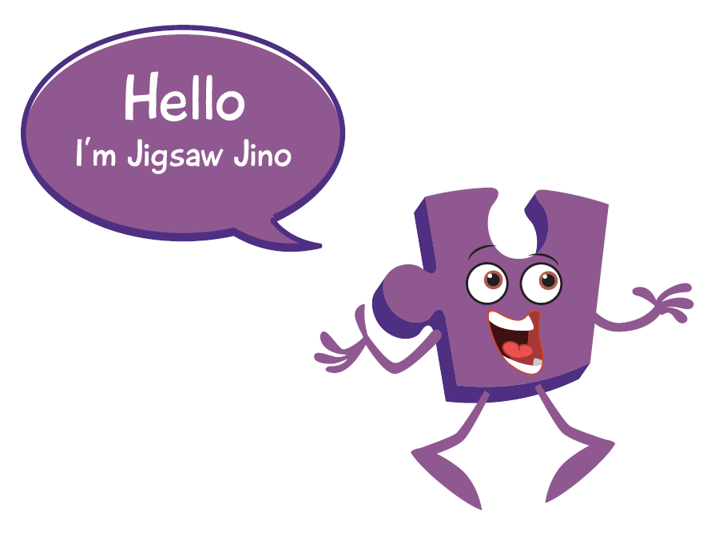

Year 3 PSHE Knowledge Mat Celebrating Difference
Subject Specific Vocabulary |  | Celebrating Difference | Key Questions
Family | A group of one or more parents living with children/a child | Knowledge | • What is the ‘Solve it together’ technique? How can it help solve a disagreement between two people? • What is a bystander in a bullying situation? (A bystander is a witness not directly involved). • How could a bystander make a bullying situation worse or better? • What types of bullying do you know about? • Where can someone get help if they were being bullied or witnessed bullying? • How does it feel to give and receive a compliment?
Loving | Feeling or showing great love or care | Know why families are important • Know that everybody’s family is different • Know that sometimes family members don’t get along and some reasons for this • Know that conflict is a normal part of relationships • Know what it means to be a witness to bullying and that a witness can make the situation worse or better by what they do • Know that some words are used in hurtful ways and that this can have consequences The class learn about families, that they are all different and that sometimes they fall out with each other. The children talk about techniques to calm themselves down and discuss a technique called ‘solve it together.’ The children revisit the topic of bullying and talk about being a witness (bystander), they took about how a witness has choices and how these choices can affect the bullying that is taking place. The children also talk about using problem-solving techniques in bullying situations. They talk about name-calling and choosing not to use hurtful words. They also talk about giving and receiving compliments and the feelings associated with this
Caring | To show kindness or care for others
Safe | To protect or be protected. Not likely to be harmful or risky.
Connected, Difference, Special, Conflict, Solve It Together, Solutions, Resolve, Witness, Bystander, Bullying, Gay, Unkind, Feelings, Tell, Consequences, Hurtful, Compliment, Unique
Family, Jobs, Lonely, Fall-out, Words, Angry, Upset, Calm me, Breathing. |  | Learning about family relationships widens to include roles and responsibilities in a family and the importance of co-operation, appreciation and trust. Friendships are also revisited with a focus on falling out and mending friendships. This becomes more formalised and the children learn and practise two different strategies for conflict resolution (Solve-it-together and Mending Friendships). Children consider the importance of trust in relationships and what this feels like. They also learn about two types of secret, and why ‘worry secrets’ should always be shared with a trusted adult. Children reflect upon different types of physical contact in relationships, which are acceptable and which ones are not. They practise strategies for being assertive when someone is hurting them or being unkind. The children also discuss people who can help them if they are worried or scared. | Skills
 |  |  | • Be able to show appreciation for their families, parents and carers • Use the ‘Solve it together’ technique to calm and resolve conflicts with friends and family • Empathise with people who are bullied • Employ skills to support someone who is bullied • Be able to ‘problem-solve’ a bullying situation accessing appropriate support if necessary • Be able to recognise, accept and give compliments

Slide 2


Prior Learning | Local /National | Unit Objective Y2
• Know there are stereotypes about boys and girls • Know that it is OK not to conform to gender stereotypes • Know it is good to be yourself • Know that sometimes people get bullied because of difference • Know the difference between right and wrong and the role that choice has to play in this • Know that friends can be different and still be friends • Know where to get help if being bullied • Know the difference between a one-off incident and bullying . | My rights and responsibilities. (UNICEF) My family and other families. Anti bullying week. E safety. Faith week. | The class talk about gender stereotypes, that boys and girls can have differences and similarities and that is OK. They talk about children being bullied because they are different, that this shouldn’t happen and how to support a classmate who is being bullied. The children talk about feelings associated with bullying and how and where to get help. They talk about similarities and differences and that it is OK for friends to have differences without it affecting their friendship.

