Slide 1








Nursery
Broad Oak Primary School

Slide 2




Agenda:
Staff Introductions
EYFS Curriculum
Day-to-day running of Nursery
Paperwork information
Questions

Slide 3
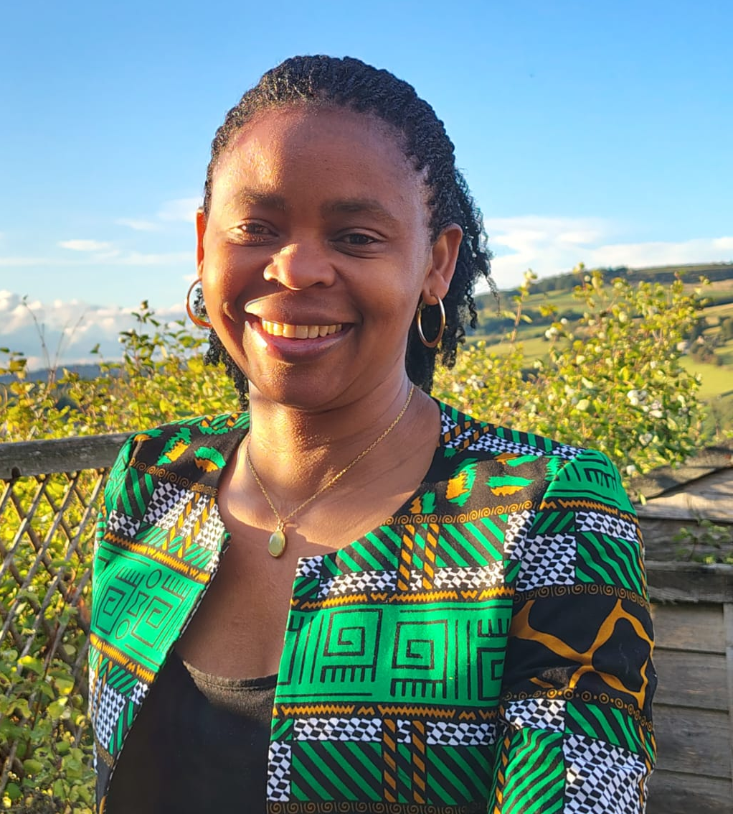
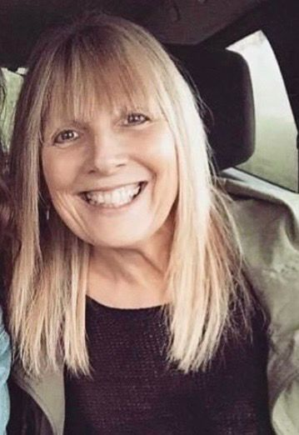
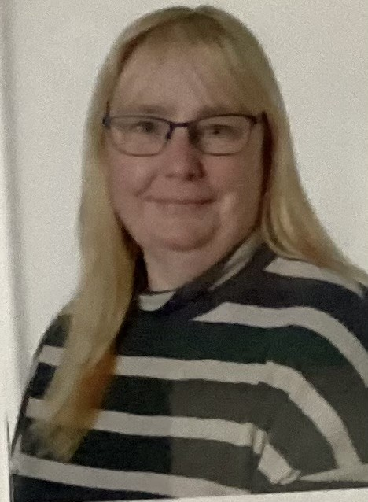
Meet the Staff
Regina Tayl0r
Nursery Teacher
Reina Gill
In Class Support
Jill Blow
In class support

Slide 4
EYFS Curriculum
PRIME AREAS:
Personal, Social and Emotional Development
Communication and Language
Physical Development
SPECIFIC AREAS
Literacy
Maths
Understanding the World
Expressive Arts and Design
Speech and language screening for all children at Broad Oak- Wellcomm Screen
New curriculum has been in place for 4 years – based on quality texts, matches new subject curriculums used in KS1 and beyond.
**Supported by the non-statutory “Birth to Five Matters”.

Slide 5


Slide 6
A day in Nursery
8.45 children come in with an adult and find their name card then find somewhere to work in the areas of provision
9.15 phonics group time
9.45-11.00 children are encouraged to join in with an adult led activity or choose an area to work with their friends
11.00 tidy up time
11.15 story group time
11.40 children are encouraged to use the toilet and wash their hands before lunch time

Slide 7
A day in Nursery
11.45 children eat packed lunches in the dining hall, supported by 2 members of the nursery staff and 1 lunchtime organiser
12.15 the children are encouraged to choose an area to work in (outdoors or inside)
12.45 children come inside to join in with physical development activity eg dance, rhythm copying, action rhymes
1.00 the children are encouraged to choose an area to work in (outdoors or inside)
2.00 group time- maths focus
2.45 tidy up time
3.00 group time- story, milk and snack
3:15 home time

Slide 8
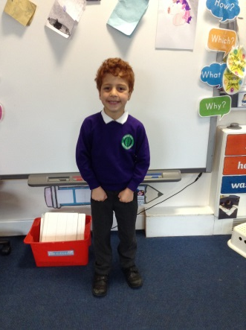
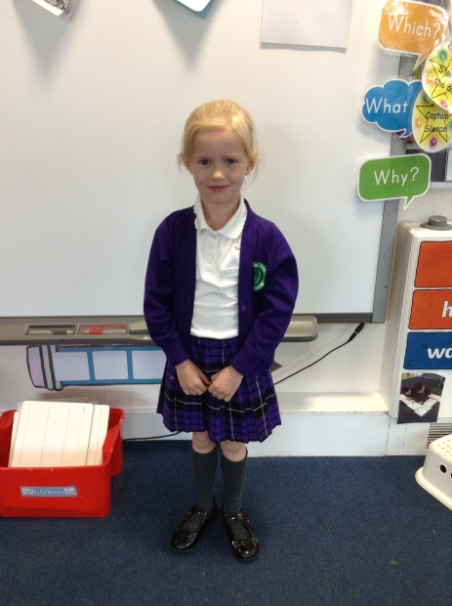
Optional School Uniform
Purple sweatshirt / cardigan with school logo
White polo shirt with school logo
Grey trousers
Purple tartan skirt or pinafore dress
Black shoes
Alternatively- pupils need to wear sensible own clothes which are appropriate for the weather that day.
Your child will also need a coat. (waterproof, hooded, no faux-fur)
Please label all items clearly with your child’s name.

Slide 9
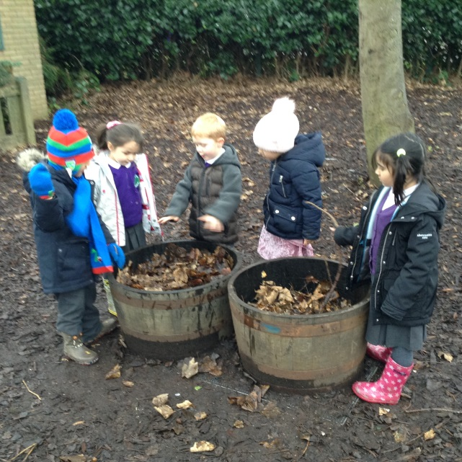
Outdoor Play
**in all weather**
Wellington boots labelled with child’s name
Waterproof coat with a hood
Hat, scarf, gloves for cold weather
Please apply sun cream before school during hot weather

Slide 10
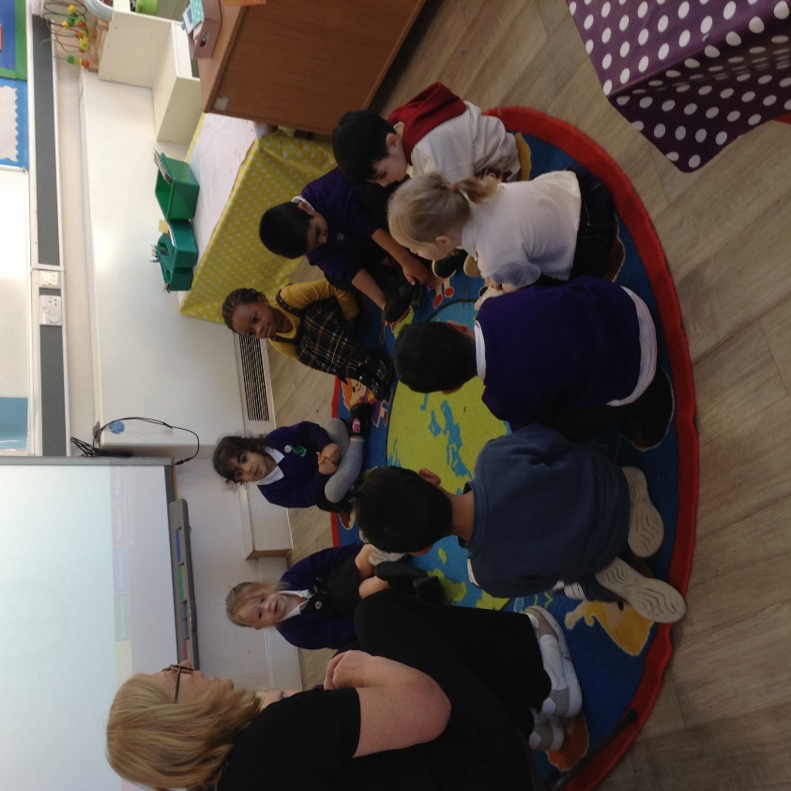
Adult led activities…

Slide 11
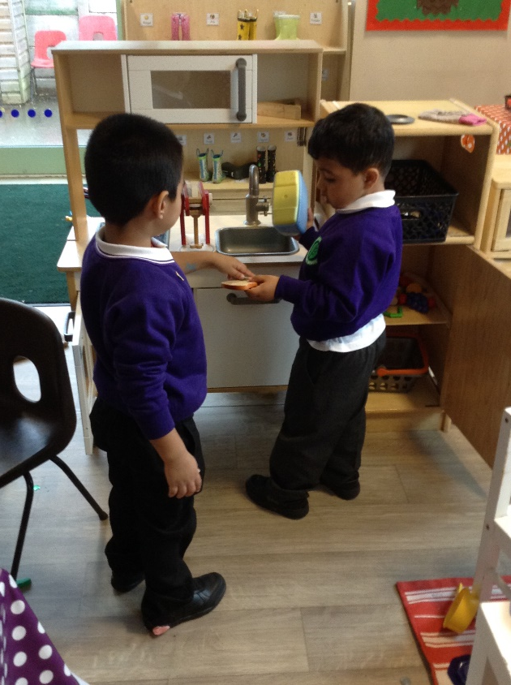
Often lead to children revisiting and exploring ideas on their own…

Slide 12
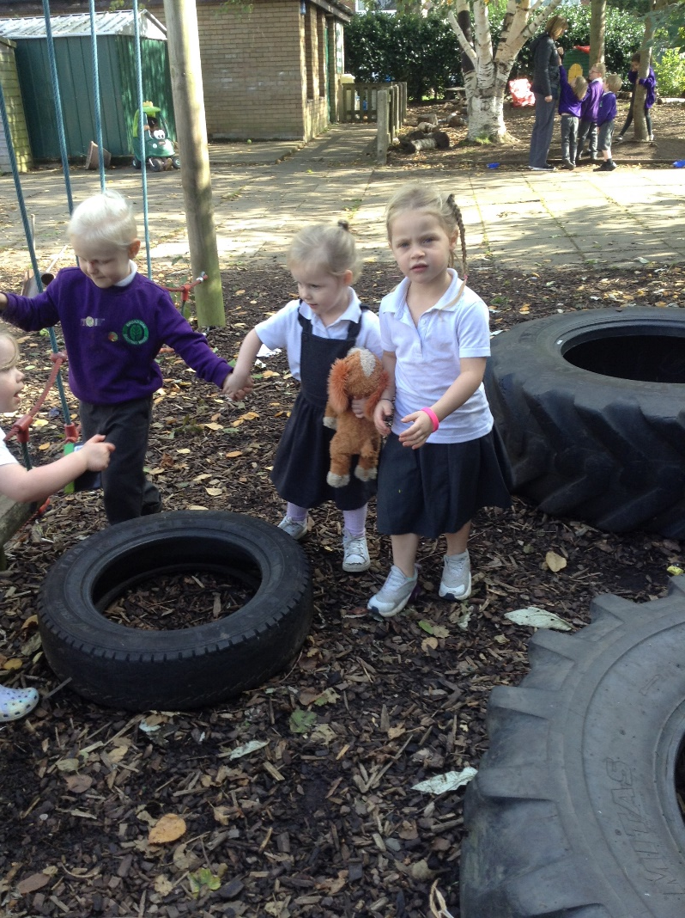
Encouraging social communication interactions…

Slide 13
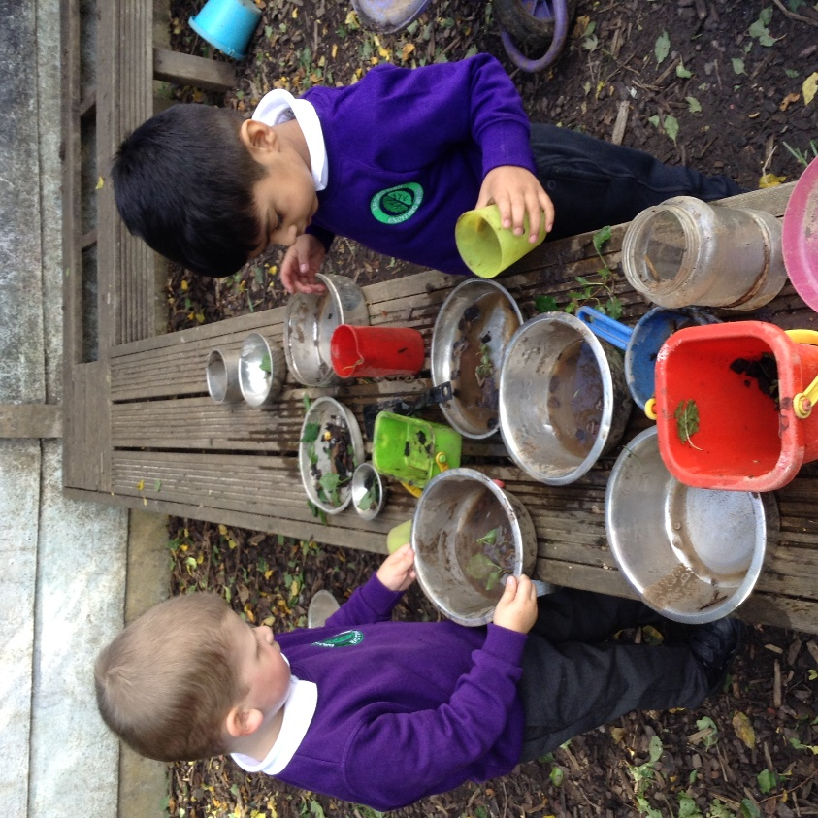
Extended role play… “making chocolate cakes”

Slide 14
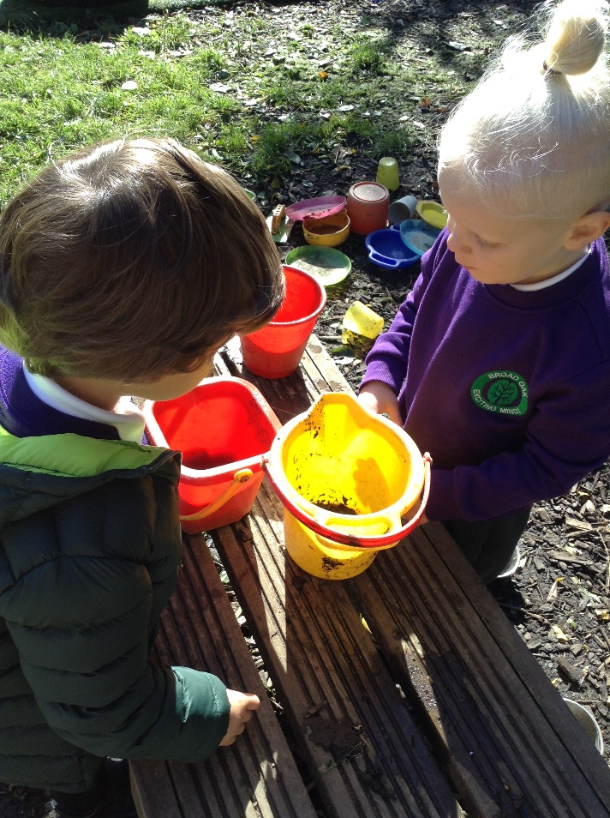
Co-operation and negotiation…

Slide 15
How to help your child to become a successful learner…
Encouraging independence eg getting dressed/ undressed
Encouraging self responsibility eg making decisions and then reviewing them
Developing ways to communicate effectively – show children how to ask for something politely (try not to speak for them)
Begin to tune in to letters and sounds eg finding letters in their name, singing nursery rhymes and familiar songs
Begin to explore maths ideas eg things can be counted to find out how many

Slide 16
Developing early language
At Broad Oak we have developed a lot of expertise in supporting early language development
We do our own language screening in nursery and reception (WELLCOMM)
We design activities in our classrooms to support identified gaps in learning
We support children who are learning English as an additional language
We work closely with the Speech and Language Therapy team in cases where an outside referral is needed
Communication, language and understanding are vital in order to access all areas of the curriculum in later school life

Slide 17
Developing early literacy skills
Nursery rhymes are essential for teaching the rhythms and patterns of language
Read stories together at bedtime- good quality spoken language needs to be repeated many times to allow children to explore new words and phrases
CAP- concepts about print- direction of text, where to start reading, return sweep, link between spoken and written forms of language
Take your child to the local library and let them choose books each week. Talk to them about their choices and look for interesting pictures together.
Try not to manipulate their choices- if the book is too hard you can read small sections / paraphrase / talk about the illustrations

Slide 18
Developing early maths skills
Sing number rhymes and use fingers to count in songs such as 5 little ducks, 1,2,3,4,5, once I saw a fish alive
Count everything- stairs on the way to bed, cars on the street, claps, jumps, actions
Look for numbers in everyday situations- car number plates, house numbers, remote controls, birthday cards
Practise counting in real life contexts- counting pennies to buy sweets, change for the car park, plates, knives , forks etc for meal times
Practise comparing groups of objects (numbers), and comparing the different properties of shapes and other objects

Slide 19
Developing fine motor skills necessary to write / manipulate tools…
Practise small movements with the fingers- pegs, rolling and moulding play dough, bread dough, using chubby crayons, chalks, jigsaw puzzles
Set up play writing activities- doing the register, writing cards to friends, writing a shopping list
Draw faces, gradually adding more features each time- drawing is the first writing- making marks on a page to communicate a message to others
Practise whole arm movements for writing- painting, water painting outside, ribbon dancing, magic wands, play swords

Slide 20
Developing good behaviour
Somewhere between the ages of 2 and 3 children begin to realise that they are not the centre of the universe!
This can come as a nasty shock after 2 years of being celebrated as the new baby of the family
Young children, encouraged by gentle adults gradually become aware that if something goes wrong they can try again – RESILIENCE, and if someone is distressed they can give comfort- EMPATHY
Sharing and turn taking must be taught with patience and sensitivity- it can take a long time to realise that “it can’t always be my turn on the tricycle”
Present the problem for them to solve themselves or with others… “What Happened?” “(Child) is crying because…” “What can we do to help?”

Slide 21
Some tips for encouraging positive behaviour
Have clear expectations and make sure all members of the family agree together, eg no hurting others / tidy up the toys at bedtime
Make sure your child knows exactly what to do and how to do it- show them
Use specific praise to encourage the behaviour you would like to see eg “I am really proud of you for tidying up the toys by yourself”
Know what to do if your child has misbehaved eg warning, then time out – be consistent about this- always follow through with a consequence
If your child is very upset / angry, allow them some time to calm down before talking to them about what happened
Give them a warning to prepare for changes eg “Ok, 5 more minutes and then we are leaving the park”

Slide 22
Where to find some useful information…
DfE publications available online:
“Parents guide to the EYFS”
“Birth to 5 Matters”
“Read Write Inc”
“Mark-Making Matters”
“Movement Matters”
“The Incredible Years” by Caroline Webster-Stratton
Youtube: social stories in the early years
NCETM: Mathematics in the Early Years

Slide 23

Seesaw
Your child will have a log in to Seesaw which is where we will be able to communicate with you.
We will post to your child’s journal and to the whole class journal.
You should have a log in already and if not, please see the class teacher.

Slide 24

Children (Rights holders):
To always try your best in every lesson.
To be resilient and try, try and try again.
To not be afraid to try new things.
To be respectful to the coaches and other adults who come into school for activities.
Children (Rights holders):
To be polite towards lunchtime organisers.
To make healthy choices at break and lunchtimes.
To keep the classroom tidy.
To look after their own, other people and school property.

Slide 25
Wrap Around Care
Breakfast Club 7.45am-8.45am
Cost TBC
After school club 3.20pm-5.45pm
Cost TBC per session (discount for additional siblings)
*Tax Free Childcare account can be used to help

Slide 26
Admissions
Admission Form
GDPR Form
Nappy Change/Toileting (if required)
INA Form (if required)
Allergy policy September 2026 – School Grid
Special Educational Needs and Disability (SEND)
We are here to help if you need it!

Slide 27
Allergy Policy September 2026
New allergy policy on the school website September 2026
Minimization of risk:
no nuts allowed in school (of any kind)
no food products to be shared without parental consent
anaphylaxis kits are now available in school
parents will be informed of all allergic reactions or “near misses”
Parents must inform school of any known allergies or allergic reactions regarding their child
All staff have received training on allergies and emergency procedures for anaphylaxis

Slide 28
Special Educational Needs and Disability (SEND)
Inclusion is at the heart of our philosophy at Broad Oak
We endeavor to meet the needs of all children at all ages and stages of development with kindness, dignity and respect
We ask parents to show sensitivity and kindness towards other children with barriers to learning, and to their parents
If you have any concerns about your child:
  Speak to the class teacher first
  Make an appointment to see the SENDCO (Ms. Child)
  Email: sendco@broadoak.Manchester.sch.uk

Slide 29
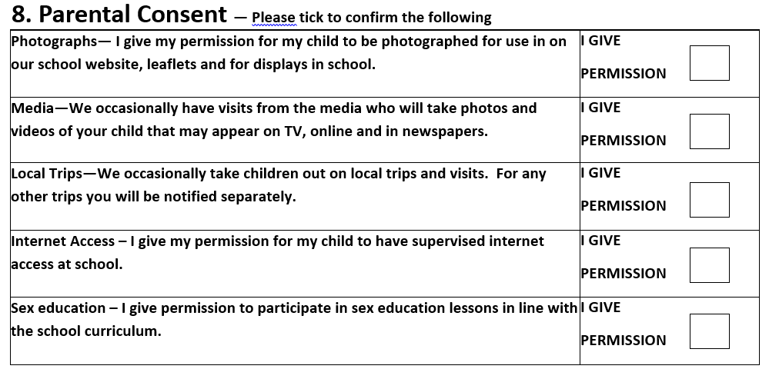

Slide 30
Thank You
If there is anything else you would like to discuss please phone or email the school office and we will get back to you:
0161 445 6577
admin@broadoak.manchester.sch.uk
growingtogether@broadoak.manchester.sch.uk

