Slide 1

Welcome to Broad Oak Primary School
Class: Pine Phase: KS1
September 2026

Slide 2
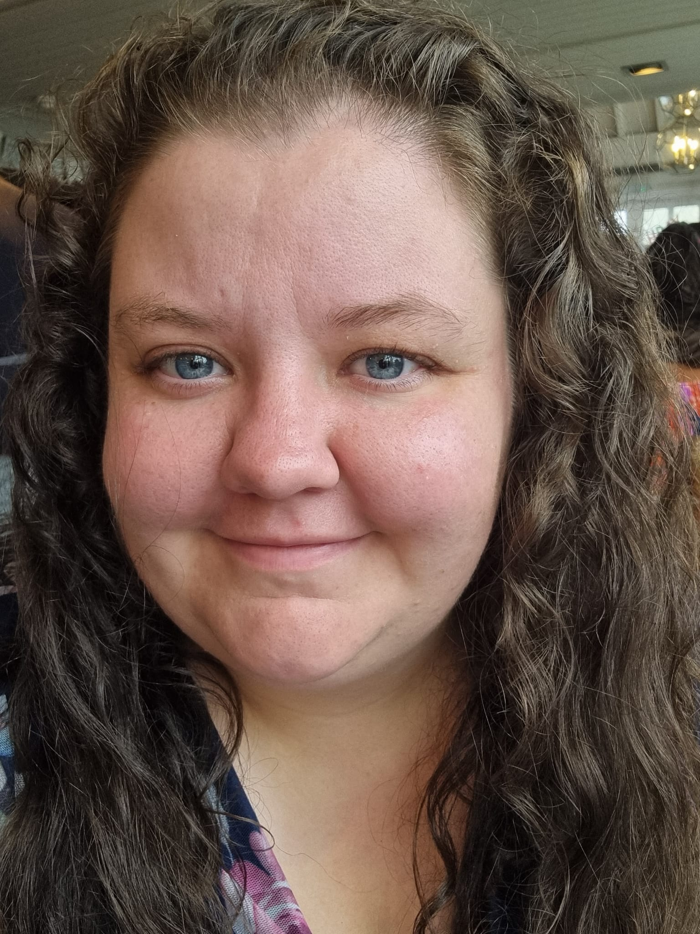
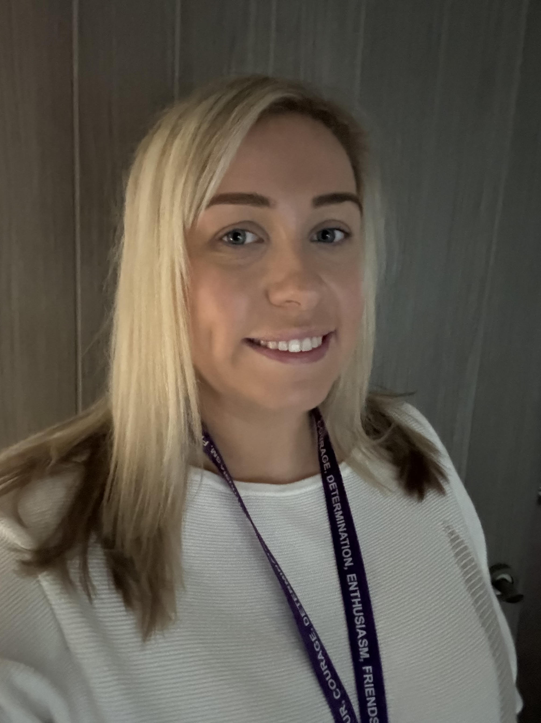
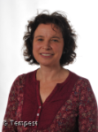
KS1 Teaching Staff
Mrs Stevenson
Mrs Everson
Ms Child
Pine Class Teacher
Music lead
Ash Class Teacher
PE Lead
Ash Class Teacher
Assistant Headteacher
SENDCO

Slide 3
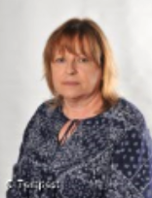
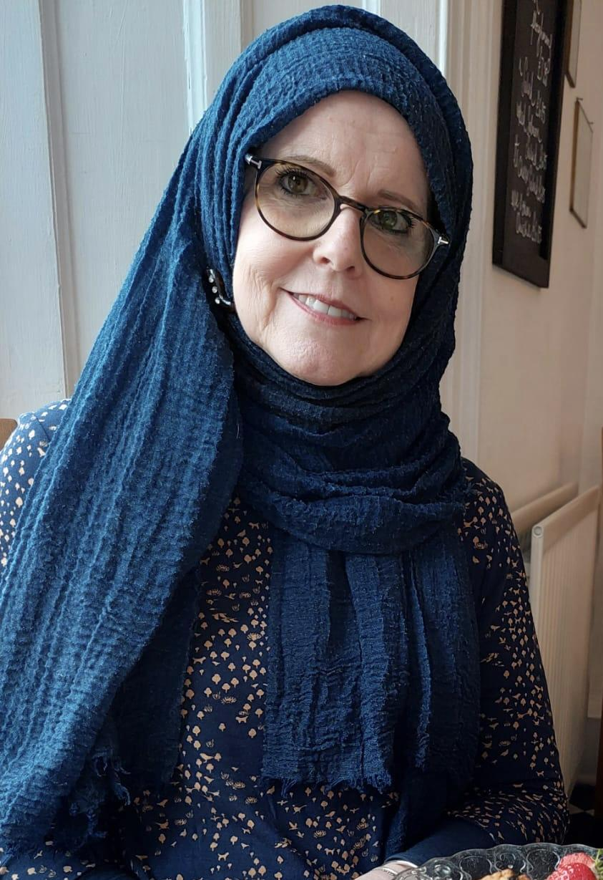
KS1 Support Staff
Miss Gee
Mrs Fattahi
Year 1
In Class Support
RWI Teacher
Year 2
In Class Support
RWI Teacher

Slide 4
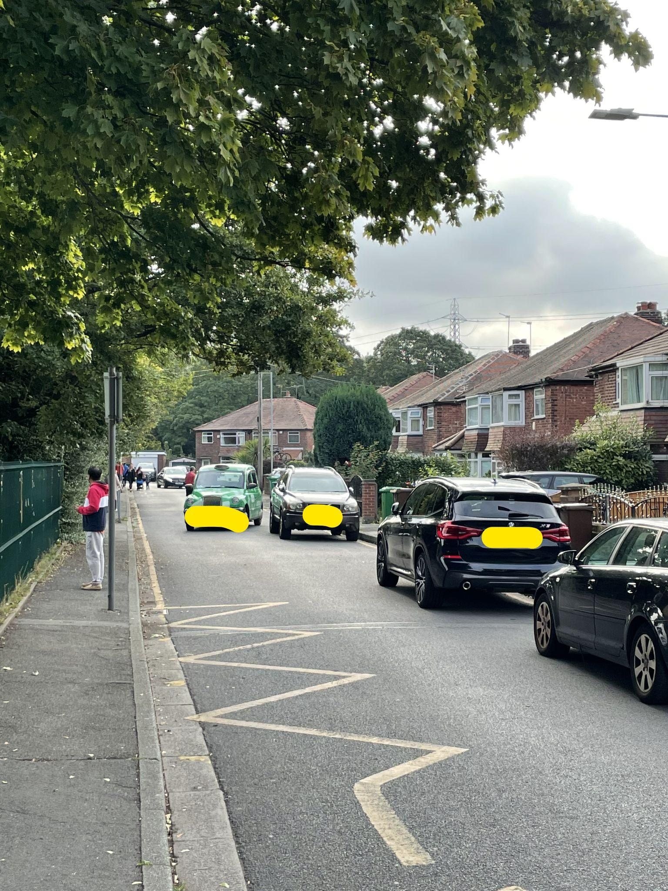
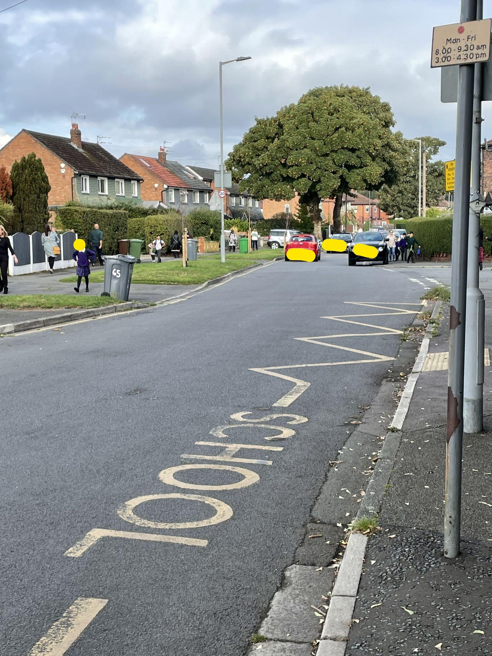
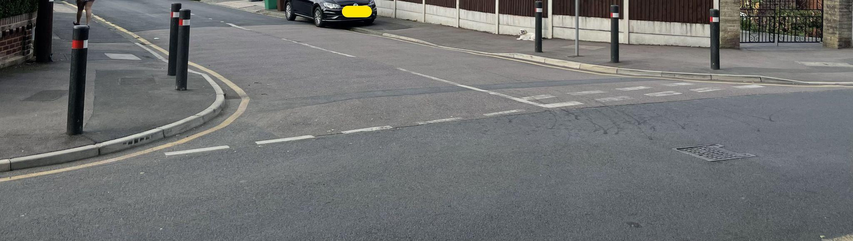
Respecting our local community
Parking
If driving to drop off and collect your child please do not park on any yellow lines. These are there to protect our pupils.
Please do not park on the corners of local streets as this makes it difficult for our pupils to safely cross the road.
Please do not park on,
or pull on to local
resident’s driveways.

Slide 5
Beginning and End of Day Routines
External gates are opened at 8:35am and locked at 8:50am.
The school day begins at 8.45am.
If late, always report to the main school office.
At the end of the school day the main gate is opened at 3.15pm for collection of pupils in Y1-6. We ask that children in EYFS are collected first.
If anyone else is collecting your child please make sure the class teacher is made aware- please phone the school office in an emergency.
Siblings must be 16 or over to collect children.
Children that have not been collected by 3.30pm will be taken to After School Club at a cost of £9.75 per pupil.

Slide 6
Out of school care
Breakfast Club is run by school staff each morning from 7.45am-8.45am
After School Club is also run by school staff from 3.20pm-5:45pm.
Sessions must be booked in advance - full details can be found on the school website.
Please contact the school admin team for an application form

Slide 7
Attendance and Punctuality
Please ensure that your child attends school every day and on time.
If child is genuinely ill please inform school as soon as possible on 0161 445 6577.
Medicines in school- must be prescribed by a doctor / signed consent from parents.
Leave during term time will not be authorised and could result in a fine of £80 per parent per child.
Please make sure your child is in class by 8.45am to receive their mark in the register.

Slide 8
Working together in partnership
Arbor is our school app for online communication between home and school.
Please remember that teachers will not be able to answer individual messages during the school day but will try to get back to you within 2 days.
Members of SLT (Senior leadership Team) will be on gate duty each day if you have any questions or concerns.
Teachers are available at classroom doors at the beginning of the day, however if you need a longer conversation please make an appointment at another time.
If you have any urgent messages for school during the school day, please telephone the school office on 0161 445 6577

Slide 9
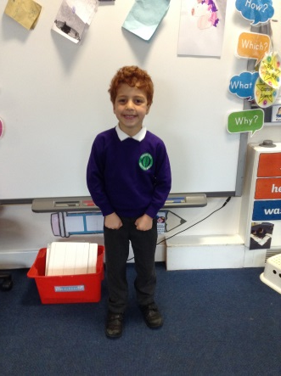
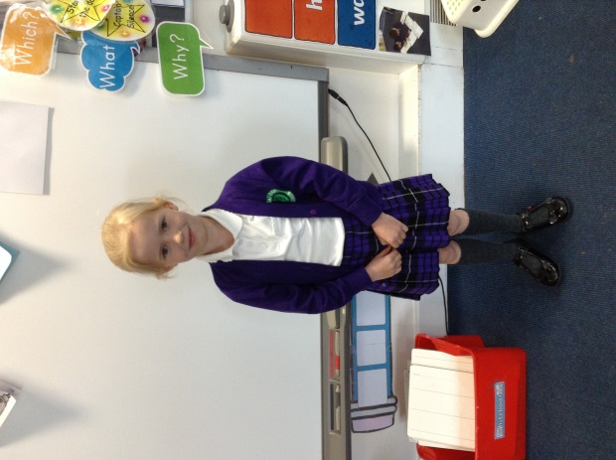
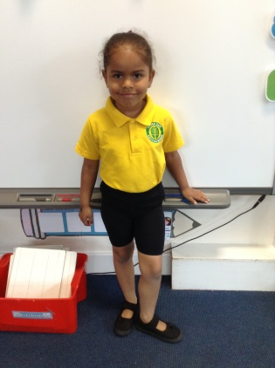

School uniform
Purple sweatshirt / cardigan
White polo shirt
Grey trousers
Purple tartan skirt or pinafore dress
Black shoes
P.E. kit:
Yellow polo shirt
Green sweatshirt/cardigan
Black shorts/pants
Sensible trainers
Long hair must be tied up and no jewellery can be worn on PE days.
Please label all items clearly with your child’s name. ‘Stick-on’ name labels can be purchased from a number of suppliers.

Slide 10
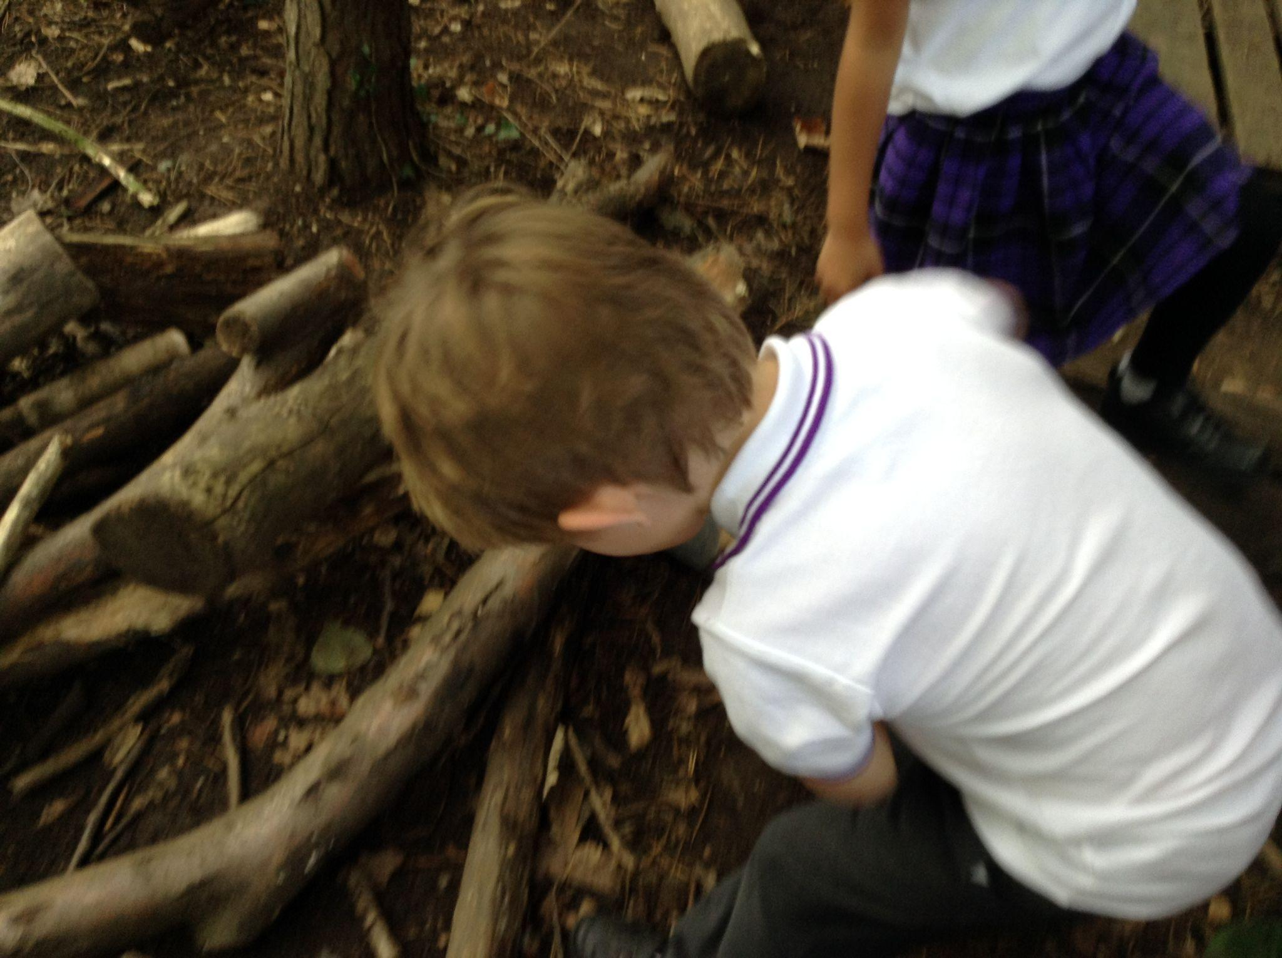
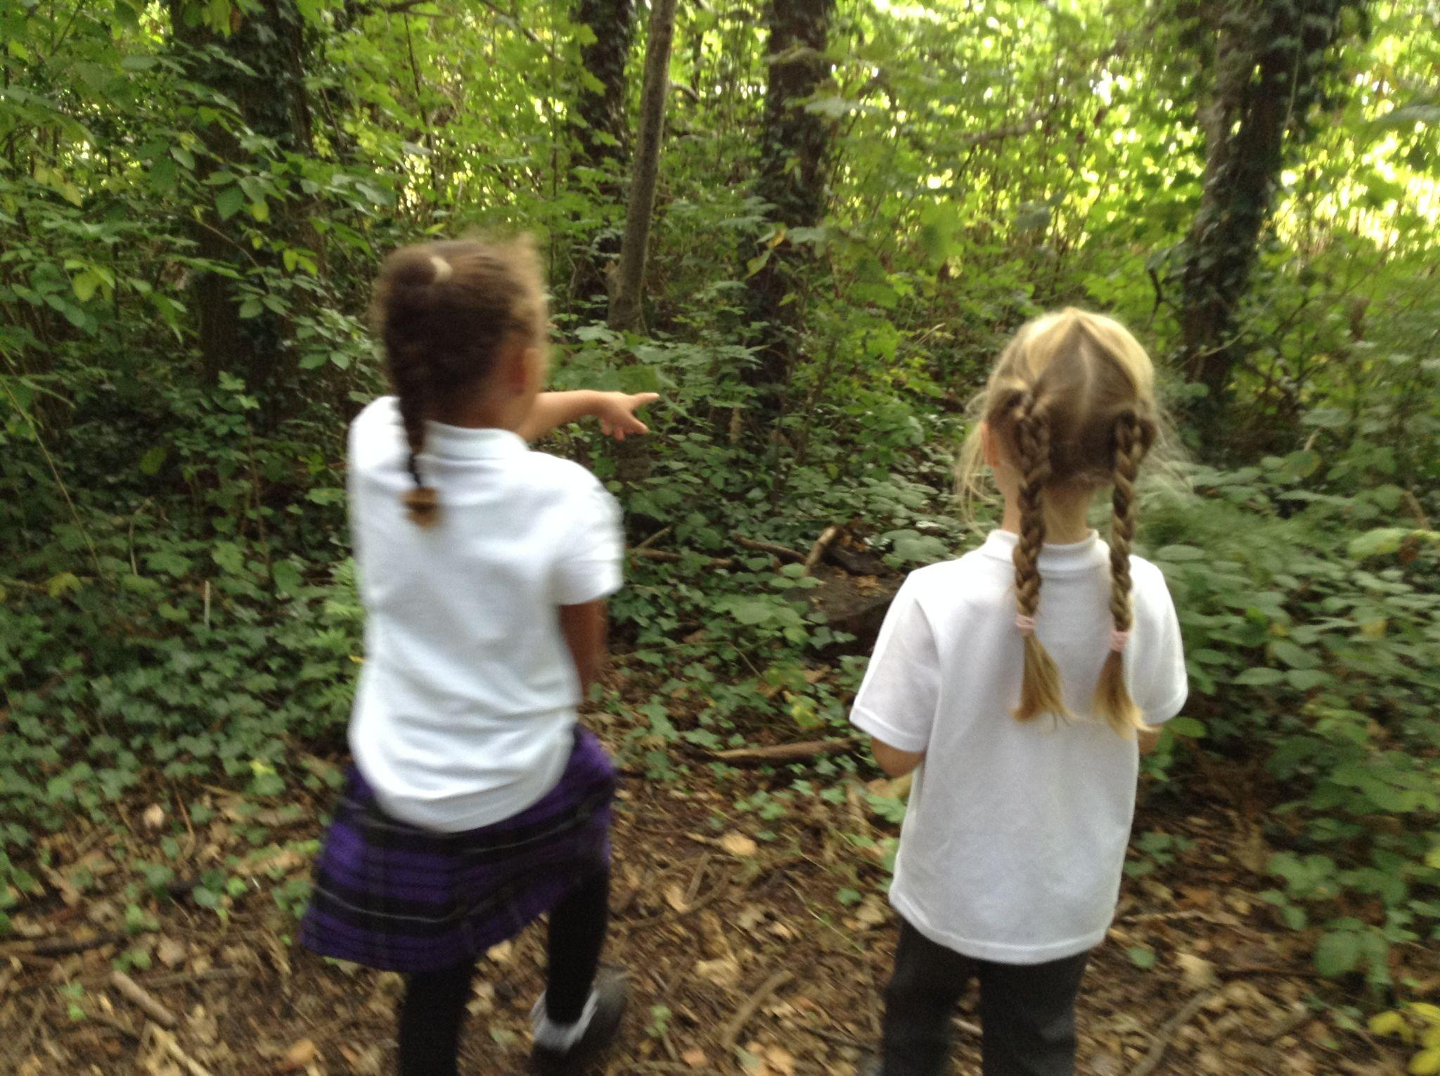
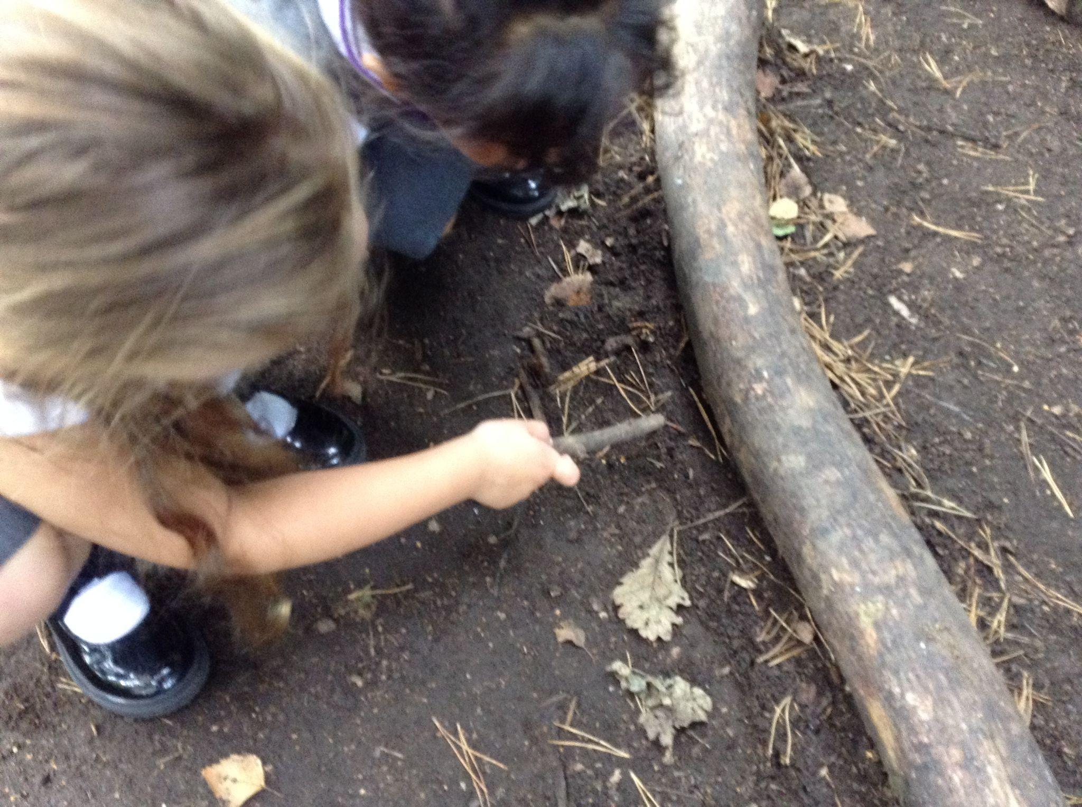
Appropriate clothing for the weather
Waterproof coat with a hood.
Hat, scarf, gloves for cold weather.
Please apply sun cream before school during hot weather and send a hat.
Ear-rings to be removed for PE lessons. Please remove them before coming to school/cover with tape.
Long hair must be tied back for outdoor activities and all P.E. lessons.

Slide 11
Encouraging independence and responsibility for learning
Students are responsible for their jumpers and belongings. Please name all items to avoid disappointment when (not if) items go missing!
Any found jumpers will be kept in classrooms for parents to go through at the end of the day if required (please ask).
Please don’t bring in toys/items from home because they can get lost/damaged which can be very traumatic.
Remind children about regular hand washing/use of tissues/shoelaces.

Slide 12
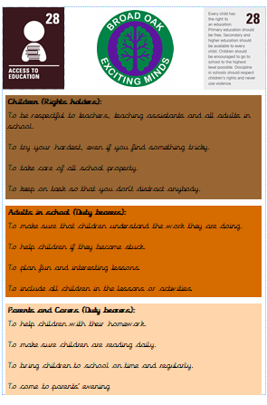
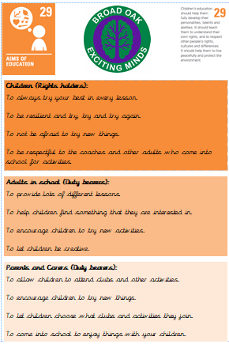
Rights Respecting Schools

Slide 13

Core Values

Slide 14
Promoting and rewarding positive behaviour
House point system - Dojos
Every child is awarded a dojo when they show they are ready to learn, keeping safe or being kind. When a child reaches 50 dojos, they will be able to choose a prize from the class prize box.
If a child is not showing expected behaviour they will be asked to complete a restorative conversation about their behaviour with the class teacher for low level disruptions. For medium level, the behaviour lead will conduct the restorative conversation and the child may lose part of a break or lunchtime. For high level behaviour the child will be removed from the class and SLT will conduct the restorative conversation.
Good to be Gold system
All children will received 30 minutes of good to be gold on a Friday afternoon. This may be shorter if a child has unfinished restorative conversations from the week.

Slide 15
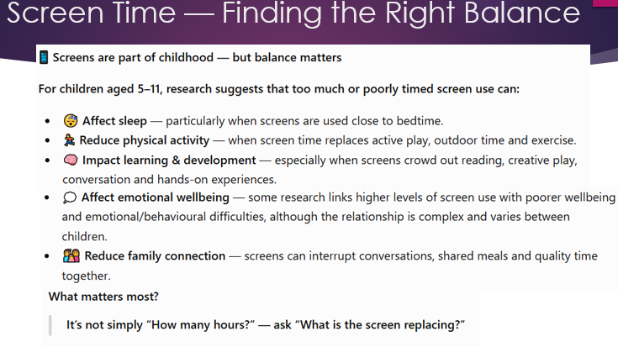

Slide 16
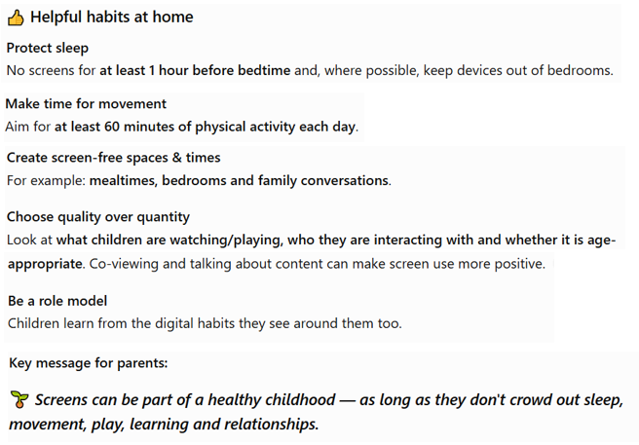

Slide 17
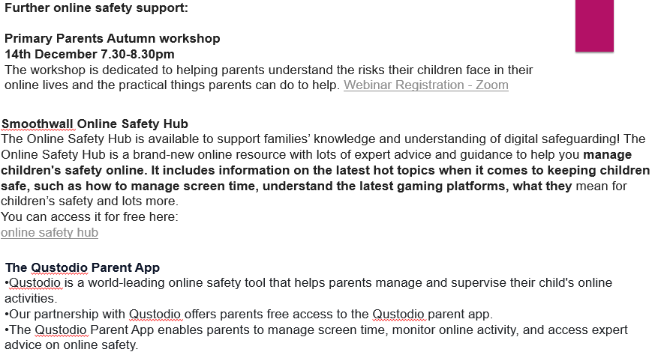

Slide 18

Milk and Snack
Milk is available at a cost for the year.
Snacks of fruit and vegetables are provided every day for children in Nursery - Year 2.
Water is available at all times.
The Broad Oak Food and Drink policy and the Broad Oak packed lunch policy are available to view here

Slide 19
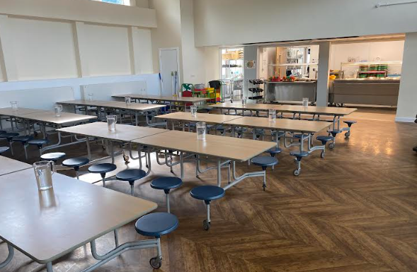
Lunchtimes
School Meals: School Grid is the online system used to pre-order and pay for school meals (free for children from Reception to Year 2).
Please contact the admin team if you have any difficulties with logging in to the system
Healthy Lunchboxes:If you choose to provide a packed lunch from home please see our Healthy Eating Policy following the link on the school website.
Timings and supervision:
Lunchtime is 12.00pm-1.00pm
Children are supervised by our team of lunchtime organisers, teaching assistants and a member of
SLT on duty each day. We also have
two sports coaches helping to organise
team games during the lunchtime period.

Slide 20

Lunchtimes: Healthy lunchbox
Packed lunches should include:
At least one portion of fruit or one portion of vegetables every day e.g. Apples, grapes, carrots
A sandwich, wrap or tortilla containing meat, cheese, fish or other source of non-dairy protein e.g. houmous and falafel.
Other items could include pasta, rice, couscous, noodles, potatoes or other type of cereals.
Dairy food such as milk, cheese, yoghurt, fromage frais every day.
Only water (still), fruit juice, milk, yoghurt or milk drinks and smoothies.
Packed lunches should avoid:
Nuts, including nutella
Snacks such as crisps
Confectionery, such as chocolate bars, chocolate-coated biscuits and sweets.
Meat products such as sausage rolls, individual pies, sausages / chipolatas should be included only occasionally.
Drinks with added sugar or sweeteners and fizzy drinks.

Slide 21
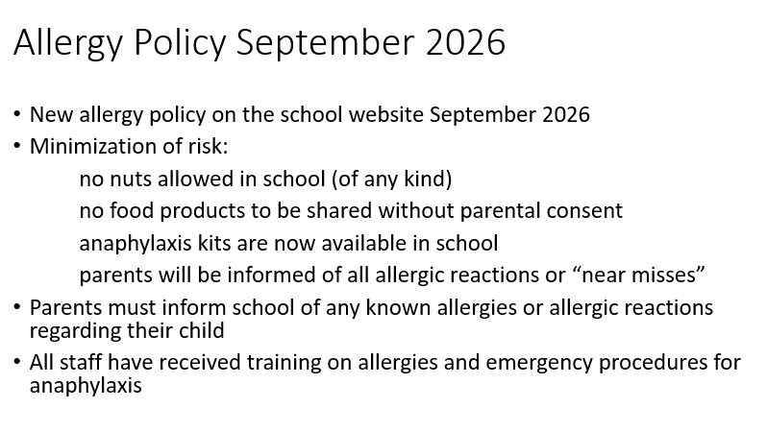

Slide 22
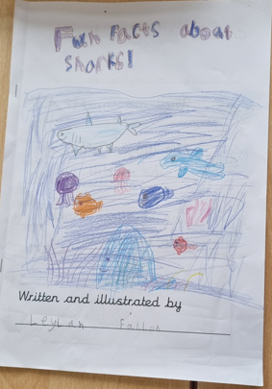
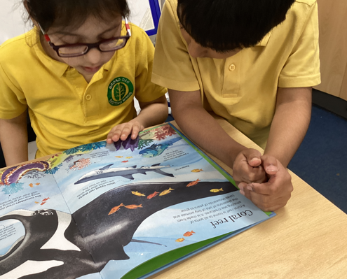
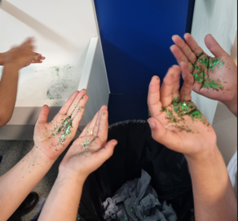
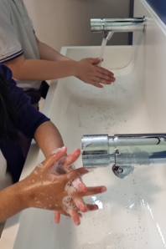
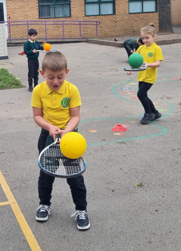
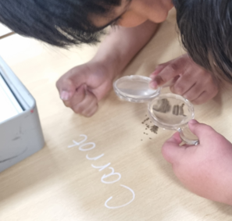
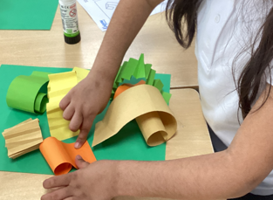
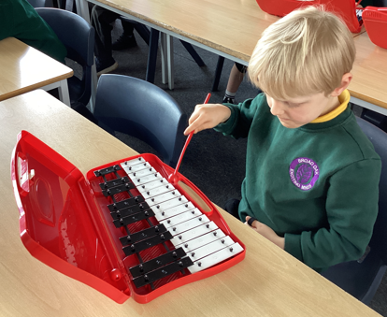
Curriculum
We endeavour to make all lessons as enjoyable as possible while making the most of every opportunity within the school day.
This includes, but is not limited to:
Daily Read, Write Inc
Daily writing
Daily Maths
Daily handwriting
PE- 2hrs per week
Foundation subjects (geography, history, music, computing, art, design & technology, PSHE, RE)

Slide 23


Slide 24
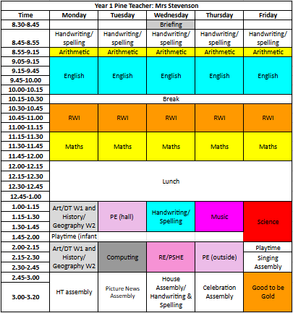
Timetable (PE: Tuesday and Thursday)

Slide 25

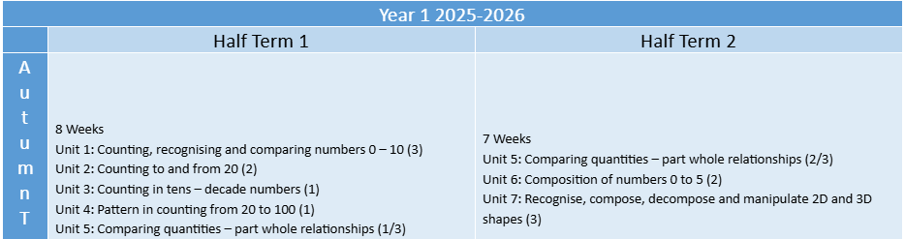
Curriculum focus for Autumn ‘26

Slide 26

Curriculum focus for Autumn ‘26
Week 1 and 2: sentence level work based on the texts;
Y1: ‘What makes me a me’
Week 3 and 4: writing simple sentences to describe and write simple commands;
Y1: ‘The scary lion’ ‘Stand up’
Over the rest of the year, we will look at a variety of genres including poetry, narrative, recounts and non-chronological reports.

Slide 27


Curriculum focus for Autumn 26

Slide 28
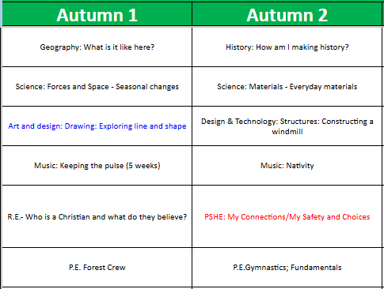

Curriculum focus for Autumn ‘26

Slide 29





Homework expectations
Set at the beginning of each half term- a letter will be sent home with expected number of tasks to be completed. Parents open afternoon each half-term to celebrate the learning. | Numbots homework is an online maths system (10 minutes practise a week). | Weekly words – sent home each week on Thursdays Weekly spelling test will be on a Wednesday. | Daily practise (10 mins). Sign journal 5 times a week to earn a Reading Raffle Ticket. Bookbags need to be returned on a Wednesday so they can be changed.

Slide 30
Assembly Dates
Class assemblies:
KS1 Nativity Concert
16th December 9am - 9:45am - Hall
17th December 2.45pm - 3:10pm - Hall
KS1 Easter Assembly
24th March 2027 2:45pm - 3:10pm - Hall
Pine Class Assembly
26th May 2027 2:45pm - 3:10pm - Hall

Slide 31




Year 1 Educational Visits:
We are planning five educational visits this year.
They will all be linked to our foundation subjects.
Our first trip will be in the Autumn term and we will be going on a walk around Didsbury to support our Geography unit of work.

