Slide 1

Welcome to Broad Oak Primary School
Class: Ash Phase: KS1
September 2026

Slide 2
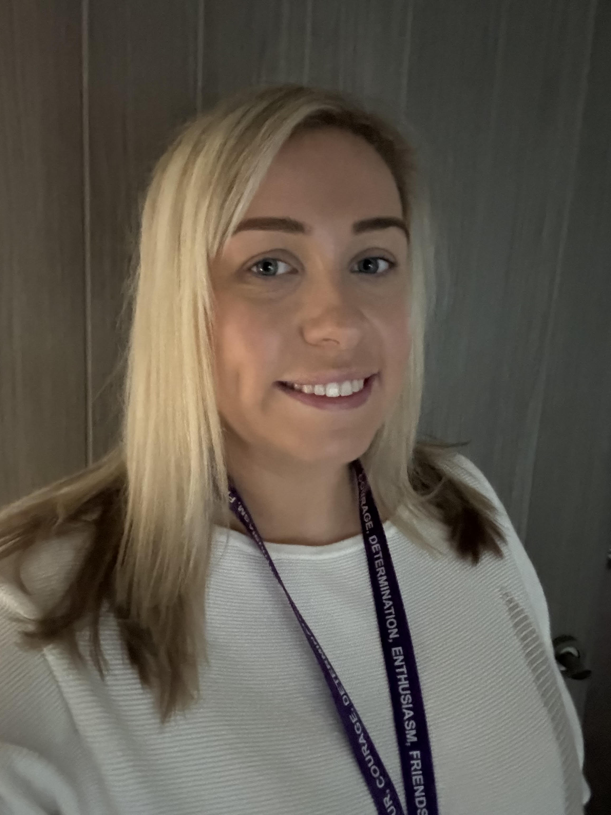
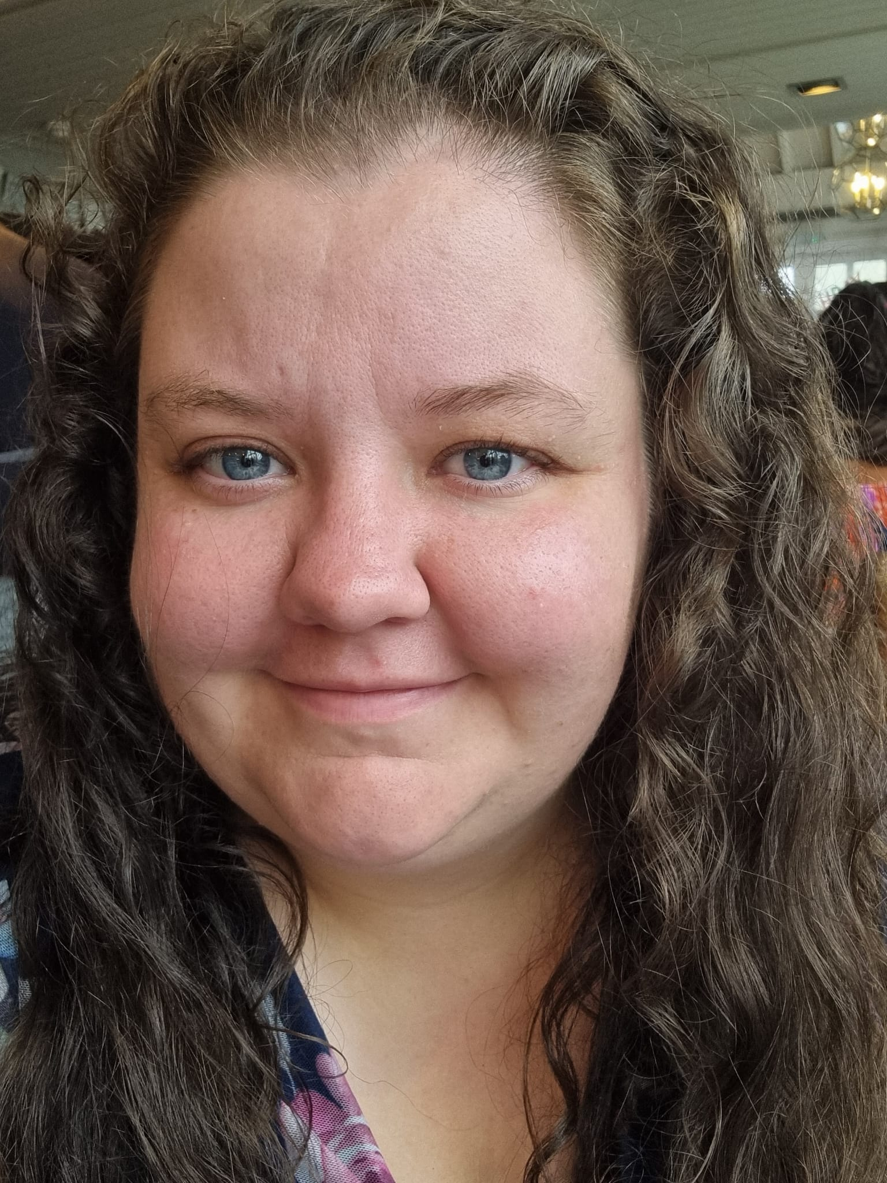

KS1 Teaching Staff
Miss MacDonald
Mrs Stevenson
Ms Child
Ash Class Teacher
PE Lead
Pine Class Teacher
Music lead
Ash Class Teacher
Assistant Headteacher
SENDCO

Slide 3

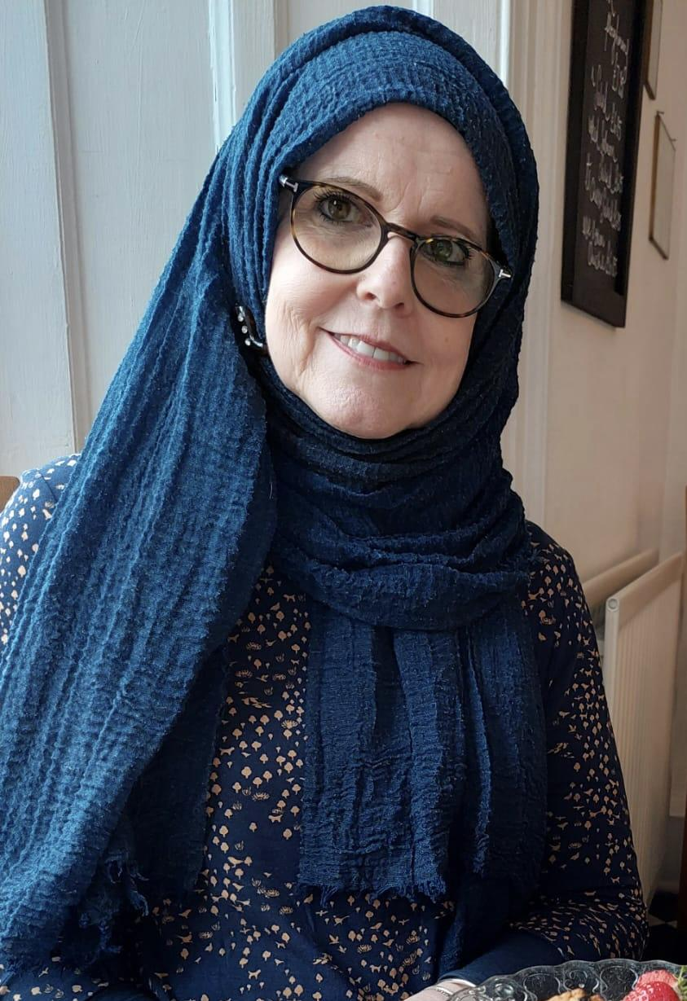
KS1 Support Staff
Miss Gee
Mrs Fattahi
In Class Support/ RWI
In Class Support/ RWI

Slide 4
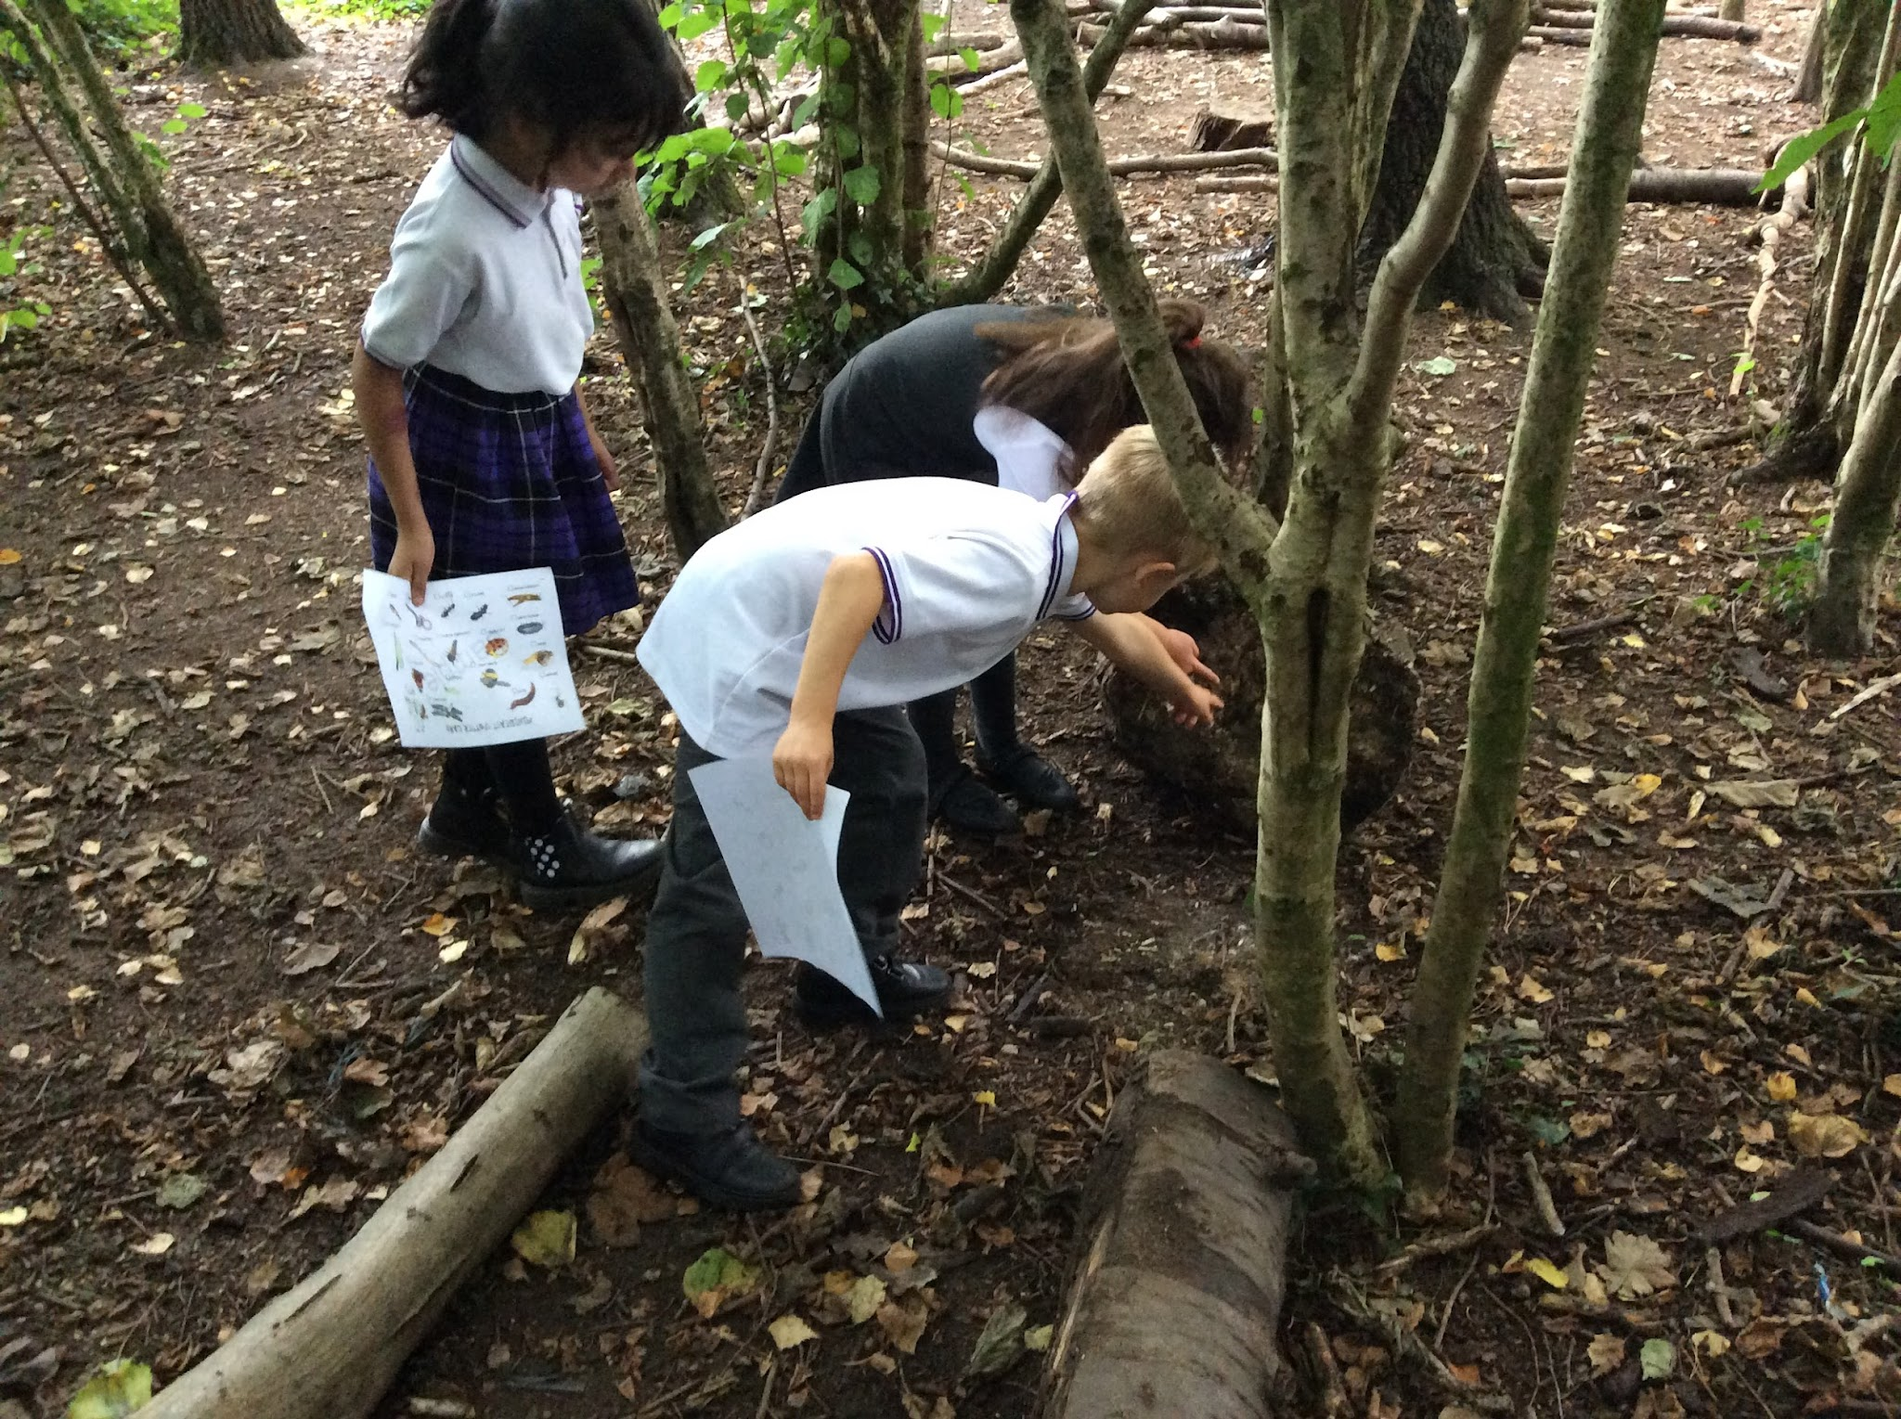
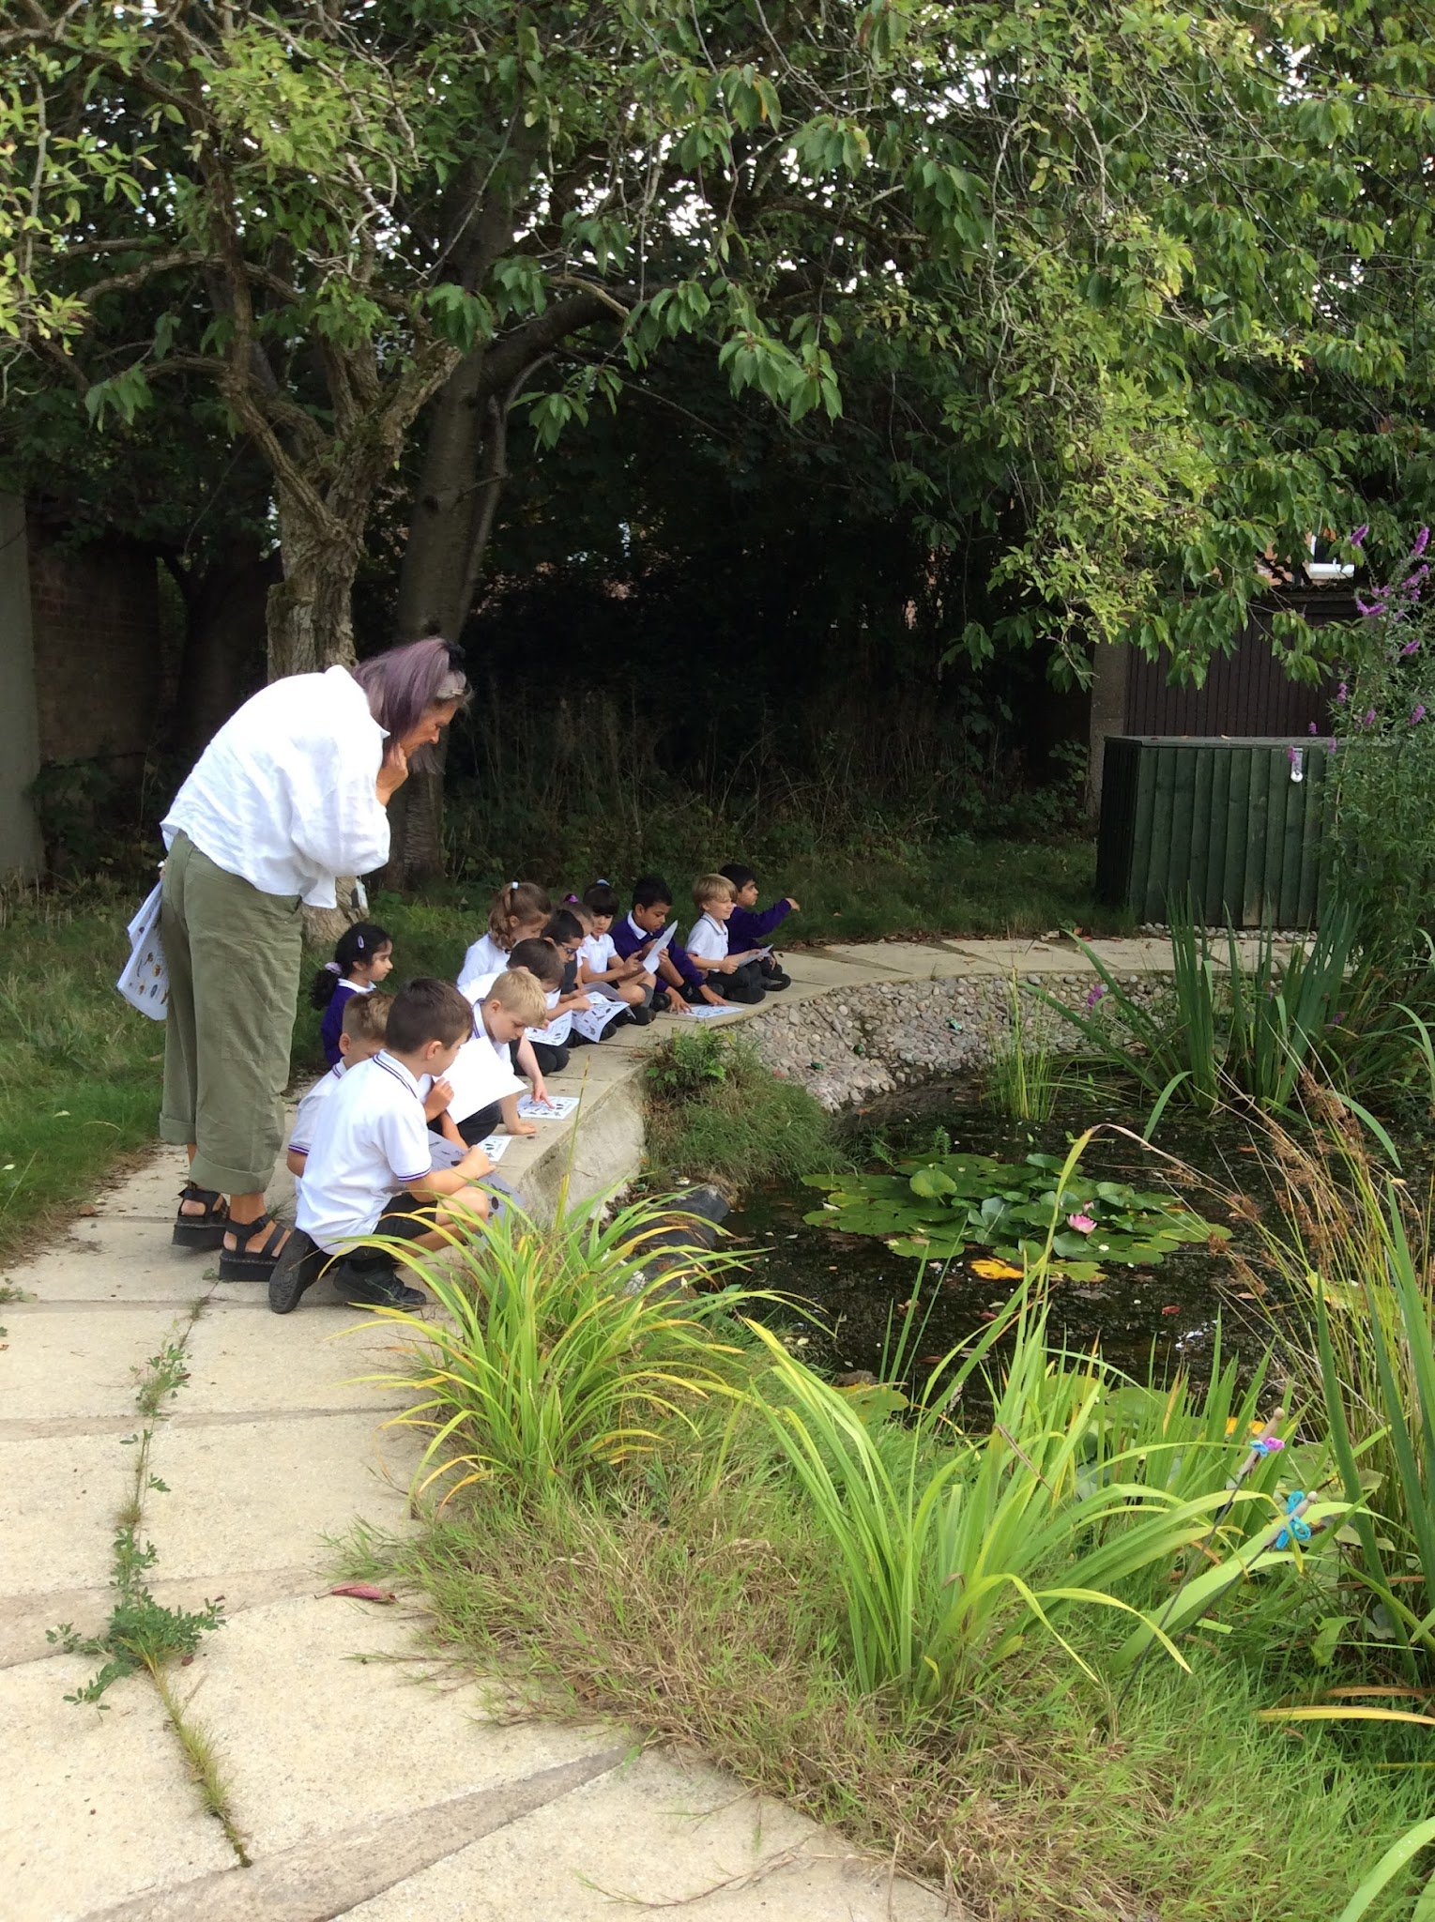
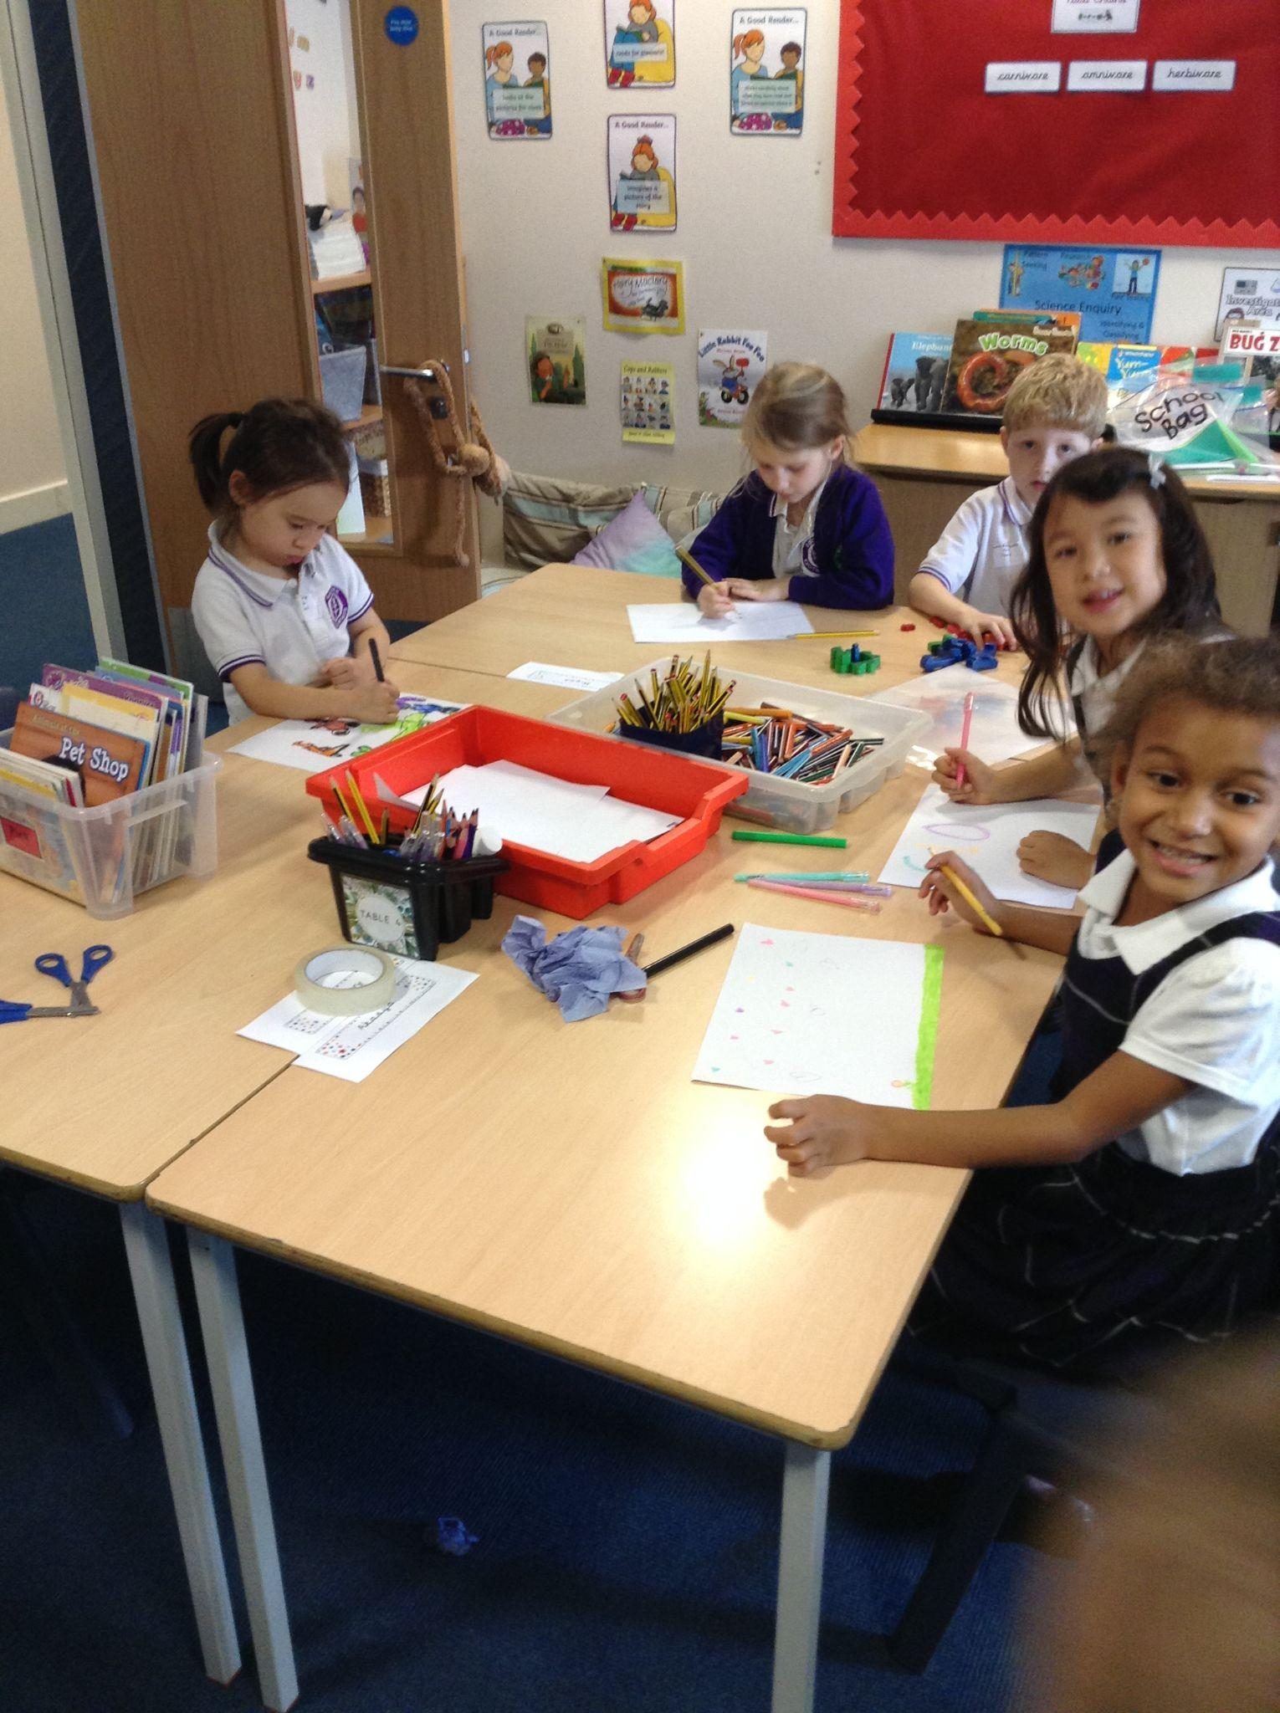
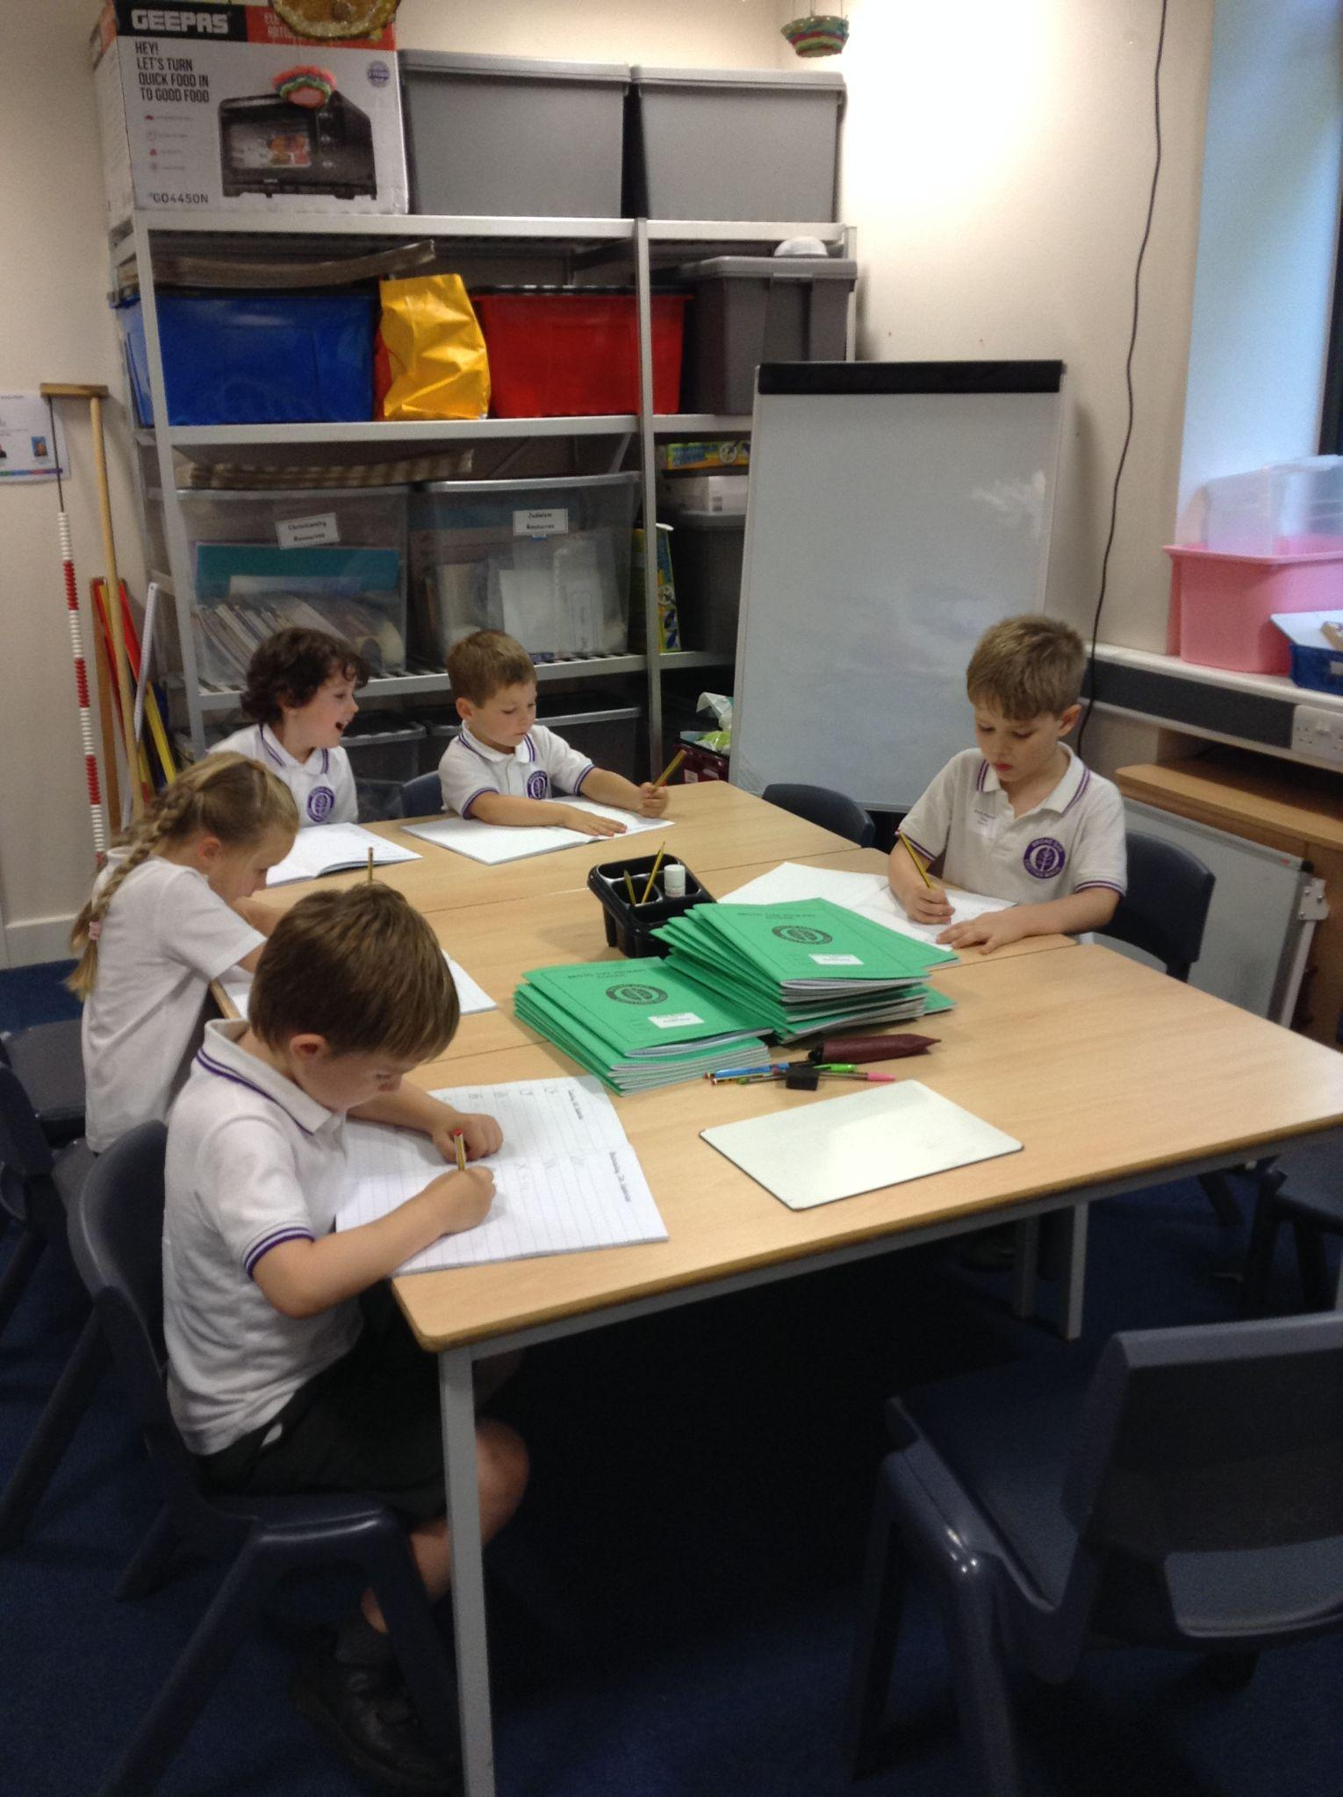
Curriculum
We endeavour to make all lessons as enjoyable as possible while making the most of every opportunity within the school day.
This includes, but is not limited to:
Daily Read, Write Inc
Daily writing
Daily Maths
PE- 2hrs per week
Foundation subjects (geography, history, music, computing, art, design & technology, PSHE, RE)

Slide 5

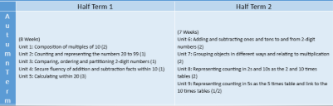
Curriculum focus for Autumn ‘26
Autumn 2

Slide 6

Curriculum focus for Autumn ‘26
Week 1 and 2: sentence level work based on the texts;
Y2: ‘Willy the Dreamer’
Week 3 and 4: writing instructions based on the texts;
Y2: ‘Thank you for looking after our pets’
Over the rest of the year, we will look at a variety of genres including poetry, narrative, recounts and non-chronological reports.

Slide 7
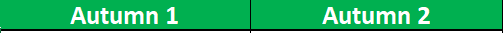
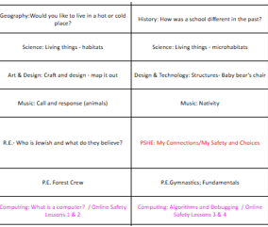

Curriculum focus for Autumn ‘26

Slide 8


Curriculum focus for Autumn 26

Slide 9
Year 2 Educational Visits:
We are planning three educational visits this year.
They will all be linked to our foundation subjects.
Our first trip will be in the Autumn term and we will be going to Manchester Jewish Museum to support our RE unit of work.

Slide 10







Homework expectations
Set at the beginning of each half term- a letter will be sent home with expected number of tasks to be completed. Parents open afternoon each half-term to celebrate the learning. | Numbots homework is an online maths system. | Weekly words – sent home each week on Wednesdays Weekly spelling test Wednesday) | Daily practise (10 mins). Sign journal 5 times a week to earn a Reading Raffle Ticket. Changed on a Friday- need to be returned on a Wednesday so they can be changed.

Slide 11
A typical day in KS1
8:35-8:45 - Gates open and welcome onto playground
8.45-8.55 -Register/Arithmetic practise
8.55- 9.15 - Mastering Number
9:15-10:15 - Maths
10:15-10:30- Morning Break (fruit snack/milk)
10:30-11:15 - RWI (phonics/reading)
11:15-12:00 - Writing
12:00-1:00 - Lunch Break
1:00-1:45 - Foundation Subjects (spread across the week)
1:45-2:00 - Afternoon Break
2:00-2:45 - Foundation Subjects
2:45-3:10- Assembly (Core values/Singing/RRSA/House/Celebration)
3:10-3:20 - Pack up
3:20- Dismissal (gates open at 3:15)

Slide 12
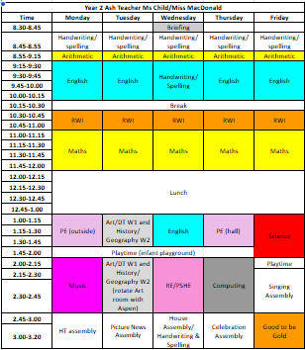
Timetable (PE: Monday Forest Crew)

Slide 13
Assembly Dates
Class assemblies:
KS1 Nativity Concert
16th December 9am- Hall
17th December 2.45pm - Hall
Ash: 16th June 2027 9am- Hall
KS1 Easter Assembly - 24th March 2027

Slide 14
Encouraging independence and responsibility for learning
Students are responsible for their jumpers and belongings. Please name all items to avoid disappointment when (not if) items go missing!
Any found jumpers will be kept in classrooms for parents to go through at the end of the day if required (please ask).
Please don’t bring in toys/items from home because they can get lost/damaged which can be very traumatic.
Remind children about regular hand washing/use of tissues/shoelaces.

Slide 15

Core Values

Slide 16
Promoting and rewarding positive behaviour
House point system - Dojos
Every child is awarded a dojo when they show they are ready to learn, keeping safe or being kind. When a child reaches 50 dojos, they will be able to choose a prize from the class prize box.
If a child is not showing expected behaviour they will be asked to complete a restorative conversation about their behaviour with the class teacher for low level disruptions. For medium level, the behaviour lead will conduct the restorative conversation and the child may lose part of a break or lunchtime. For high level behaviour the child will be removed from the class and SLT will conduct the restorative conversation.
Good to be Gold system
All children will received 30 minutes of good to be gold on a Friday afternoon. This may be shorter if a child has unfinished restorative conversations from the week.

Slide 17
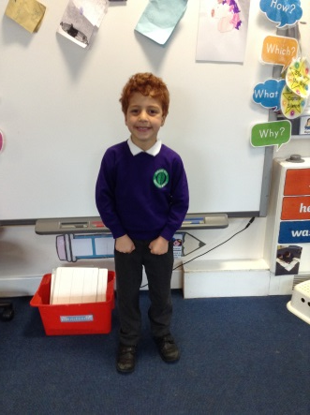
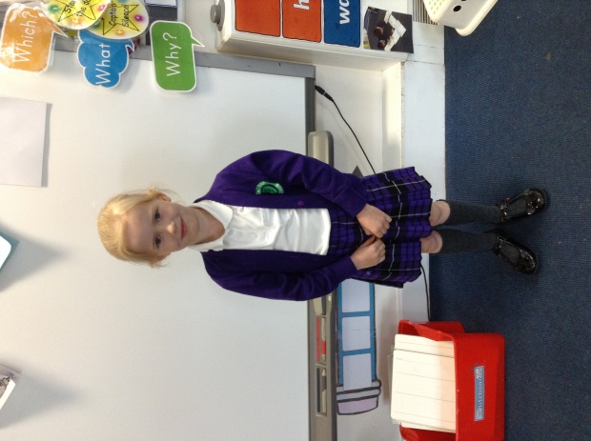
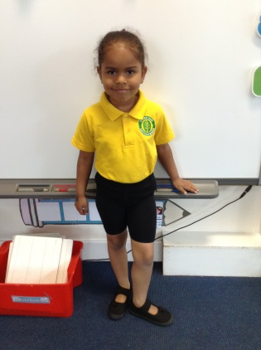

School uniform
Purple sweatshirt / cardigan
White polo shirt
Grey trousers
Purple tartan skirt or pinafore dress
Black shoes
P.E. kit:
Yellow polo shirt
Green sweatshirt/cardigan
Black shorts/pants
Sensible trainers
Long hair must be tied up and no jewellery can be worn on PE days.
Please label all items clearly with your child’s name. ‘Stick-on’ name labels can be purchased from a number of suppliers.

Slide 18
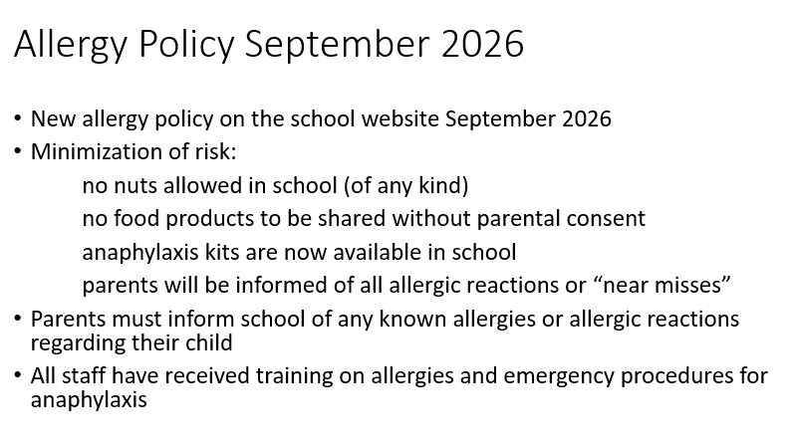

Slide 19


Slide 20
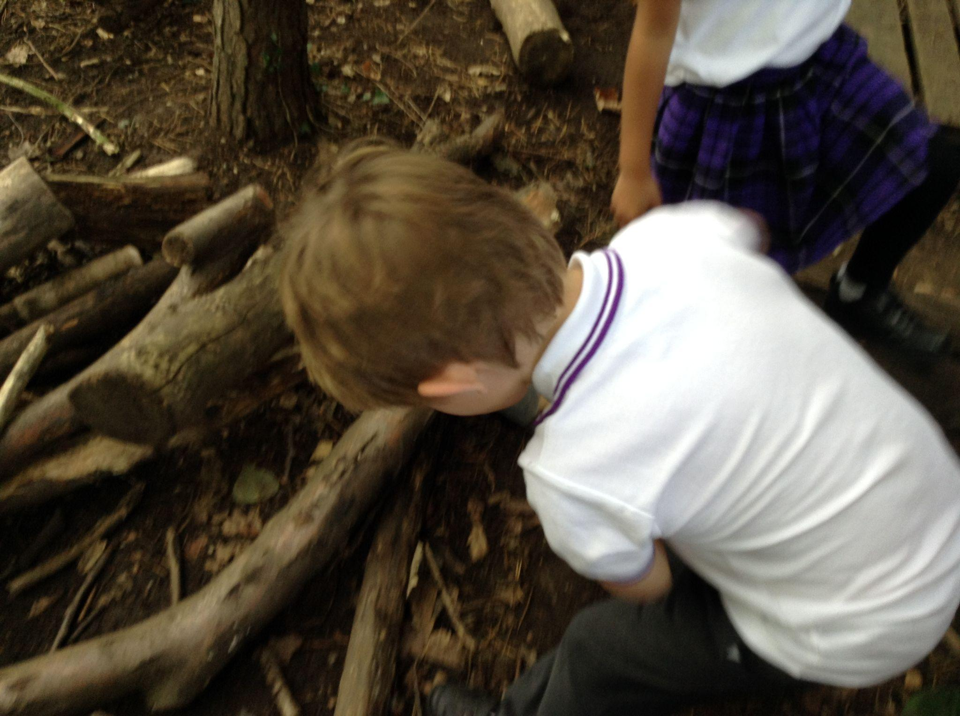
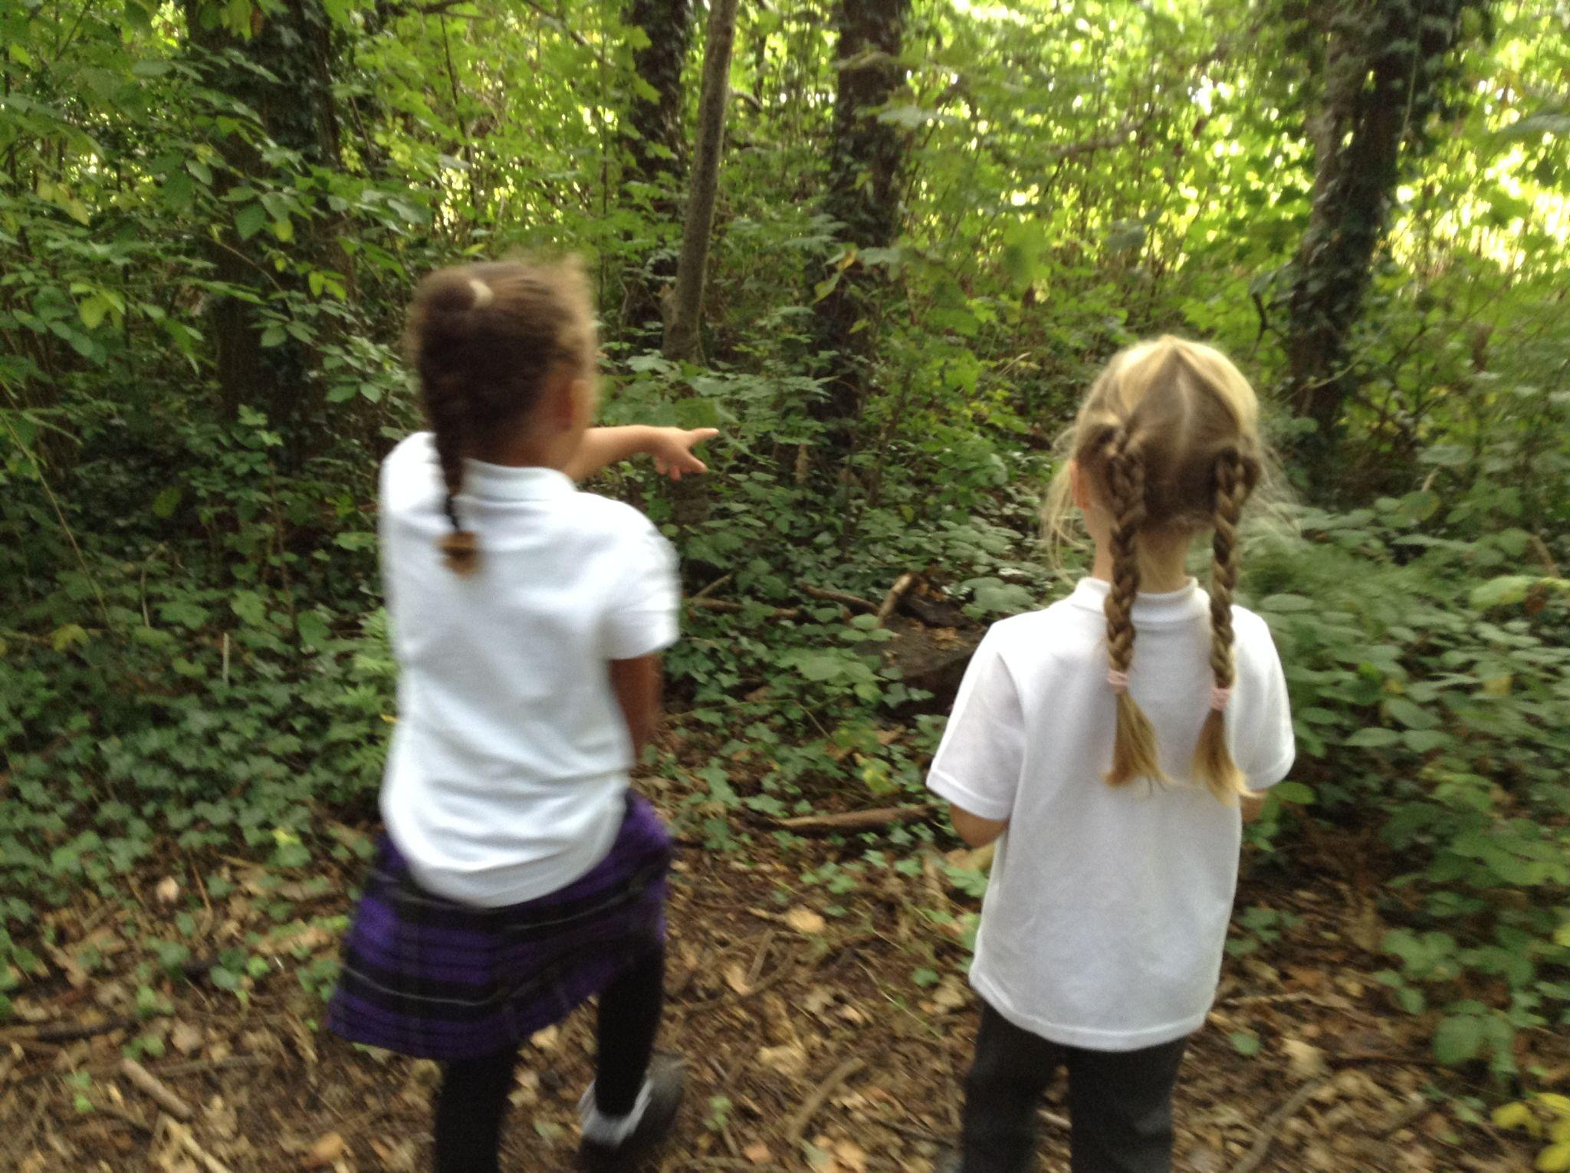
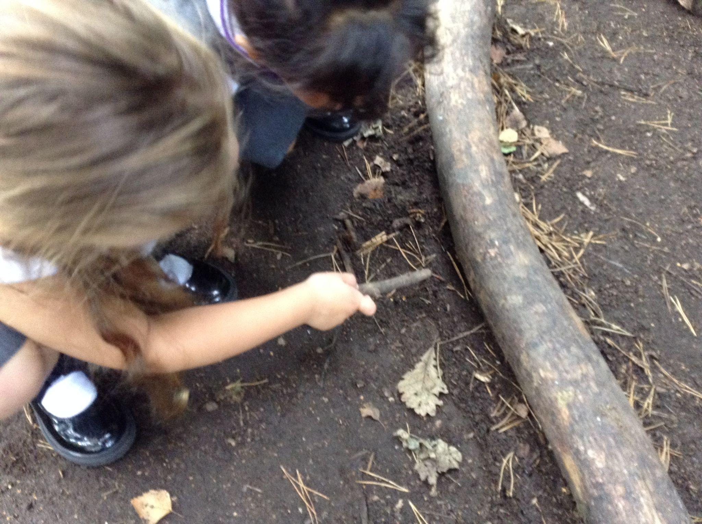
Appropriate clothing for the weather
Waterproof coat with a hood.
Hat, scarf, gloves for cold weather.
Please apply sun cream before school during hot weather and send a hat.
Ear-rings to be removed for PE lessons. Please remove them before coming to school/cover with tape.
Long hair must be tied back for outdoor activities and all P.E. lessons.

Slide 21
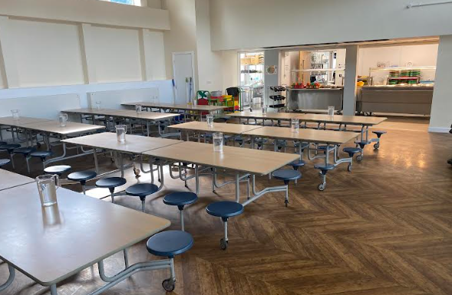
Lunchtimes
School Meals: School Grid is the online system used to pre-order and pay for school meals (free for children from Reception to Year 2).
Please contact the admin team if you have any difficulties with logging in to the system
Healthy Lunchboxes:If you choose to provide a packed lunch from home please see our Healthy Eating Policy following the link on the slide below.
Timings and supervision:
Lunchtime is 12.00pm-1.00pm
Children are supervised by our team of lunchtime organisers, teaching assistants and a member of the SLT each day. We also have two sports coaches helping to organise team games during the lunchtime period.

Slide 22

Lunchtimes: Healthy lunchbox
Packed lunches should include:
At least one portion of fruit or one portion of vegetables every day e.g. Apples, grapes, carrots
A sandwich, wrap or tortilla containing meat, cheese, fish or other source of non-dairy protein e.g. houmous and falafel.
Other items could include pasta, rice, couscous, noodles, potatoes or other type of cereals.
Dairy food such as milk, cheese, yoghurt, fromage frais every day.
Only water (still), fruit juice, milk, yoghurt or milk drinks and smoothies.
Packed lunches should avoid:
Snacks such as crisps
Confectionery, such as chocolate bars, chocolate-coated biscuits and sweets.
Meat products such as sausage rolls, individual pies, sausages / chipolatas should be included only occasionally.
Drinks with added sugar or sweeteners and fizzy drinks.

Slide 23
Milk and snack
Milk is available at a cost for the year.
Piece of fruit is provided every day for children in Nursery - Year 2.
Water is available at all times - please provide a named water bottle for your child each day.
Children in Years 3-6 can bring in their own healthy snack to eat at playtime.
The Broad Oak Food and Drink policy and the Broad Oak packed lunch policy are available to view here

Slide 24
Beginning and End of Day Routines
External gates are opened at 8.35am and locked at 8.50am.
The school day begins at 8.45am.
If late, always report to the main school office.
The main gate is opened at 3.15pm for collection of all pupils. We ask that children in EYFS are collected first.
If anyone else is collecting your child please make sure the class teacher is made aware- please phone the school office in an emergency.
Siblings must be 16 or over to collect children.
Children that have not been collected by 3.30pm will be taken to After School Club at a cost of £9.75 per pupil.

Slide 25
Attendance and Punctuality
Please ensure that your child attends school every day and on time.
If child is genuinely ill please inform school as soon as possible on 0161 445 6577.
Medicines in school- must be prescribed by a doctor / signed consent from parents
Leave during term time will not be authorised and could result in a fine of £80 per parent per child.
Please make sure your child is in class by 8.45am to receive their mark in the register.

Slide 26
Parent pay
The school is ‘cashless’. All payments for educational visits, school lunches, before and after school clubs must be made via Parent Pay. All parents/ carers will be issued with login details. If you are having difficulty accessing it, please contact the school office who will be happy to help.
School lunches- menu choices are available to view up to half a term in advance. Please ensure that choices for that school day are made before the start of the school day. Pre-order and payments for school lunches is through School Grid.

Slide 27
Out of school care
Breakfast Club is run by school staff each morning in the old Year 1 building from 7.45am-8.45am
Sessions must be booked in advance - full details can be found on the school website
After School Club is also run by school staff from 3.20pm-5:45pm (same location as above)
Please contact the school admin team for an application form

Slide 28
Working together in partnership
Arbor is our school app for online communication between home and school
Please remember that teachers will not be able to answer individual messages during the school day but will try to get back to you within 2 days.
Members of SLT (Senior leadership Team) will be on gate duty each day if you have any questions or concerns
Teachers are available at classroom doors at the beginning of the day, however if you need a longer conversation please make an appointment at another time
If you have any urgent messages for school during the school day, please telephone the school office on 0161 445 6577
At Broad Oak we believe that reading is the key to success in all areas of the school curriculum. Please make sure that your child reads at home for at least 10 minutes each day
Please make sure that your child arrives at school on time each day, ready to learn

Slide 29
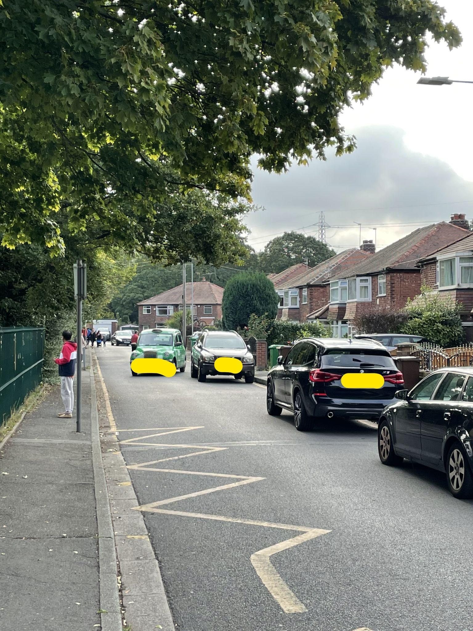
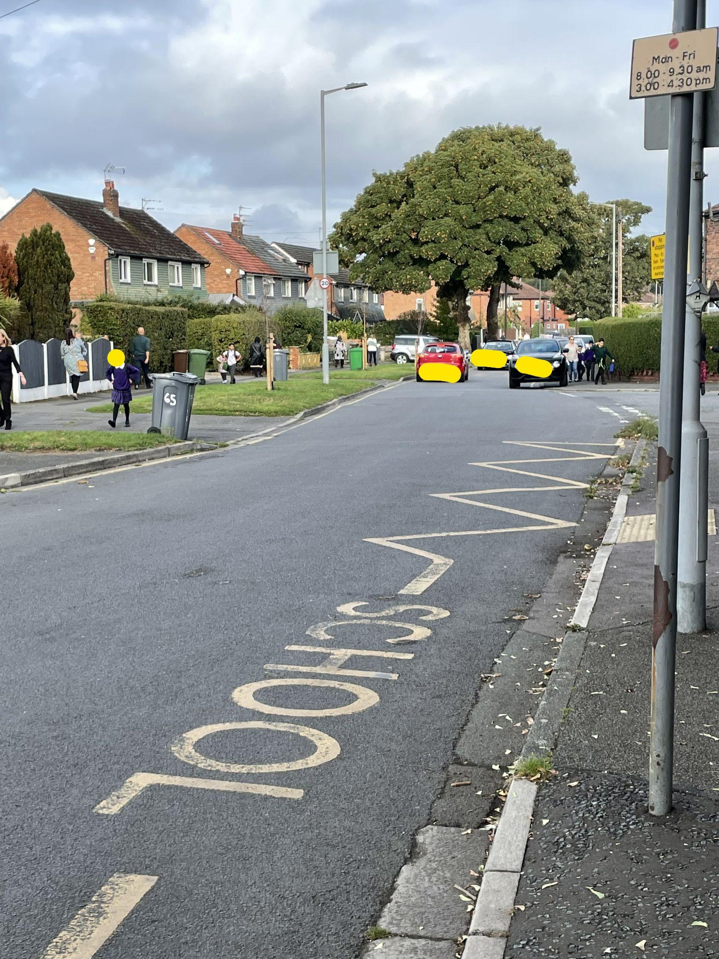
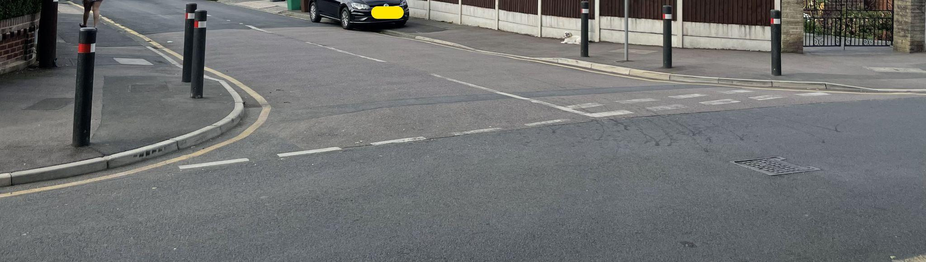
Respecting our local community
Parking
If driving to drop off and collect your child please do not park on any yellow lines. These are there to protect our pupils.
Please do not park on the corners of local streets as this makes it difficult for our pupils to safely cross the road.
Please do not park on,
or pull on to local
resident’s driveways.

Slide 30
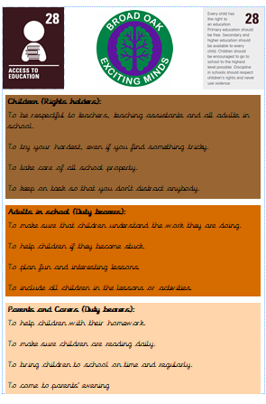
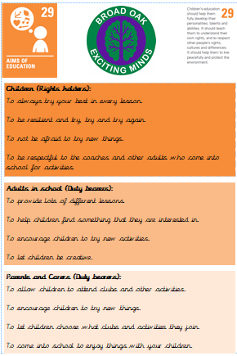
Rights Respecting Schools

Slide 31
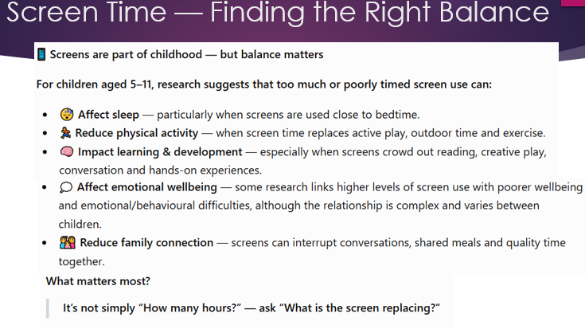

Slide 32
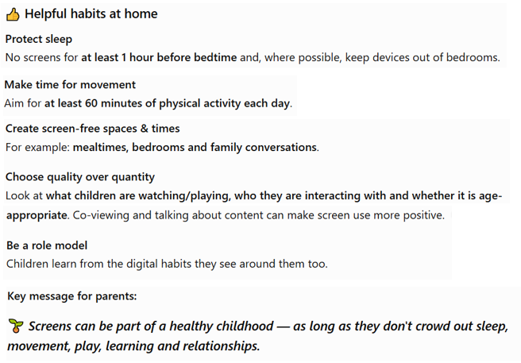

Slide 33
