Slide 1

Welcome to
Broad Oak Primary School
Year 3 - Phase: LKS2 September 2026

Slide 2
LKS2 Staff
Mr Bush Mrs Mitchell Mrs McKrell Mr Corteen
Hazel Class Teacher T.A. TA PPA
Miss Gee Miss Gill Mrs Fatahi
T.A. T.A. T.A.

Slide 3
Curriculum
English: Reading- 3 class guided reads and two Reading Plus session
Writing: taught daily based around a class text alongside spellings and handwriting
Mathematics- taught daily
Geography / History- taught weekly in half termly blocks
RE / PSHE – taught weekly in half term blocks
Computing – taught weekly
PE – taught twice a week (including one half term of Forest Crew)
Music – taught alternate weeks
Art / DT – taught weekly in half term blocks
French taught weekly
Science taught weekly

Slide 4
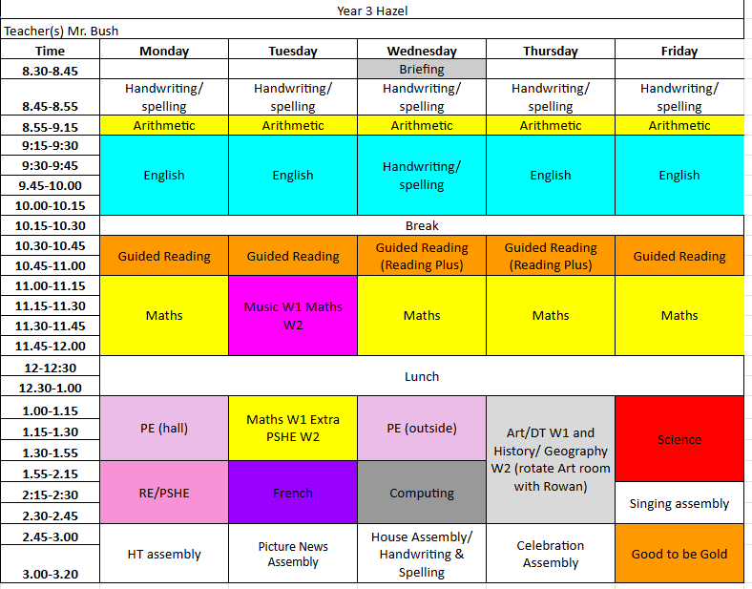
Sample Timetable

Slide 5
Curriculum focus for Autumn 1 26
An overview of the curriculum for Autumn
In Maths, the focus will be Number and Place Value, Addition and Subtraction, Multiplication and Division
In Guided Reading we are looking at Fairy Tales and alterative versions
In Writing we are focussing on sentence structures.
In Science we are looking at Animals: Movement and Nutrition.
In Geography, the children will be learning about Volcanoes and why people live near them.
Design Technology this term is looking at Pneumatic toys
Music is being taught by One Education where they will be learning to play an instrument
French will be doing a unit called J’apprends le francais – I am learning French
P.E. days
Hazel – Monday and Wednesday
PE kit to be worn – long hair tied up and NO earrings to be worn

Slide 6
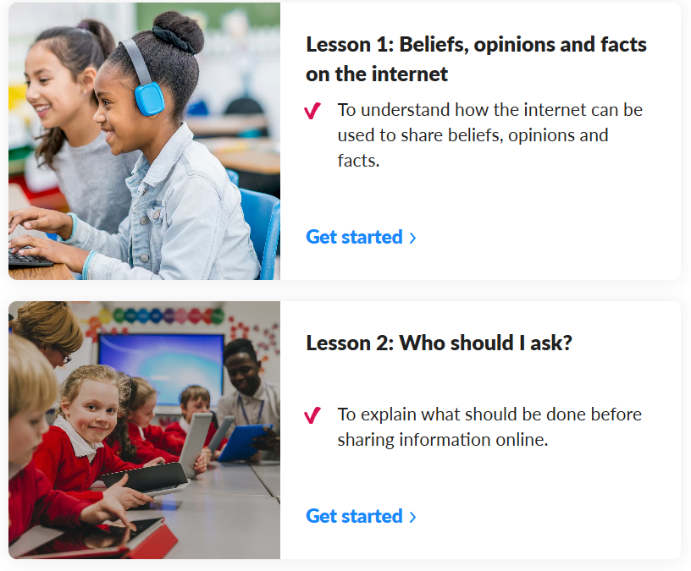
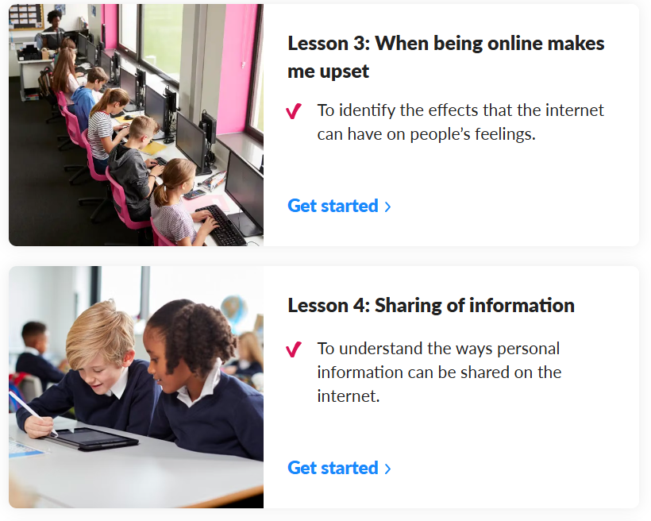
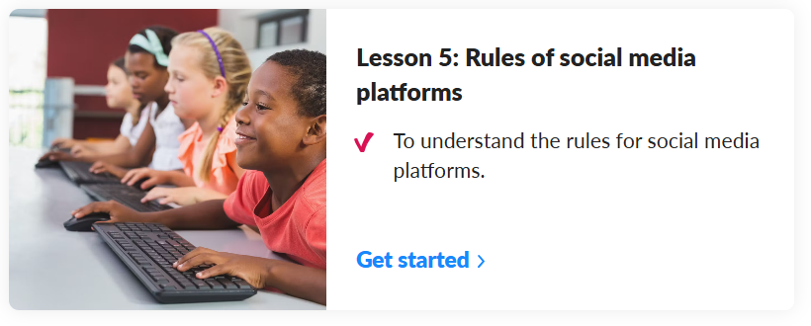
Curriculum focus for Autumn 1 26
We cover Internet safety and using the computers sensible through out the year. We have lessons we cover from Kapow, alongside Safer Internet Day in February of each year.

Slide 7
Homework expectations
Weekly Homework tasks:
TTRS – times tables practise
Spellings
Reading Plus
Daily Reading
Reading Plus and Reading Records checked and raffle tickets given for every 5 reads completed.
Checked on Wednesdays
Topic activities – half termly for the homework showcase

Slide 8
School Assemblies
This year we having the class assemblies which you are warmly invited to attend. Below are the dates of the assemblies; they are at 2:45pm in the school hall:
Year 3 Diwali Assembly:
Wednesday 11th November 2026
Hazel Class Assembly:
Wednesday 27th January 2027

Slide 9
Educational Visits
We are going to be carrying out fieldwork studies in the local area for Geography and are planning to visit a place of worship linked to one of our R.E. topics.
We have booked the following trips:
Ancient Egypt
Bolton Museum on Monday 2nd November 2026
The Jolly Christmas Postman
Lowry Theatre on Thursday 10th December 2026
Stone Age
Venture Out on Wednesday 9th June 2027

Slide 10
Encouraging independence and responsibility
Using the toilets sensibly and taking responsibility for keeping them tidy.
Remembering to read their book every day at home and bringing them in every day – Reading raffle tickets
Labelled school uniform
Responsibility for their belongings – if they leave their jumper somewhere etc.
Completing their homework tasks each week.

Slide 11
Allergy Policy September 2026
New allergy policy on the school website September 2026
Minimization of risk:
no nuts allowed in school (of any kind)
no food products to be shared without parental consent
anaphylaxis kits are now available in school
parents will be informed of all allergic reactions or “near misses”
Parents must inform school of any known allergies or allergic reactions regarding their child
All staff have received training on allergies and emergency procedures for anaphylaxis

Slide 12
Special Educational Needs and Disability (SEND)
Inclusion is at the heart of our philosophy at Broad Oak
We endeavor to meet the needs of all children at all ages and stages of development with kindness, dignity and respect
We ask parents to show sensitivity and kindness towards other children with barriers to learning, and to their parents
If you have any concerns about your child:
  Speak to the class teacher first
  Make an appointment to see the SENDCO (Ms. Child)
  Email: sendco@broadoak.Manchester.sch.uk

Slide 13

Core Values

Slide 14
Promoting and rewarding positive behaviour
Class Dojos
The class each have their own Dojo and are awarded Dojos for following:
Being Kind
Being Safe
Ready to Learn
Golden Time is on Friday at 2:45pm – all children will be able to choose from a range of activities.
Each time the children achieve 50 dojos will be rewarded a dip in the prize box.

Slide 15




Right Respecting School
UNICEF – Rights of the Child
We are working towards our Silver award and during weekly assemblies the children learn about their rights. Each class has a class charter which we have all signed up to showing our support of these rights.

Slide 16
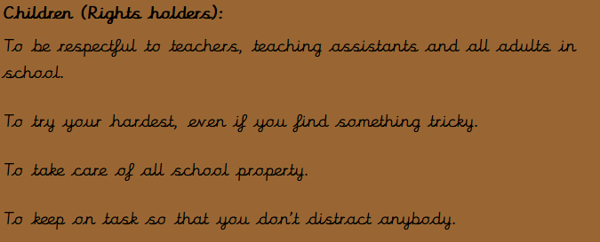
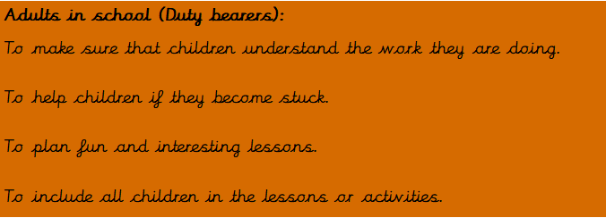
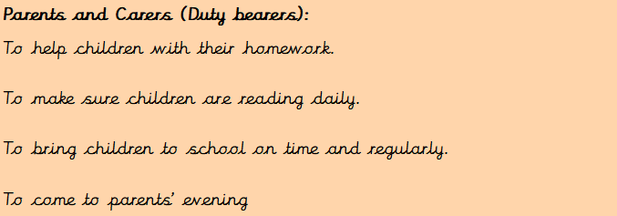
Right Respecting School

Slide 17
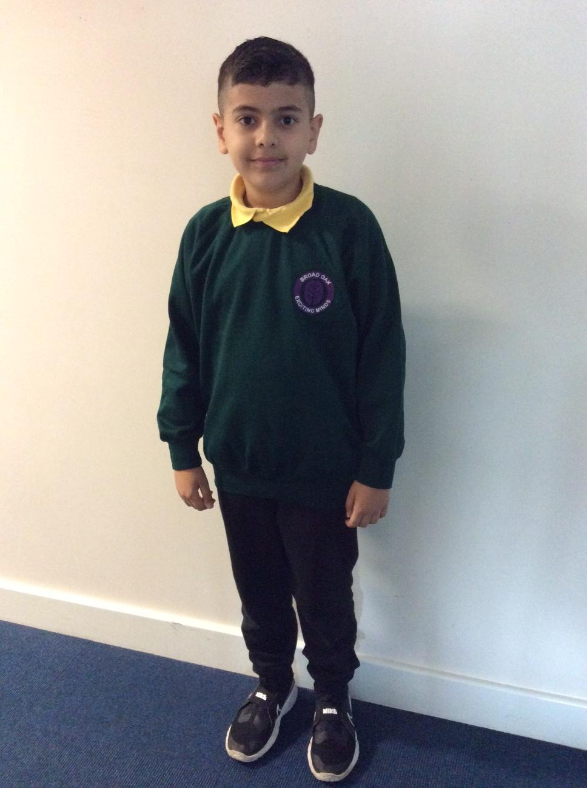
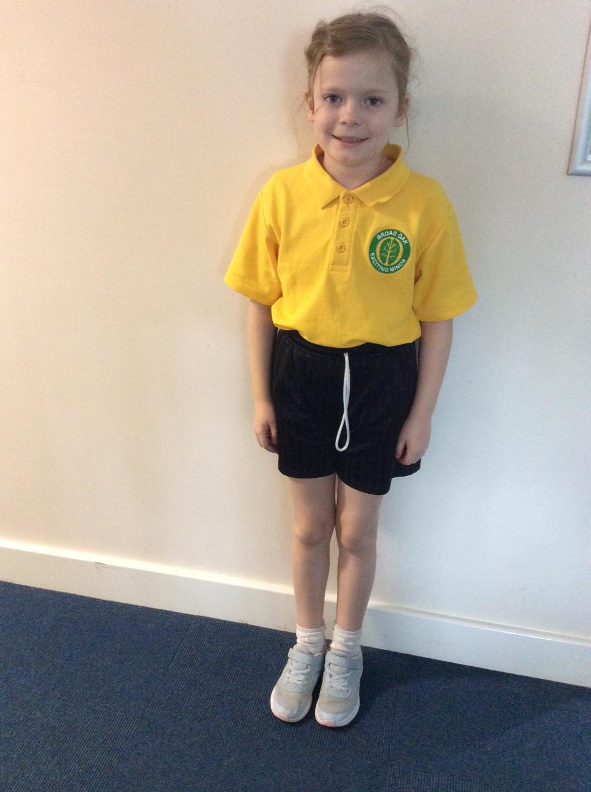

School uniform
Purple sweatshirt / cardigan
White polo shirt
Grey trousers
Purple tartan skirt or pinafore dress
Black shoes
P.E. kit:
Yellow polo shirt
Black shorts
Black pumps
Please label all items clearly with your child’s name. ‘Stick-on’ name labels can be purchased from a number of suppliers.

Slide 18
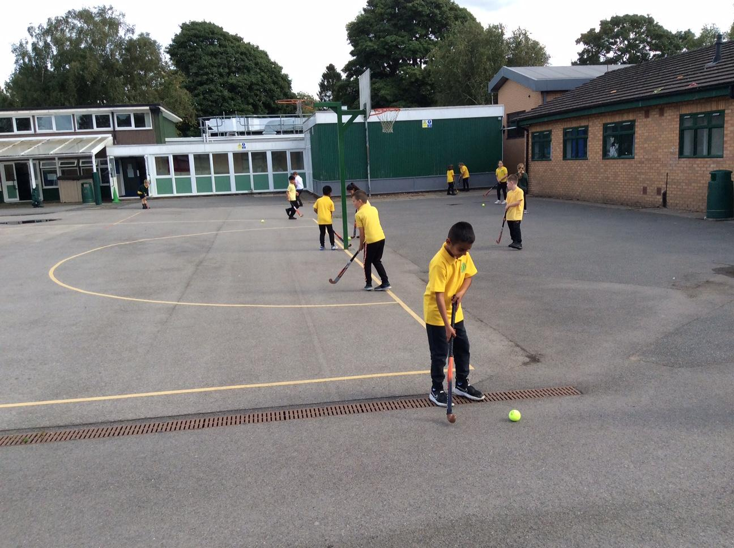
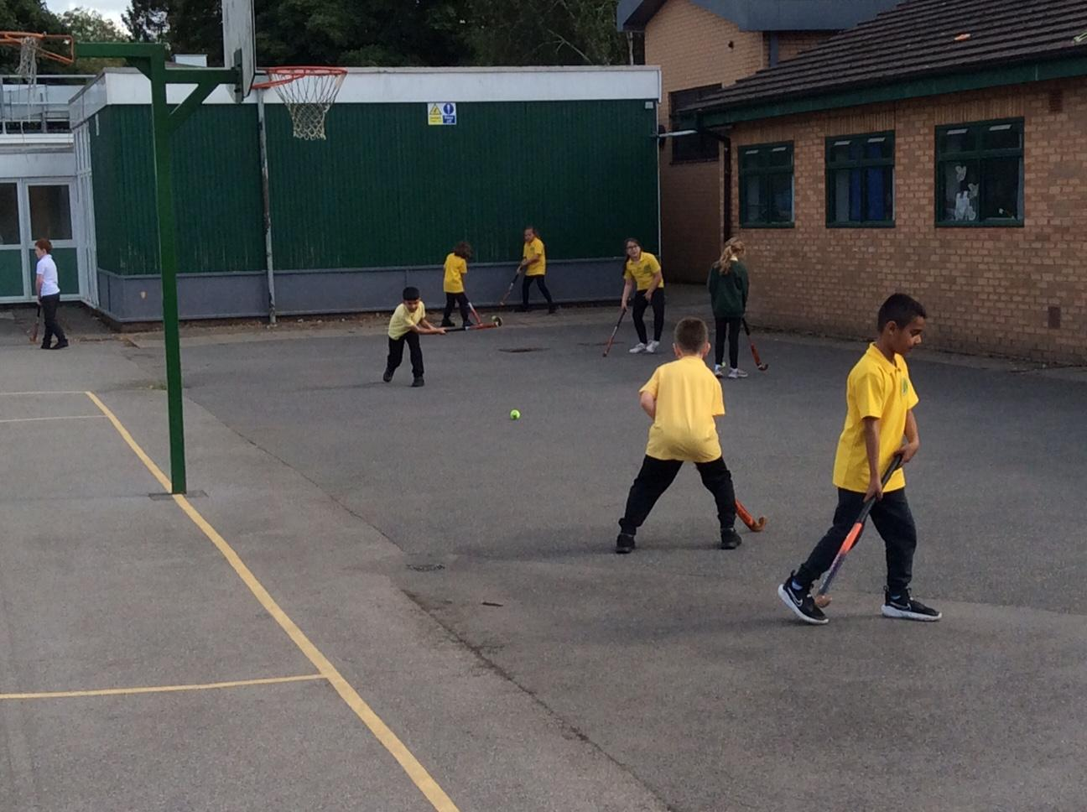
Appropriate clothing for the weather
Waterproof coat with a hood
Hat, scarf, gloves for cold weather
Please apply sun cream before school during hot weather
Ear-rings to be removed for PE lessons. If your child is unable to do this independently, please remove them before coming to school.
Long hair must be tied back for outdoor activities and all P.E. lessons
Sometimes the children come from their house to the car to school without a coat and then at playtime/lunchtime have no coat to wear.

Slide 19
Lunchtimes
School Meals: School Grid is the online system used to pre-order and pay for school meals.
Parents are responsible for informing the school of any allergies their child has. Any food allergies have to be updated by parents on SchoolGrid.
Please contact the admin team if you have any difficulties with logging in to the system.
Healthy Lunchboxes: If you choose to provide a packed lunch from home please see our Healthy Eating Policy following the link on the slide below.
Timings and supervision:
Lunchtime for Year 3 is 12.00pm-1.00pm
Children are supervised by our team of lunchtime organisers, teaching assistants and a member of the SLT each day. We also have sports coaches helping to organise team games during the lunchtime period.

Slide 20
Milk and snack
Milk is available to order via the office for the year
Water is available at all times - please provide a named water bottle for your child each day
Children in Years 3-6 can bring in their own healthy snack to eat at playtime.
KS2 Only fresh fruit, dried fruits and seeds and cut up vegetables are allowed to be brought in as snacks at break time.
No chocolate, sweets, biscuits or crisps should be brought into school. To ensure the safety of children with nut allergies, no nuts of any kind should be brought into school.
The Broad Oak Food and Drink policy and the Broad Oak packed lunch policy are available to view here

Slide 21
Beginning and End of Day Routines
External gates are opened at 8.35am and locked at 8.50am.
The school day begins at 8.45am.
If late, always report to the main school office.
At the end of the school day the main gate is opened at 3.15pm for collection of pupils in Y3 for 3.20pm.
If anyone else is collecting your child please make sure the class teacher is made aware- please phone the school office in an emergency.
Siblings must be 16 or over to collect children.
Children that have not been collected by 3.30pm will be taken to After School Club.

Slide 22
Attendance and Punctuality
Please ensure that your child attends school every day and on time.
If child is genuinely ill please inform school as soon as possible on 0161 445 6577.
Medicines in school- must be prescribed by a doctor / signed consent from parents
Leave during term time will not be authorised and could result in a fine per parent per child.
Please make sure your child is in class by 8.55am to receive their mark in the register.

Slide 23
Arbor
The school is ‘cashless’. All payments for educational visits, before and after school clubs must be made via Arbor. All parents/ carers will be issued with login details. If you are having difficulty accessing it, please contact the school office who will be happy to help.
School lunches- School Grid menu choices are available to view up to half a term in advance. Please ensure that choices for that school day are made before the start of the school day. You can order for the week/ half term in advance.

Slide 24

Communication
The Arbour App is now available – please sign up via the email.
If you haven’t received the email please contact the school office.
Pupil Premium – if your child qualifies, school receives extra funding and your child is eligible for Free School Meals and shopping vouchers in the school holidays.

Slide 25
Out of school care
Breakfast Club is run by school staff each morning in the old Year 1 building from 7.45am-8.45am
Sessions must be booked in advance - full details can be found on the school website
After School Club is also run by school staff from 3.20pm-6.00pm (same location as above)
Please contact the school admin team for an application form

Slide 26
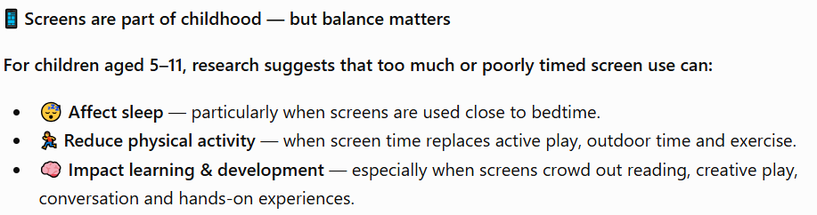
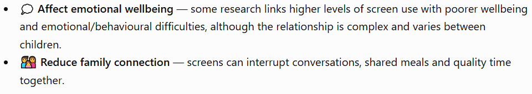

Screen Time — Finding the Right Balance

Slide 27
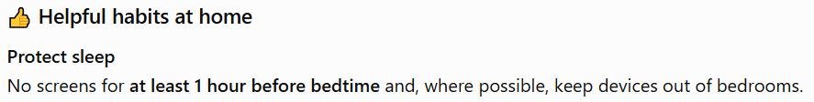

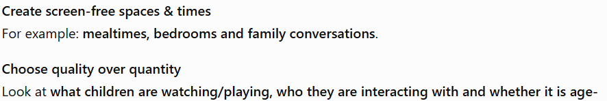
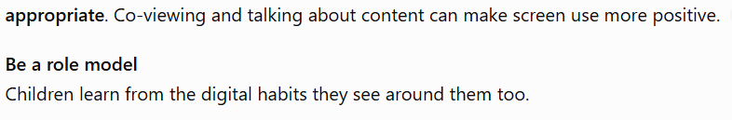
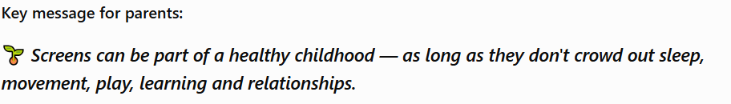

Slide 28
Further online safety support:
Primary Parents Autumn workshop
14th December 7.30-8.30pm
The workshop is dedicated to helping parents understand the risks their children face in their online lives and the practical things parents can do to help. Webinar Registration - Zoom
Smoothwall Online Safety Hub
The Online Safety Hub is available to support families’ knowledge and understanding of digital safeguarding! The Online Safety Hub is a brand-new online resource with lots of expert advice and guidance to help you manage children's safety online. It includes information on the latest hot topics when it comes to keeping children safe, such as how to manage screen time, understand the latest gaming platforms, what they mean for children’s safety and lots more.
You can access it for free here:
online safety hub
The Qustodio Parent App
Qustodio is a world-leading online safety tool that helps parents manage and supervise their child's online activities.
Our partnership with Qustodio offers parents free access to the Qustodio parent app.
The Qustodio Parent App enables parents to manage screen time, monitor online activity, and access expert advice on online safety.

Slide 29
Thank you! any questions?

