Slide 1


Welcome to
Year 6
Aspen Class
Year 6 September 2026

Slide 2
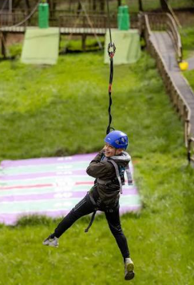
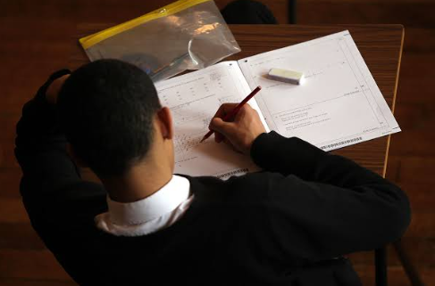


It’s a BIG year ahead!

Slide 3
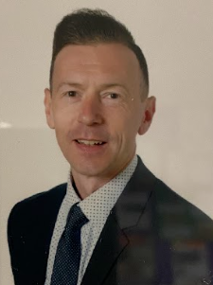

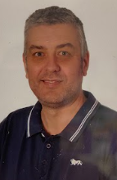
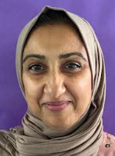
Year 6 Staff
Class Teacher
Teaching assistant
Teaching assistant
Teaching assistant
Mr Shore
Miss Holt
Mr Vost
Mrs Rehman

Slide 4
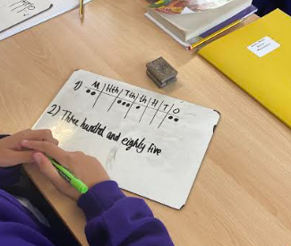
Curriculum
- Reading: 3 class guided lessons: Vocabulary/Read/Respond
- Reading + 2x Weekly
- Writing: taught daily
- Mathematics: taught daily
- SPAG: taught once a week
- Geography / History: taught weekly in half termly blocks
- Computing: taught once a week
- Science: taught once a week
- P.E: taught twice a week (P.E/Forest Crew)
- P.S.H.E / R.E: taught weekly in half termly blocks
- French: taught once a week
- Music: taught once a week
- Art & Design / D&T: taught weekly in half termly blocks

Slide 5
Curriculum focus for Autumn 1 2026
Mathematics Addition Subtraction Multiples | Writing Instructions Diary Narrative | Guided Reading The Girl of Ink and Stars | Geography: Why does population change?
Science Living things - classifying. | Computing Internet Safety | Art & Design Expressing Ideas | P.E Gymnastics Hockey
Music Dynamics - pitch and texture. | R.E What do religions say to us when life gets hard? | French Phonics | SPAG Y5/6 Spelling

Slide 6
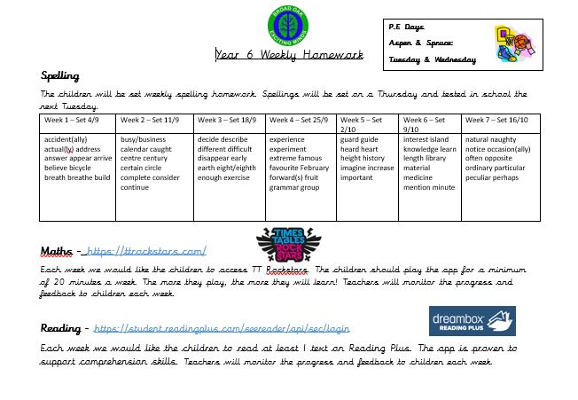


Homework expectations
Weekly homework will focus on basic skills including weekly spelling tests, TT Rockstars and Reading Plus. Homework will be set on Fridays and will be expected to be completed by the following Friday.

Slide 7
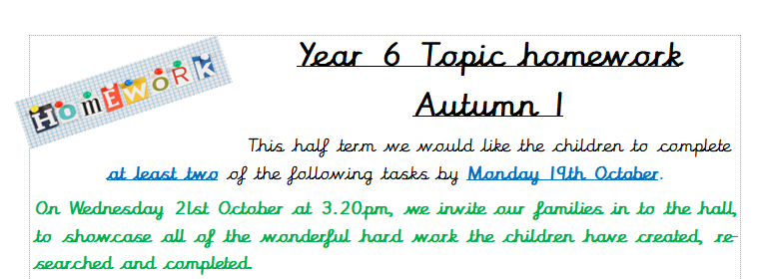
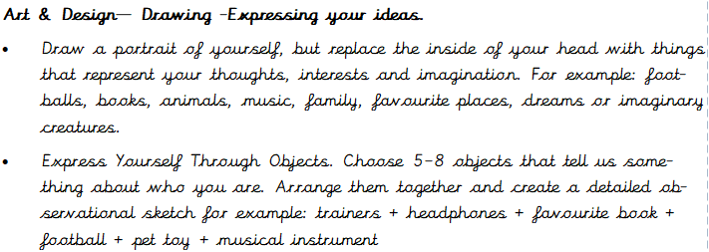
Homework expectations

Slide 8
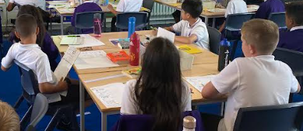
A typical day in year 6…
Year 6
8.45am come in to school and place belongings into their locker. Walk to the classroom and begin morning activity.
9.00am Registration
9.00am-9:30am Assembly
9.30am-10:15am English
10:15am-10:30am – Break time
11:00am – 12:00pm – Mathematics
12:00pm-1:00pm - Lunch
1:00pm-2:00pm - Science
2:00pm-3:00pm – Art and Design
3:20pm - Home time

Slide 9
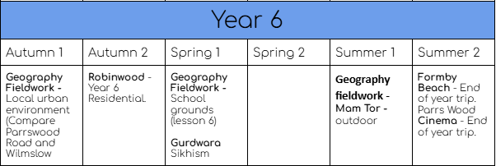
Educational Visits
Meeting Monday 21st September at 3:30 in the school hall!

Slide 10

Promoting and rewarding positive behaviour
Our behaviour expectations are:
Be Kind
Be Safe
Be Ready to Learn
Children who manage their behaviour and present expected and safe behaviour choices are rewarded Dojos.
Dojos are awarded to children who are following our expected behaviours. Milestones of 50 dojos result in a prize.
Children will have a weekly Reward Time on a Friday afternoon for 30 minutes. This will be managed in class by their class teacher.
Our School uses a restorative approach to challenging behaviours. We understand behaviour as communication, therefore it is important to ensure students have learning experiences with logical consequences. We create a culture of repair and reflection based on the principles of restorative approaches. A restorative approach includes:
Repairing relationships
Restorative conversations

Slide 11
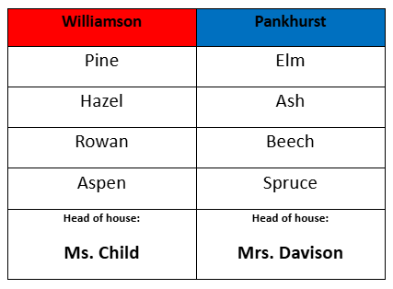
Houses
The children have been split into house teams. They earn dojo points for their house and the winning house is awarded a trophy.
The children take part in house colours for sports day.

Slide 12

House Assemblies
The children will take part in house assemblies. During these assemblies, the children will lead the assembly sharing their learning. Parents will be invited to attend. These start at 9.05am for approximately 20 minutes.
14/10/26
2.45pm – 3:10pm
Williamson
House
Aspen
(Parents invited)
Aut 1 Curriculum

Slide 13

SATs
SATs begin on the 10th May and
end of the 13th May.
The children will sit the following exams:
Spelling Test consisting of 20 spellings / SPAG Test.
Writing is based on a number of written pieces that take place from December.
Reading Test.
Maths - Arithmetic / Reasoning 1 / Reasoning 2

Slide 14

Encouraging independence and responsibility for learning.
In Year 6
Children are responsible for completing homework tasks on time.
Children responsible for keeping belongings safe inside their locker.
Children are responsible for reading their book at home and logging pages read in their reading record.
Children are responsible for knowing P.E days and arriving at school in the appropriate clothing.
Children are responsible for communicating to staff if they have forgotten a packed lunch or do not have lunch plans for a given day.

Slide 15

Core Values

Slide 16
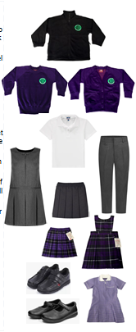
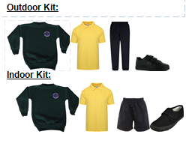

School uniform
Purple sweatshirt / cardigan
White polo shirt
Grey trousers
Purple tartan skirt or pinafore dress
Black shoes
P.E. kit:
Yellow polo shirt
Black shorts
Black pumps
Please label all items clearly with your child’s name. ‘Stick-on’ name labels can be purchased from a number of suppliers.

Slide 17
P.E Days
Aspen: Thursday and Friday

Slide 18



Appropriate clothing for the weather
Waterproof coat with a hood
Hat, scarf, gloves for cold weather
Please apply sunscreen before school during hot weather
Earrings to be removed for PE lessons. If your child is unable to do this independently, please remove them before coming to school.
Long hair must be tied back for outdoor activities and all P.E. lessons

Slide 19
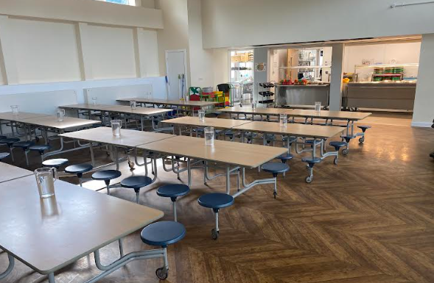
Lunchtimes
School Meals: School Grid is the online
system used to pre-order and pay for
school meals (free for children from
Reception to Year 2).
Please contact the admin team if you
have any difficulties with logging in to the
system
Healthy Lunchboxes:If you choose to provide a packed lunch from home please see our Healthy Eating Policy following the link on the slide below.
Timings and supervision:
Lunchtime for Year 6 is 12.00pm-1.00pm
Children are supervised by our team of lunchtime organisers, teaching assistants and a member of the SLT each day. We also have two sports coaches helping to organise team games during the lunchtime period.

Slide 20

Lunchtimes: Healthy lunchbox
Packed lunches should include:
At least one portion of fruit or one portion of vegetables every day e.g. Apples, grapes, carrots
A sandwich, wrap or tortilla containing meat, cheese, fish or other source of non-dairy protein e.g. houmous and falafel.
Other items could include pasta, rice, couscous, noodles, potatoes or other type of cereals.
Dairy food such as milk, cheese, yoghurt, fromage frais every day.
Only water (still), fruit juice, milk, yoghurt or milk drinks and smoothies.
Packed lunches should avoid:
Snacks such as crisps
Confectionery, such as chocolate bars, chocolate-coated biscuits and sweets.
Meat products such as sausage rolls, individual pies, sausages / chipolatas should be included only occasionally.
Drinks with added sugar or sweeteners and fizzy drinks.

Slide 21

Please bring a water bottle!
Water is available at all times - please provide a named water bottle for your child each day
Children in Years 3-6 can bring in their own healthy snack to eat at playtime.

Slide 22
Attendance and Punctuality
Please ensure that your child attends school every day and on time.
If child is genuinely ill please inform school as soon as possible on 0161 445 6577.
Medicines in school- must be prescribed by a doctor / signed consent from parents
Leave during term time will not be authorised and could result in a fine of £80 per parent per child.
Please make sure your child is in class by 8.55am to receive their mark in the register.

Slide 23
Arbor
The school is ‘cashless’. All payments for educational visits, school lunches, before and after school clubs must be made via Arbor. All parents/ carers will be issued with login details. If you are having difficulty accessing it, please contact the school office who will be happy to help.
School lunches- menu choices are available to view up to half a term in advance. Please ensure that choices for that school day are made before the start of the school day.

Slide 24
Out of school care
Breakfast Club is run by school staff each morning in the old Nursery building from 7.45am-8.55am
Sessions must be booked in advance - full details can be found on the school website
After School Club is also run by school staff from 3.20pm-6.00pm (same location as above)
Please contact the school admin team for an application form

Slide 25
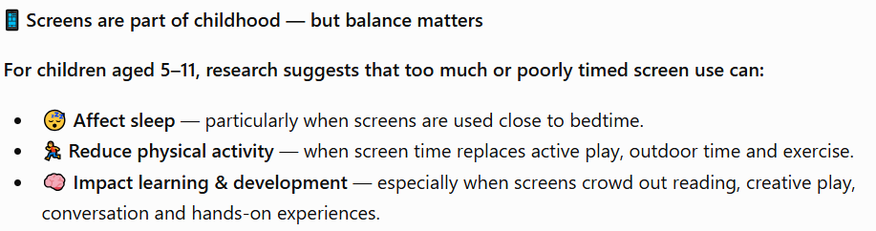
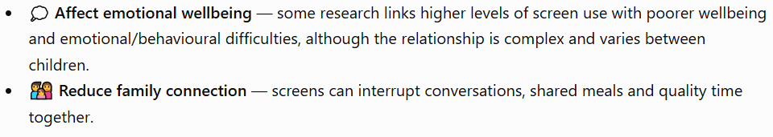

Screen Time — Finding the Right Balance

Slide 26
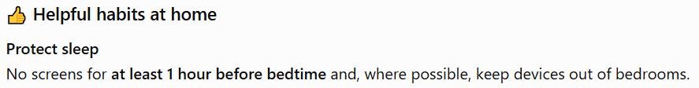

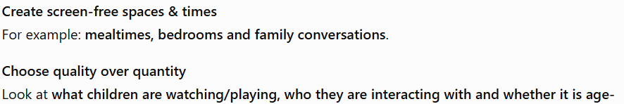
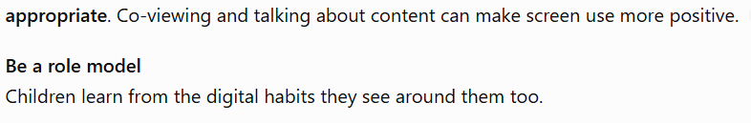
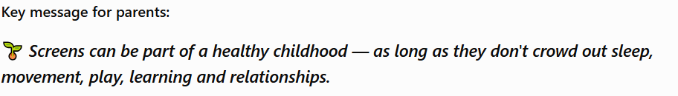

Slide 27
Further online safety support:
Primary Parents Autumn workshop
14th December 7.30-8.30pm
The workshop is dedicated to helping parents understand the risks their children face in their online lives and the practical things parents can do to help. Webinar Registration - Zoom
Smoothwall Online Safety Hub
The Online Safety Hub is available to support families’ knowledge and understanding of digital safeguarding! The Online Safety Hub is a brand-new online resource with lots of expert advice and guidance to help you manage children's safety online. It includes information on the latest hot topics when it comes to keeping children safe, such as how to manage screen time, understand the latest gaming platforms, what they mean for children’s safety and lots more.
You can access it for free here:
online safety hub
The Qustodio Parent App
Qustodio is a world-leading online safety tool that helps parents manage and supervise their child's online activities.
Our partnership with Qustodio offers parents free access to the Qustodio parent app.
The Qustodio Parent App enables parents to manage screen time, monitor online activity, and access expert advice on online safety.

Slide 28
Allergy Policy September 2026
New allergy policy on the school website September 2026
Minimisation of risk:
no nuts allowed in school (of any kind)
no food products to be shared without parental consent
anaphylaxis kits are now available in school
parents will be informed of all allergic reactions or “near misses”
Parents must inform school of any known allergies or allergic reactions regarding their child
All staff have received training on allergies and emergency procedures for anaphylaxis

Slide 29
Special Educational Needs and Disability (SEND)
Inclusion is at the heart of our philosophy at Broad Oak
We endeavor to meet the needs of all children at all ages and stages of development with kindness, dignity and respect
We ask parents to show sensitivity and kindness towards other children with barriers to learning, and to their parents
If you have any concerns about your child:
  Speak to the class teacher first
  Make an appointment to see the SENDCO (Ms. Child)
  Email: sendco@broadoak.Manchester.sch.uk

Slide 30
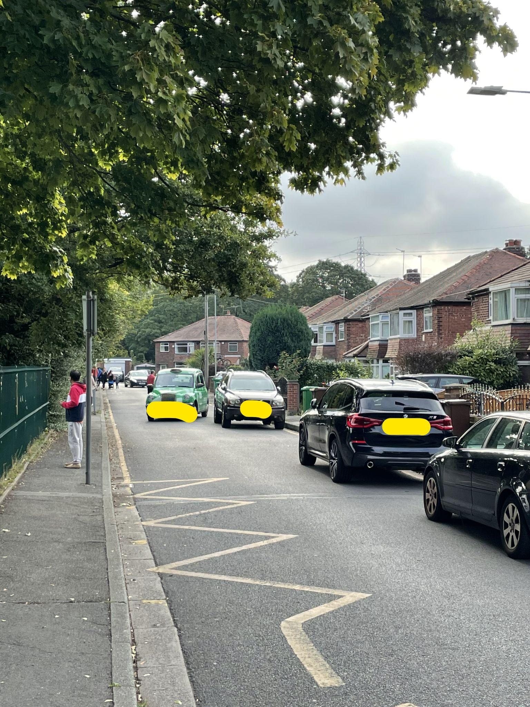
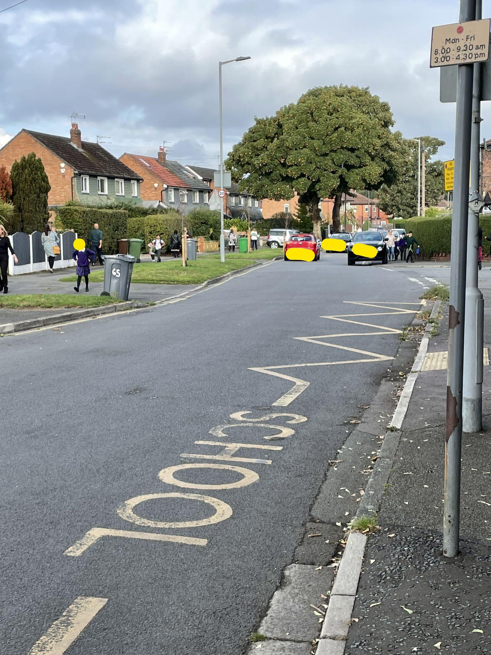
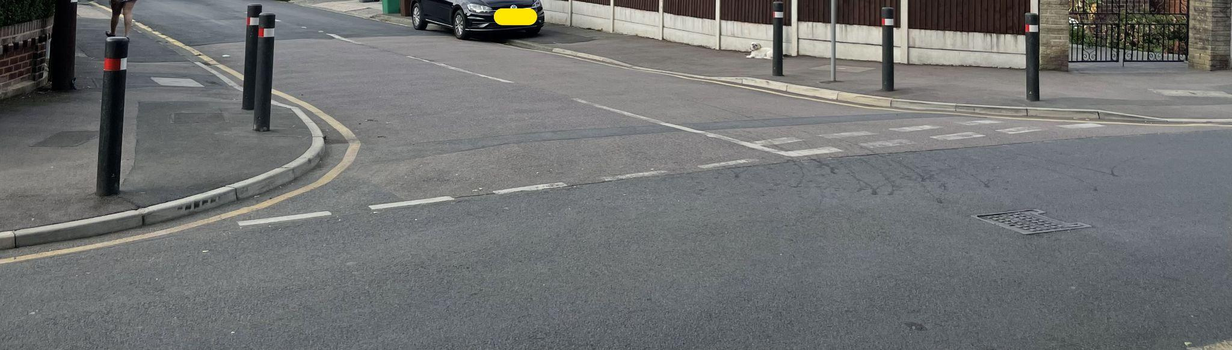
Respecting our local community
Parking
If driving to drop off and collect your child please do not park on any yellow lines. These are there to protect our pupils.
Please do not park on the corners of local streets as this makes it difficult for our pupils to safely cross the road.
Please do not park on, or pull on to local resident’s driveways.

