Slide 1

Welcome to YEAR 5
September 2026

Slide 2


Staff
Class Teachers
Mrs Harrison
Miss Bruce

Slide 3
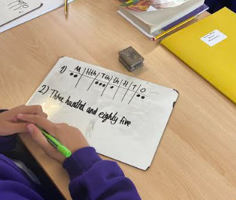
Curriculum
- Reading: 3 class guided lessons: Vocabulary/Read/Respond
- Reading plus: 2x Weekly
- Writing: taught daily
- Mathematics: taught daily
- Geography / History: taught weekly in half termly blocks
- Computing: taught once a week
- Science: taught once a week
- P.E: taught twice a week (P.E - indoor/ outdoor &Forest Crew)
- P.S.H.E / R.E: taught weekly in half termly blocks
- French: taught once a week
- Music: taught once a week
- Art & Design / D&T: taught weekly in half termly blocks

Slide 4
Curriculum focus for Autumn 1 2026
Mathematics Tenths Addition and subtraction Fractions Money Negative numbers Multiplication (partitioning) Division | Writing Instructions Non-chronological report Biography | Guided Reading If A Natural History of Magical Beasts Walter Tull | Geography What is Life like in the Alps?
Science Materials – mixtures and separation | Computing Search Engines | Art & Design Sculpture and 3D interactive installations | P.E Gymnastics Rugby
Music Composition: The Egyptians | R.E. Why Do Some People Think God Exists? | French Numbers La Date | SPELLING AND HANDWRITING

Slide 5
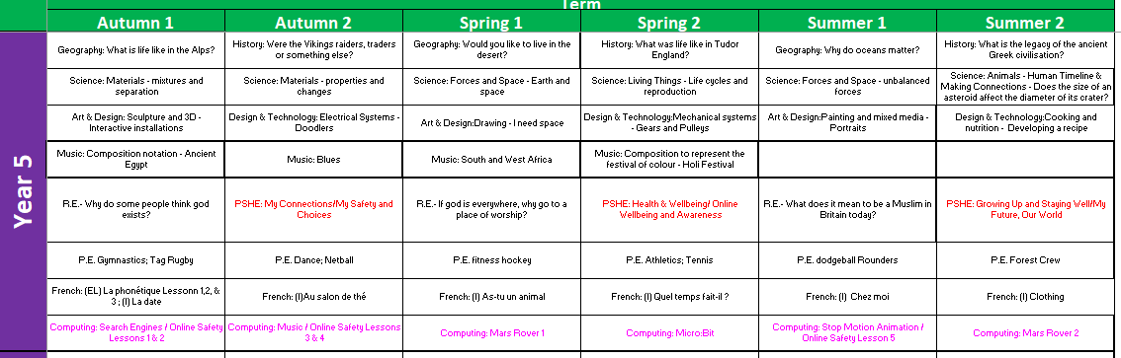
Curriculum focus for Year 5

Slide 6


Homework expectations
Weekly homework for KS2 will be:
Spellings (paper copy sent home weekly)
Reading Plus (3 tasks)
Reading books with signed reading records (5 per week to earn a raffle ticket)
TTRS
Homework menu with an exhibition at the end of term

Slide 7
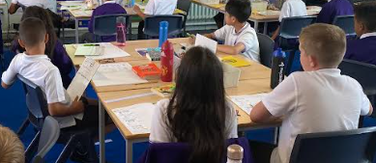
A typical day in Y5
Year 5
8.45 am come in to school and place belongings into their locker. Walk to the classroom and begin morning activity. (spelling, times tables, handwriting, comprehension task, editing, completing a previous task)
8.55 am Registration
9.00 am-9:15(arithmetic)
9.15 – 10.15 am English
10.15 – 10.30 am – break
10.30 – 11.00 am – Guided reading/ Reading Plus
11.00 – 12.00 Maths
12.00 – 1.00pm Lunch
1.00 pm – 1.55pm – Foundation
1.55pm – 2.45 – foundation
2.45 – 3.10 – Assembly
3.20pm - Hometime

Slide 8
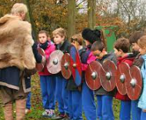
Educational Visits
Year 5
Our trip for the Autumn Term - We will be conducting fieldwork in Didsbury Village on the 23rd September linked to our Geography Topic.
Our trip in the Spring term trips will be to Jodrell Bank linked to our Earth and Space Science topic. We will also be visiting Ordsall Hall to study life in Tudor Britain.
In the Summer term, we will be visiting Crosby Beach to study a marine environment as part of our Geography unit.
Visits will be announced via letter and the new Arbour app. Payment for all educational visits will be made via parent pay.

Slide 9
Promoting and rewarding positive behaviour
The class each have their own Dojo and are awarded Dojos for following:
Being Kind
Being Safe
Ready to Learn
Golden Time is on Friday at 2:45pm – all children will be able to choose from a range of activities based in the classroom
Each Friday at Each time the children achieve 50 dojos will be rewarded a dip in the prize box.

Slide 10




Right Respecting School
UNICEF – Rights of the Child
We are working towards our Silver award and during weekly assemblies the children learn about their rights. Each class has a class charter which we have all signed up to showing our support of these rights.

Slide 11
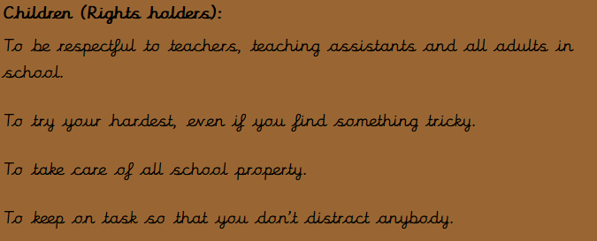
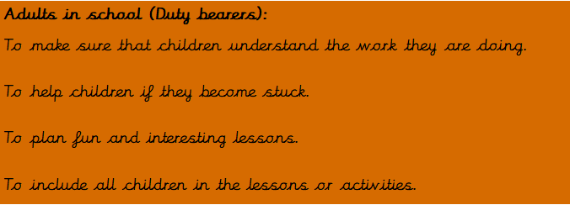
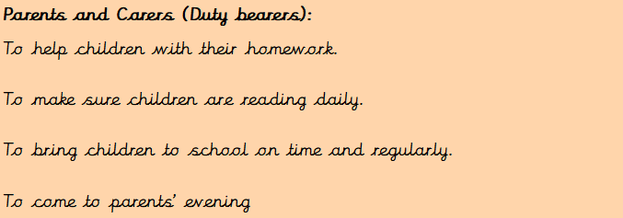
Right Respecting School

Slide 12
Houses
The children have been split into house teams. They earn house points for their house and the winning house is awarded a trophy.
The children take part in house colours for sports day.
Rowan are in Williamson – our team colour is red.
Spruce are in Pankhurst – our team colour is blue.

Slide 13
Class Assemblies
The children will take part in house assemblies. During these assemblies, the children will lead the assembly sharing their learning. Parents will be invited to attend. These start at 2.45pm for approximately 20 minutes.
Spruce – 18.11.26 - class assembly – 2.45pm
Rowan – 25.11.26 - class assembly – 2.45pm
14th December – Ks 2 Sing Along Concert
Rowan - 21st^{h} April – Religious festival – Sikh New Year
Spruce – 19th May – Religious Festival - Eid ul Adha
Star of the week Assemblies will take place on Thursdays at 2.45pm – children who have been awarded star of the week will receive a letter.

Slide 14

Encouraging independence and responsibility for learning.
In Year 5
Children are responsible for completing homework tasks on time.
Children are responsible for looking after their pencil cases and replenishing the contents
Children responsible for keeping belongings safe inside their locker.
Children are responsible for reading their book at home and logging pages read in their reading record.
Children are responsible for knowing P.E days and arriving at school in the appropriate clothing.
Children are responsible for communicating to staff if they have forgotten a packed lunch or do not have lunch plans for a given day.

Slide 15

Core Values

Slide 16
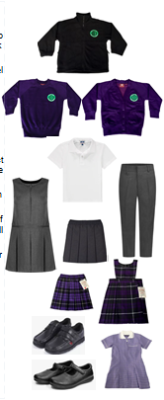
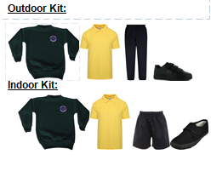

School uniform
Purple sweatshirt / cardigan
White polo shirt
Grey trousers
Purple tartan skirt or pinafore dress
Black shoes
P.E. kit:
Yellow polo shirt
Black shorts
Black pumps
Please label all items clearly with your child’s name. ‘Stick-on’ name labels can be purchased from a number of suppliers.

Slide 17
P.E Days
Rowan
Monday –outdoor (Rugby)
Wednesday – indoor (Gymnastics)
Spruce
Monday – Outdoor (Rugby)
Tuesday – indoor (Gymnastics)

Slide 18



Appropriate clothing for the weather
Waterproof coat with a hood
Hat, scarf, gloves for cold weather
Please apply sunscreen before school during hot weather
Earrings to be removed for PE lessons. If your child is unable to do this independently, please remove them before coming to school.
Long hair must be tied back for outdoor activities and all P.E. lessons

Slide 19
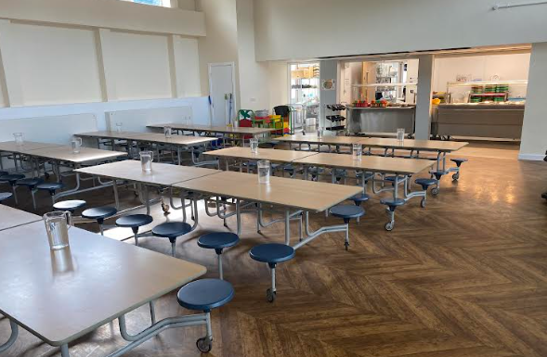
Lunchtimes
School Meals: School Grid is the online
system used to pre-order and pay for
school meals (free for children from
Reception to Year 2).
Please contact the admin team if you have any difficulties with logging in to the system
Healthy Lunchboxes:If you choose to provide a packed lunch from home please see our Healthy Eating Policy following the link on the slide below.
Timings and supervision:
Lunchtime for the Nursery and Reception 11.45am-12.45pm
Lunchtime for Year 1-6 is 12.00pm-1.00pm
Children are supervised by our team of lunchtime organisers, teaching assistants and a member of the SLT each day. We also have two sports coaches helping to organise team games during the lunchtime period.

Slide 20

Lunchtimes: Healthy lunchbox
Packed lunches should include:
At least one portion of fruit or one portion of vegetables every day e.g. Apples, grapes, carrots
A sandwich, wrap or tortilla containing meat, cheese, fish or other source of non-dairy protein e.g. houmous and falafel.
Other items could include pasta, rice, couscous, noodles, potatoes or other type of cereals.
Dairy food such as milk, cheese, yoghurt, fromage frais every day.
Only water (still), fruit juice, milk, yoghurt or milk drinks and smoothies.
Packed lunches should avoid:
Snacks such as crisps
Confectionery, such as chocolate bars, chocolate-coated biscuits and sweets.
Meat products such as sausage rolls, individual pies, sausages / chipolatas should be included only occasionally.
Drinks with added sugar or sweeteners and fizzy drinks.

Slide 21
Snacks
Water is available at all times - please provide a named water bottle for your child each day
Children in Years 3-6 can bring in their own healthy snack to eat at playtime.
The Broad Oak Food and Drink policy and the Broad Oak packed lunch policy are available to view here

Slide 22
Allergy Policy September 2026
New allergy policy on the school website September 2026
Minimization of risk:
no nuts allowed in school (of any kind)
no food products to be shared without parental consent
anaphylaxis kits are now available in school
parents will be informed of all allergic reactions or “near misses”
Parents must inform school of any known allergies or allergic reactions regarding their child
All staff have received training on allergies and emergency procedures for anaphylaxis

Slide 23
Beginning and End of Day Routines
External gates are opened at 8.35am and locked at 8.50am.
The school day begins at 8.45am
If late, always report to the main school office.
At the end of the school day the main gate is opened at 3.15pm for collection of pupils in Y1-6 at 3.20pm
If anyone else is collecting your child please make sure the class teacher is made aware- please phone the school office in an emergency.
Siblings must be 16 or over to collect children.
Children that have not been collected by 3.30pm will be taken to After School Club at a cost of £9.75 per pupil.

Slide 24
Attendance and Punctuality
Please ensure that your child attends school every day and on time.
If child is genuinely ill please inform school as soon as possible on 0161 445 6577.
Medicines in school- must be prescribed by a doctor / signed consent from parents
Leave during term time will not be authorised and could result in a fine of £80 per parent per child.
Please make sure your child is in class by 8.55am to receive their mark in the register.

Slide 25
Special Educational Needs and Disability (SEND)
Inclusion is at the heart of our philosophy at Broad Oak
We endeavor to meet the needs of all children at all ages and stages of development with kindness, dignity and respect
We ask parents to show sensitivity and kindness towards other children with barriers to learning, and to their parents
If you have any concerns about your child:
  Speak to the class teacher first
  Make an appointment to see the SENDCO (Ms. Child)
  Email: sendco@broadoak.Manchester.sch.uk

Slide 26
Parent pay
The school is ‘cashless’. All payments for educational visits, school lunches, before and after school clubs must be made via Parent Pay. All parents/ carers will be issued with login details. If you are having difficulty accessing it, please contact the school office who will be happy to help.
School lunches- menu choices are available to view up to half a term in advance. Please ensure that choices for that school day are made before the start of the school day.

Slide 27
Out of school care
Breakfast Club is run by school staff each morning in the old Nursery building from 7.45am-8.55am
Sessions must be booked in advance - full details can be found on the school website
After School Club is also run by school staff from 3.20pm-6.00pm (same location as above)
Please contact the school admin team for an application form

Slide 28
Working together in partnership
Arbour is our school app for online communication between home and school
The school website will be used for homework and class announcements.
Members of SLT (Senior leadership Team) will be on gate duty each day if you have any questions or concerns.
If you have any urgent messages for school during the school day, please telephone the school office on 0161 445 6577.
At Broad Oak we believe that reading is the key to success in all areas of the school curriculum. Please make sure that your child reads at home for at least 10 minutes each day
Please make sure that your child arrives at school on time each day, ready to learn.

Slide 29
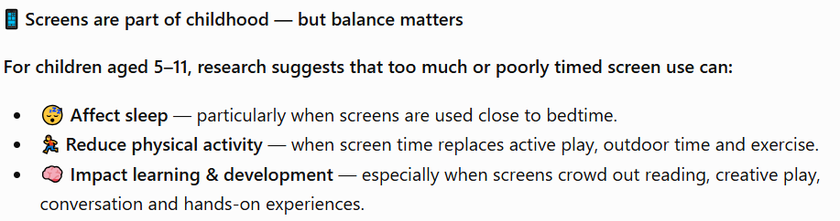
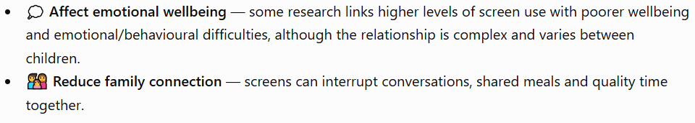

Screen Time — Finding the Right Balance

Slide 30
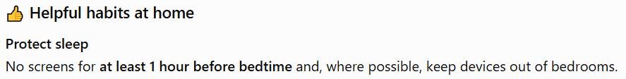

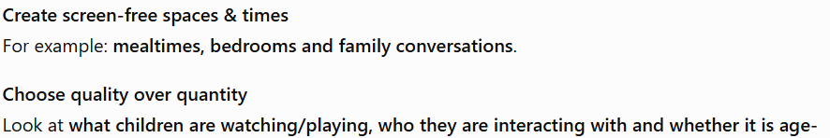
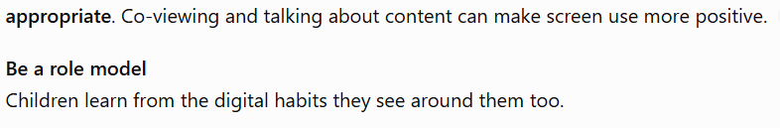
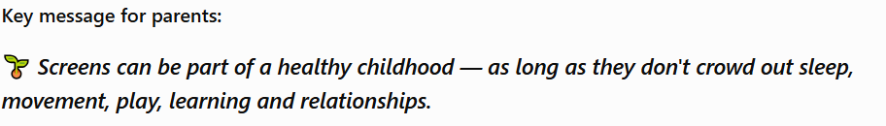

Slide 31
Further online safety support:
Primary Parents Autumn workshop
14th December 7.30-8.30pm
The workshop is dedicated to helping parents understand the risks their children face in their online lives and the practical things parents can do to help. Webinar Registration - Zoom
Smoothwall Online Safety Hub
The Online Safety Hub is available to support families’ knowledge and understanding of digital safeguarding! The Online Safety Hub is a brand-new online resource with lots of expert advice and guidance to help you manage children's safety online. It includes information on the latest hot topics when it comes to keeping children safe, such as how to manage screen time, understand the latest gaming platforms, what they mean for children’s safety and lots more.
You can access it for free here:
online safety hub
The Qustodio Parent App
Qustodio is a world-leading online safety tool that helps parents manage and supervise their child's online activities.
Our partnership with Qustodio offers parents free access to the Qustodio parent app.
The Qustodio Parent App enables parents to manage screen time, monitor online activity, and access expert advice on online safety.

Slide 32
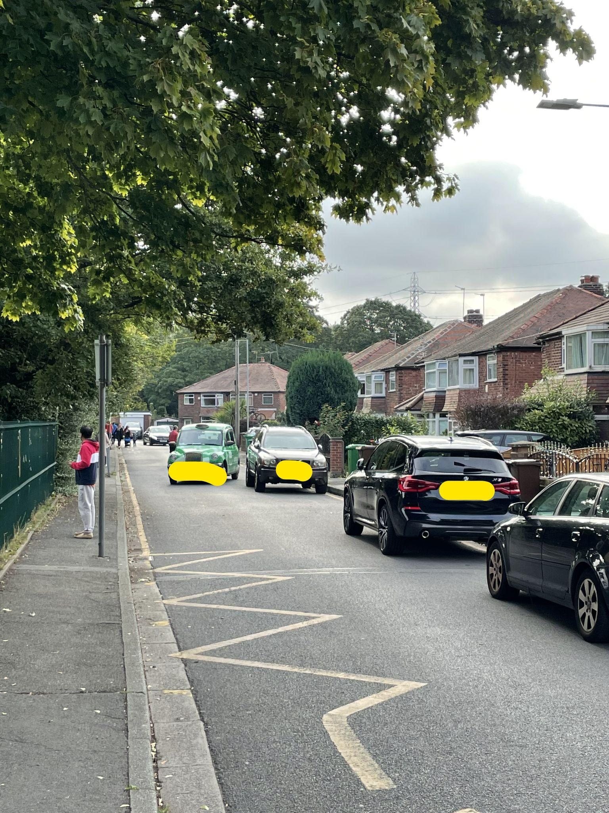
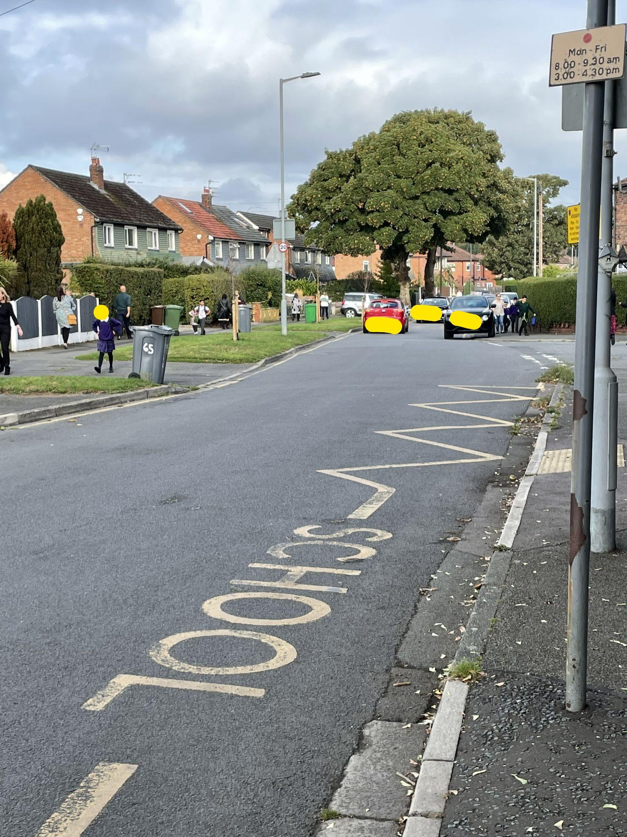
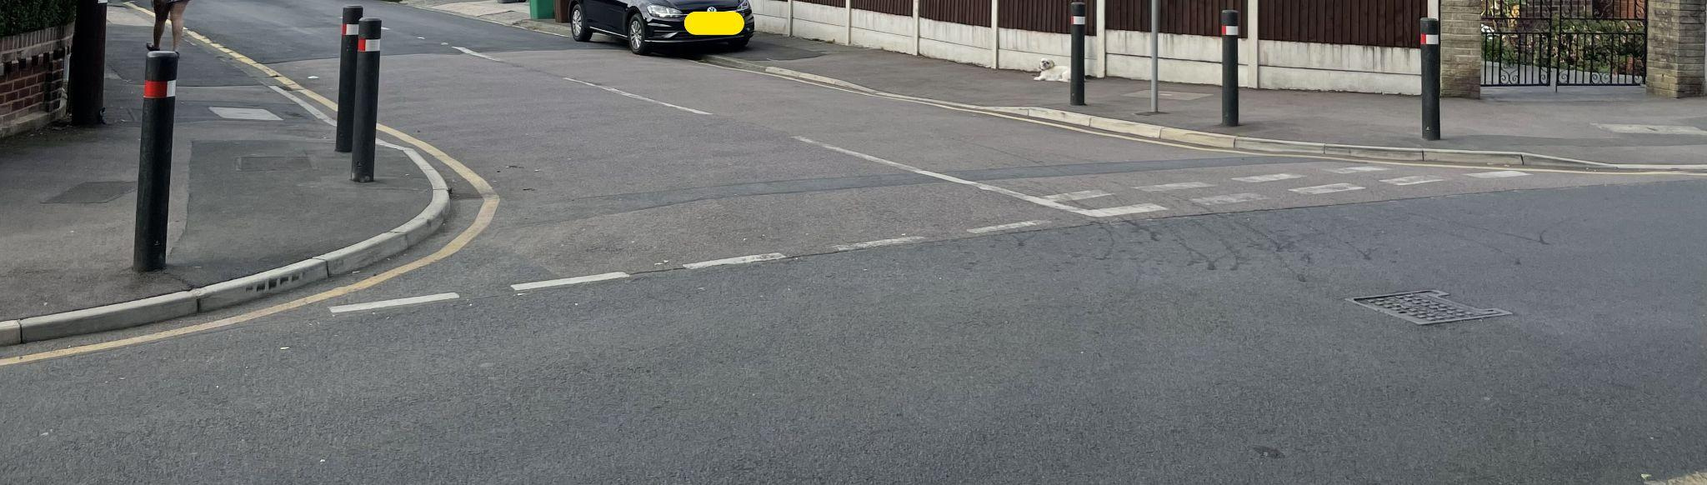
Respecting our local community
Parking
If driving to drop off and collect your child please do not park on any yellow lines. These are there to protect our pupils.
Please do not park on the corners of local streets as this makes it difficult for our pupils to safely cross the road.
Please do not park on, or pull on to local resident’s driveways.

