Slide 1
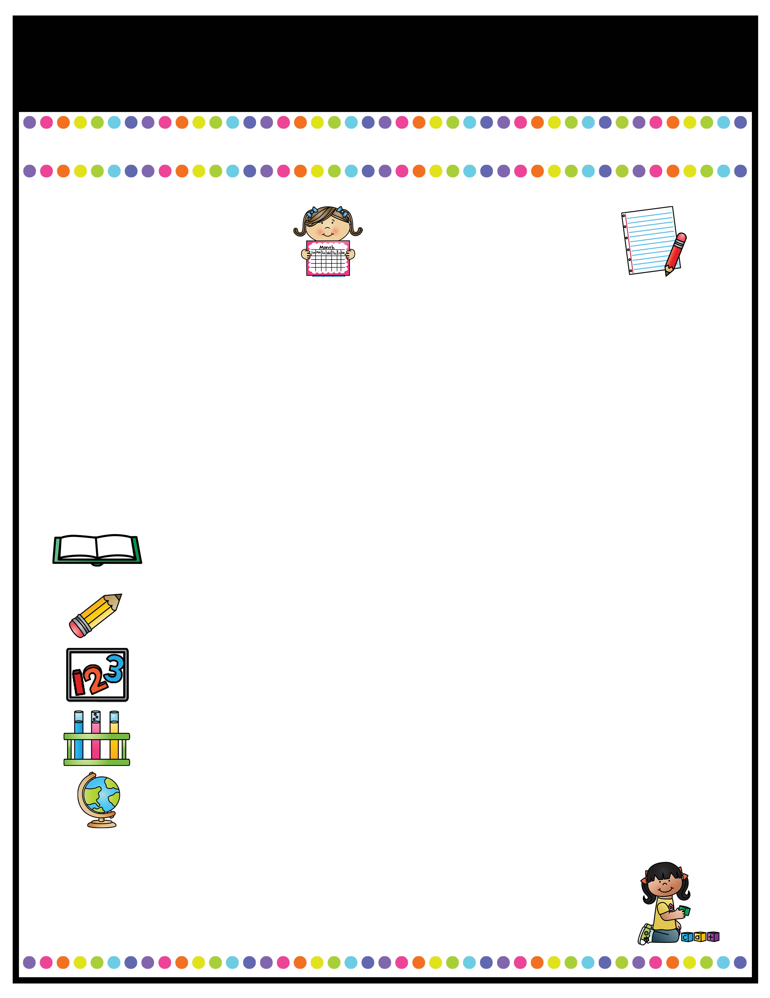
Our Classroom News
Ruby Class – Summer Term Two!
A note from the
teachers
Important Information
Welcome back to Ruby Class! I hope you have all had a lovely half term and are all ready for the excitement of the final summer term! In Ruby class, we are very lucky to have Mrs Stanaway, Miss Tellwright, Mrs Hodgkinson and Mrs Pritchard to help and support us on a daily basis!
Miss Pate ☺
P.E days will be continue to be on Tuesdays for the full afternoon this term.. Please remember to bring labelled PE kit in a labelled bag to be kept in school. Please ensure it is not too bulky as it must be stored in the lockers.
Forest School lessons will take place every week on a Thursday afternoon for this term. Please come to school in uniform with appropriate spare clothes to change into.
Reading books will be checked weekly; children must be reading at home at least 4 times a week. If a child is consistently not reading, parents will be contacted.
Homework: Homework will continue to be on SATS companion. Emails with spellings and tasks set each week will be sent out on Friday afternoons. This will only be for Year 5s this term.
A Peek At What We Are Learning
Reading
Writing
Maths
Science
Foundation Studies
This half term, our reading focus will be on the script for our Year 5/6 performance – children will be using this time to learn their lines and songs for the play.
In English, we will be writing a non-chronological report about Yellow Spotted Lizards based on ‘Holes’ by Louis Sachar.
In Maths, we will be working in year groups, Year 5s will be continuing to work on geometry: including shape and measure. Year 6s will be beginning to put in preparations for Enterprise Week.
In Science, we will be learning about Forces. We will be studying the concept of forces by completing many different experiments.
We will be learning about Land Use in the UK in Geography, taking part in athletics for PE lessons and we will be using our creative skills to create an African Savannah Silhouette out of various textiles.
Reading Text for the Term:
Holes by Louis Sachar
l.pate@woodcockswell.cheshire.sch.uk

