Slide 1
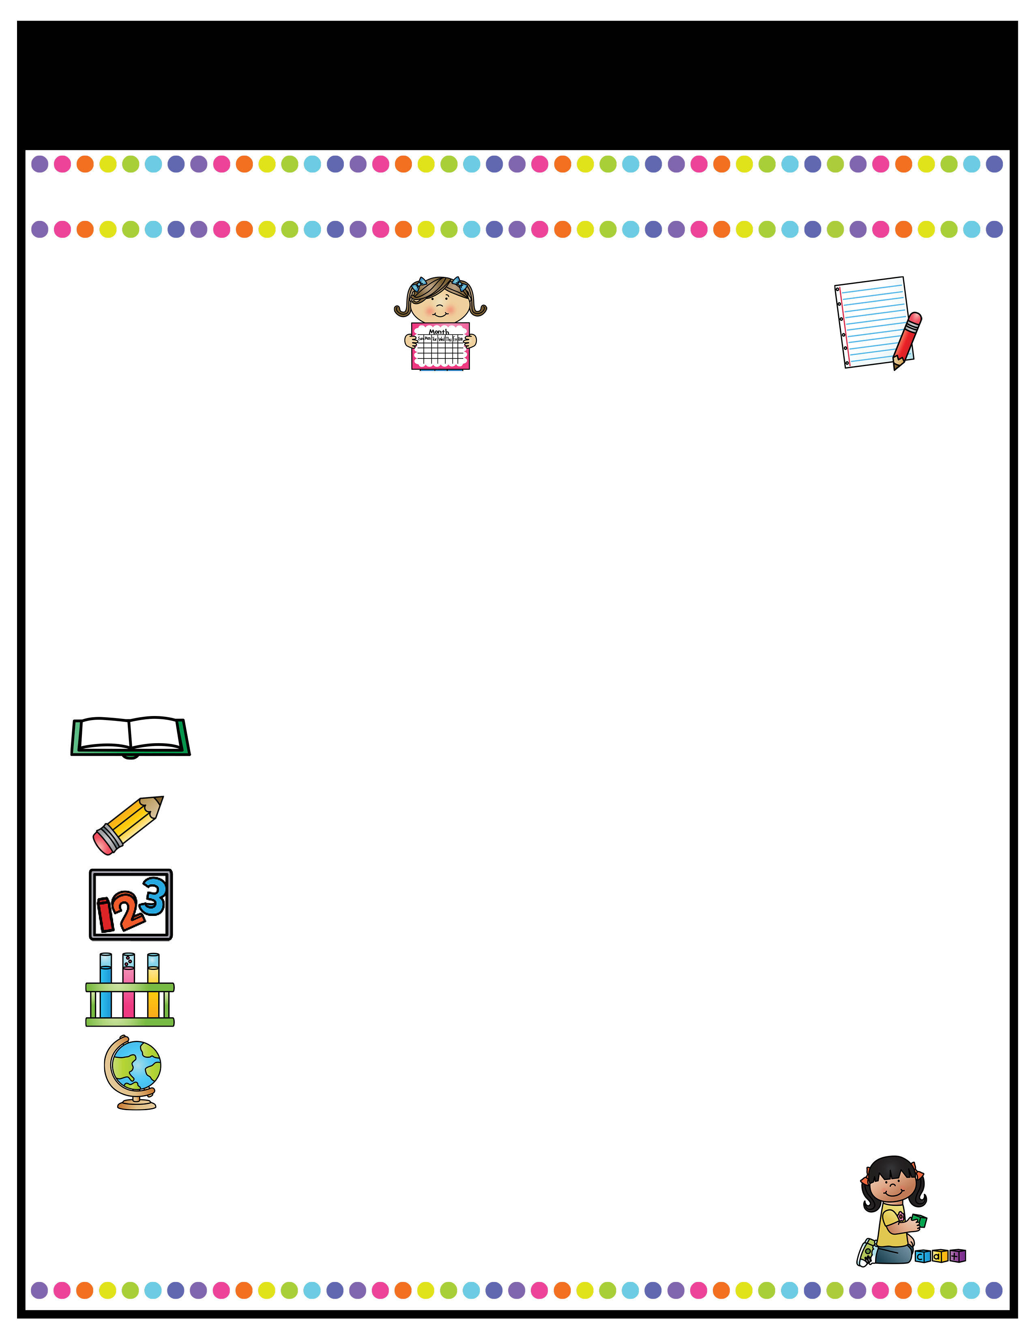
Our Classroom News
Ruby Class – Summer Term One!
A note from the
teachers
Important Information
Welcome back to Ruby Class! I hope you have all had a lovely Easter break and are all ready for our new topics in the summer term. In Ruby class, we are very lucky to have Mrs Stanaway, Miss Tellwright, Mrs Hodgkinson and Mrs Pritchard to help and support us on a daily basis! Just a reminder for Year 6s, that SATs boosters will be continuing in the this term up until SATS with myself and Mrs Beckett.
Miss Pate ☺
P.E days will be continue to be on Tuesdays for the full afternoon this term.. Please remember to bring labelled PE kit in a labelled bag to be kept in school. Please ensure it is not too bulky as it must be stored in the lockers.
Forest School lessons will take place every week on a Thursday afternoon for this term. Please come to school in uniform with appropriate spare clothes to change into.
Reading books will be checked weekly; children must be reading at home at least 4 times a week. If a child is consistently not reading, parents will be contacted.
Homework: Homework will continue to be on SATS companion. Emails with spellings and tasks set each week will be sent out on Friday afternoons.
A Peek At What We Are Learning
Reading
Writing
Maths
Science
Foundation Studies
This half term, we will be focusing on practice SATS questions in Guided Reading in preparation for Year 6 SATS. We will be reading ‘Holes’ by Louis Sachar for our English writing this term.
In English, we will be writing a letter of complaint using the subjunctive form based on ‘Holes’ by Louis Sachar.
In Maths, we will be working in year groups, Year 5s will be continuing to look at fractions and decimals, whilst Year 6 will be starting to recap previous learning on shapes and geometry.
In Science, we will be learning about Evolution and Inheritance. This will follow on from our learning about life cycles of humans from Autumn 1.
We will be learning about Travel and Tourism over the years in History, taking part in Cricket for PE lessons and we will be using our creative skills to create a wooden house for the Forest School in D&T.
Reading Text for the Term:
Holes by Louis Sachar
l.pate@woodcockswell.cheshire.sch.uk

