Slide 1
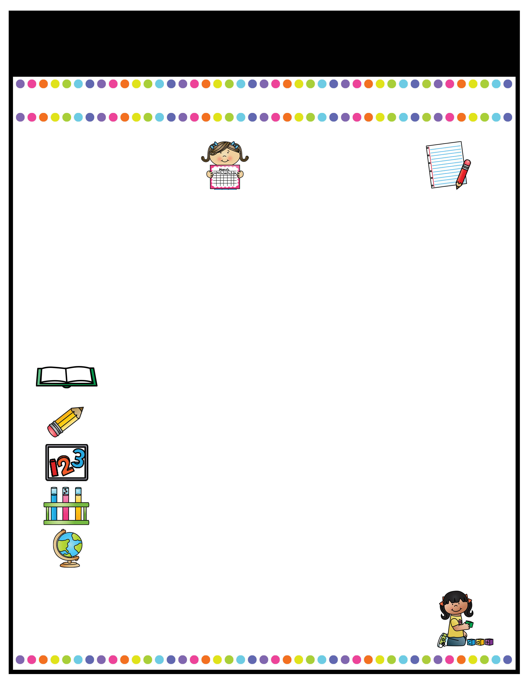
Our Classroom News
Ruby Class – Spring Term Two!
A note from the
teachers
Important Information
Welcome back to Ruby Class! I hope you have all had a lovely break and are all ready for our new topics in the spring 2 term. In Ruby class, we are very lucky to have Mrs Stanaway, Miss Tellwright, Mrs Hodgkinson and Mrs Pritchard to help and support us on a daily basis! Just a reminder for Year 6s, that SATs boosters will be continuing in the this term with myself and Mrs Beckett.
Miss Pate ☺
P.E days will be continue to be on Tuesdays for the full afternoon this term.. Please remember to bring labelled PE kit in a labelled bag to be kept in school. Please ensure it is not too bulky as it must be stored in the lockers.
Forest School lessons will take place every week on a Wednesday afternoon for this term. Please come to school in uniform with appropriate spare clothes to change into.
Reading books will be checked weekly; children must be reading at home at least 4 times a week. If a child is consistently not reading, parents will be contacted.
Homework: Homework will continue to be on SATS companion. Emails with spellings and tasks set each week will be sent out on Friday afternoons.
Please ensure your child is coming to school in a coat as the weather is still cold and they will asked to wear their coat for break and lunchtimes..
A Peek At What We Are Learning
Reading
Writing
Maths
Science
Foundation Studies
This half term, we will continuing to read the book ‘Impossible Creatures’ as our guided reading text.
In English, we will be continuing our narrative writing of Hansel and Gretel Twisted tale, however we will be adding direct speech to advance the action in the climax of the story.
In Maths, we will be working in year group, Year 5s will be continuing to look at fractions and decimals, whilst Year 6 will be starting to look at ratio and algebra.
In Science, we will be learning about Light. This will be done in our Forest School afternoon as there will be plenty of experiments to carry out.
We will be learning about the Mountains in Geography, taking part in Tennis and Badminton for PE lessons and we will be using our creative skills to replicate art work using paint.
Reading Text for the Term:
Impossible Creatures by Katherine Rundell
l.pate@woodcockswell.cheshire.sch.uk

