Slide 1
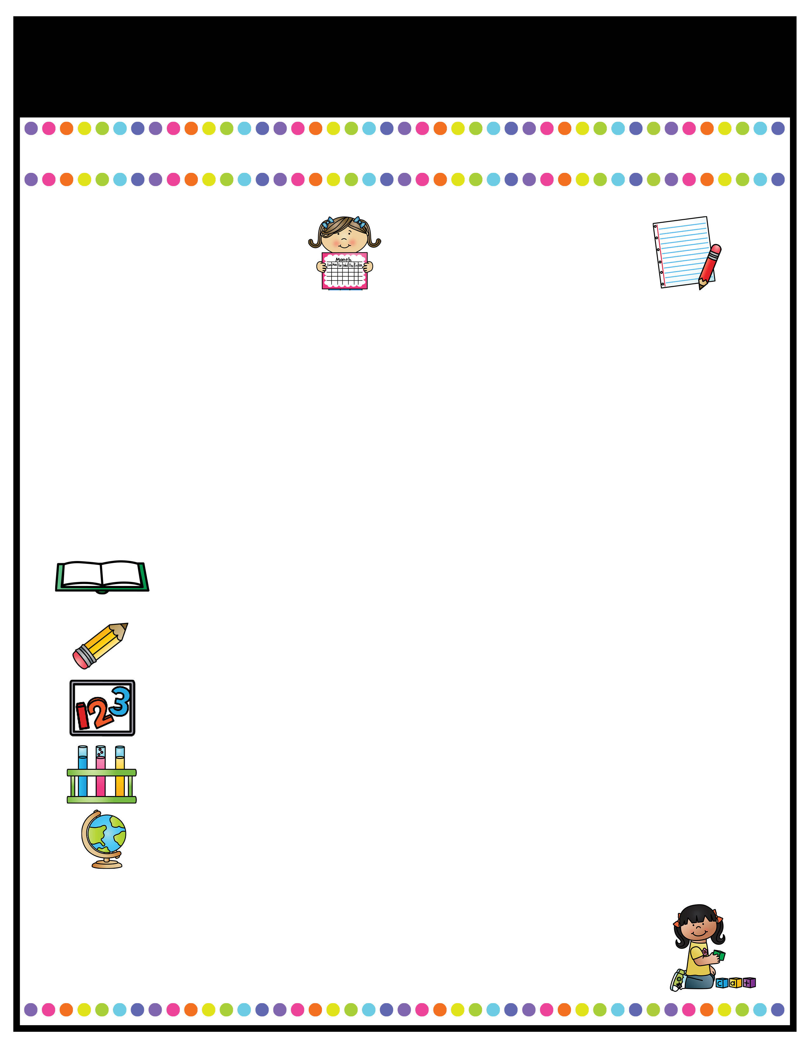
Our Classroom News
Ruby Class – Spring Term One!
A note from the
teachers
Important Information
Welcome back to Ruby Class! I hope you have all had a lovely Christmas and a very happy new year. I am really looking forward to the new year as we have some really exciting new topics to start this term. In Ruby class, we are very lucky to have Mrs Stanaway, Miss Tellwright, Mrs Hodgkinson and Mrs Pritchard to help and support us on a daily basis! Just a reminder for Year 6s, that SATs boosters will be continuing in the new year, with myself and Mrs Beckett.
Miss Pate ☺
P.E days will be continue to be on Tuesdays for the full afternoon this term.. Please remember to bring labelled PE kit in a labelled bag to be kept in school. Please ensure it is not too bulky as it must be stored in the lockers.
Forest School lessons will take place every week on a Wednesday afternoon for this term. Please come to school in uniform with appropriate spare clothes to change into.
Reading books will be checked weekly; children must be reading at home at least 4 times a week. If a child is consistently not reading, parents will be contacted.
Homework: Homework will continue to be on SATS companion. It seems to be working really well – any questions please don’t hesitate to contact me
Please ensure your child is coming to school in a coat as the weather is still cold and they will asked to wear their coat for break and lunchtimes..
A Peek At What We Are Learning
Reading
Writing
Maths
Science
Foundation Studies
This half term, we will continuing to read the book ‘Impossible Creatures’ as our guided reading text.
In English, we will be developing a new Grammar skill of ‘active and passive voice’ during our writing of a twisted fairytale of ‘Hansel and Gretel’.
In Maths, we will be working in year groups with a particular focus on fractions and decimals (year 6s will be learning about percentages).
In Science, we will be learning about Earth and Space, including planets of the solar system and exploring famous astronomers.
We will be learning about the Tudors in History, taking part in Gymnastics for PE lessons and we will be using our creative skills to make Automata animals in D&T.
Reading Text for the Term:
Impossible Creatures by Katherine Rundell
l.pate@woodcockswell.cheshire.sch.uk

