Slide 1
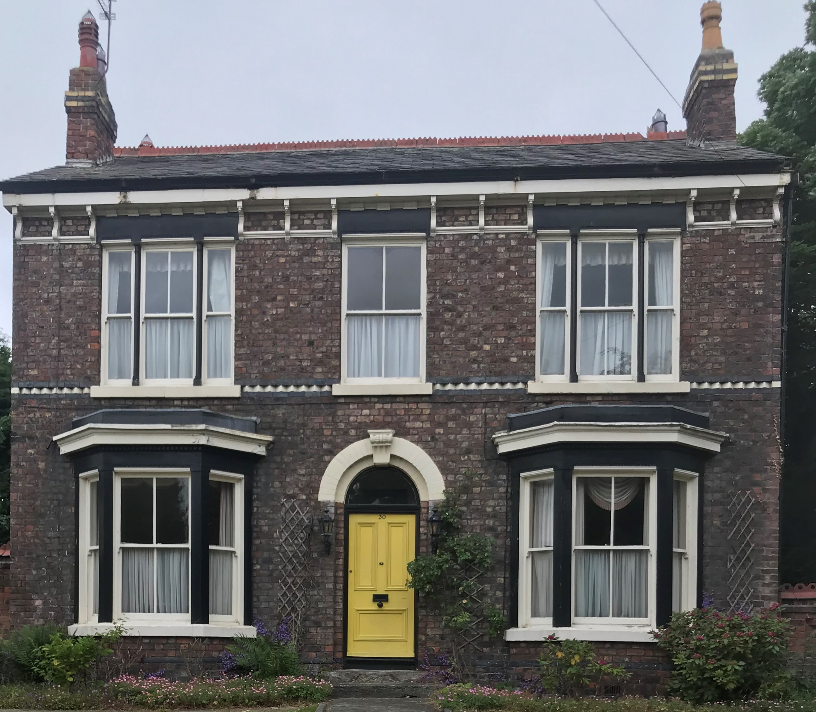
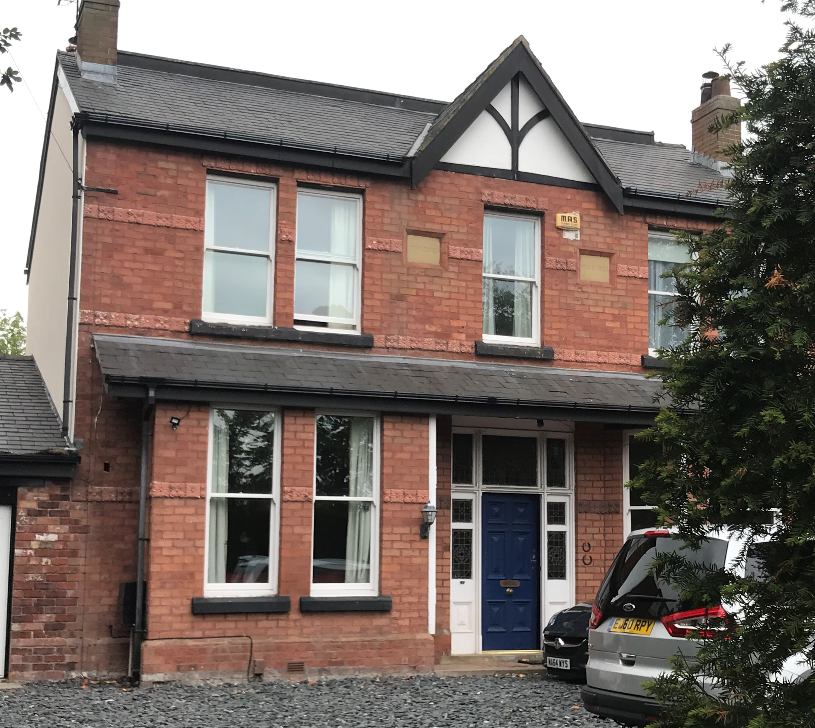
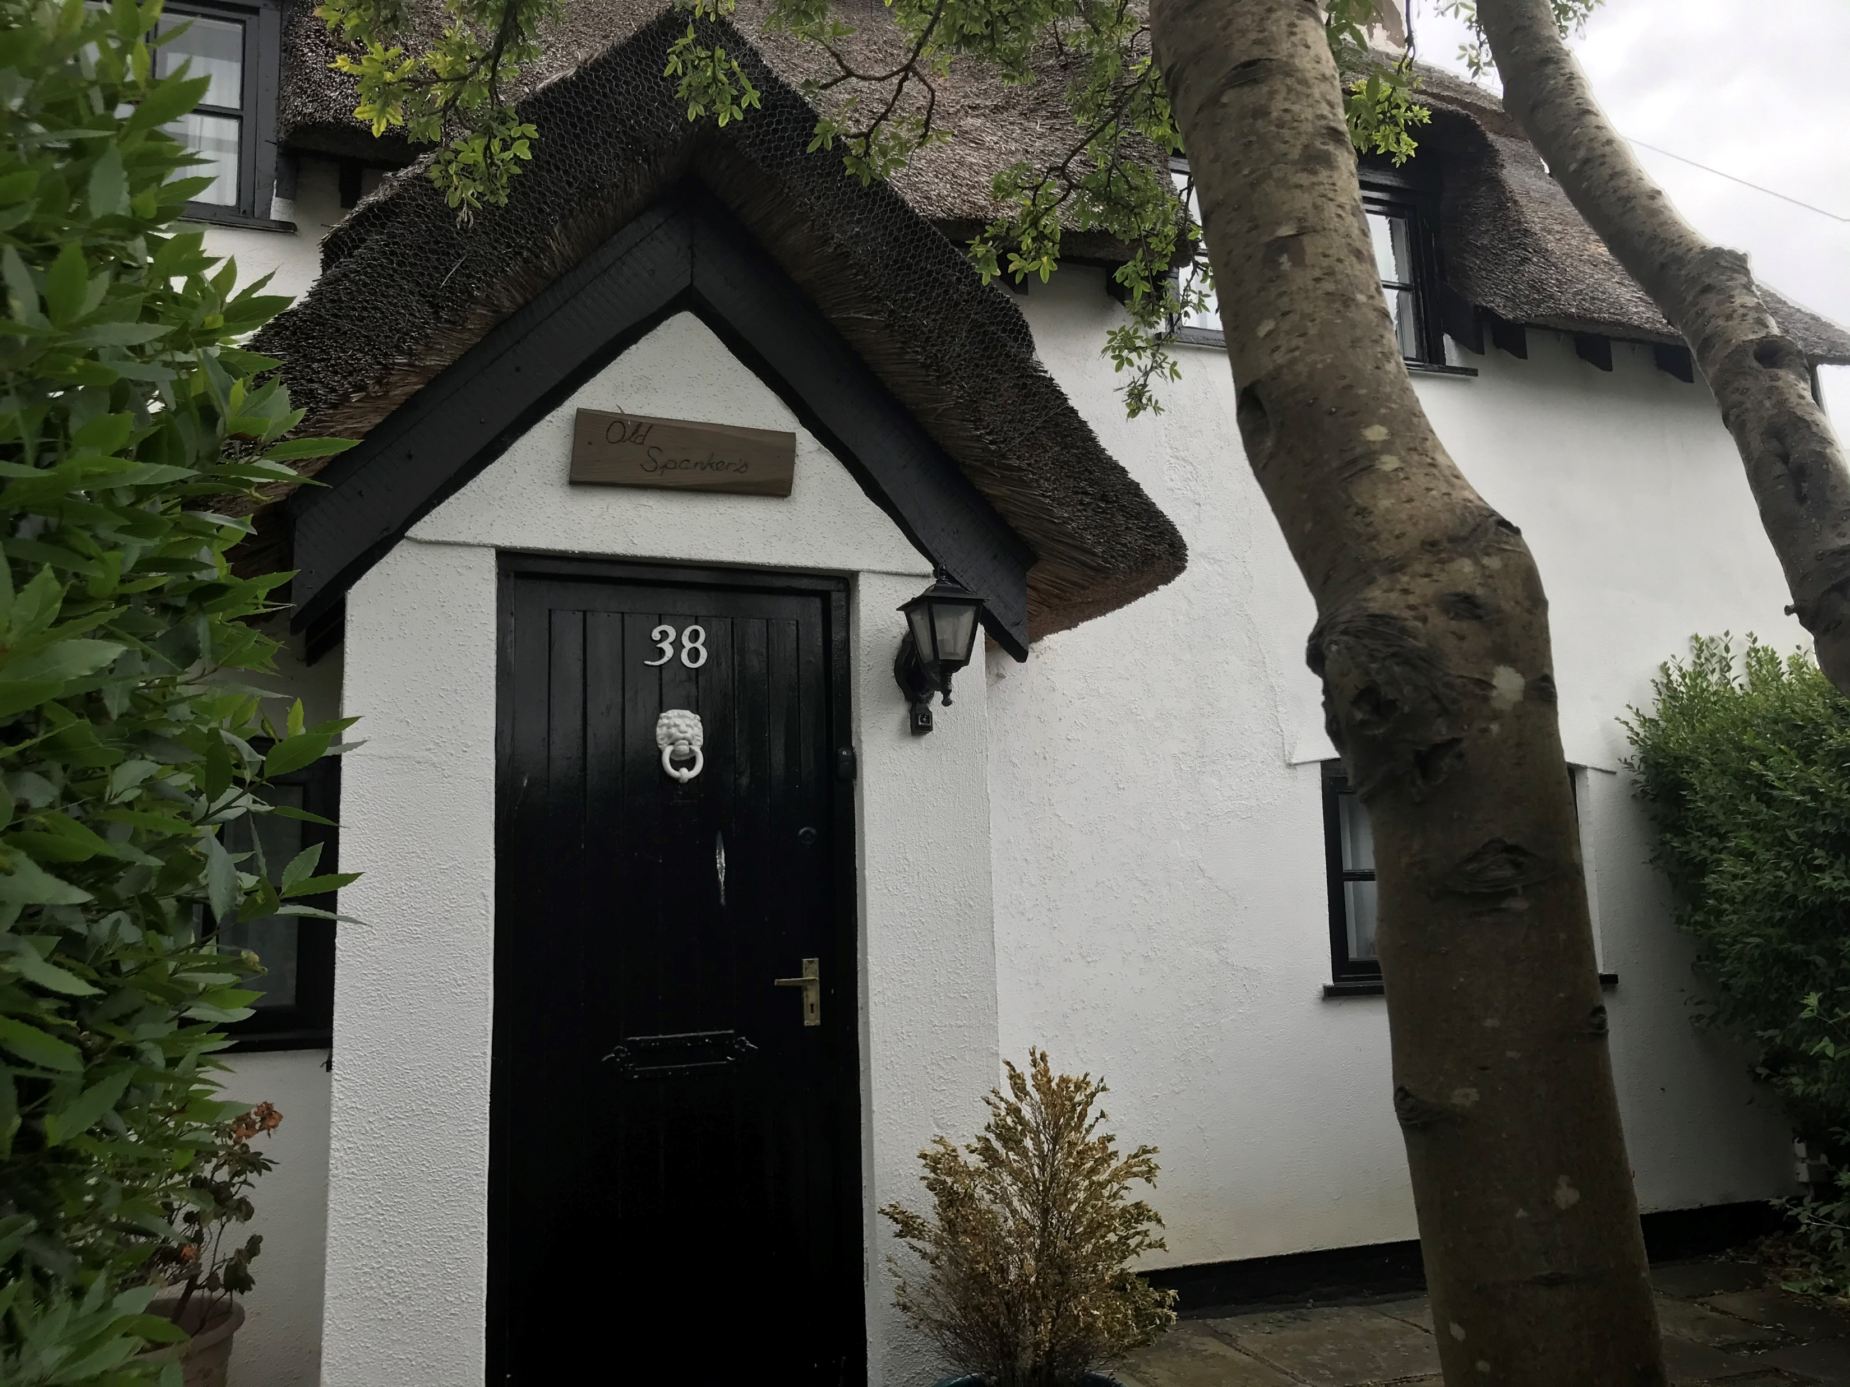
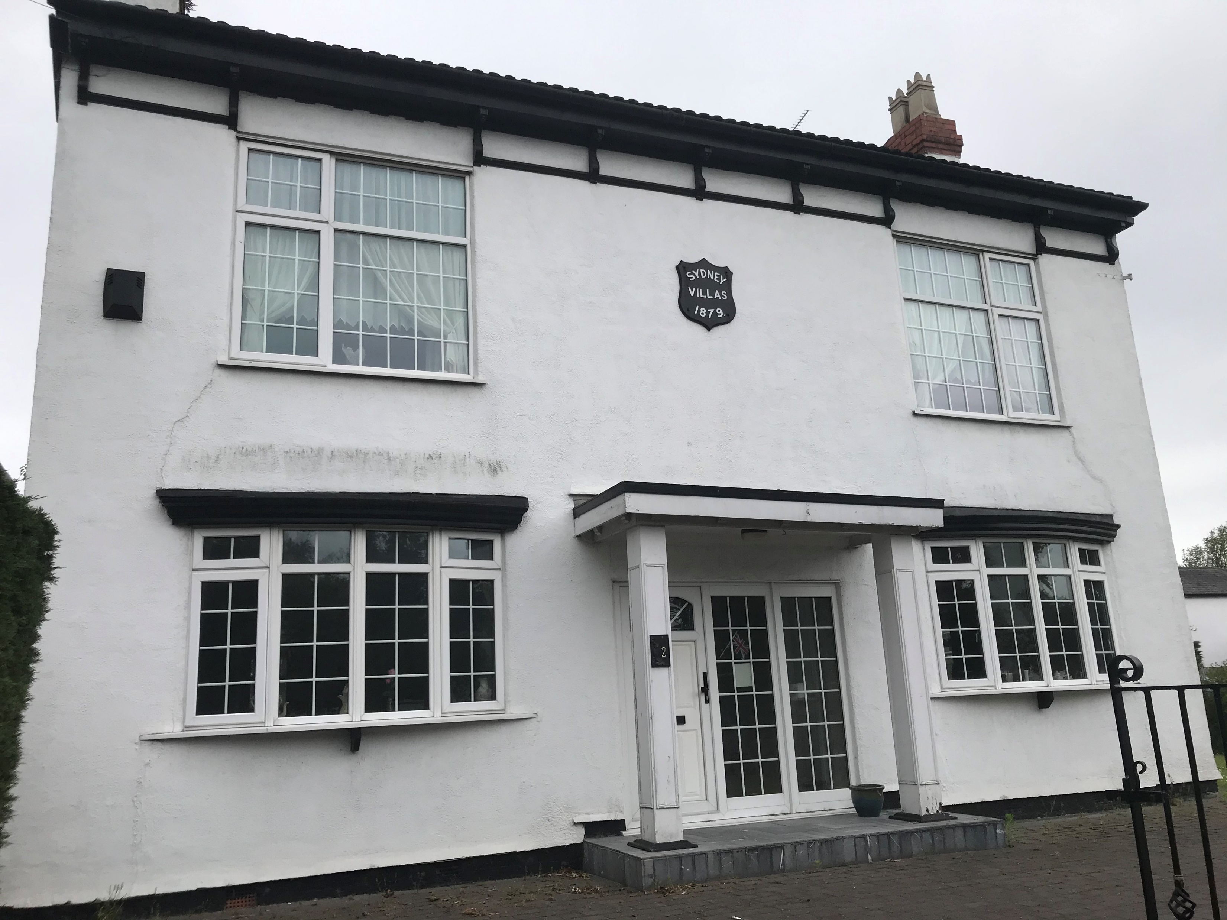
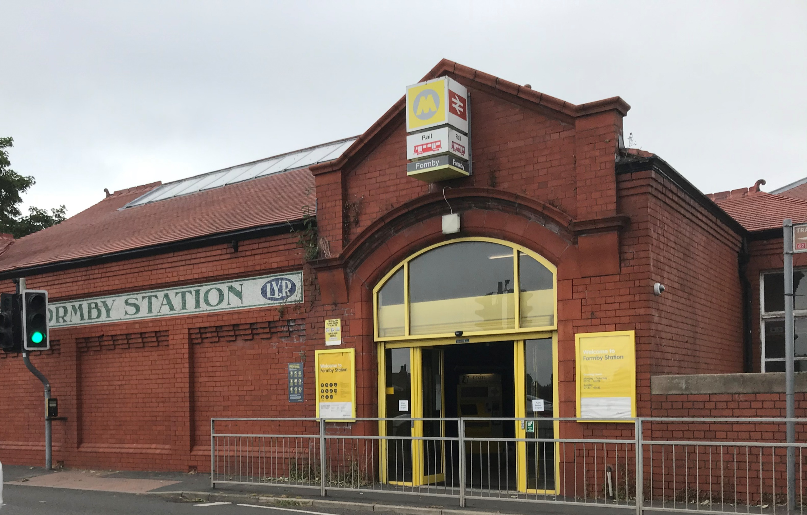
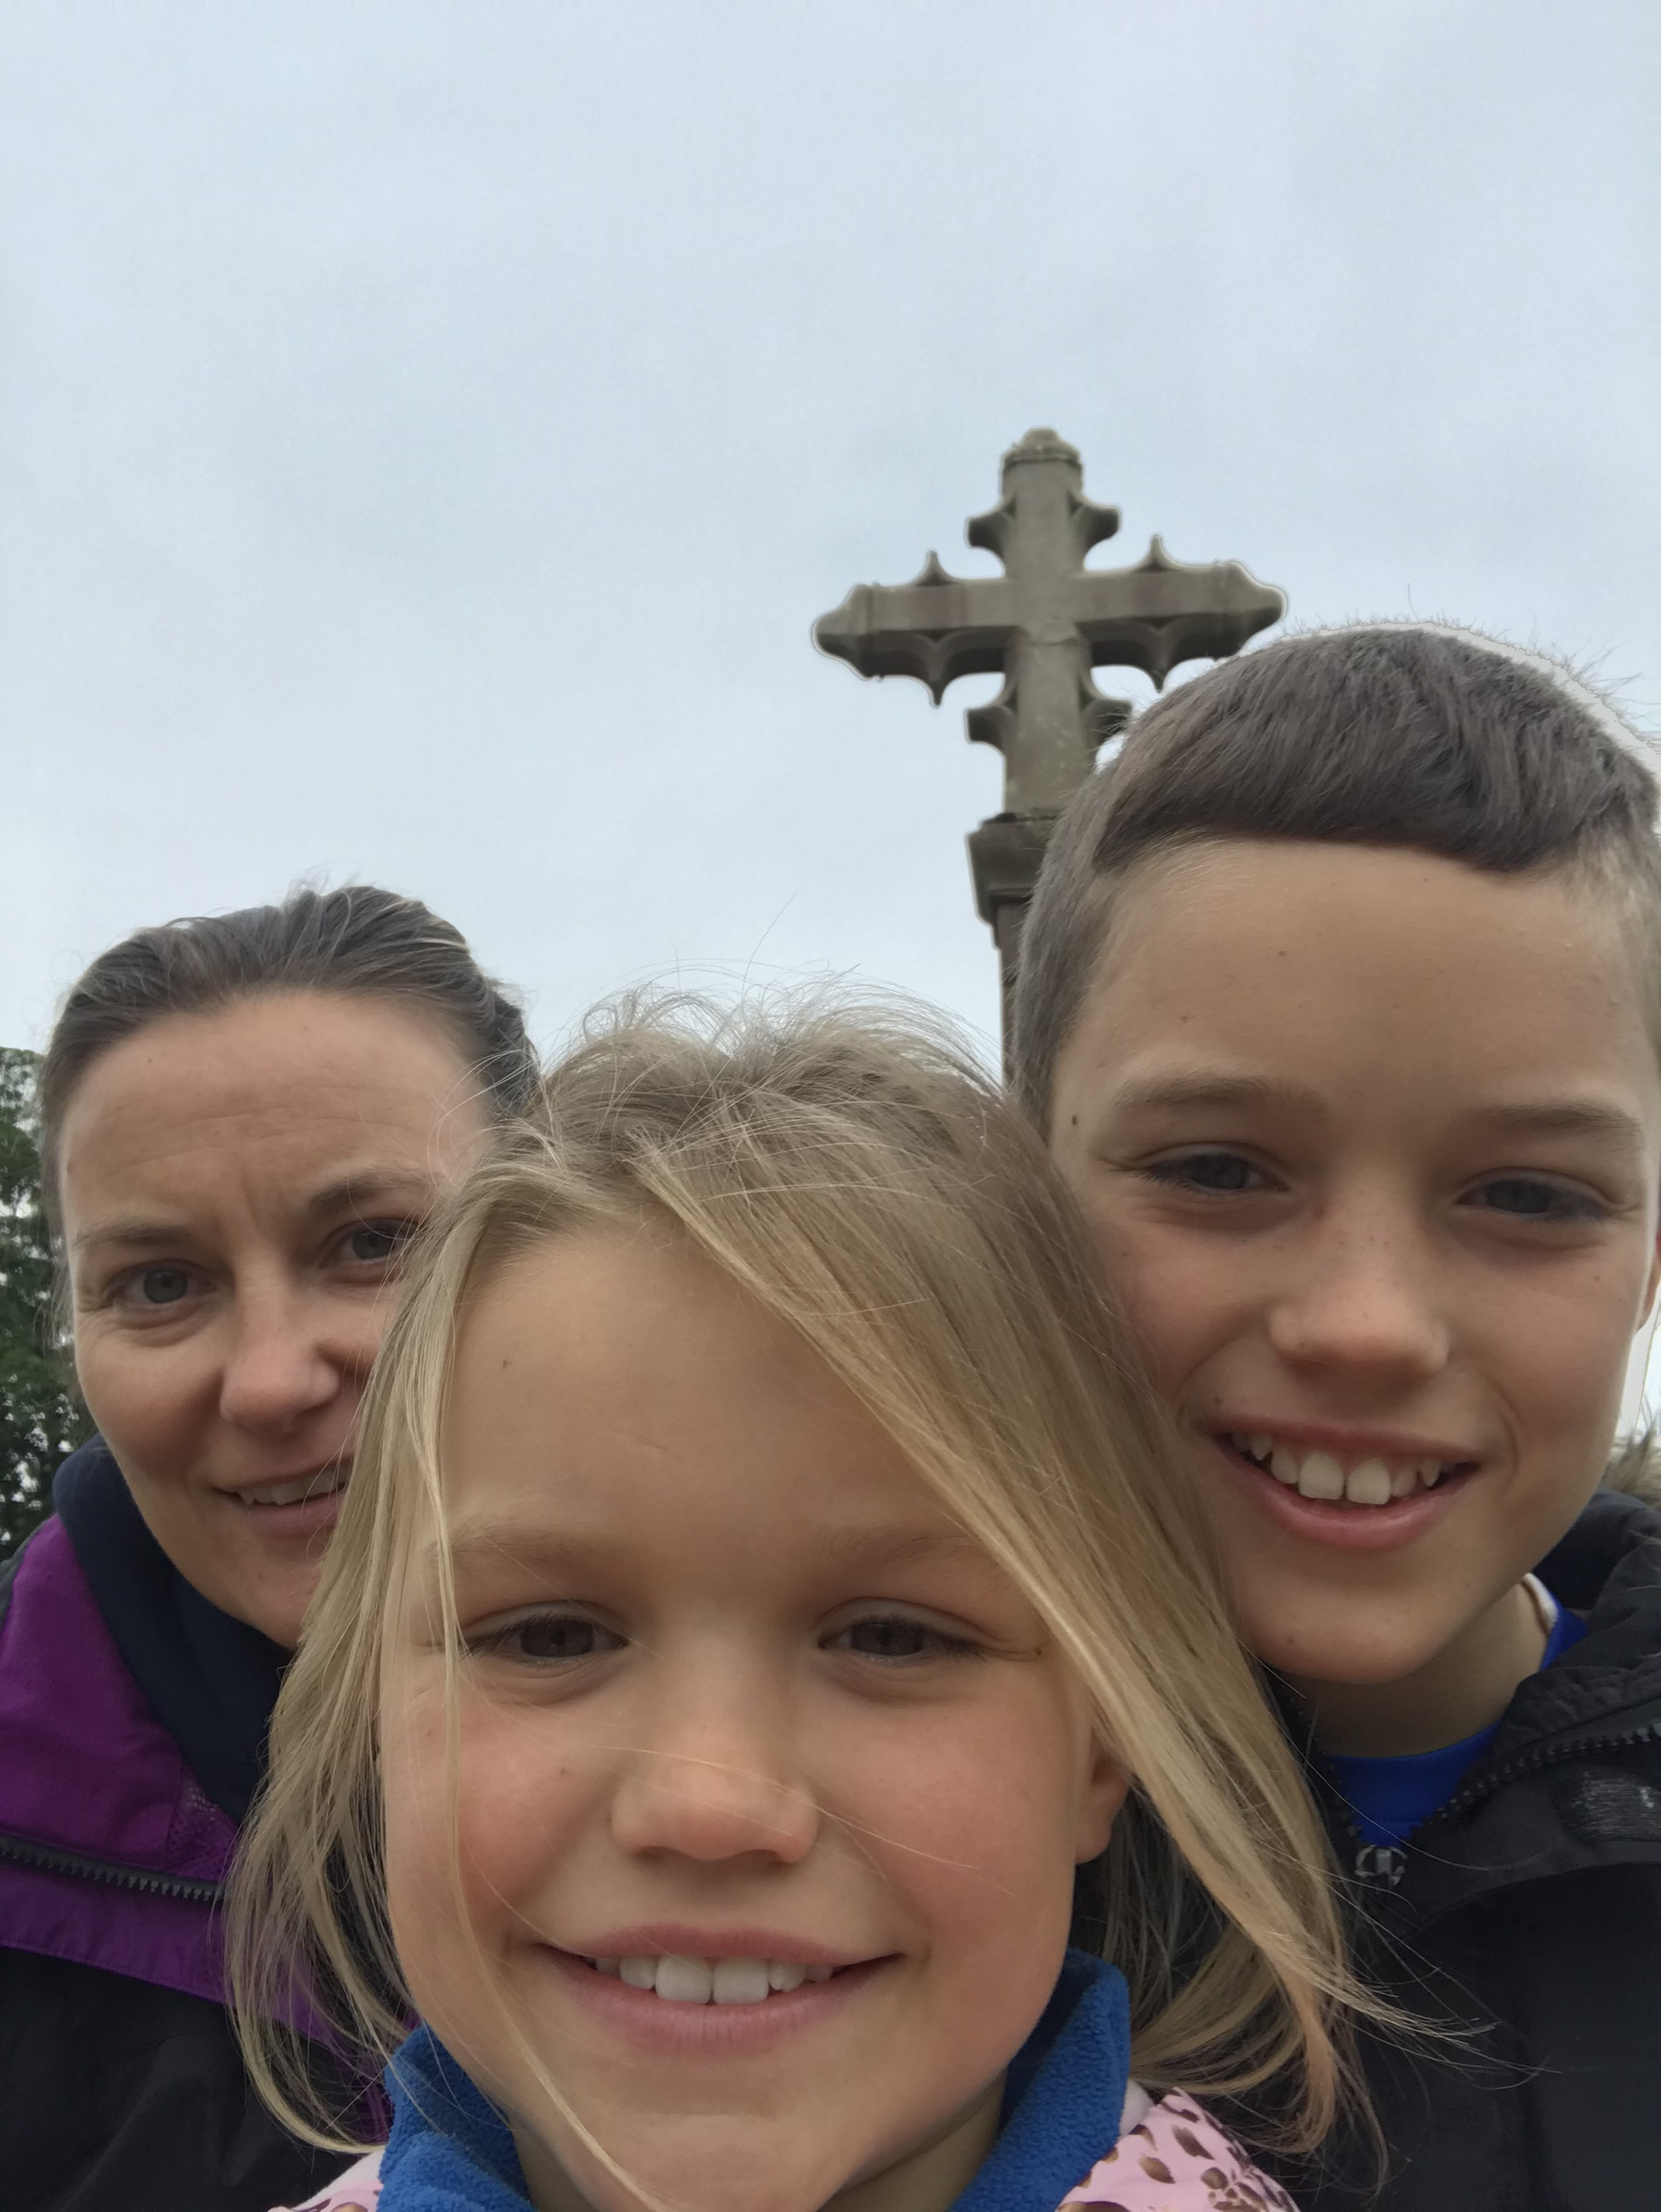
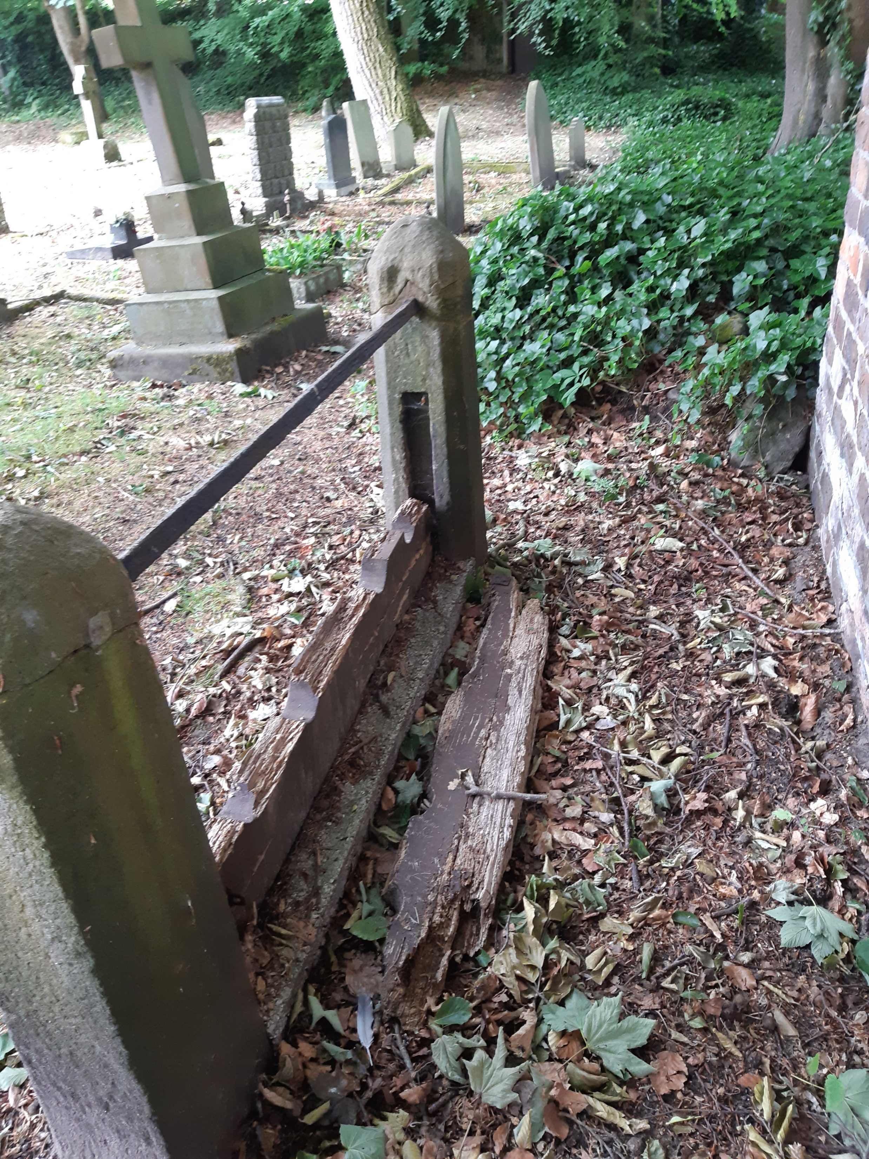
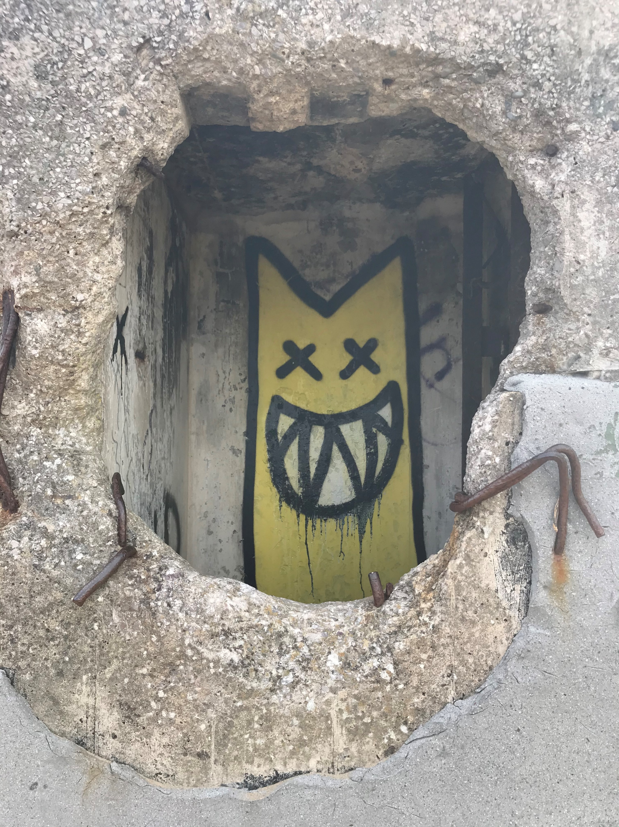
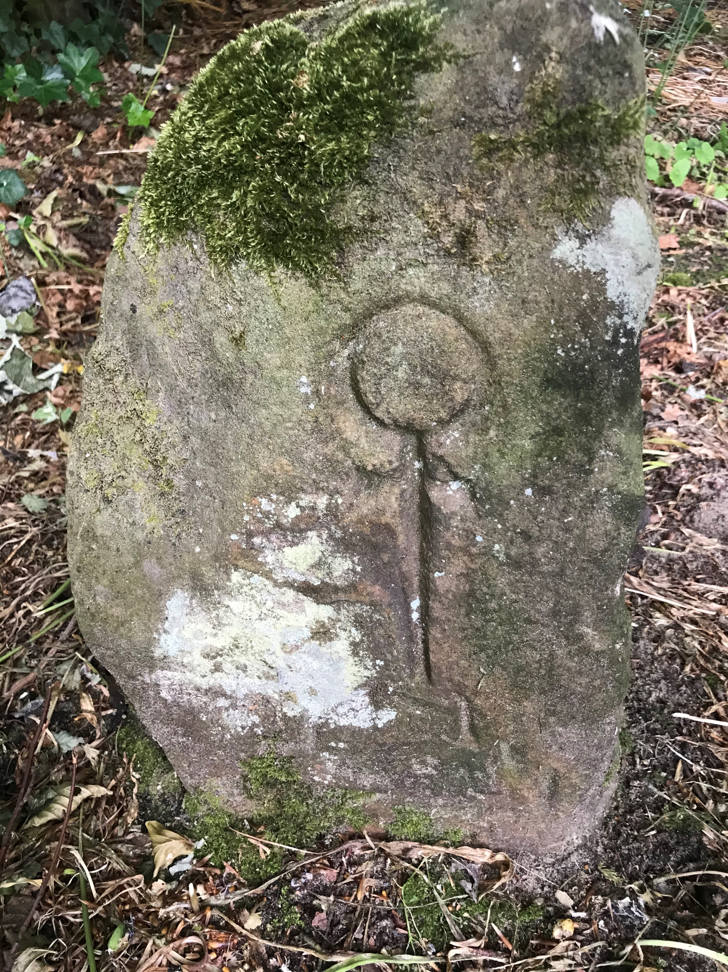
These are pictures I took while looking for old and new buildings around Formby. We started on Liverpool Road and saw some houses that were built around 1880’s, then we walked to the roundabout at the cross keys were we saw the cross which dated back to 1879! Then we walked to the train station and the man who worked there told us it opened it 1948. Then we walked to St Luke’s Church where we saw some gravestones, the oldest ones we saw were from 1700’s and there were stocks also dating back to the 18th Century! We decided to walk to the cold war bunker and Devils Hole in the sand dunes. Our exploration walk around Formby took us to lots of new and interesting places that we hadn’t seen before!
By Emilia Guy

