Slide 1


It All
Adds Up!
Teaching Maths in the Early Years

Slide 2
Aims of the session:
How to support children in their mathematical development
How maths can be supported through play and daily routines
The role of the adult, including mathematical language

Slide 3
I hate maths!
We want to develop a positive ‘can do’ attitude towards maths right from the start!
‘Children will become more deeply involved when you provide something that is new and unusual for them to explore, especially when it is linked to their interests’ (DfE, 2012)
Playful Learning
Real Life Context

Slide 4
Number sense:
A feeling for numbers
Solid Foundations

Slide 5
Number sense:
A feeling for numbers
Counting – Sequence
Cardinality – The value: ‘fiveness’ of five
Comparison – Which is more, 5 or 8?
Composition – Numbers hidden inside numbers
Notes:
Bottom two both rely on an understanding of cardinality

Slide 6
Counting
Number sequence- forwards and back
Crossing boundaries: 10 11
One number one object and keeping on track- being systematic
Understanding that the last one is ‘how many’
Purposeful counting to find ‘how many?’

Slide 7
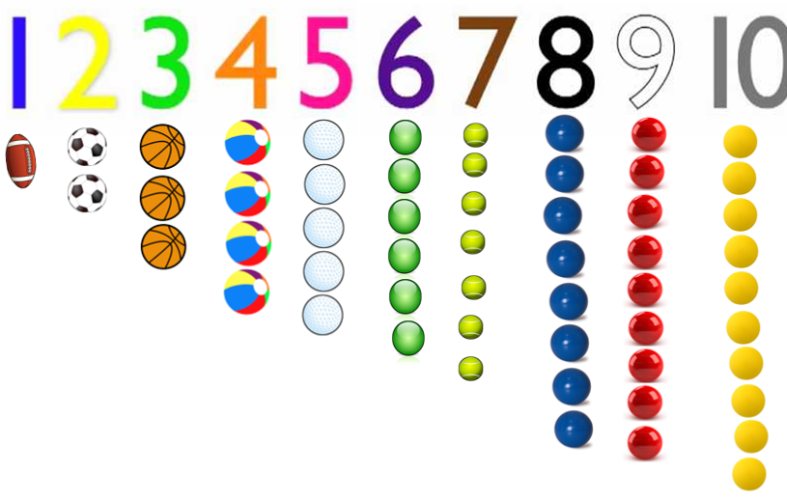
Counting
Children need to link counting with the size of numbers (which involves understanding cardinality)
8 comes before 9 because it is one less and 10 comes after 9 because it is one more

Slide 8




Cardinality: Value of Numbers
The fiveness of five
Counting out from a larger group
Understanding number symbols- Reading numbers with cardinal meanings
Securing these skills take a long time
Notes:
Bday party with teddies- susie isnt coming, one less, one less plate etc
Baking- makes 6 cakes (read number) six spaces on tin, six paper cases
Board games- four people can play (read number) count the amount of players we have

Slide 9
How to help develop
number sense:
One more- how many now?
How many more until you win?
Board games- dice represents steps
Numbers on containers for tidying up- cars, teddies
How many more do we need?
Hungry Hippos- counting for a purpose
Problem solving- sharing in role play
Routines
Games
How do we know we have got them all? Count to check
Count the ingredients for meals- represent with fingers
Add one or take one away
Competitive sports- foot ball, scores, how many more?
Money
Counting forwards and backwards
We are going in 6 days- represent with fingers
Representing amounts with fingers or numbers
Songs and Rhymes
Enjoyable conversation and shared thinking
Playfully make mistakes- too many candles on the cake
One more/One less- Two more
Model language

Slide 10
Some examples of Mathematical Language
Numbers (counting, more, less)
Shapes
(2D names, 3D names)
Mathematical Language
Time (morning, before, after, today...)
Capacity (full, half full, empty)
Length (long, short, tall, high, low, deep, shallow...)

Slide 11
Zero, none
How many?
One, two, three, four, five...
First, second, third...
Eleven, twelve, thirteen...
Number Language
More than
Twenty, thirty...hundreds
Less than
Altogether
Add, take away
One more

Slide 12
Long, longest
Short, tall
Height, depth
Deep, shallow
Heavy, heavier, heaviest
Big, small, thick, thin
Shape, Space & Measure Language
Size
High, low
Shapes
Weight
Length, width
Wide, narrow

Slide 13
Small world
Technology
Music
Exploration
Water
Cooking
Mark making & writing
Outdoors
Maths
Blocks
Construction
Malleable e.g. playdough
Books
Junk modelling and craft
Sand
Role play

