Slide 1
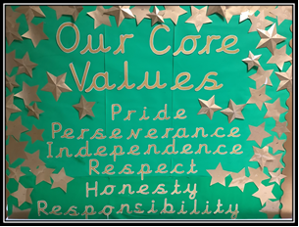



British Values
at the heart of
North Walkden
Primary School

Slide 2

British Values
Rule of Law
Democracy
Mutual Respect
Tolerance
Individual Liberty

Slide 3


Slide 4



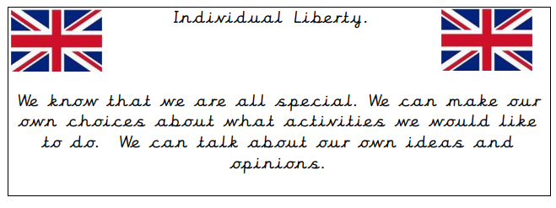
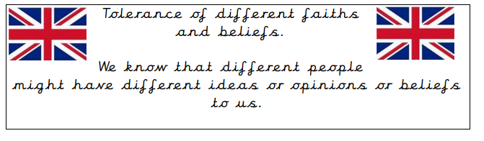
Child Speak Cards

Slide 5


Slide 6
What we do now...
What we are going to do ...
Have lunchtime buddies in the infant playground.
Court Trip-Year 5
Chosen charities to donated to based on current issues if necessary. CIN-RND-Christmas Shoe box Appeal .
Eco warriors (school council) and local community work-Litter picking
Pupil/Staff/Parents- Questionnaires completed
Learn about apartheid and Black history
Develop understanding of propaganda-WW2 Year 6
Learn about the voting system -Vote for roles & responsibilities in class
Developed a debating club- JS
Develop the roles of the Eco Council
Learn the National Anthem and more about our new Reigning King
School council members voted in from each class
Classroom monitors/Year 6 helpers
RE scheme developing understanding that people have different views on things and how this affects the world
Invested in ‘First News’, encouraging debates about current affairs
DEMOCRACY
Learn about the ‘History of the British Monarchy and our political leaders’

Slide 7


Slide 8
What we do now...
What we are going to do ...
RULE OF LAW
Behaviour and anti-bullying assemblies and policies
Our Golden Rules/School Rules are on the website and on display in every classroom (age appropriate)
We have a Rewards & Sanctions system- traffic lights in KS1+ KS2 and sun, cloud, rainy cloud in EYFS
Weekly Achievement assemblies- focus’ on team work as well as individual rewards
Road Safety assemblies take place
Bikeability, Respect, Crucial Crew-Year 6 -We hold E-Safety assemblies for children
Year 5 Road Safety workshop/vistors.
Road safety committed assembled- competition within school .
We invite the emergency services in to teach us how rules keep us safe
. Developed whole school reward display and incentive
Hold an annual e safety event for parents.
Develop links with local emergency services-invite the local police
Develop inter- school sporting tournaments with our family of schools.
Learn about the English civil and criminal law.

Slide 9



Slide 10
What we do now...
What we are going to do ...
We promote good manners in everything we do.
We have high expectations of behaviour-Good to be green displays
School core values are discussed and celebrated each week
We treat other people the way we wish to be treated.
We learn about different faiths and religions in RE. New RE scheme coverage
We learn about important festivals in other faiths in RE-Chines New Year, Diwali
We sell poppies for remembrance day.
We collect groceries and make food packages at Harvest Time/local Food Banks .
We sing at local care homes at Christmas time.
We raise funds for current national disasters, Shoebox Appeal,
Hold family workshops with different themes-KS2 workshop Theme-Christmas Celebrations around the world
LTP assemblies within KS1/KS2 to ensure RE/PSHE/BV/School Values coverage
-Stories from other cultures within our literacy lessons
Used assemblies to celebrate festivals from other faiths as well as Christianity (new assembly LTP)
French day held-whole school
Develop rights and responsibilities understanding from UNICEF (Y6) MHW assembly LKS2
We have themed lunches from around the world
Make link with other faith schools.
Develop a range of different places of worship.(LTP-RE)
Give out a School Core Values certificate each week in class.
Rights Respecting Schools
TOLERANCE & RESPECT

Slide 11
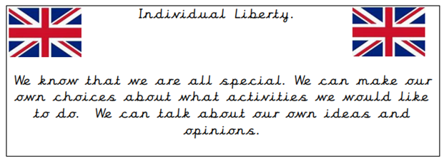

Slide 12

What we do now...
What we are going to do ...
We are confident at independent research.
Continuous provision with EYFS
We work well in pairs and groups when learning together.
Mixed ability groups and pairs for some foundation subjects
Choice of ideas for what we do in afterschool clubs
Class assemblies to celebrate and share learning
We encourage child initiated learning.
We choose our own reading books.
We have a choice of clubs we can access-pupil voice used for new club ideas.
Developed maths and budgeting skills in Key stage 2 with a mini enterprise scheme.
Pupil voice by subject leads –shared on Newsletter and school Facebook
Invested in ‘First News’ choosing what we want to read and forming an opinion about it
Invited the school governors for an open day to watch us engaged in our learning.
Coffee mornings held each half term for parents
INDIVIDUAL LEARNING/ LIBERTY
In the Summer, each KS2 class will choose a mini- topic they want to learn about in PSHE and present it in an age appropriate way.
Develop money sense/value-CLB organise bank visit
Look at how we can encourage more parents to attend coffee mornings once every half term

Slide 13
School Core Values Display
photo

Slide 14

Our School Promise
Together we will:
Never give up,
Open your mind,
Reach for the stars!
Treat each other with respect,
Help to make a difference.
Welcome everyone,
Accept the challenge,
Learn to listen; listen to learn,
Keep our school safe,
Drive our ambitions,
Encourage one another,
Never give up!

Slide 15


Slide 16
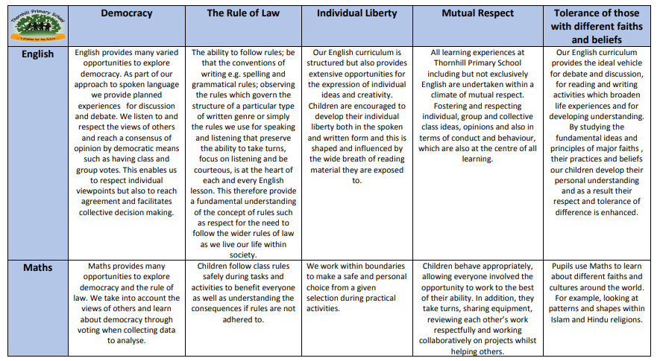
British Values:
Coverage within the Curriculum
All learning experiences at North Walkden Primary are undertaken within a climate of mutual respect.

Slide 17
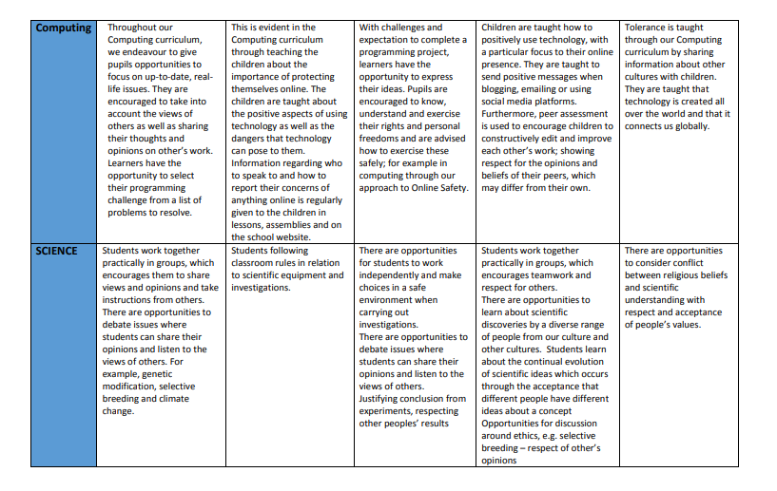

Slide 18
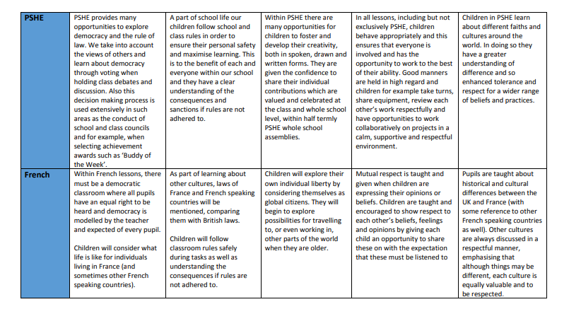

Slide 19
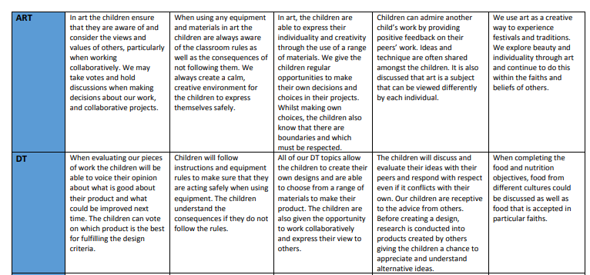

Slide 20
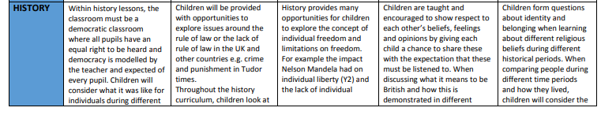
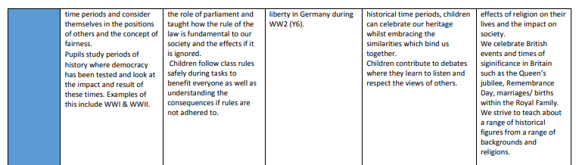

Slide 21
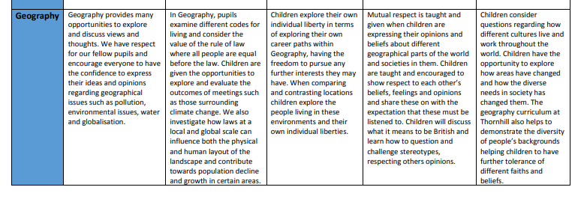
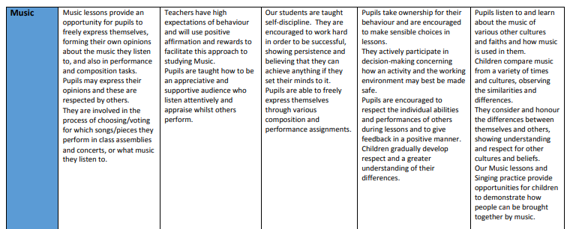

Slide 22
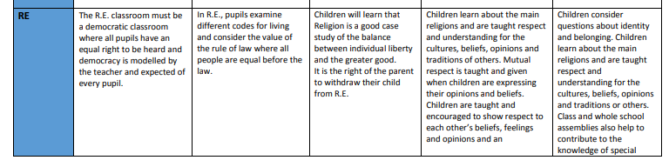

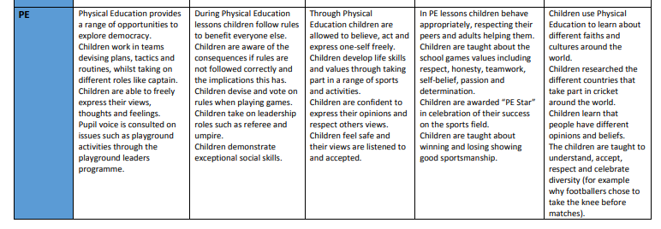

Slide 23
2023-2024
British Values
at the heart of
North Walkden
Primary School

