Slide 1
RWI Phonics Parent Meeting

Slide 2
Aims of the session:
to introduce the way we teach phonics at North Walkden Primary School.
look at our home reading system.
share strategies to support you at home with your child’s reading development.

Slide 3
What is phonics?
Phonics is a way of teaching reading. Your child will be taught two crucial things when they are learning to read using phonics:
How sounds are represented by written letters. For example, they will be taught that the letter ‘m’ represents an mmm sound.
How sounds can be blended together to make words. For example, they will be taught that the sounds of the letters ‘c-a-t’ blend together to make the word ‘cat’.

Slide 4

Why Phonics?
A systematic and structured programme for teaching phonics and reading.
Meets the demands of the National Curriculum, giving your children the best chance of success in the national tests.
One-to-one tutoring - no child is left behind.
Storybooks align with the sounds learnt in class.

Slide 5
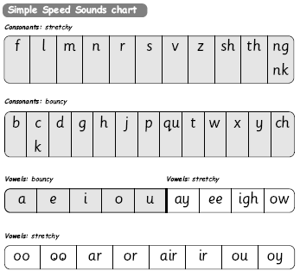
Special friends...2 letters that make 1 sound
RWI uses only pure sounds.

Slide 6
The English language is a complex code…
It would be easy if we only had to learn Set 1 and Set 2 sounds.
ay | igh
play eight cake straight | right pie kite fly
Set 3 sounds

Slide 7
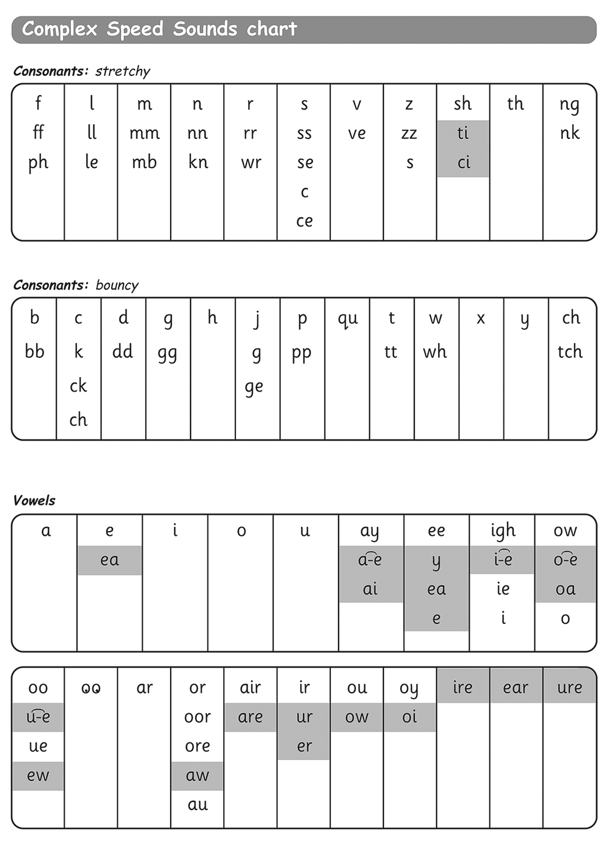
Only when set 1 and 2 are effortless!
Set 3 sounds
Splits...where’s my friend, he’s on the end!

Slide 8
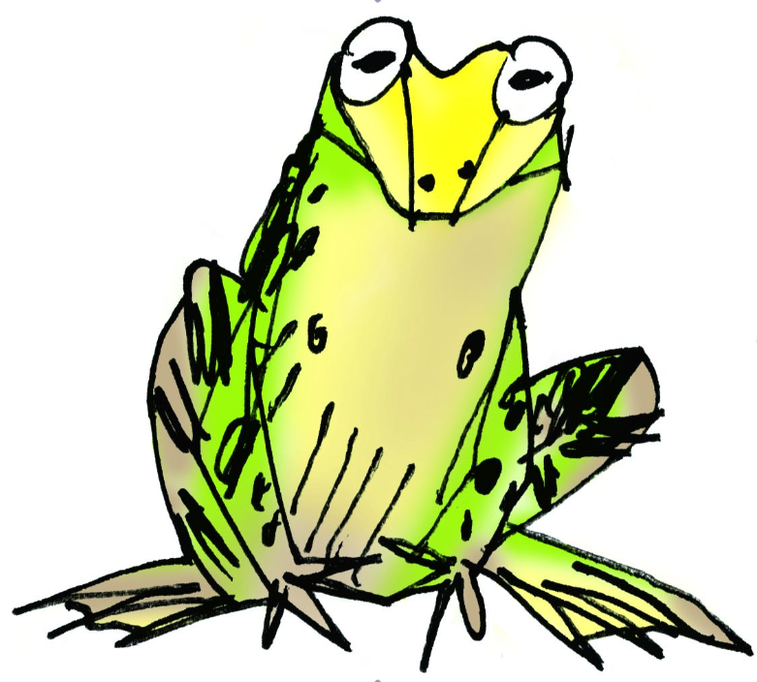
How do phonics help us read?
We use Fred to help us teach phonics.
Fred can only talk in sounds...
He says “c_a_t.” Not cat.
We call this Fred Talk.

Slide 9


Green Words & Red Words
Green words – contain all the sounds we know
Special friends
Fred talk
Say the word
Fred in your head
No Fred talk – speedy reading
Alien words!
Red words
‘You can’t Fred a red!’

Slide 10

Spelling:
Fred Fingers for spelling
Say the word and
pinch on the sounds
Write it down
c
a
t

Slide 11
We ensure that the children are seeing and practising the sounds lots throughout the day, especially those who are finding it difficult to recall them.
This will speed up the recall of Speed Sounds!
Play games
Teacher will ‘Fred Talk’ instructions for the children to follow.

Slide 12

How to help your child at home…

Slide 13
Reading at home.
Read favourite stories over and over again.
Read some stories at a higher level than they can read themselves.
We will send home a book for you to share and enjoy with your child weekly – reading for pleasure.
Listen to them reading their home reading books – this is at the same ability as the book they are reading in class. We will not hear your child read this book, but we will teach and hear your child read every day.
Change books – Wednesday only
Notes:
View the Ruth Miskin Training suggested reading lists for great books to read with your children.
http://www.ruthmiskintraining.com/teacher-support/tag-44/index.html

Slide 14
And...
Asking lots of questions!
You will find questions at the back of the book.
Use these prompts to help you:
What is that character thinking?
What do you think
happens next?
What is happening?
What do you
think that character is
feeling now?
What is the character saying?

Slide 15
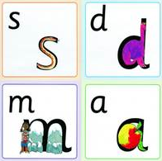
You can practise saying the sounds.
Remember to use only pure sounds, no ‘fuh’ and ‘luh’!
https://home.oxfordowl.co.uk/reading/reading-schemes-oxford-levels/read-write-inc-phonics-guide/ ( a guide to the pronunciation to pure sounds).

Slide 16
You can practise saying the sounds.
Only practise the sounds they have been learning in class.
Read some of the RWI books available for free on the oxford owl website.
https://www.oxfordowl.co.uk/for-home/find-a-book/library-page/

Slide 17
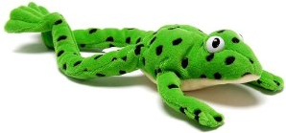
You can have fun with Fred Talk.
“What a tidy r-oo-m!”
“Where’s your c-oa-t?”
“Time for b-e-d!”

Slide 18

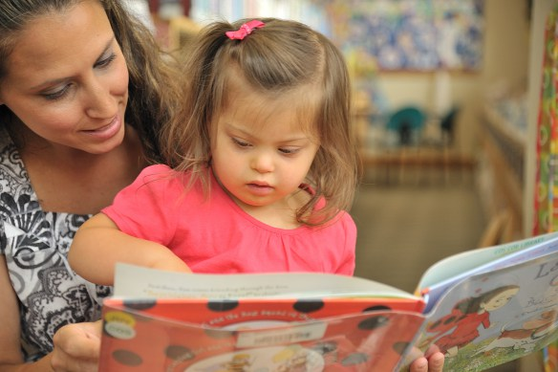
Thank you...
Questions

