Slide 1
Language of the Half-Term
Español!
(Spanish)

Slide 2
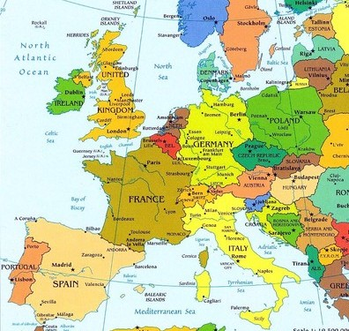
Where is Spain?

Slide 3
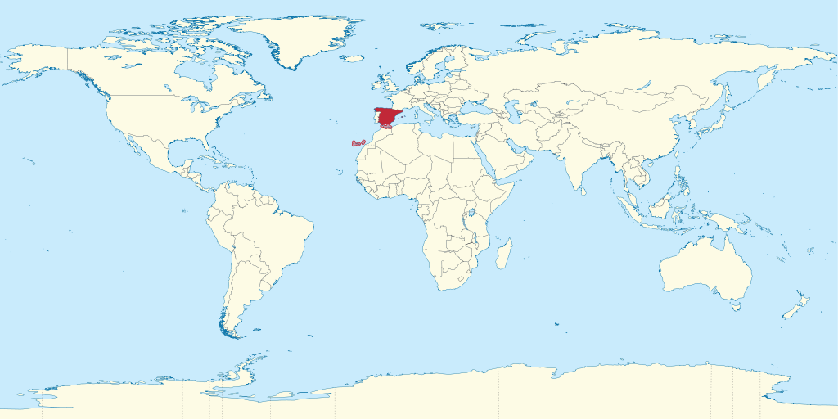
Where is Spain?

Slide 4
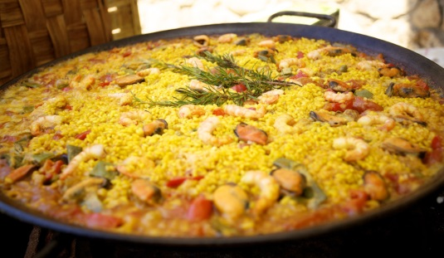
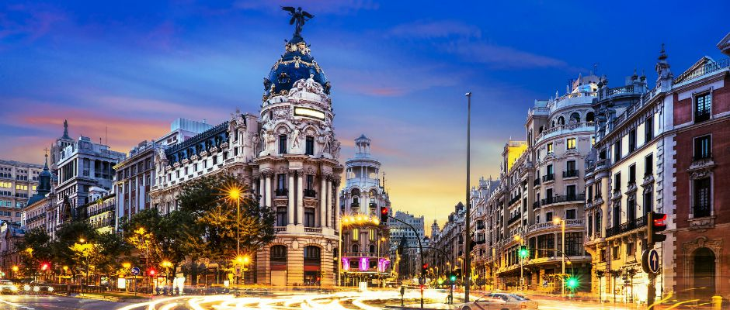
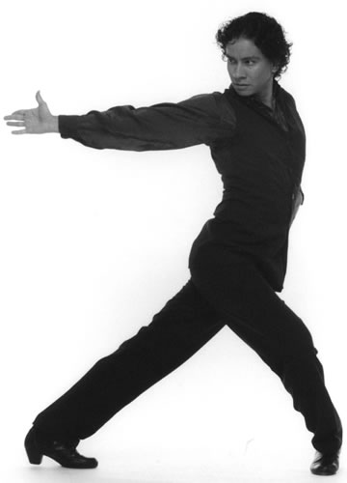
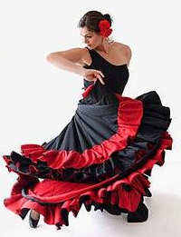
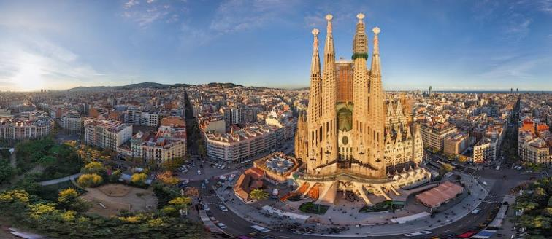
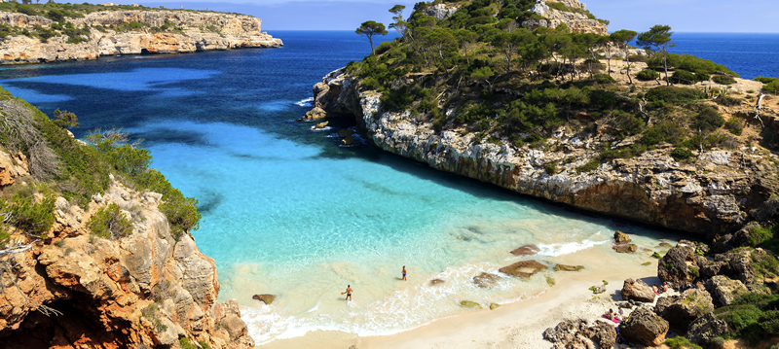
What do you think about, when you think of Spain?
Madrid!
(The capital
of Spain)
Barcelona!

Slide 5
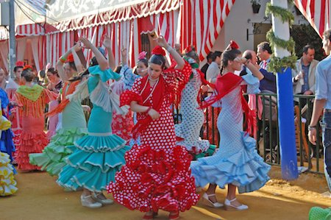
Spain is known for its flamenco dance. In many towns and villages people dance the flamenco for special festivities. Here you can see the girls performing at a fiesta in Seville.

Slide 6
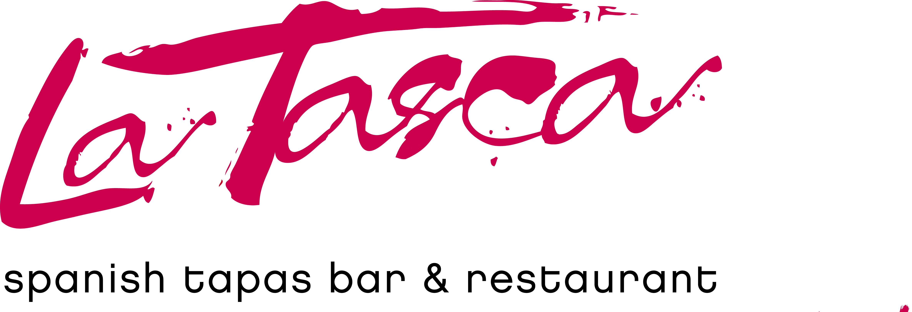
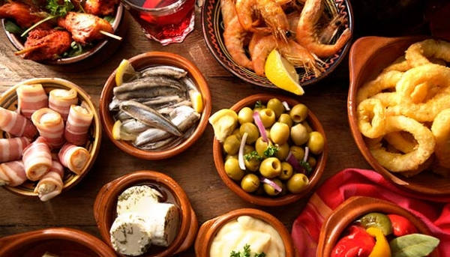
Tapas is lots of small dishes of food, rather than just one meal. You might get 3 or 4 little meals instead!

Slide 7
Here are some useful Spanish words:
Buenos dias: Good day
¡Hola! Hello
¿Que tal? How are you?
adios: Bye
gracias: Thank you
The Spanish language uses inverted question marks and exclamation marks.

Slide 8

Let’s learn weather!

Slide 9
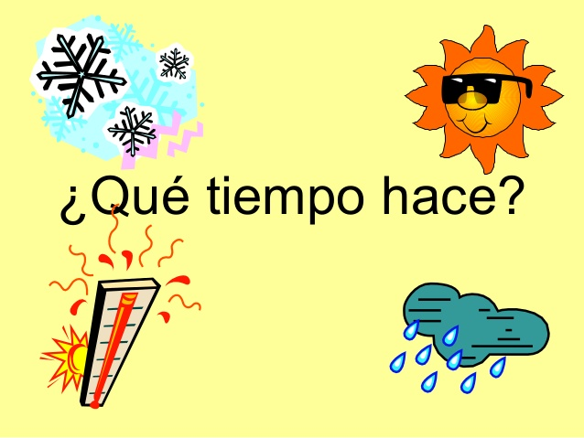

Slide 10
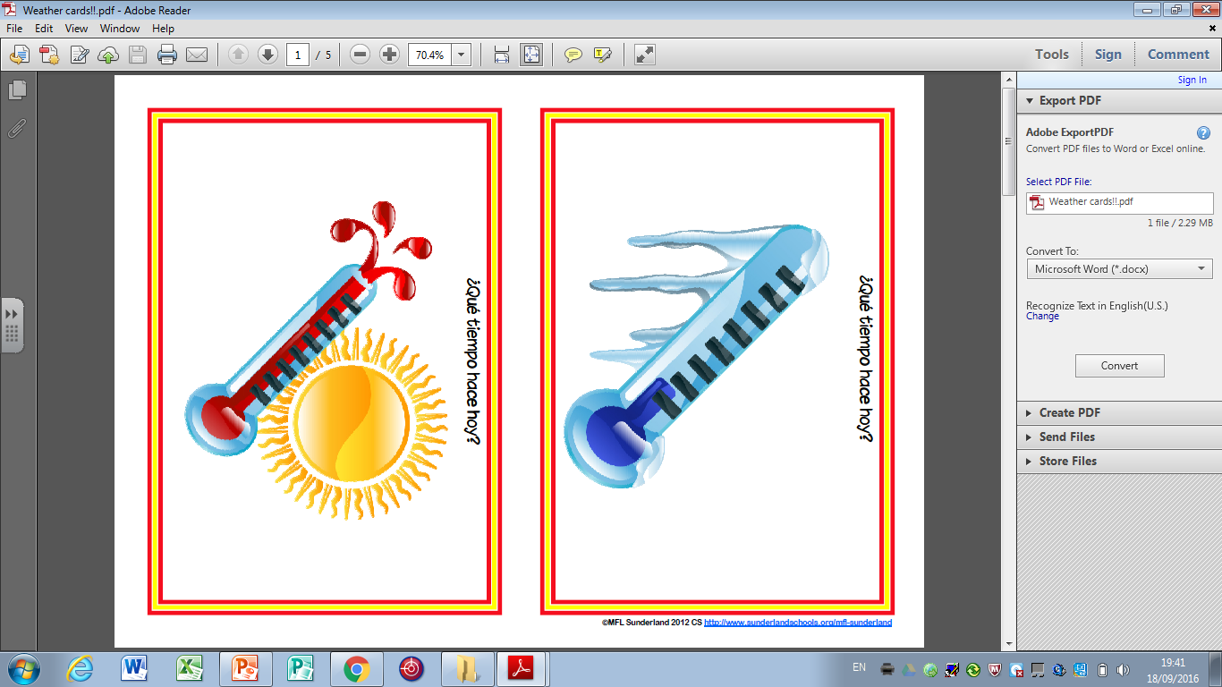
Hace calor

Slide 11
Hace frío

Slide 12
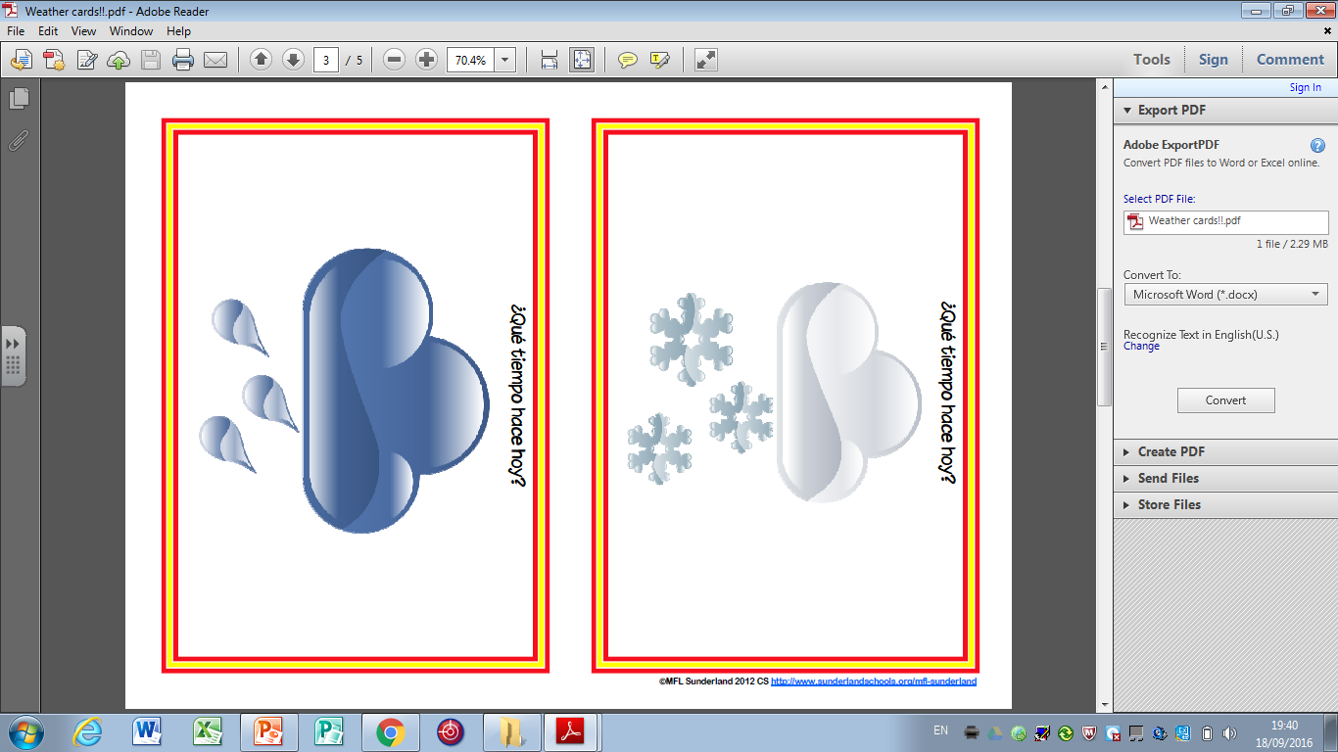
Llueve

Slide 13
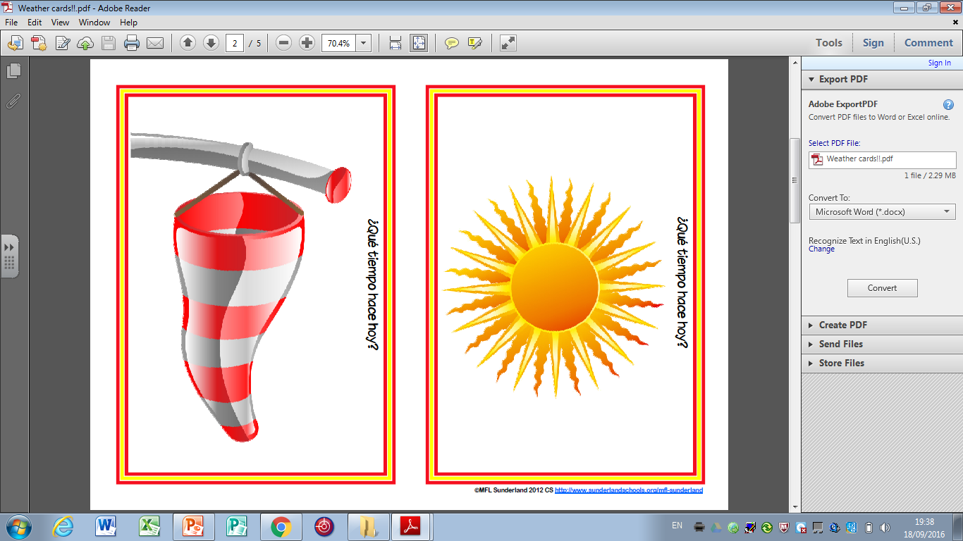
Hace sol

Slide 14
Hace calor
Hace frío
Llueve
Hace sol

Slide 15
Hace calor
Hace frío
Llueve
Hace sol

Slide 16
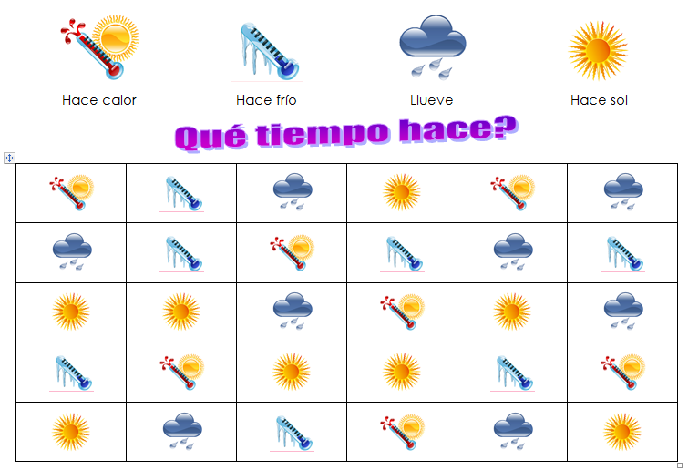

Slide 17
