Slide 1
Bengali
Language of Spring Term 2018

Slide 2
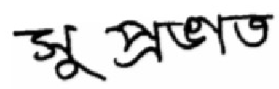

“Good morning”
“Shu – pro - bhat”
Please click on the picture…

Slide 3
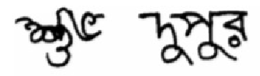
“Good afternoon”
“Shu – baw – dhupur”

Slide 4
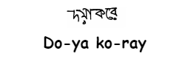

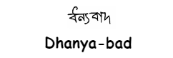

Slide 5

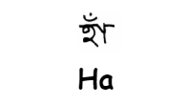

What do you think these words mean?

Slide 6
Where is Bengali spoken?
It is spoken by more than 210 million people as a first or second language, with some 100 million Bengali speakers in Bangladesh; about 85 million in India, primarily in the states of West Bengal, Assam, and Tripura; and sizable immigrant communities in the United Kingdom, the United States, and the Middle East.

Slide 7
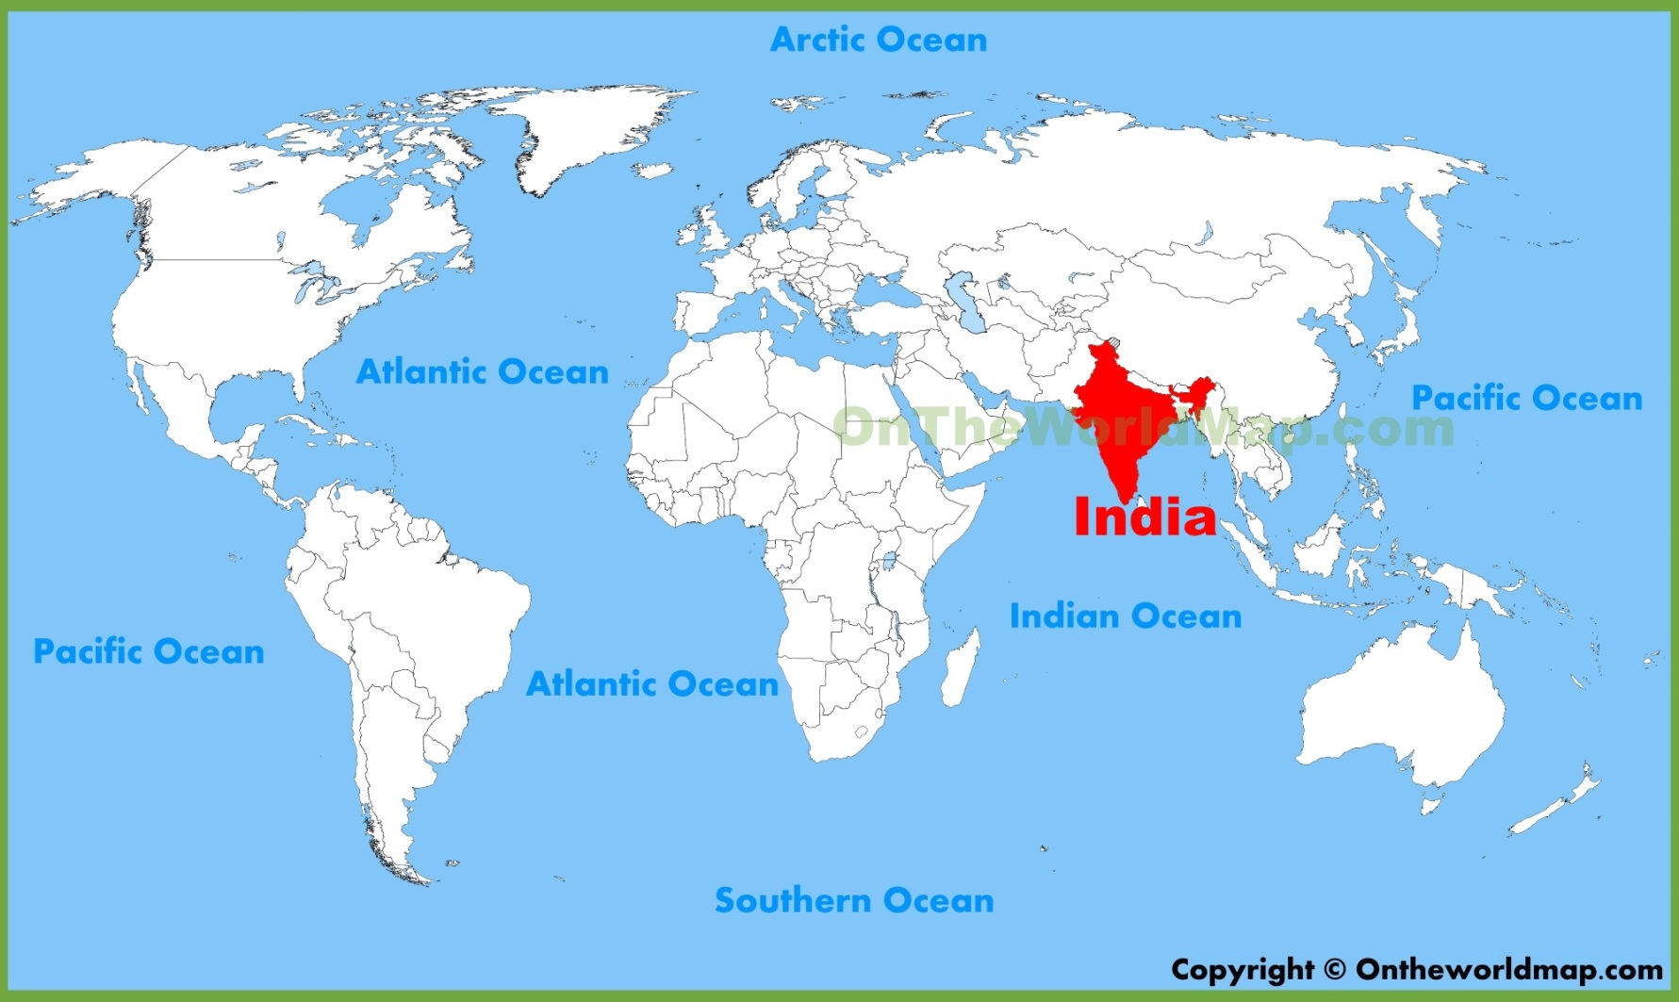
Where is India?
What continent is it on?
What are the surrounding oceans?

Slide 8
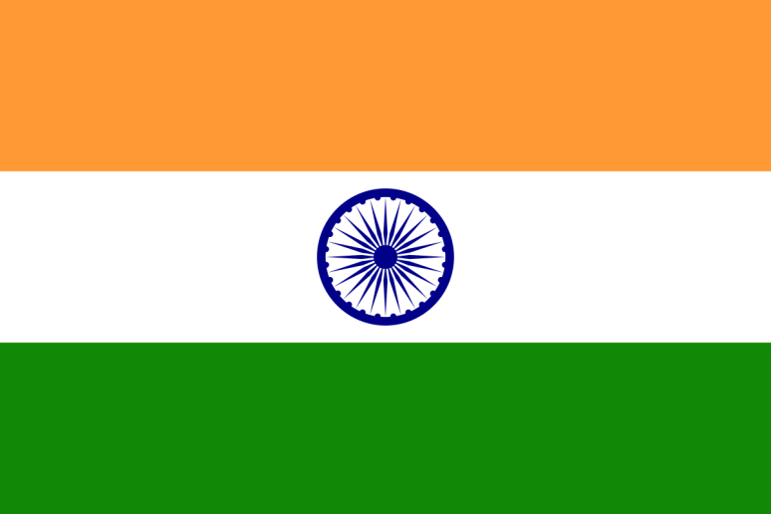
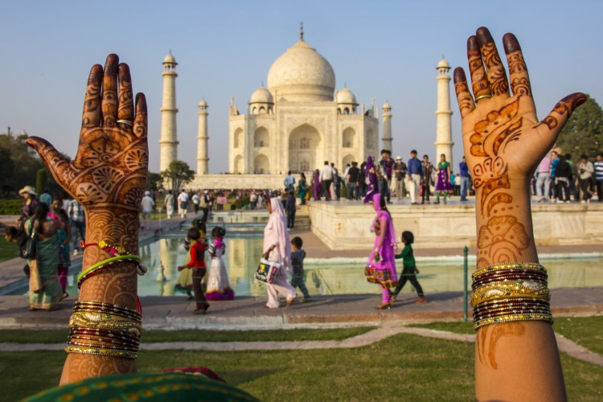
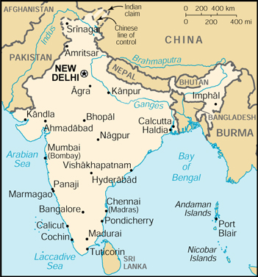
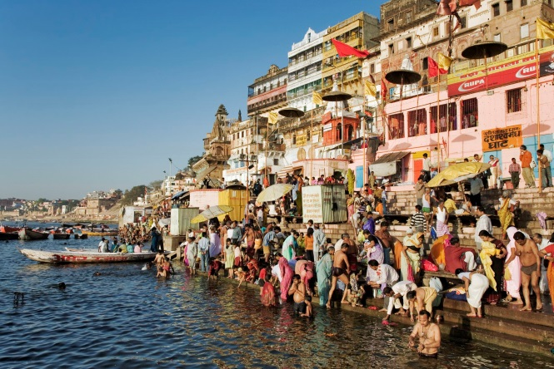
India!
Have you heard of any of these places?

Slide 9
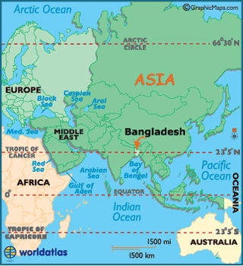
Where is Bangladesh?

Slide 10
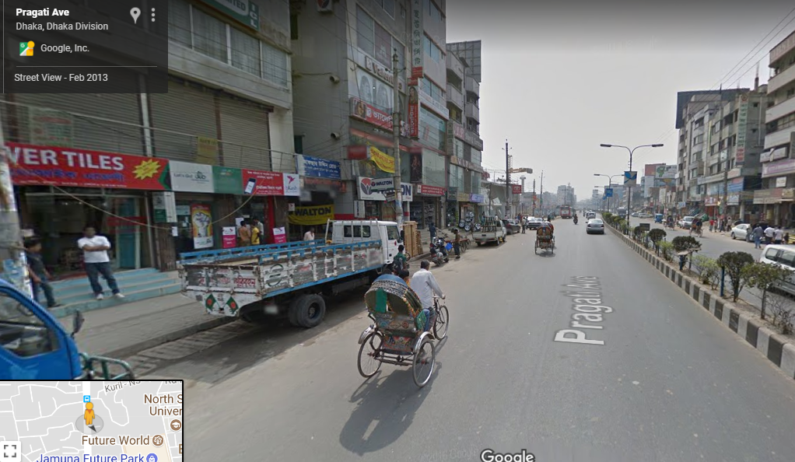
Why don’t we have a walk around Bangladesh’s capital, Dhaka? Click on the picture…
What languages are signs written in?
Can you find a bus and a tuk tuk?
How are most people travelling?

Slide 11
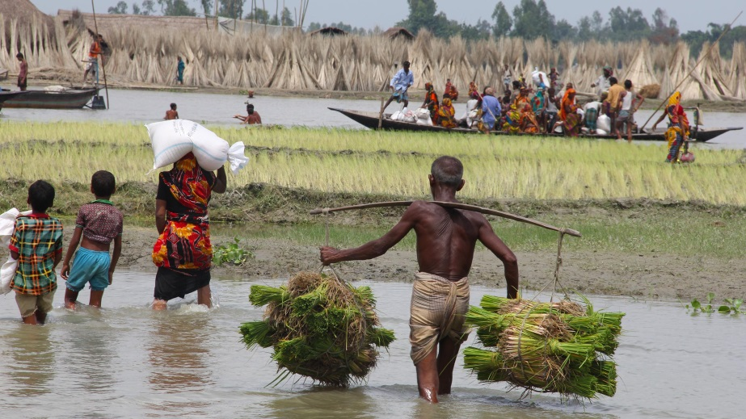
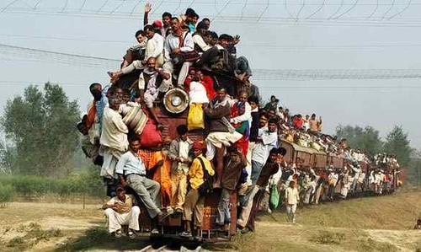
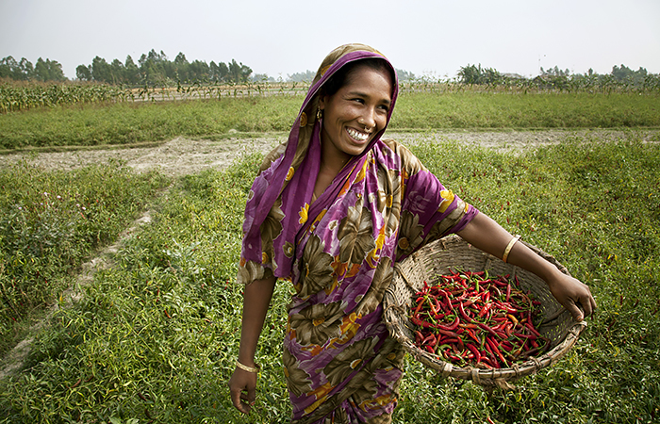
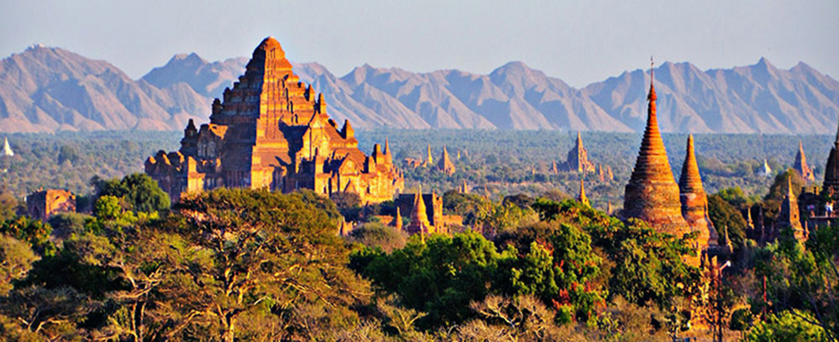
Have you noticed your green background with the red circle? That’s the Bangladeshi flag!

Slide 12
I hope you enjoy using Bangladeshi in your classes.
Dhanya-bad!

