Slide 1


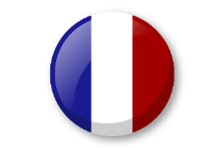

Knowledge organiser: Alien family
Noun Bank: Family
le papa - the dad
le frère – the brother
le bébé – the baby
le grand- père – the grandad
la maman - the mum
la soeur – the sister
la grand-mère- the grandma
la famille– the family
Je suis… – I am ….
Noun Bank : Face parts
le nez – the nose
la bouche- the mouth
la tête- the head
les cheveux- the hair
les yeux – the eyes
les oreilles- the ears
J’ai…. – I have …
Je n’ai pas de… - I don’t have any
Grammar
There are two words for “the” in French with singular nouns.
These words are “le” and “la”
Grammar
There is only one word for “the” with French plural nouns and this is “les”.
Phonics
“ez” (nez)
“ll” (famille, oreilles)
“eux” (cheveux, yeux)
“ère” (père, frère)
“j’” (j’ai, je)
Fact Bank
In English hair is a singular noun and in French “hair” is a plural noun (les cheveux).

