Slide 1
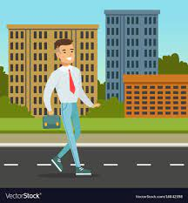
Road Safety
By Seb & Oscar

Slide 2

In Todays Worship We Will Be Learning About
Road Safety
What Do You Think Road Safety Is???
Now Lets Watch A Video About Road Safety!!!
https://www.youtube.com/watch?v=uAgxZ-l5pY8

Slide 3
Now Seb Is Going To Cross The Road, What Does He Need To Do Before He Starts Walking???

Slide 4

Oscar Is Going To Have A Walk At Night
What Does He Need To Have, To Stay Safe???
Any Suggestions
Hands Up

Slide 5
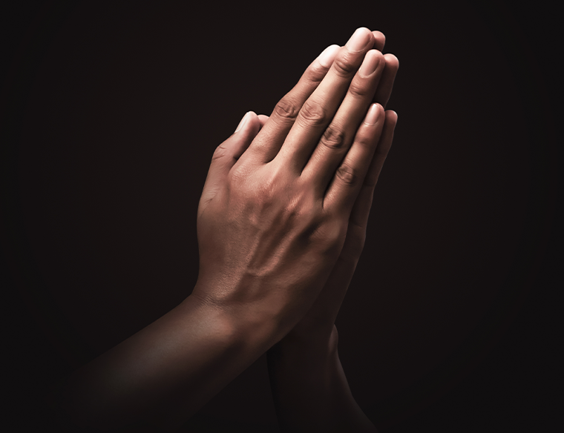
Now We Are Going To Have A Listening Prayer.

