Slide 2

Art
By Merryn, Amber, Rosie, Naomi and Aaliyah.

Slide 3

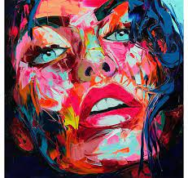
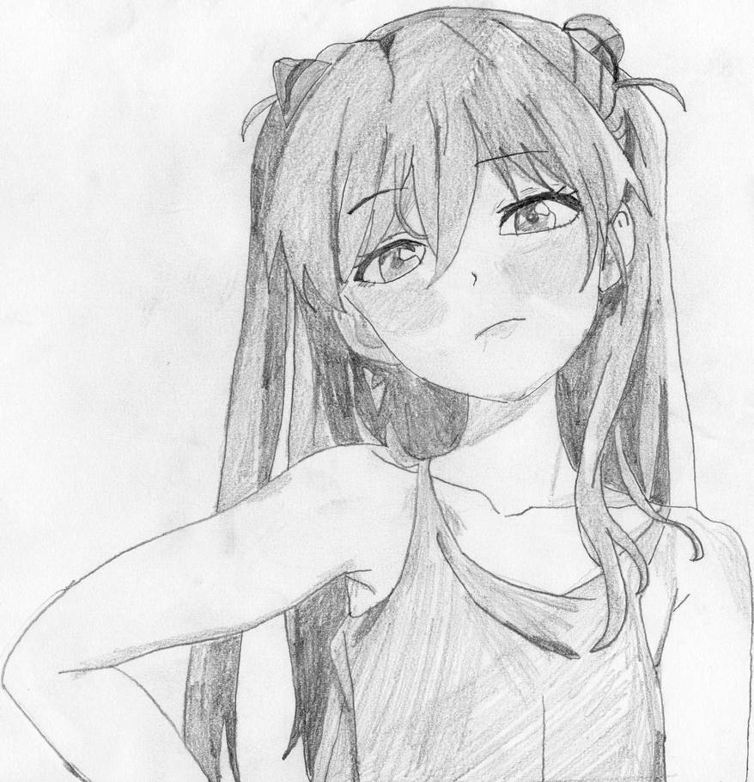
Number 1
Number 2

Slide 4
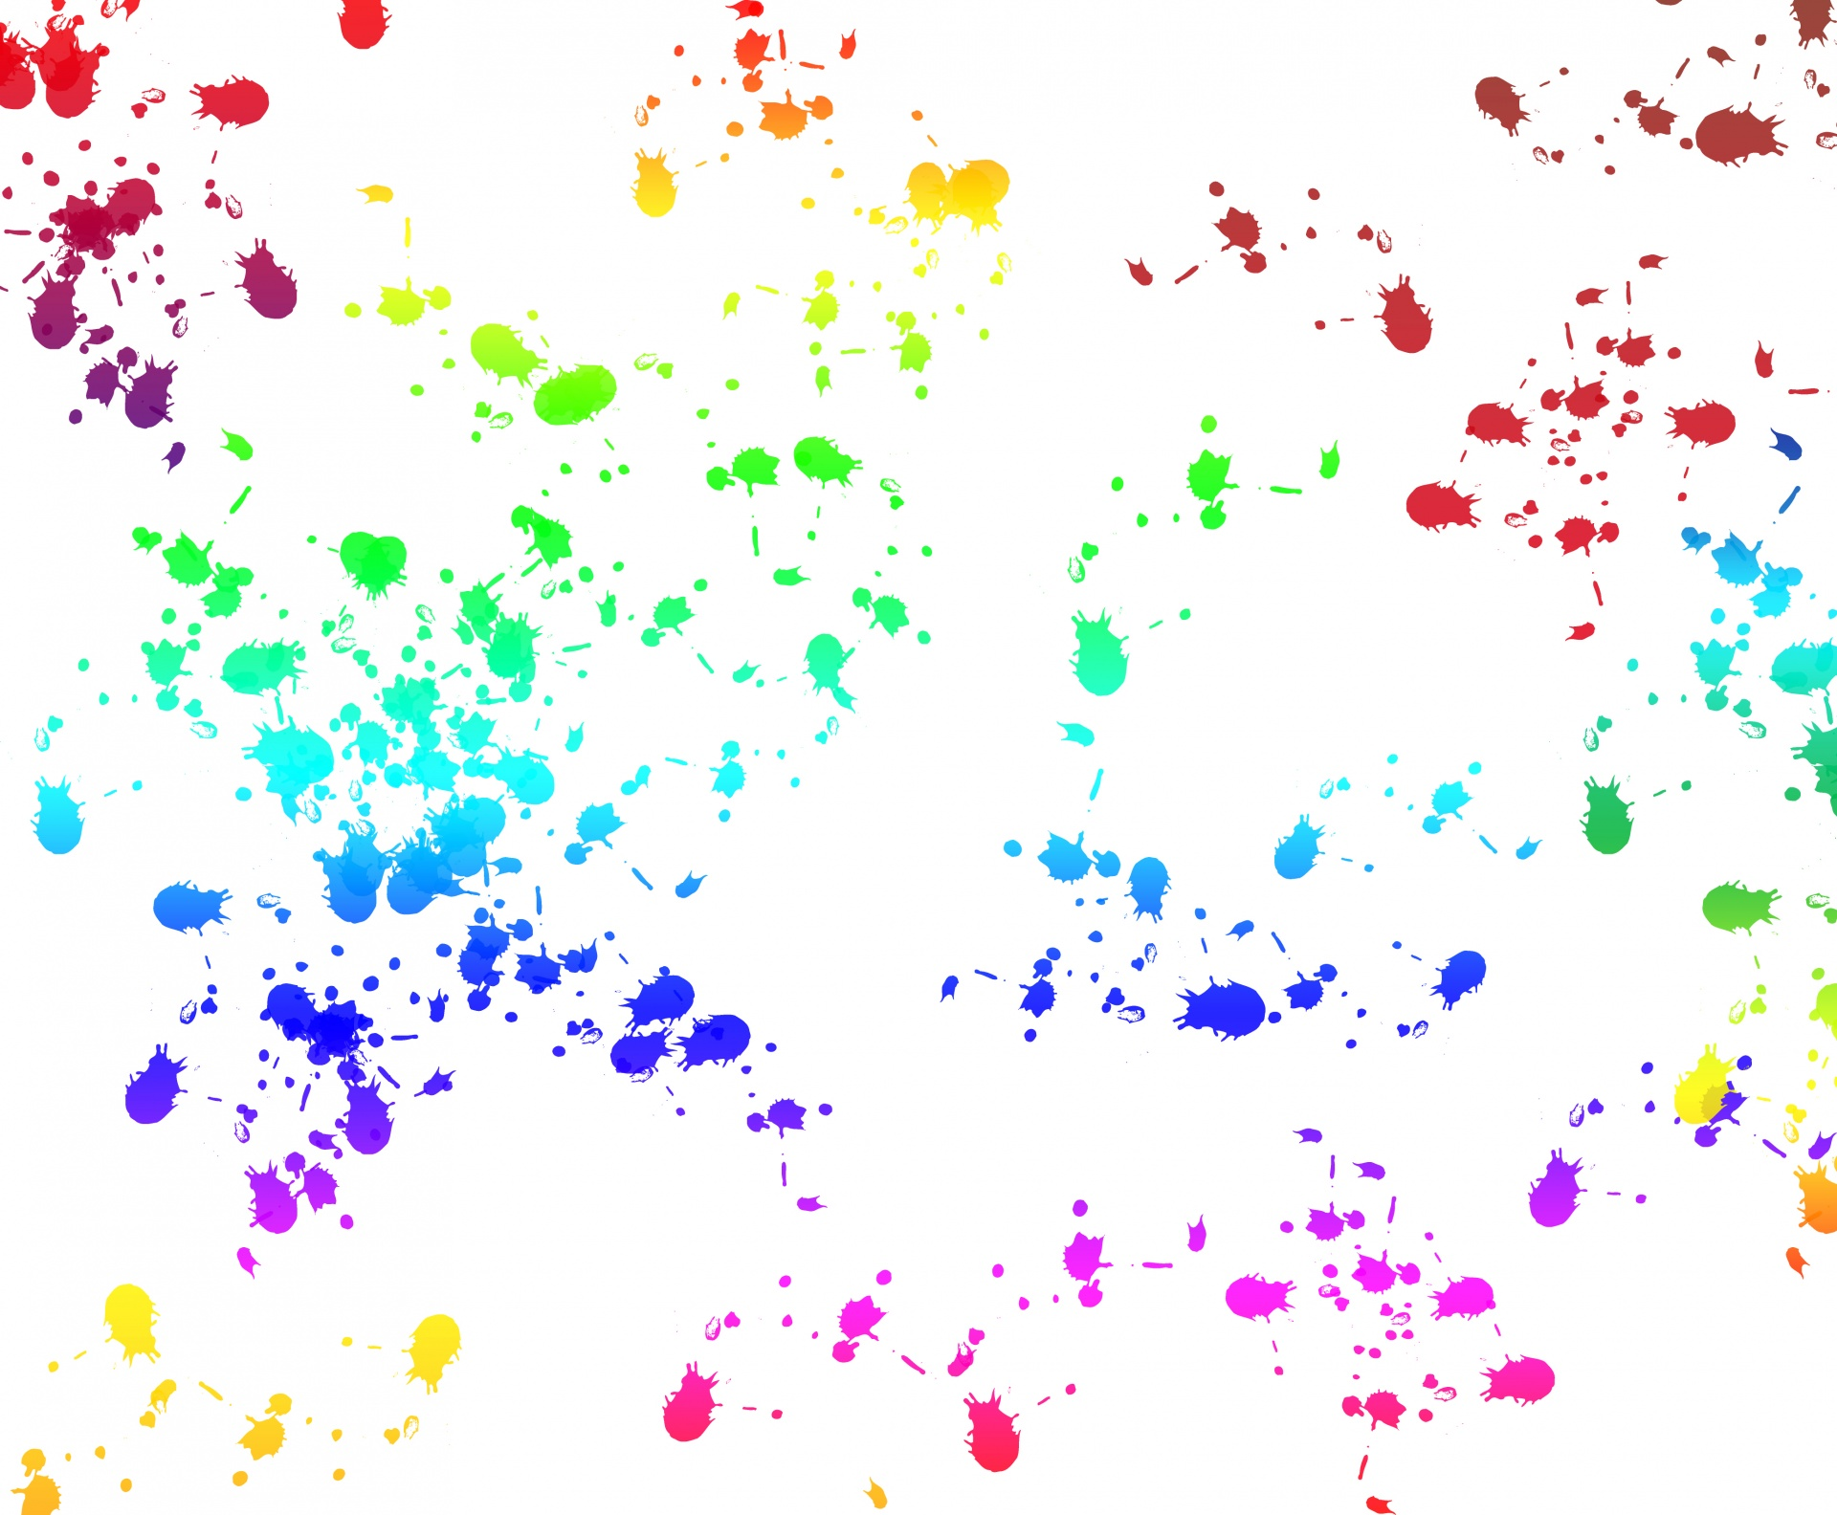
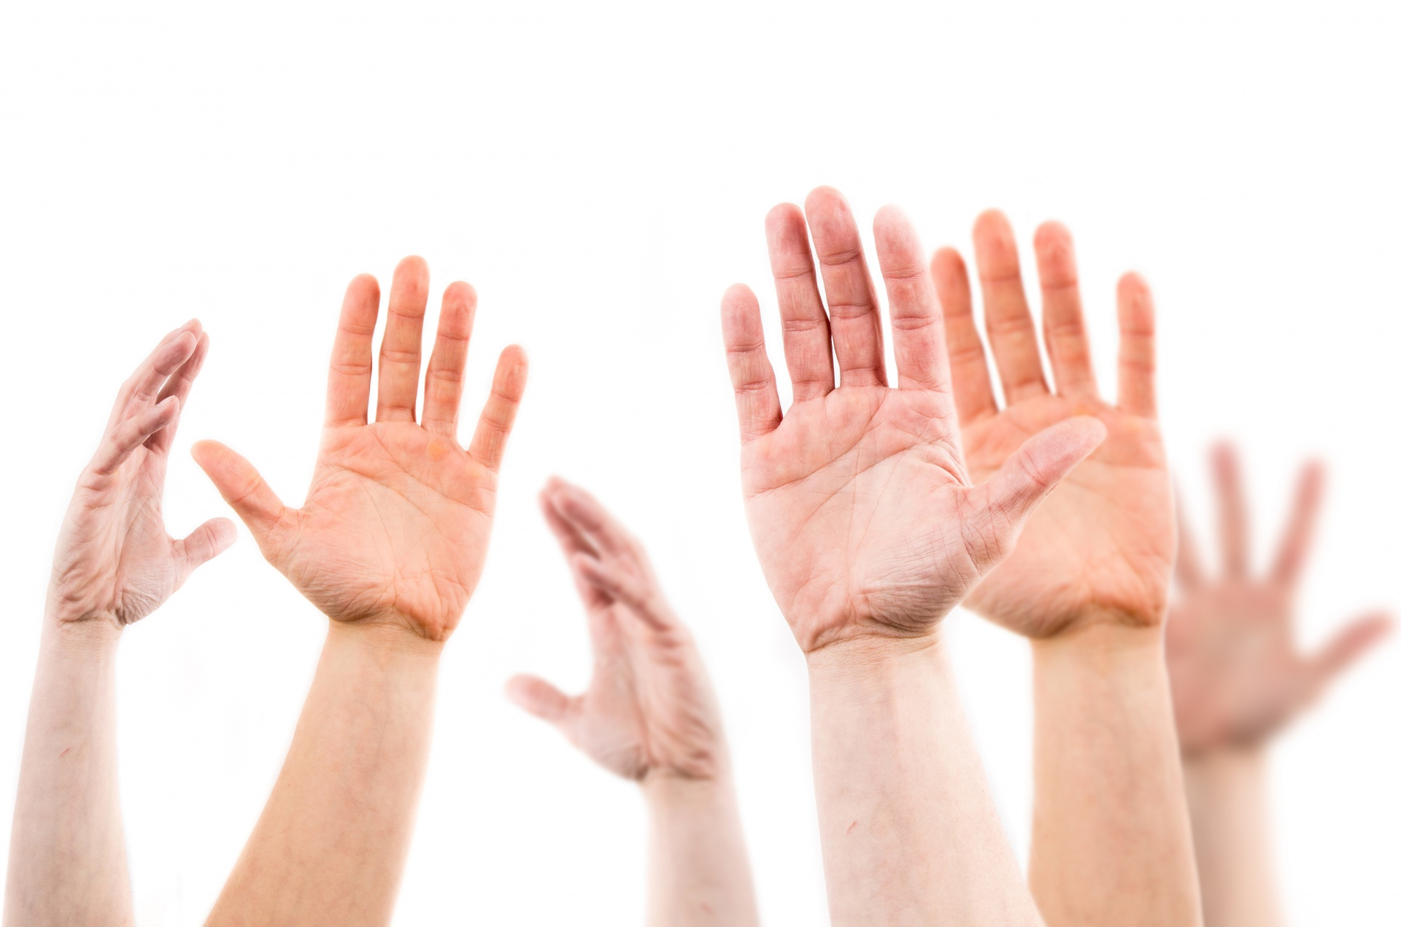
Which is your favourite?
Number 1
Number 2
Hands up!

Slide 5
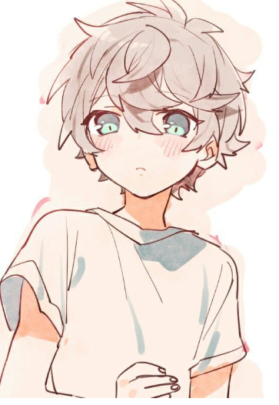
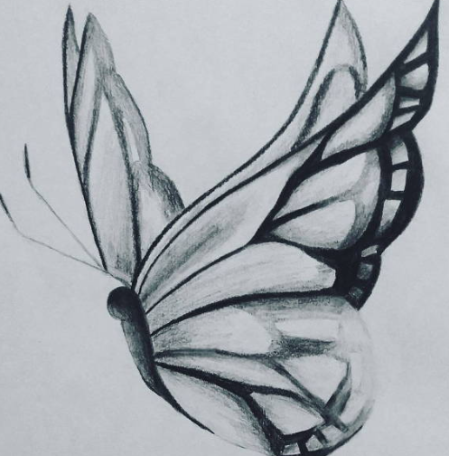

Slide 6
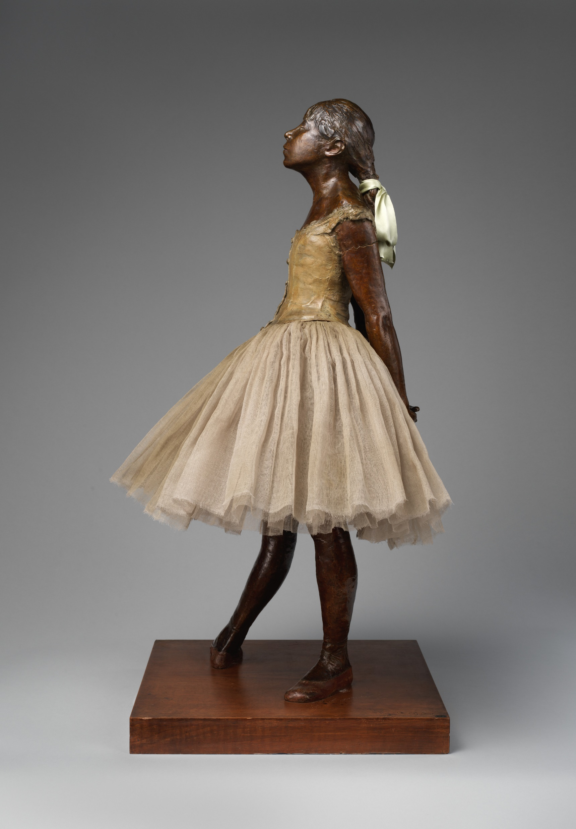
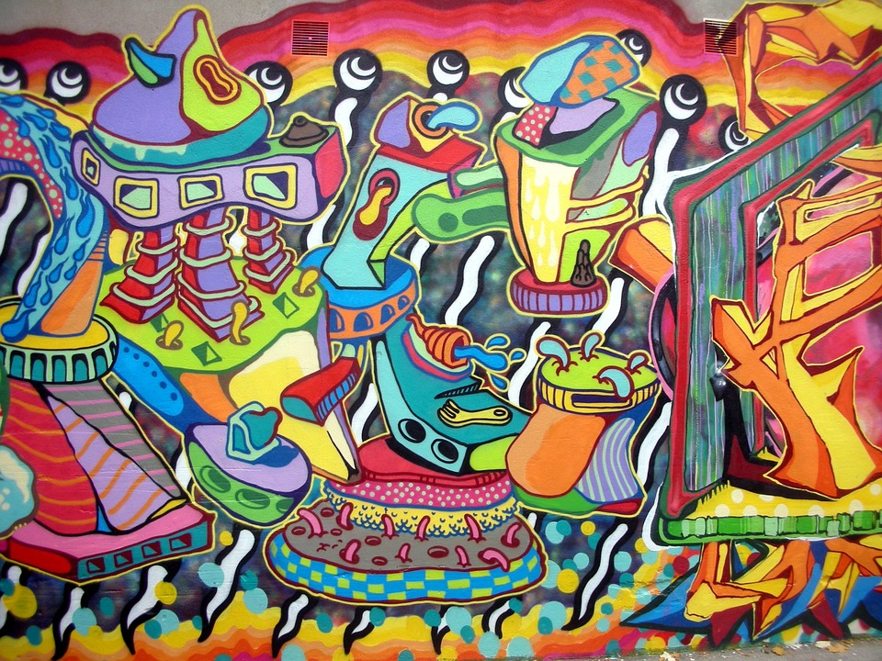
Not all Art is on paper!

Slide 7
Facts about famous artists
Pablo Picasso was a great animal lover.
Pablo has 23 words in his whole name!
Van Gogh Believed His Most Famous Work Was a Failed Effort.

Slide 8

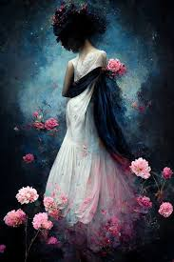
How does this piece make you feel?

Slide 9
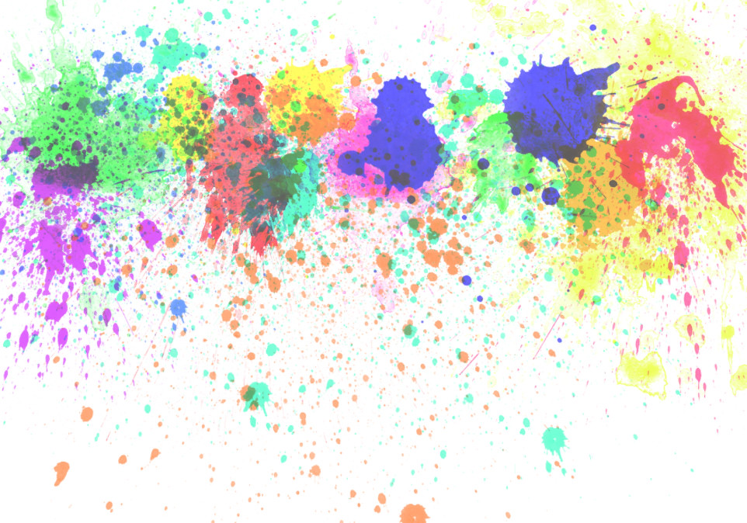
Calm
Lonely
emotional
Sad

Slide 10
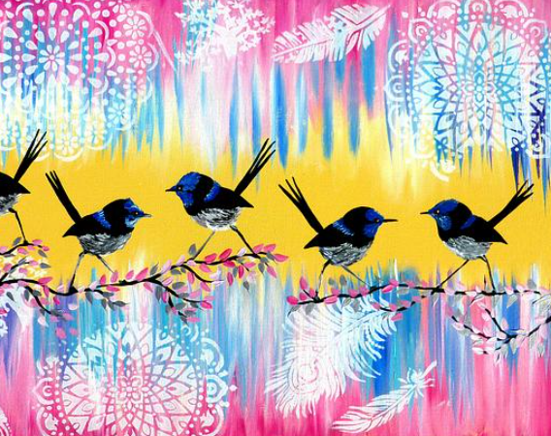
Different art can make different people feel different things. Does this piece make you happy?

Slide 11


Thanks for listening!

