Slide 1
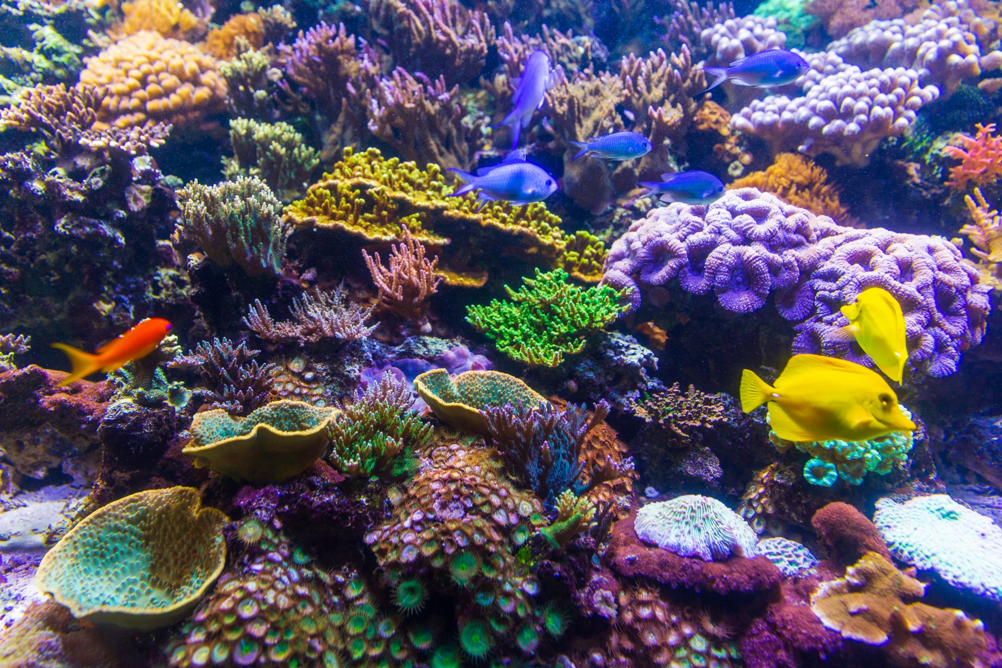
Marine life & Pollution
BY
BEA
NAOMI
JOSIE

Slide 2
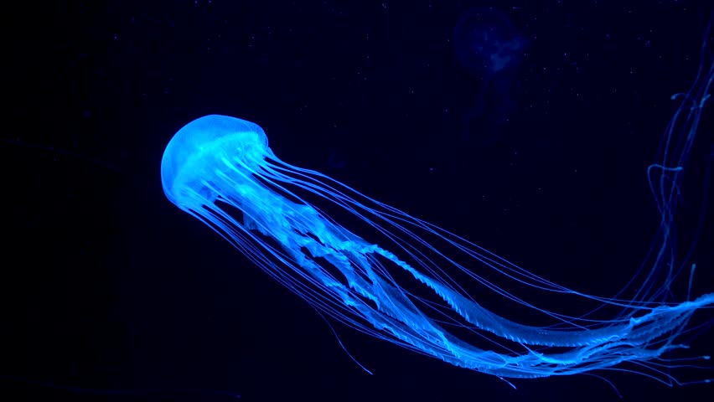
What does Marine Life mean?
Talk to your talking partner.
It means sea or ocean life. It is the plants, animals, and other organisms that live in the salt water of seas or oceans.

Slide 3
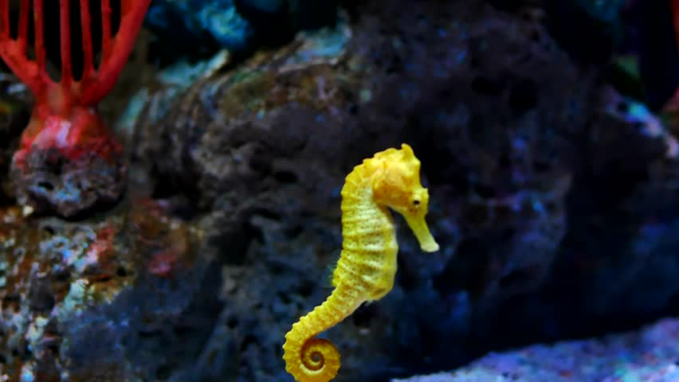
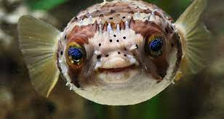
Did you know that the male seahorses' carry the baby seahorses.
Parrot fish produce 85% of the sand that builds up reef islands like in the Maldives.

Slide 4
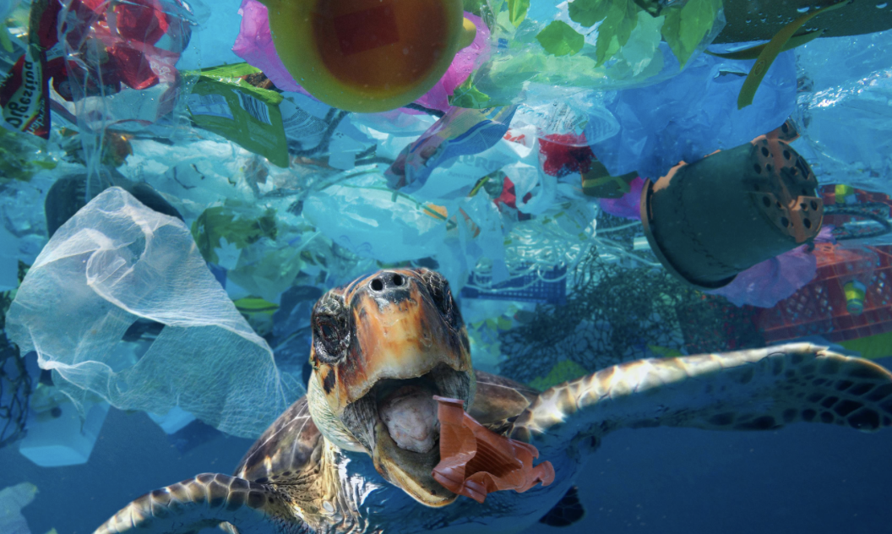
Save the Planet!
Poor animals eat these every day.
With your help the pollutions may stop.
This Photo by Unknown Author is licensed under CC BY

Slide 5
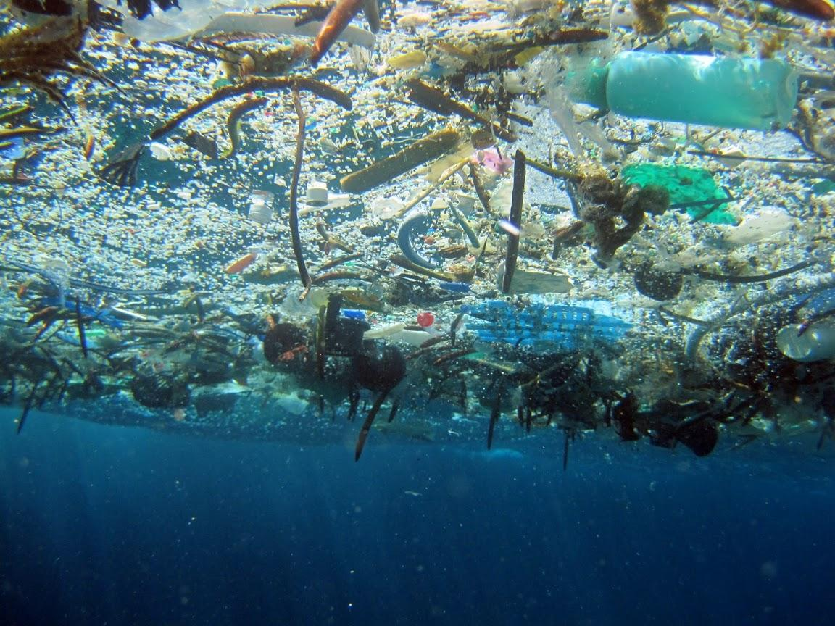
Every day more plastic is in the ocean if we keep on throwing rubbish on the floor.
If you see a bottle try and recycle it.
This Photo by Unknown Author is licensed under CC BY-SA

Slide 6
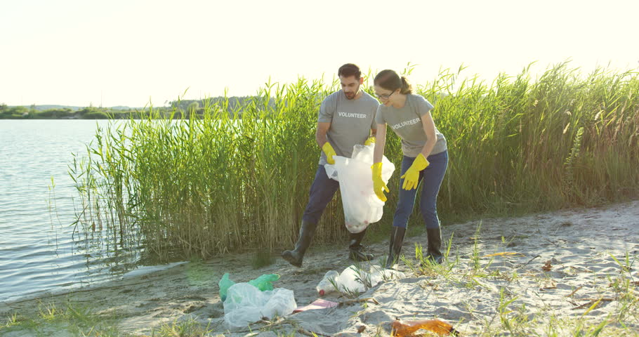
Here is a picture of people picking up rubbish.☺
91% of rubbish has been picked up by volunteers.
Have a go at doing this next time you go to the seaside☺

Slide 7
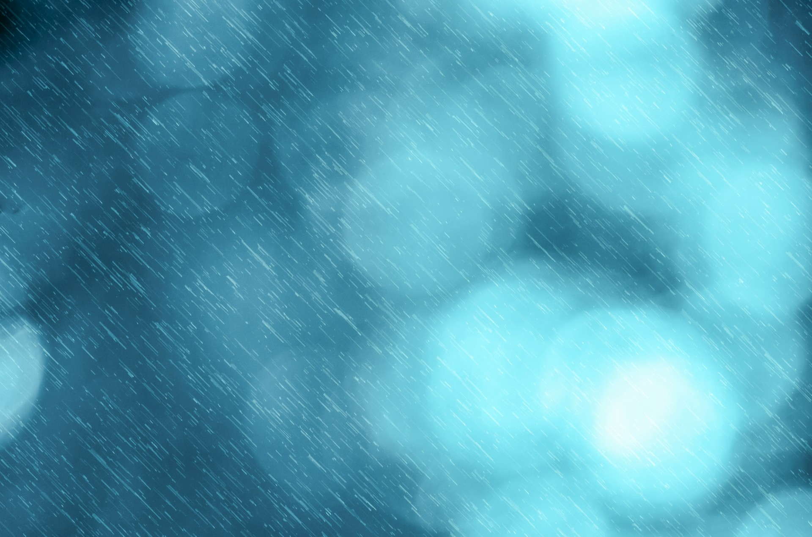
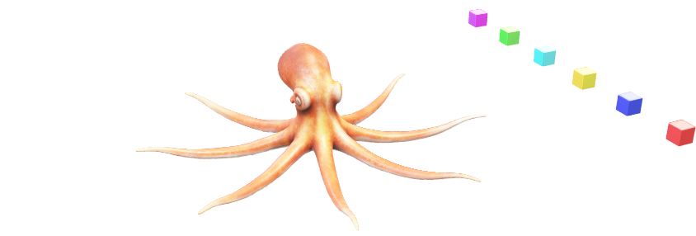
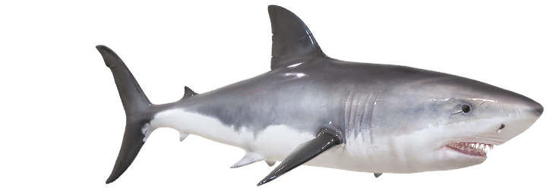
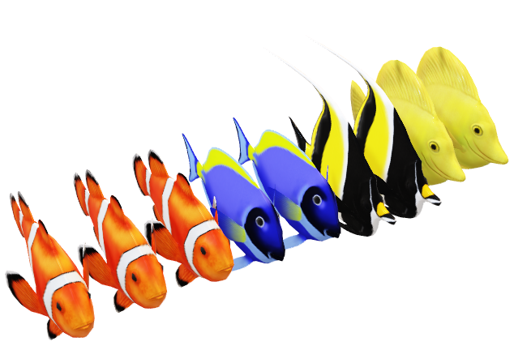

Slide 8
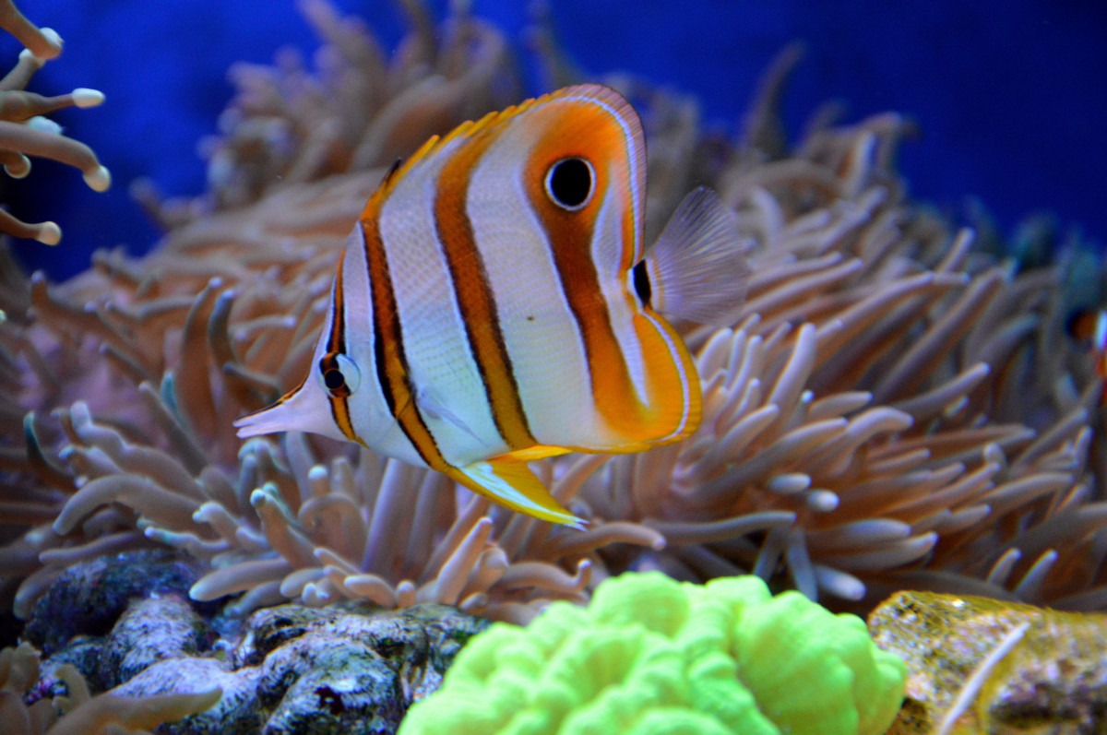
THE END
☺

