Slide 2
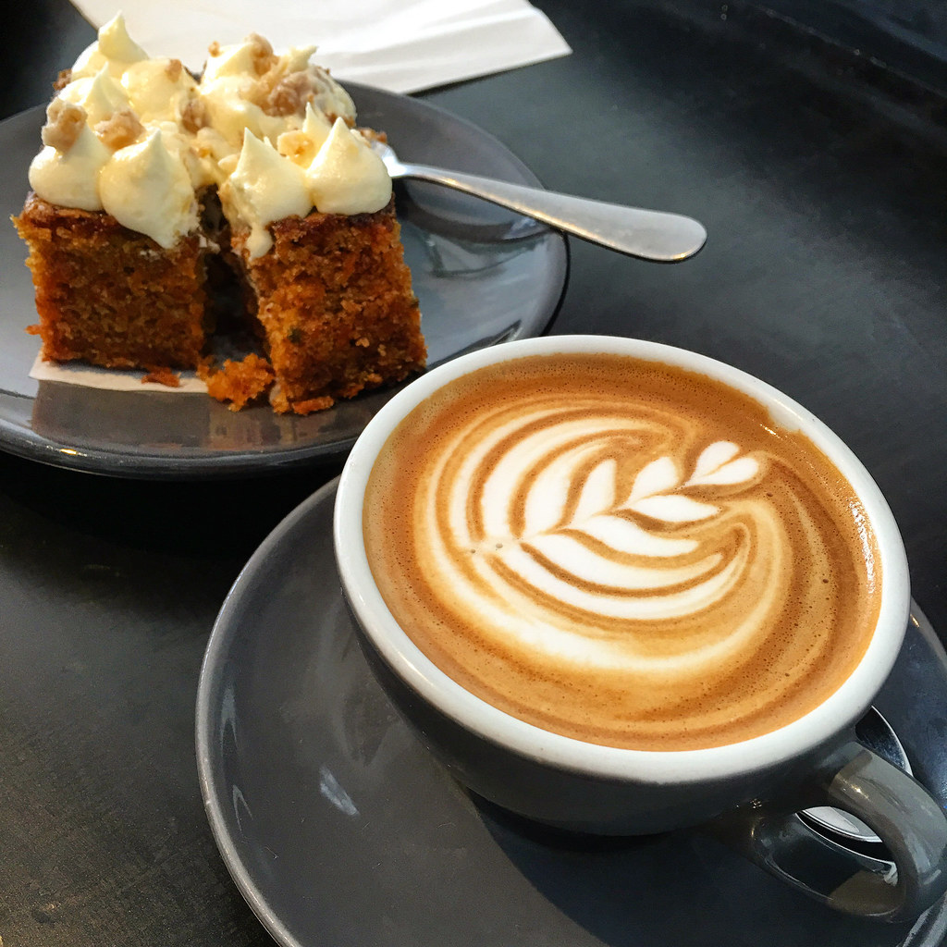
MacMillan cancer support
Power point by Evie, Merryn and Rosie

Slide 3

What is Macmillan Cancer support?
Macmillan helps people with cancer by receiving donations made by YOU!

Slide 4


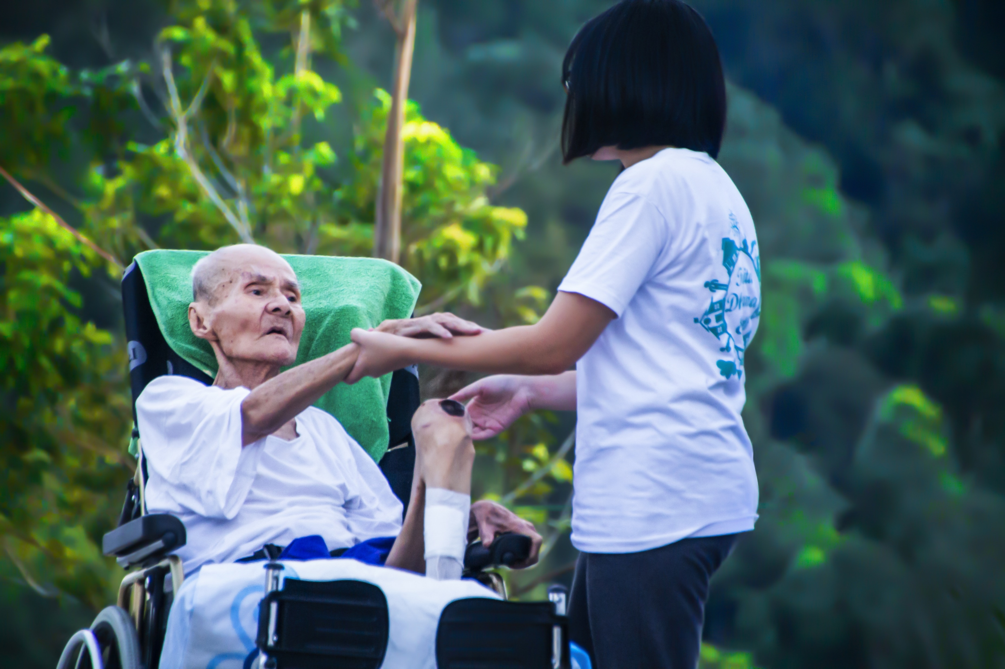
How Macmillan Works
Macmillan

Slide 5

When Macmillan started
Macmillan has been a cancer charity since 1911.
They have been a cancer support group for 112 years!

Slide 6

Macmillan facts
Macmillan has helped 2.4 million people with cancer.
103,000 people have been helped by Macmillan on the phone, email or webchat.
The 3 Macmillan values are: With strength, With heart, With ambition.

Slide 7



Quiz!
What does Macmillan do?
A. Help people with diabetes
B. Help people with cancer
C. Help people with Covid-19
the answer is… B

Slide 8

Remember coffee morning on Friday!
Bring £1.00

Slide 9
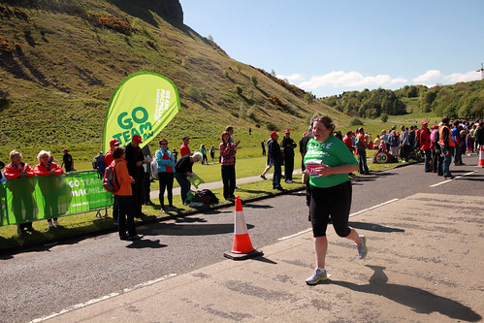
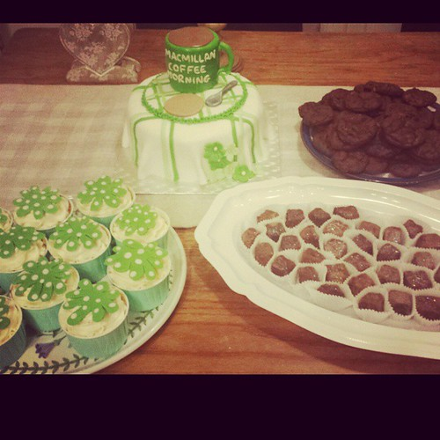
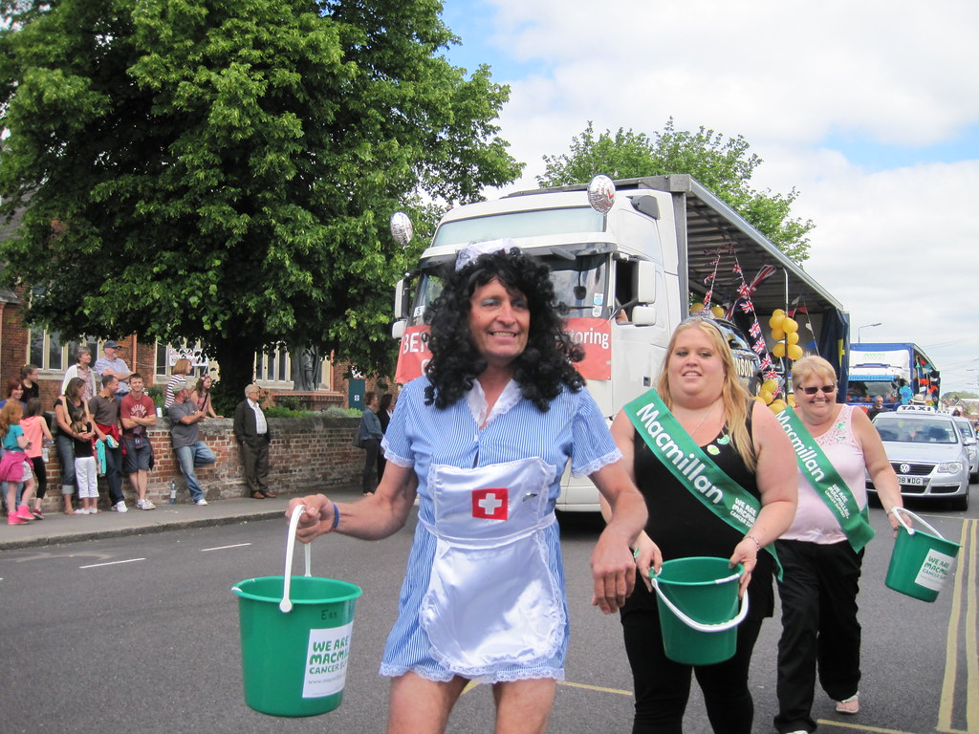

These are some of the things Macmillan do:
Sponsored run
Cake sales
Fundraising

Slide 10

Thank you for listening!

Slide 11

