Slide 1
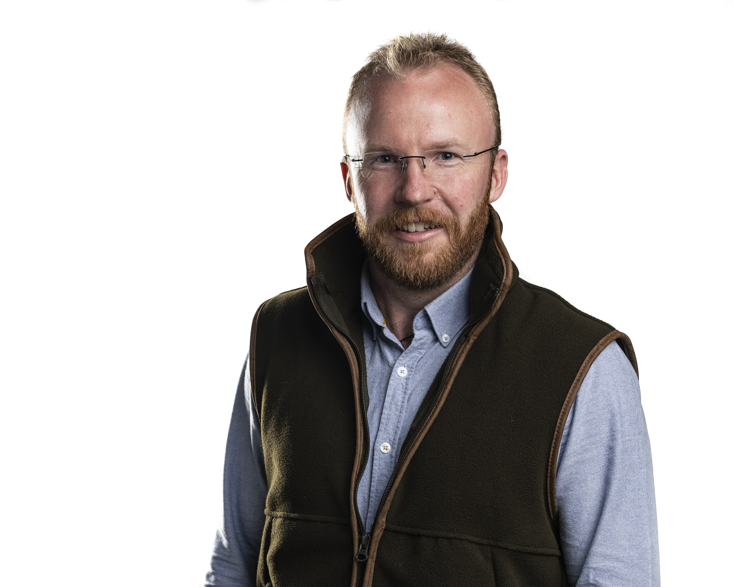

Slide 2

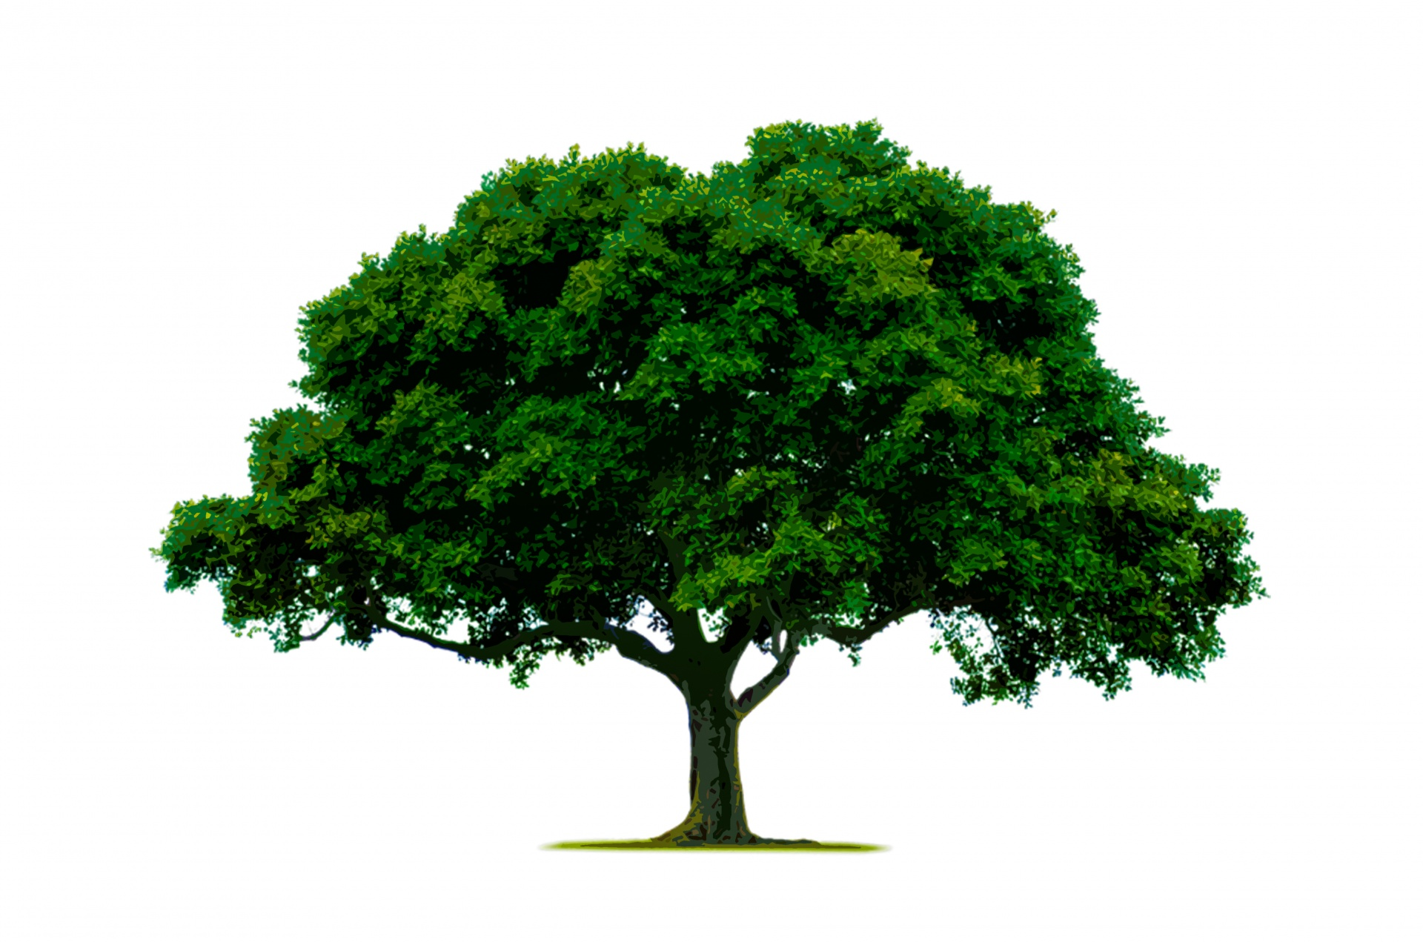
Welcome To Our Nature Worship
By Barnaby Lowe

Slide 3
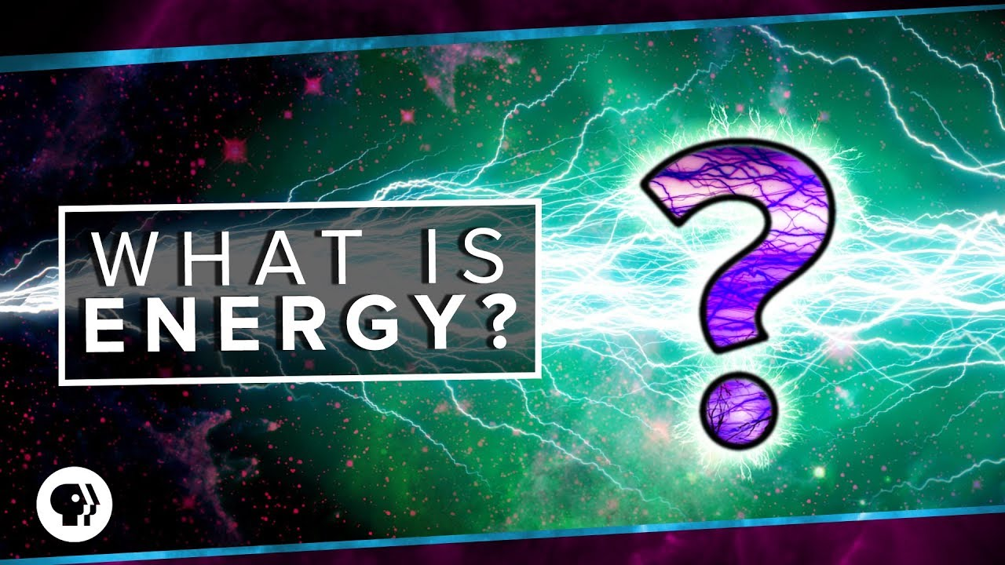

What Is Energy?
Scientists define energy as the ability to do work. Modern civilization is possible because people have learned how to change energy from one form to another and then use it to do work.

Slide 4
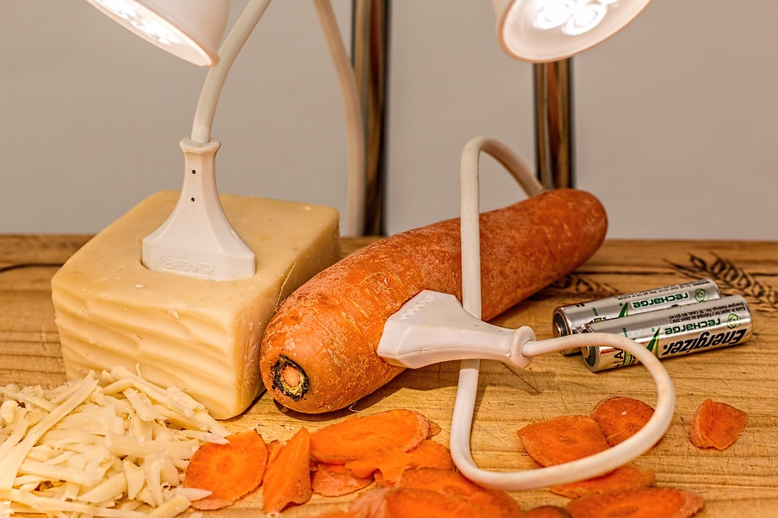


energy
Why not try carrot or cheese energy!!
What energy do you use?
Perhaps you use mains electricity, or even a mini turbine, a generator, or gas.

Slide 5
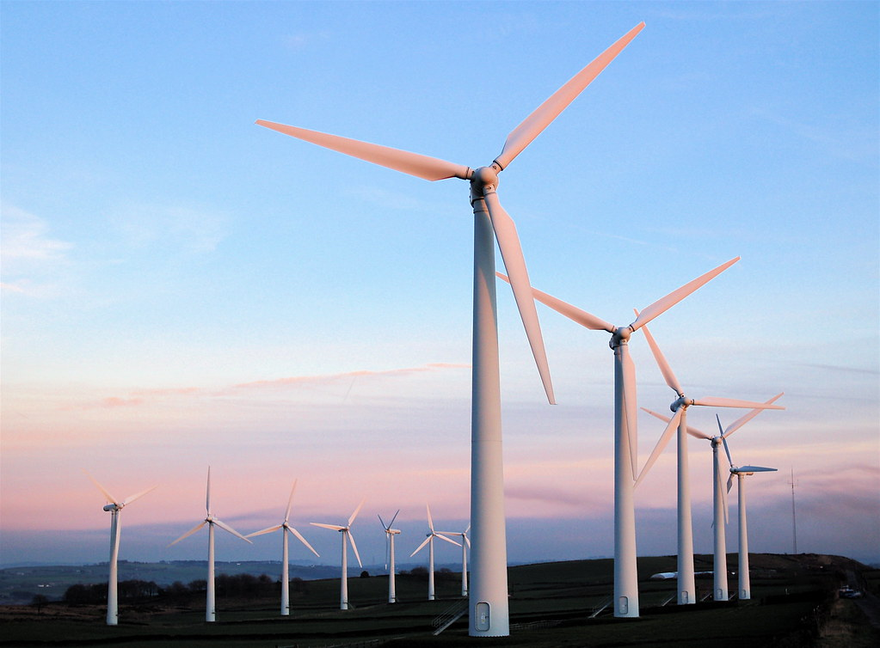

Wind energy
What are they?
Ever seen 1 of these?

Slide 6
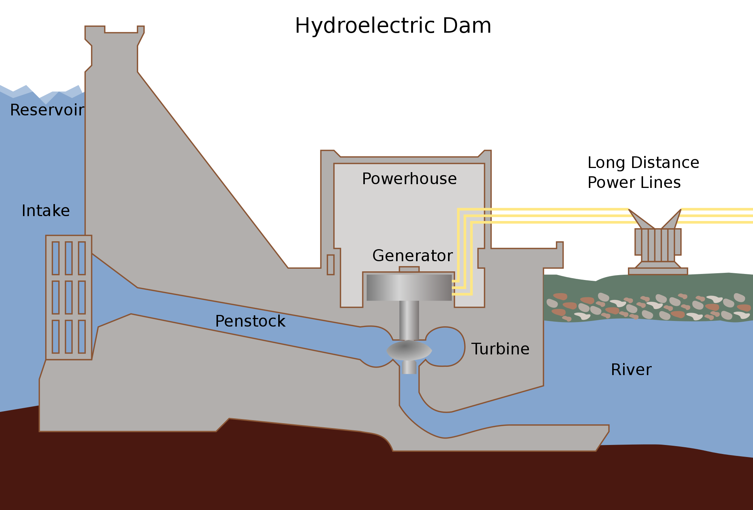
Water power

Slide 7
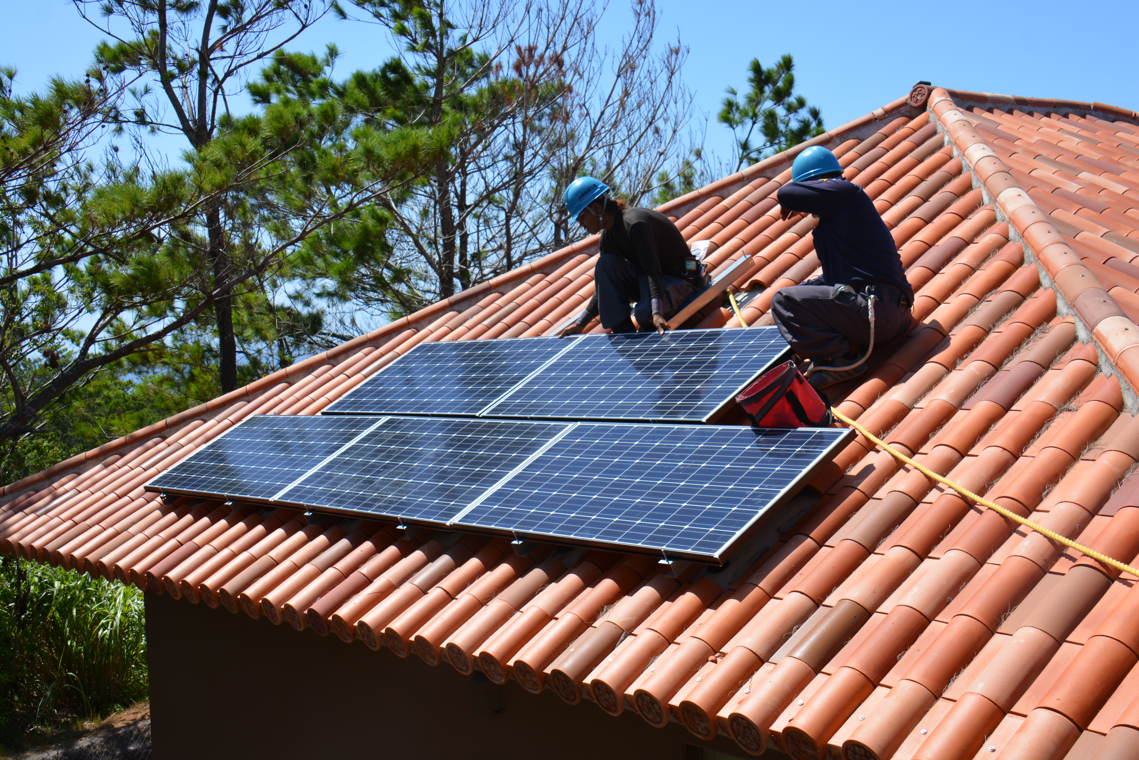


Solar energy
Solar panels
Do you have one of these?
This Photo by Unknown Author is licensed under CC BY

Slide 8

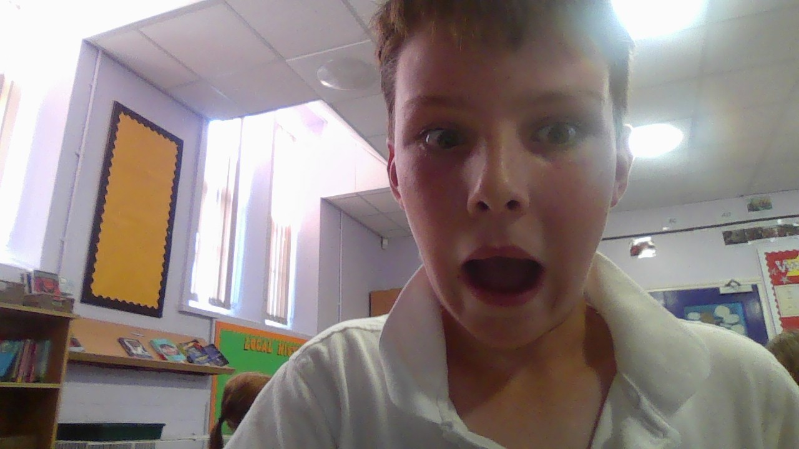

ALL THESE TYPES OF ENERGY
ARE NATURAL!
!
!
!

Slide 9
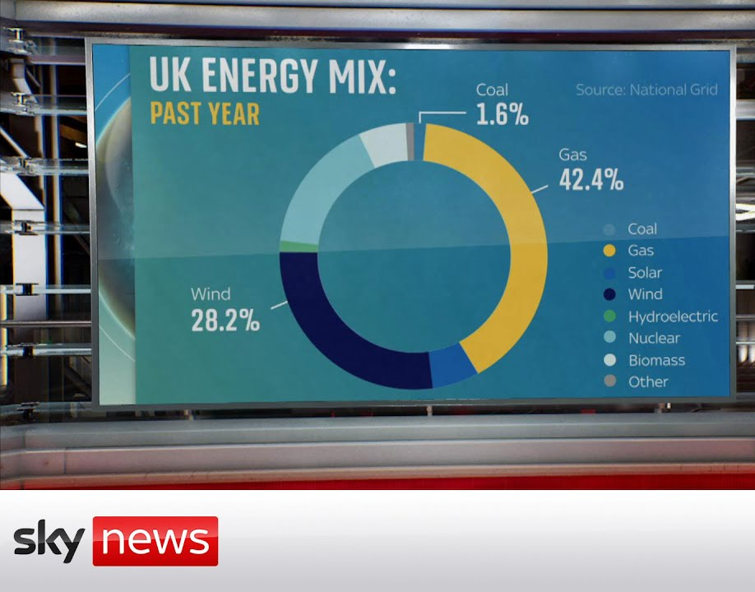

Slide 10
Quiz
What is Renewable Energy?
What is Renewable Energy?
A. Energy from petroleum
B. Energy from sun wind and naturally sources
C. Energy from coal
D. Energy from fossil fuel

Slide 11


Thanks for listening
By Seb, Oscar H.S, Logan, Kegan and Barnaby Lowe

