Slide 1

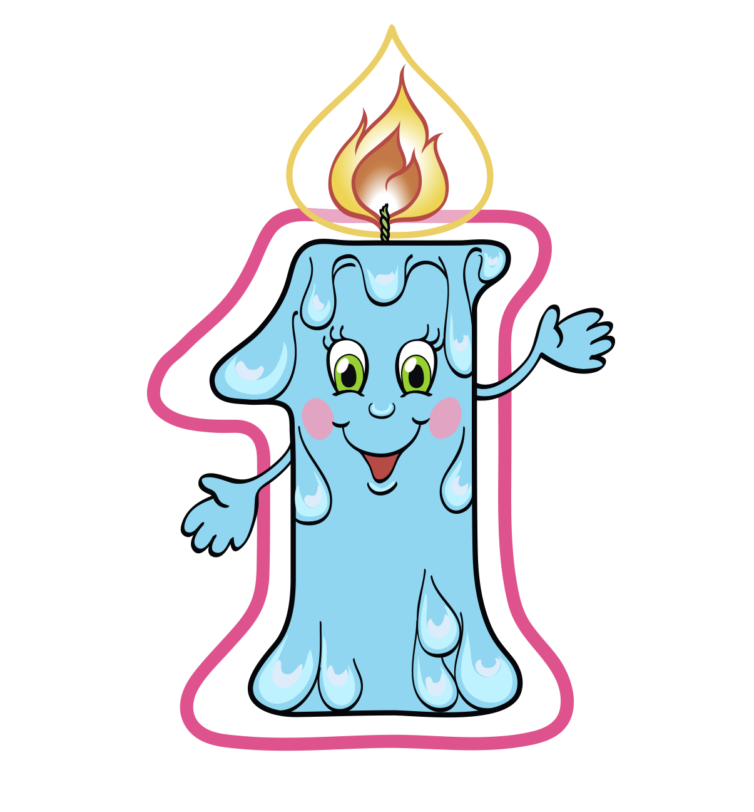
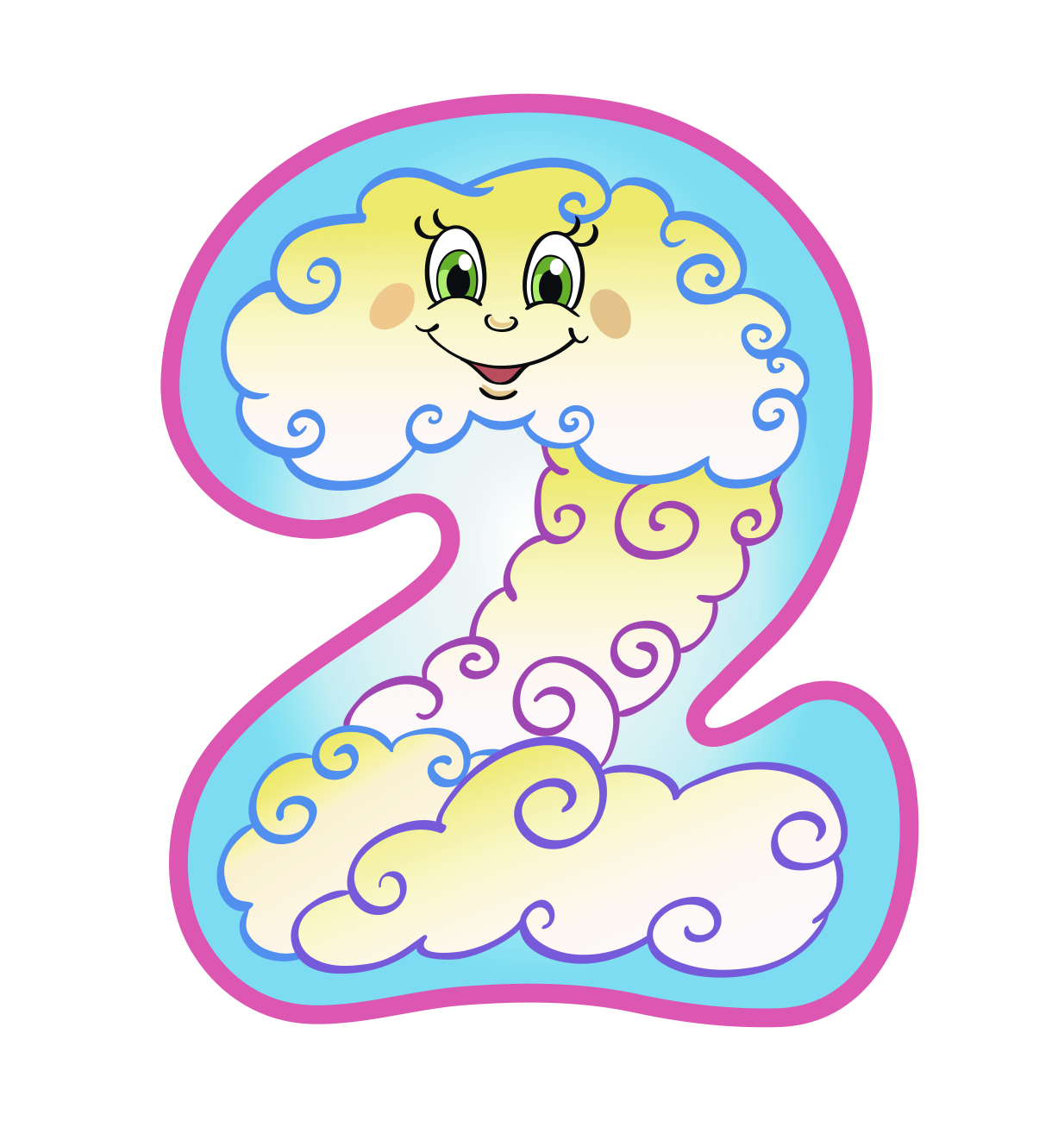
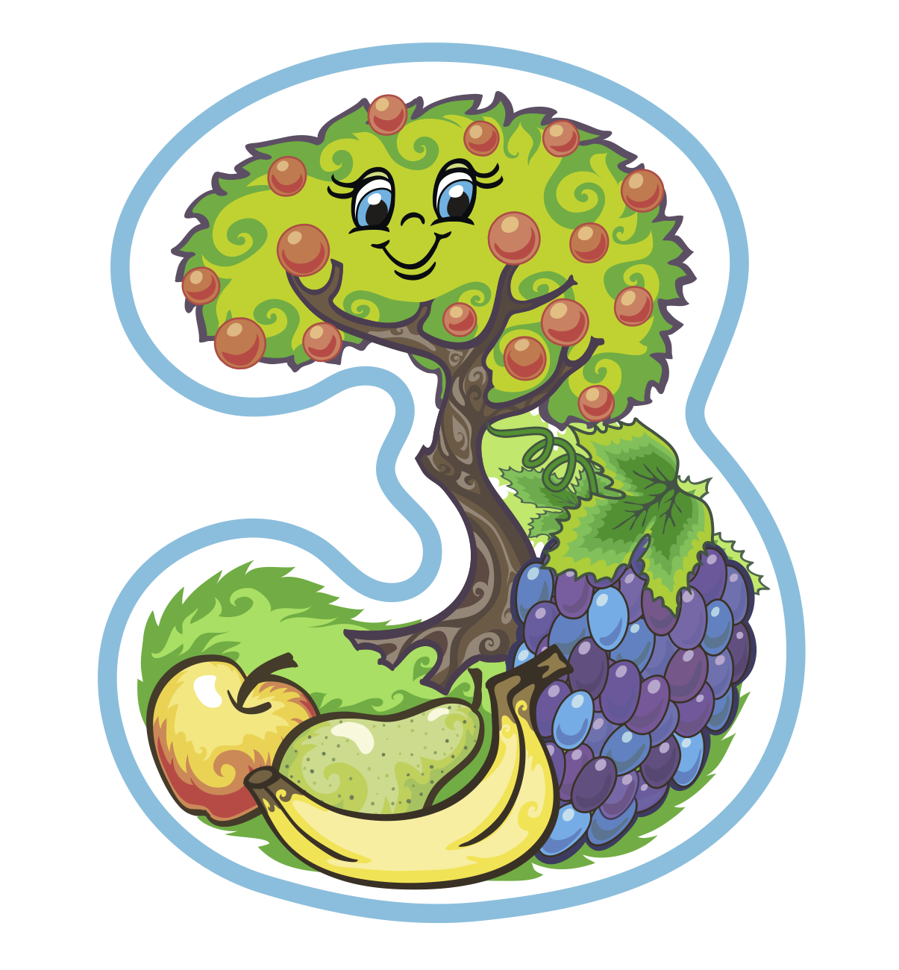
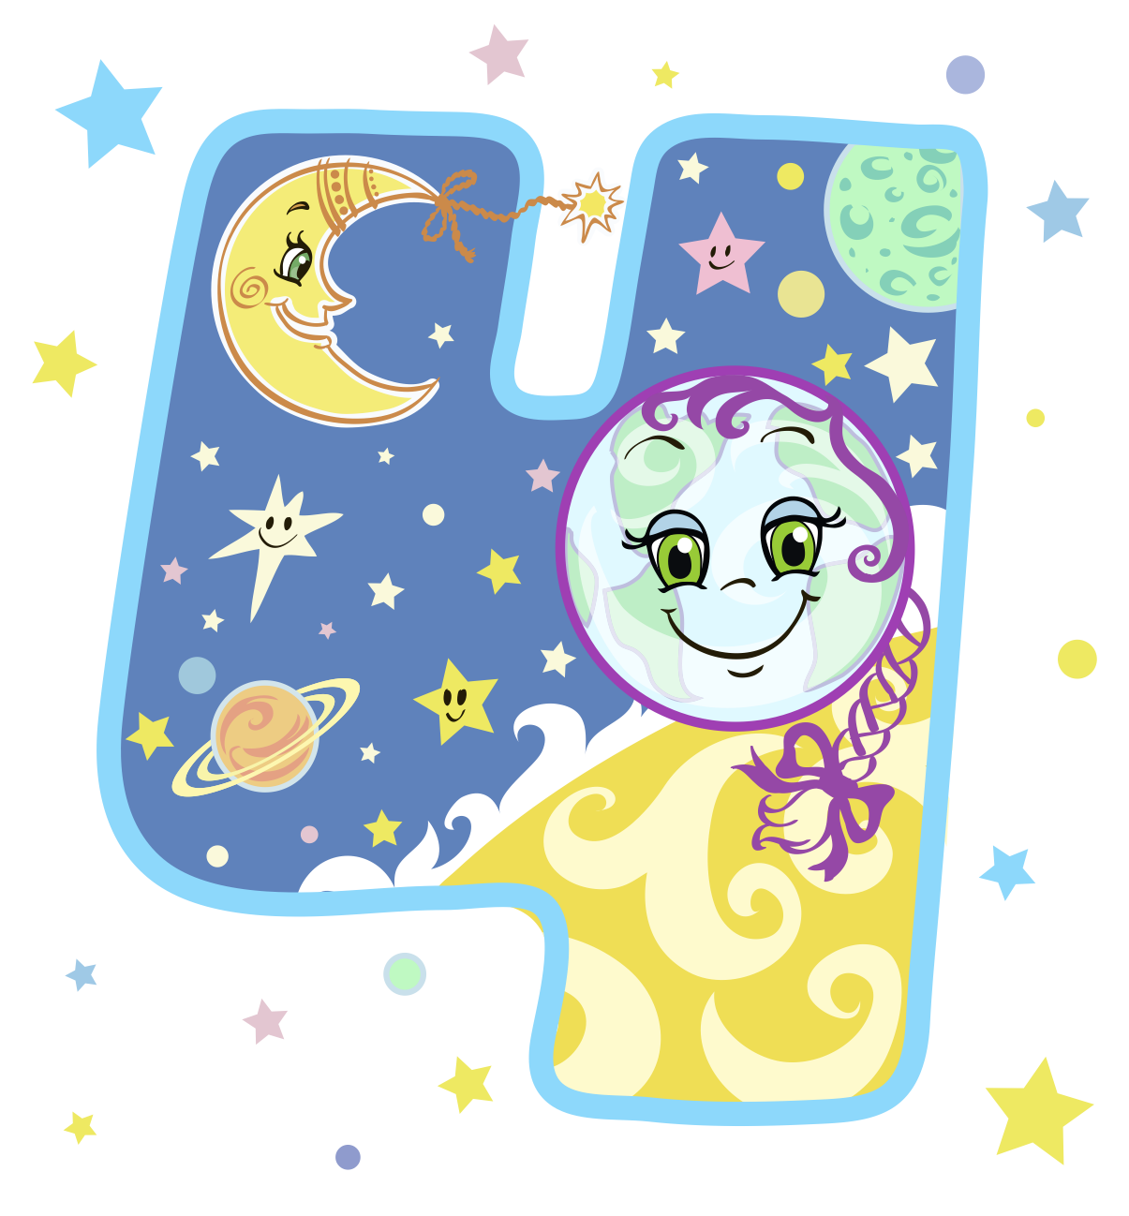

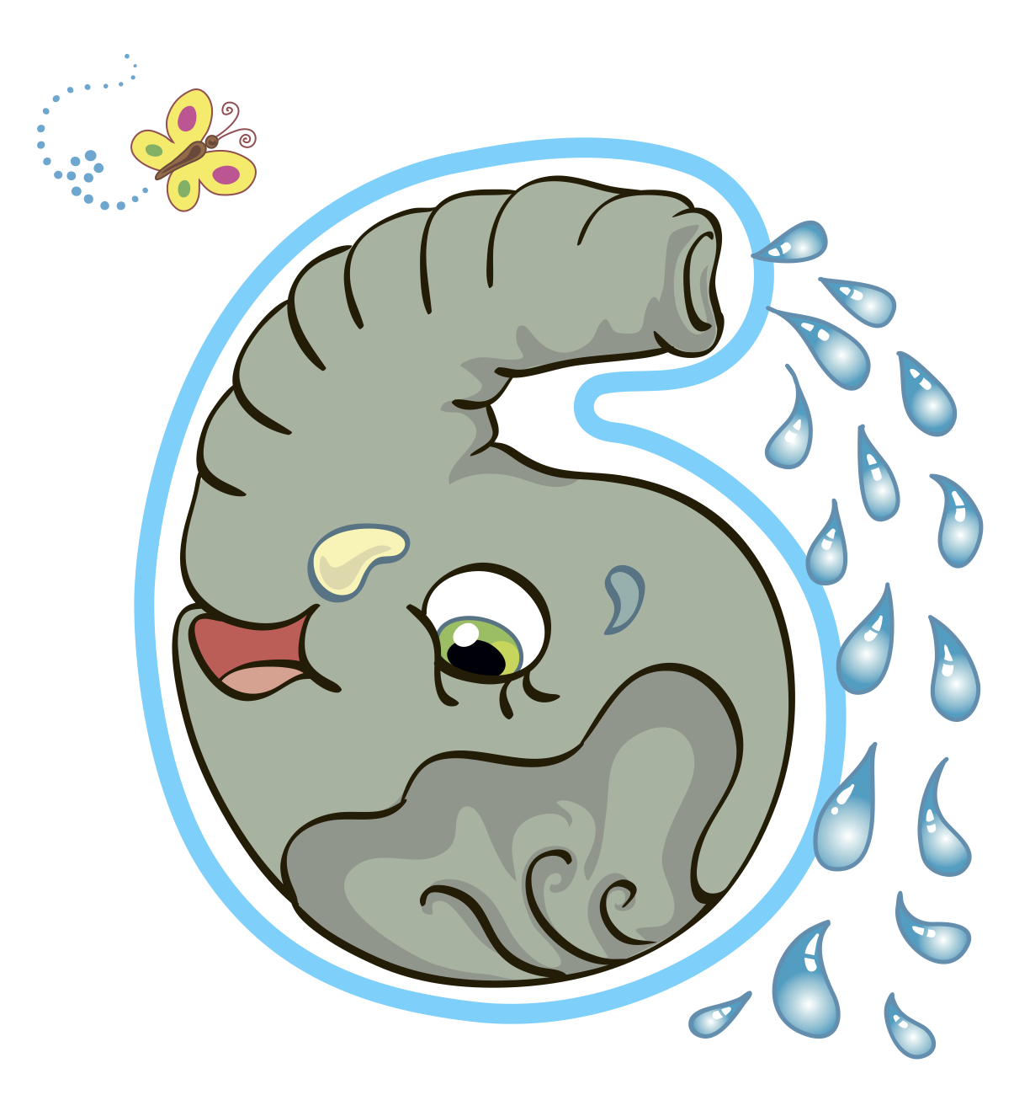
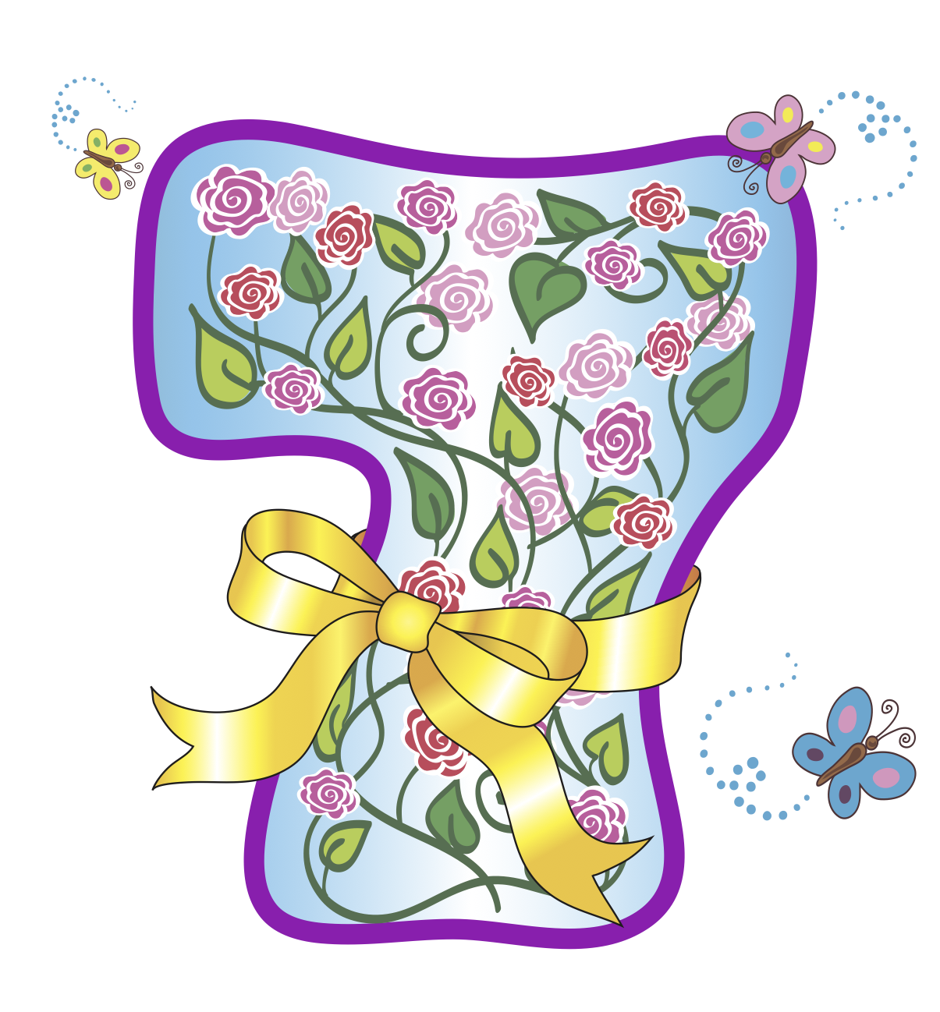
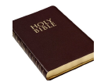

Year 2 – Autumn A
Does how we treat the
world matter?
Prior Knowledge:
Know that Christians refer to God as ‘Father’
Why Christians might compare God to a loving parent
How and why Christians might want to talk to God (prayer)
Suggest symbolic meanings of rituals and items used in Christian prayer
The 7 days of creation
Light
Sky
Land, seas, plants and trees
Sun, moon and stars
Fish and birds
Land, animals and humans
Rest
Religious Text
The special text in Christianity is called The Bible.
Place of Worship
A Christian place of worship is called a Church.
Christianity - God
Key Vocabulary

Slide 2
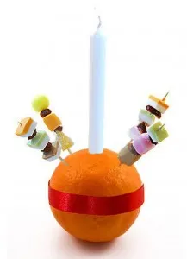
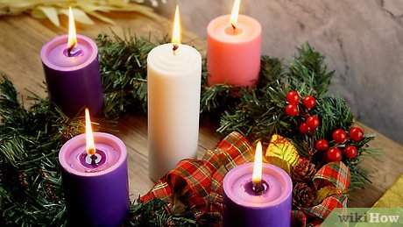
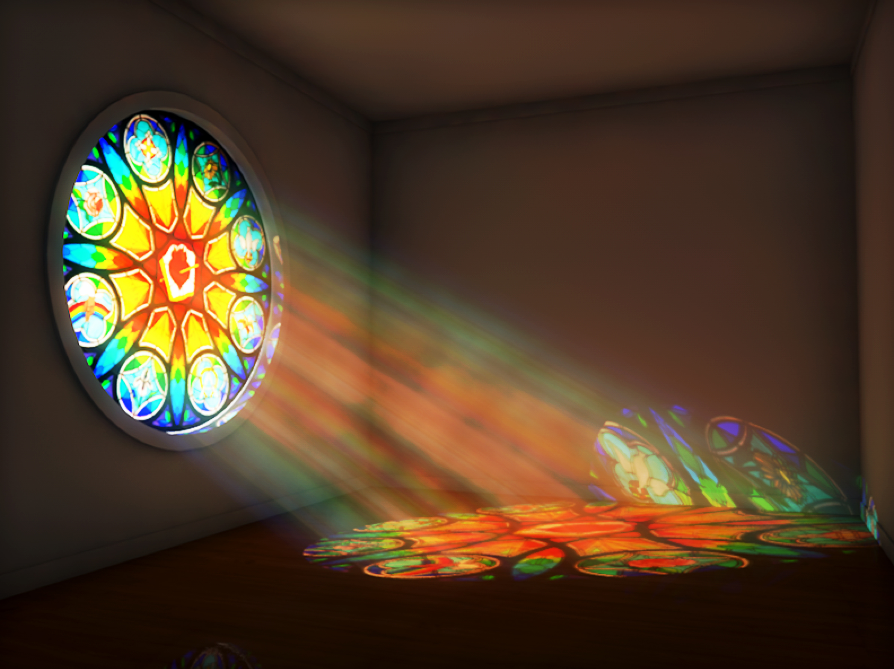
Year 2 – Autumn B
Why do Christians say Jesus
is the ‘Light of the World’?
Prior Knowledge:
A simple version of the nativity story
Why Christians would say that Jesus is a special baby
How different characters in the nativity welcome the baby Jesus
Identify religious aspects of Christmas celebrations
Why Christmas is a special time for Christians
Christingle – A tradition at Christmas that represents different Christian beliefs.
The candle represents Jesus being the light of the World, bringing hope to people.
The sweets/ dried fruit represent God’s creations in the 4 seasons.
The orange represents the world.
The red ribbon wrapped around the orange represents God’s love for the world and the blood of Jesus.
Jesus
Christians believe that Jesus is the light of the world.
Christians believe that Jesus can be the light that shows them how to live their life.
Other uses of light for Christians
Christianity - Jesus
Key Vocabulary

Slide 3
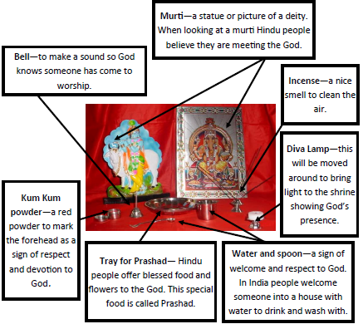
Year 2 – Spring A
How might people express
their devotion?
Prior Knowledge:
That Hindus believe in one God in many forms
That Hindus believe that God is present in all living things
What Hindus might learn about God from the story of the blind men and the elephant
How and why Hindus might use statues and images (murtis) in their worship
Suggest symbolic meanings expressed in the images
Hinduism
Key Vocabulary

Slide 4
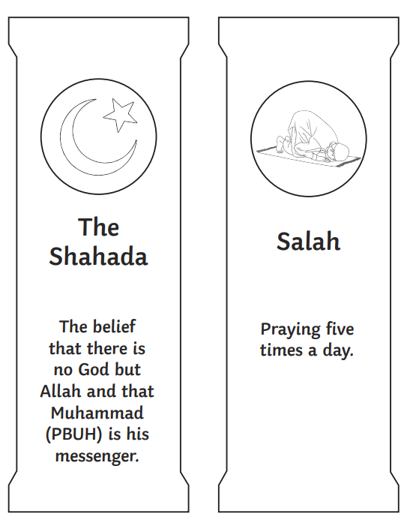
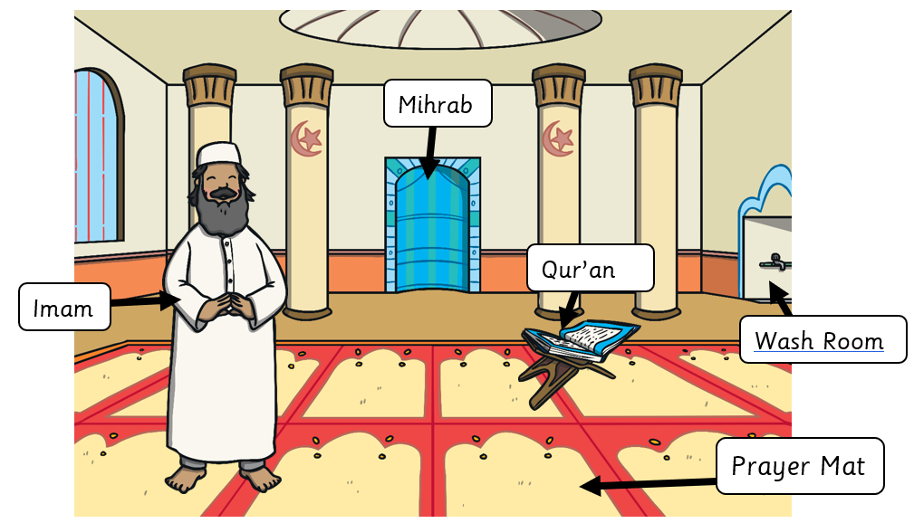
Year 2 – Spring B
Why do Muslims believe it is important to obey God?
Prior Knowledge:
That Muslims believe in one God (Allah)
That Muslims believe the world was created by God
Why Muslims might value the natural world
That Islam teaches that humans should be caretakers (stewards/Khalifahs) of the planet
Muslims might show respect for God by caring for the natural world
There are 5 Pillars of Islam. In Y2 we learn about the first 2 Pillars of Islam.
The Islamic place of worship is called a Mosque.
Islam
Key Vocabulary

Slide 5
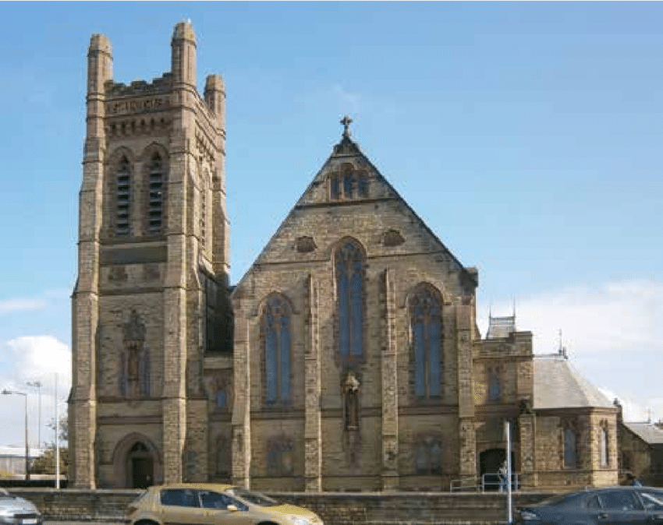
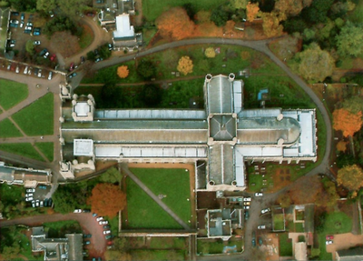
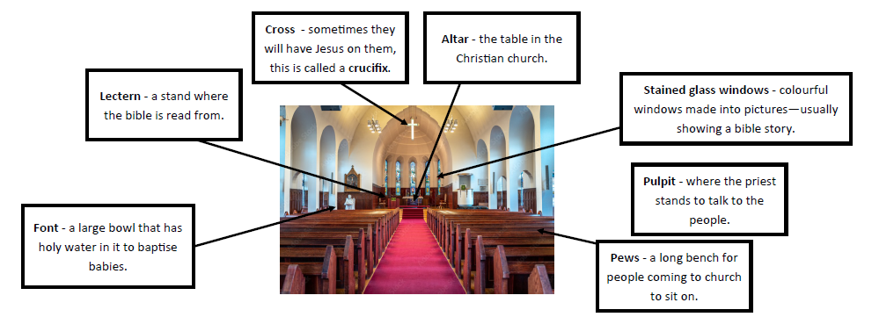
Year 2 – Summer A
What unites the Christian community?
Prior Knowledge:
That some Christians welcome babies into the God’s family (the Church) with baptism ceremonies
What it might mean to belong to the Church family
Features of baptism – eg. the font, candles, godparents
Why parents might want to have their child baptised
What is means to belong to a family
Lots of churches are made in the shape of a cross.
Lots of churches have a bell tower that has bells ringing at different times.
Cross – sometimes they will have Jesus on them, this is called a crucifix
Altar – the table in the Christian church
Lectern – a stand where the Bible is read from.
Stained glass windows - colourful windows made into pictures – usually showing a bible story
Font – a large bowl that has holy water in it to baptise babies.
Pulpit – where the priest stands to talk to people
Pews – long benches for people coming to church to sit on
Christianity - Church
Key Vocabulary

Slide 6
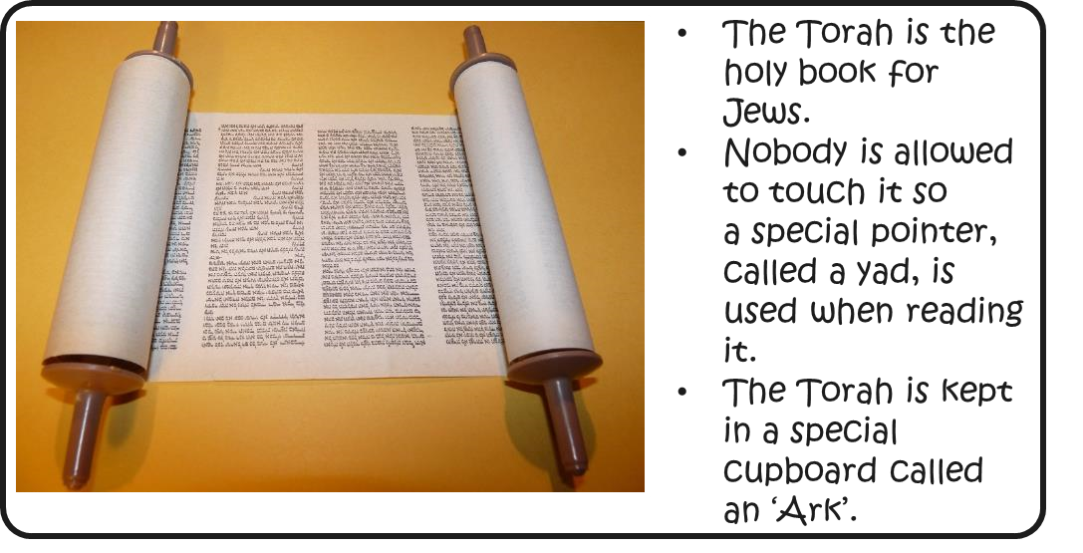
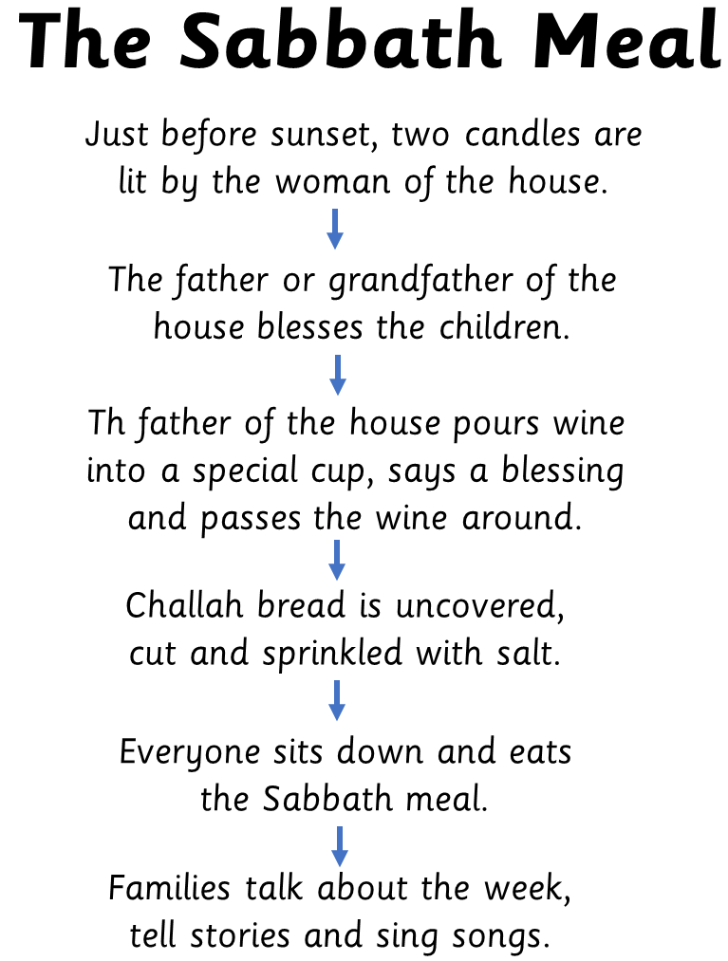
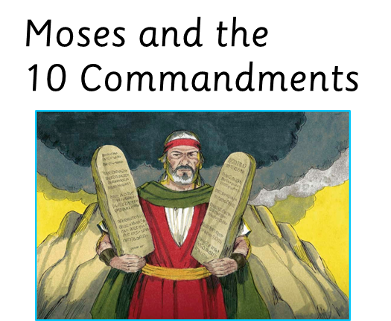
Year 2 – Summer B
What aspects of life really matter?
Prior Knowledge:
Give an example of a key belief (ie. that Jews believe in one God) and/or a religious story (the story of Noah and/or Abraham)
Give an example of a core value or commitment (trusting that God will keep his promise)
Use some religious words and phrases to recognise and name features of religious traditions (eg. Sukkot, festival)
Talk about the way that religious beliefs might influence the way a person behaves (eg. like Noah and Abraham, Jewish people should trust that God keeps his promises)
Judaism
Key Vocabulary

