Slide 1

Year 1 – Autumn A
Christianity – God:
Why do Christians say that God is a ‘father’?

Slide 2
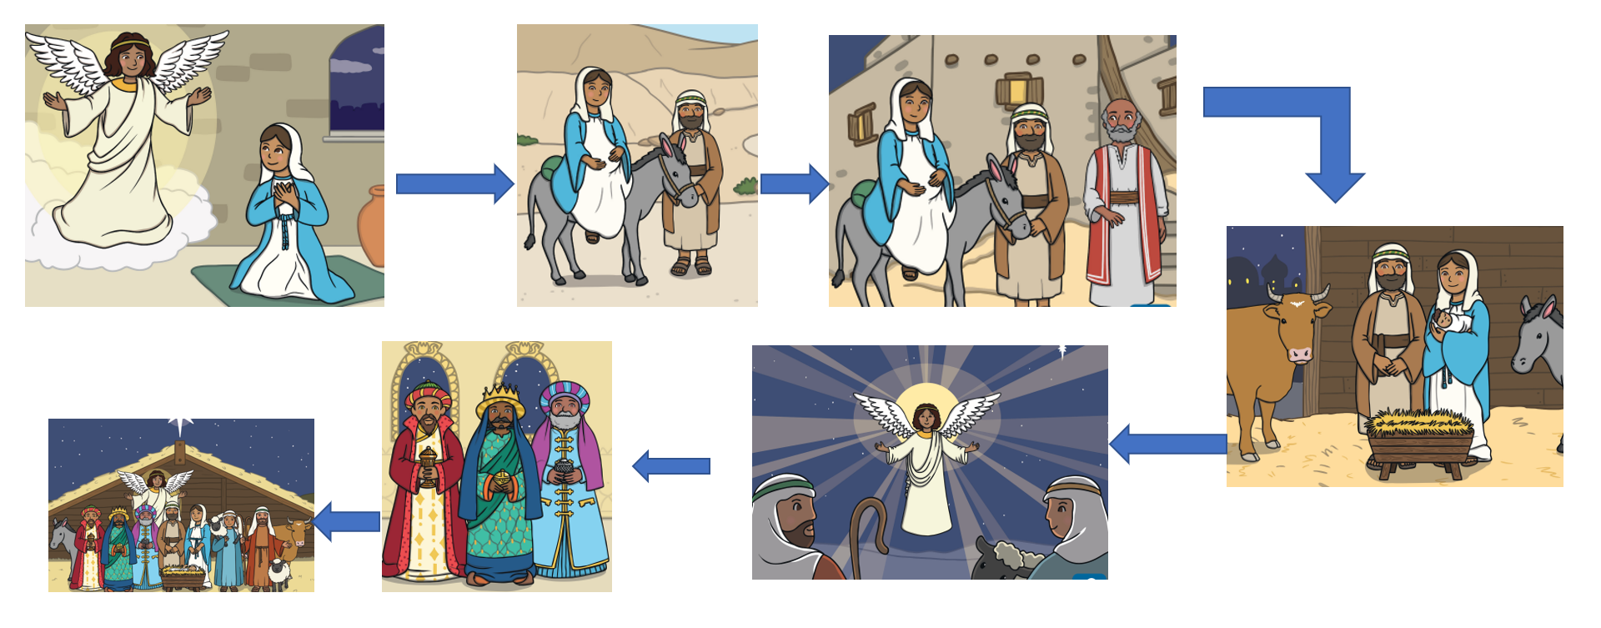
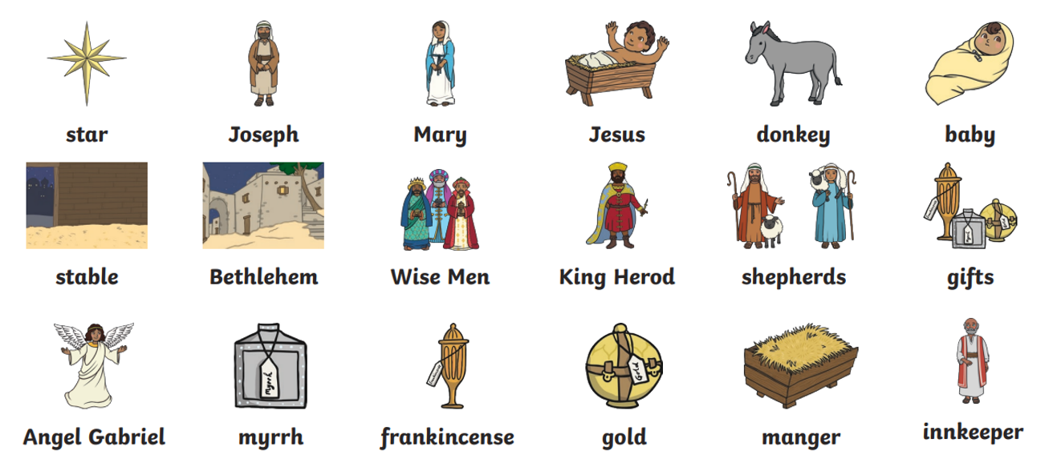
Year 1 – Autumn B
Christianity – Jesus:
Why is Jesus special to Christians?
The Nativity

Slide 3
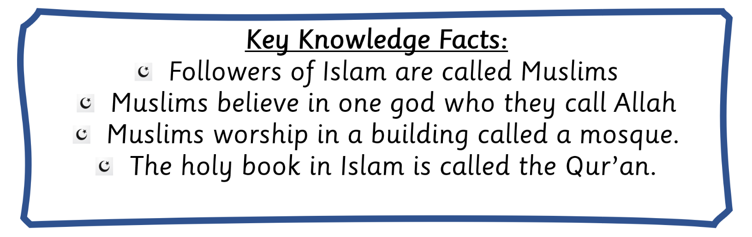
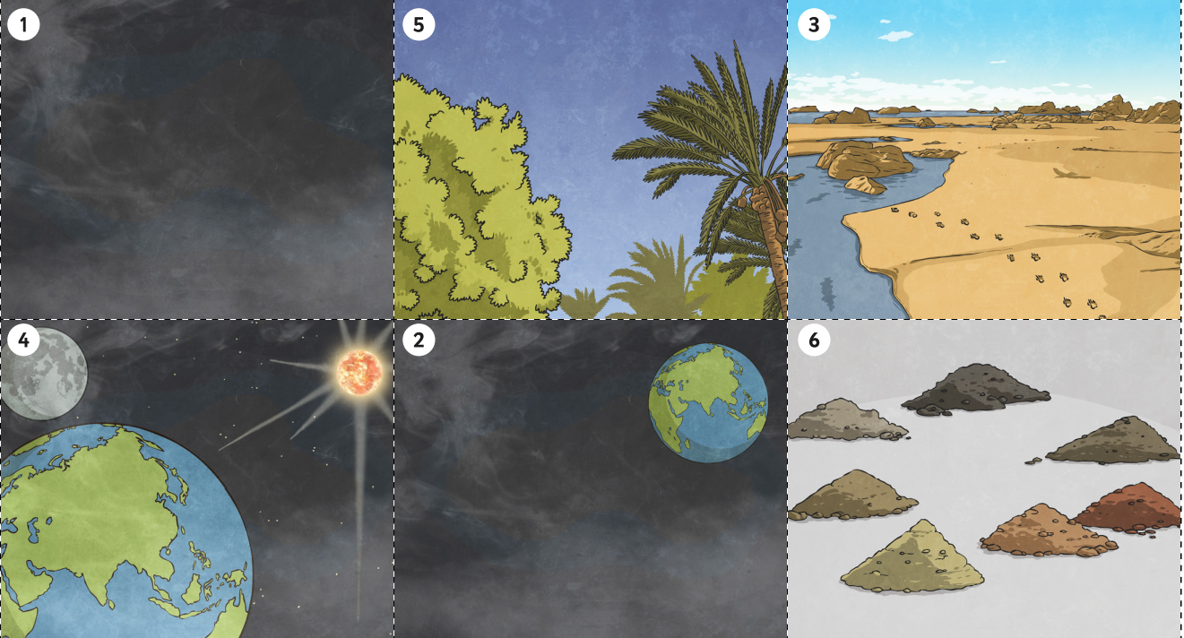


Year 1 – Spring A
Islam:
How might beliefs about creation affect the way people treat the world?
Islamic Creation Story

Slide 4
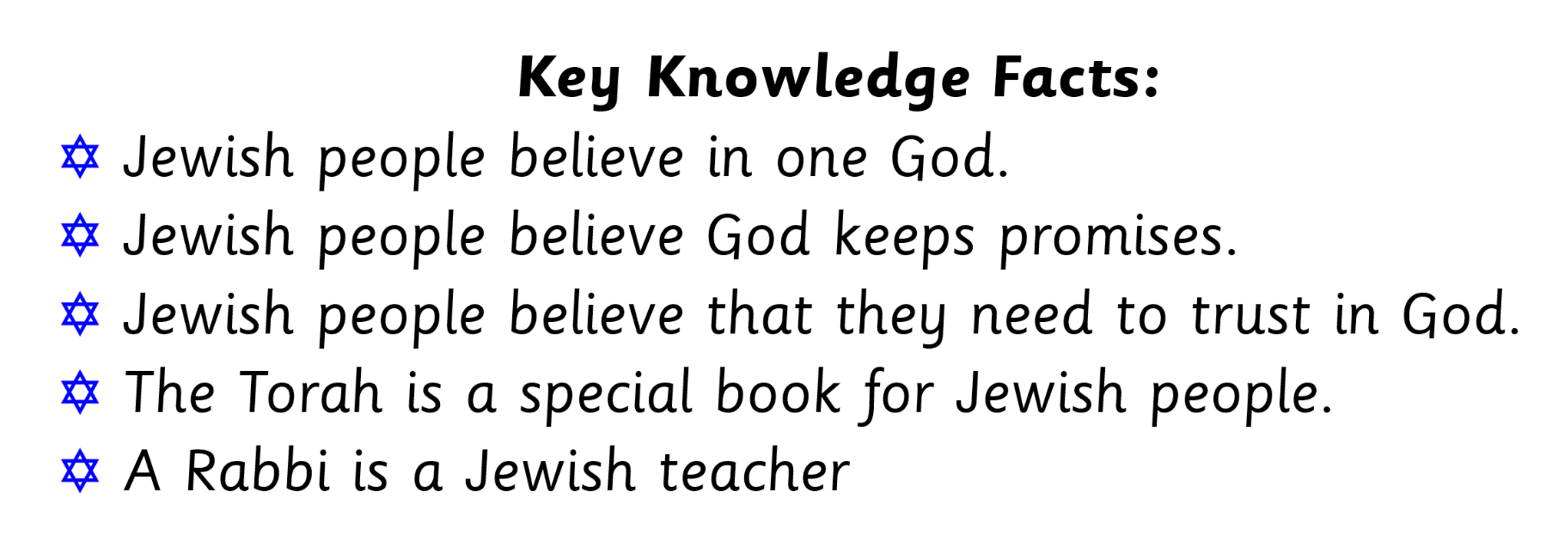
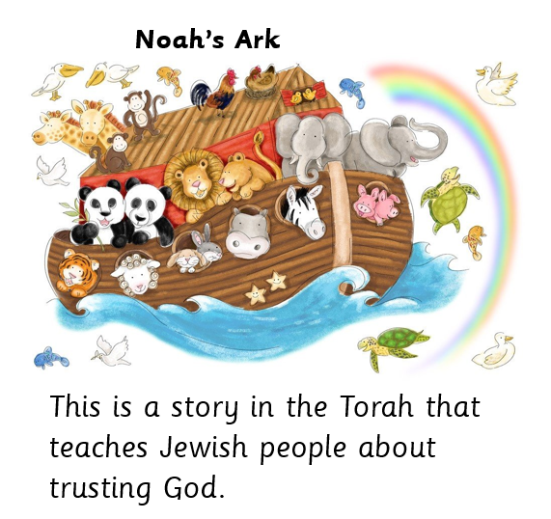
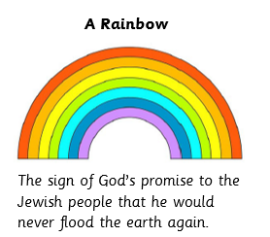
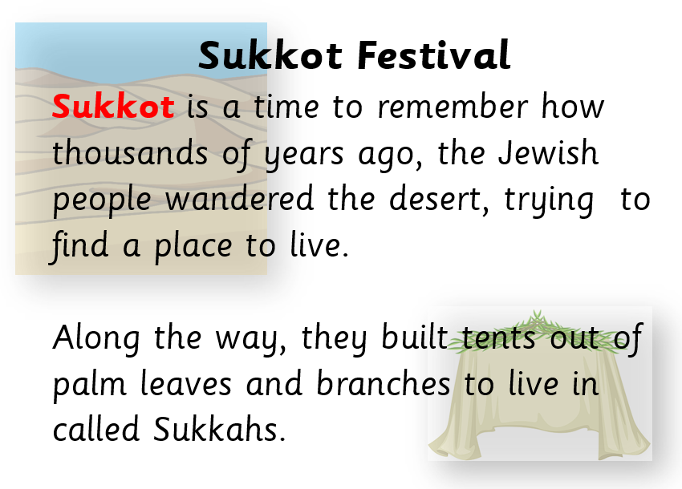
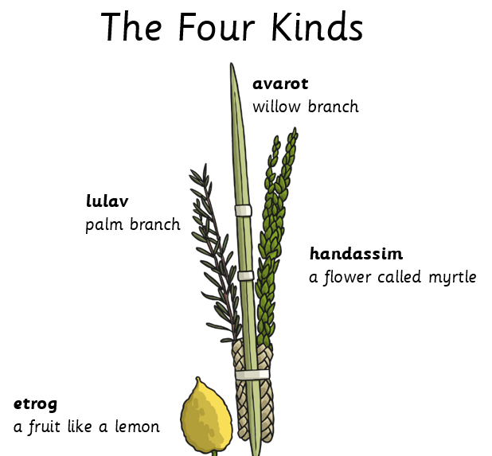
Year 1 – Spring B
Judaism:
Why might some people put their trust in God?

Slide 5
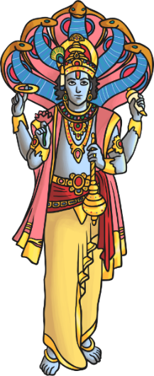
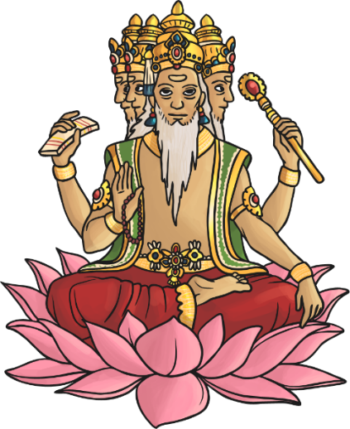
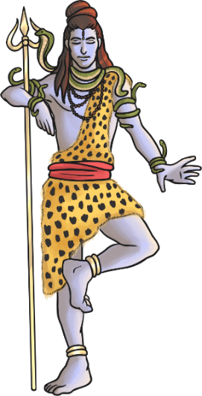
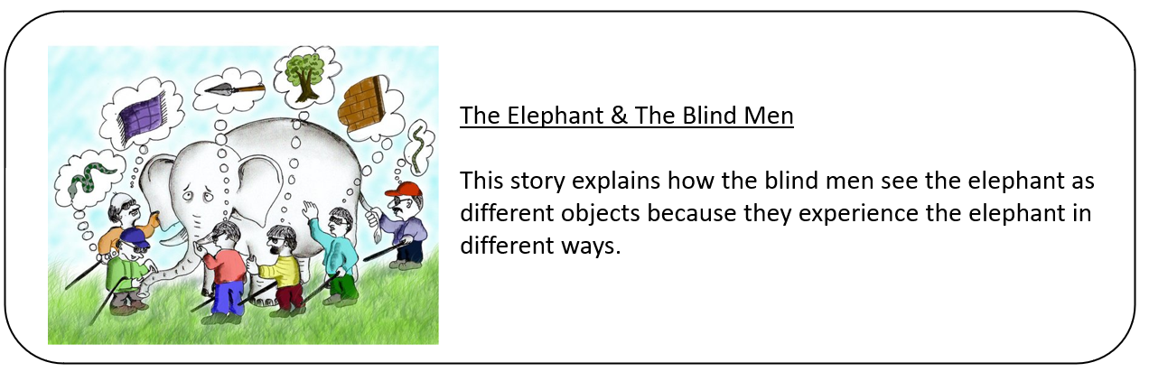
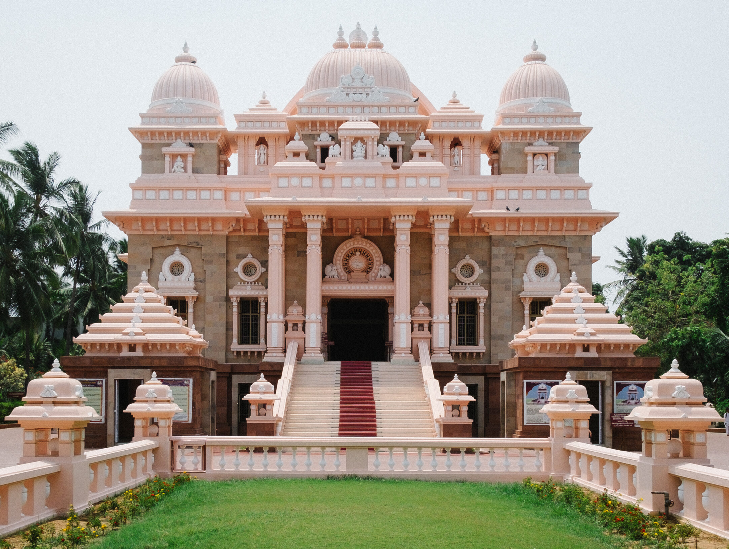
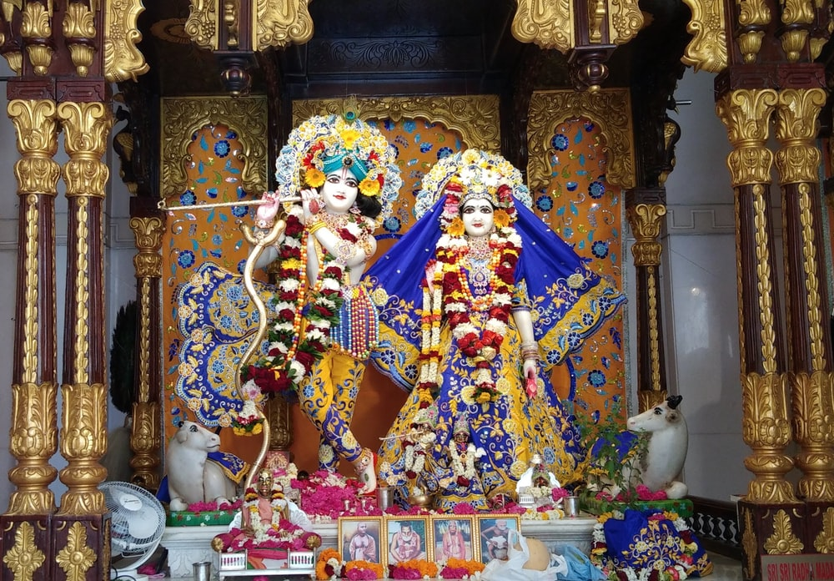
Year 1 – Summer A
Hinduism:
What do Hindus believe about God?
God:
Hindus believe in one God called Brahman.
The gods of the Trimurti represent different forms of Brahman
Vishnu – The Protector
Brahma – The Creator
Shiva – The Destroyer
Worship:
The Hindu place of worship is called a mandir, or Hindu temple.
Hindus use murtis when they are praying. They are small pictures of statues that show one deity. The objects and pictures on the deity show what they deity represents.

Slide 6
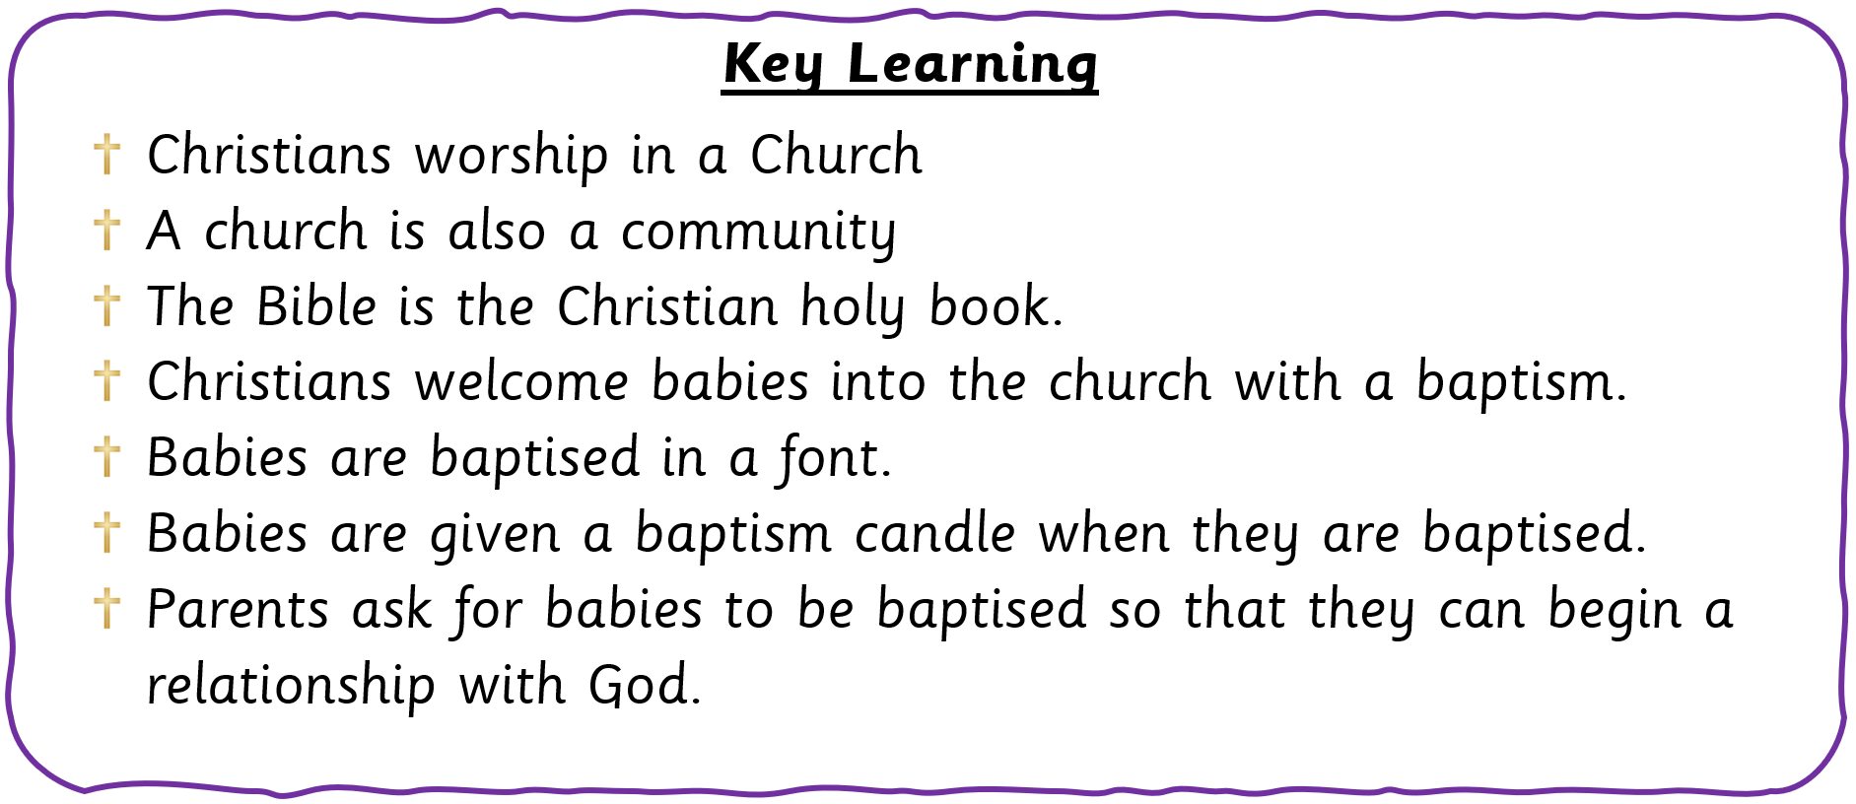
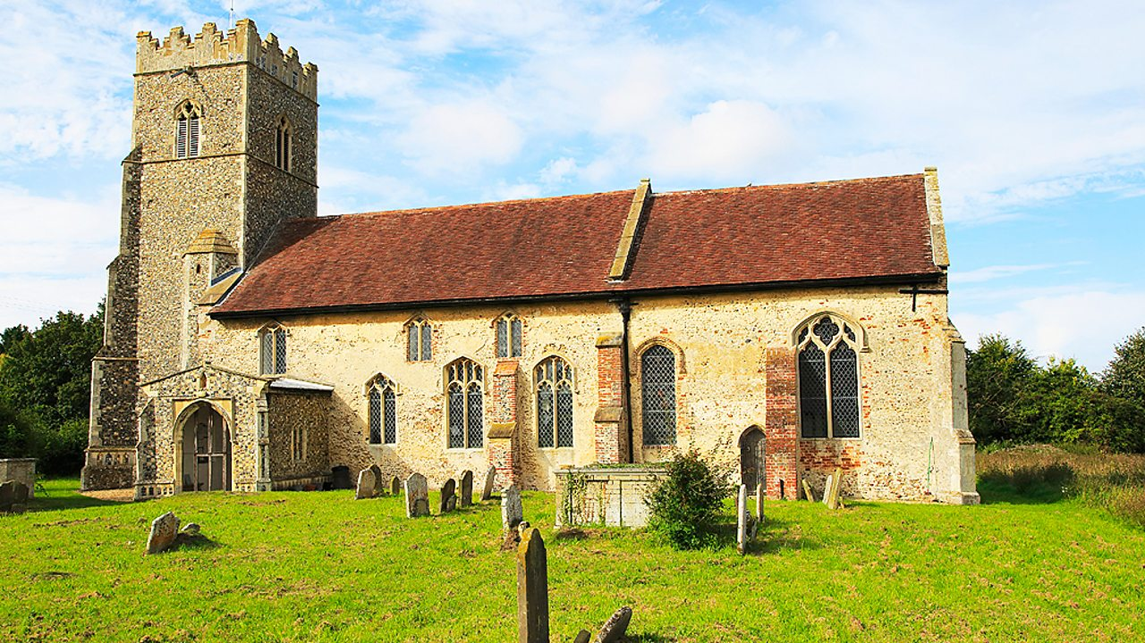
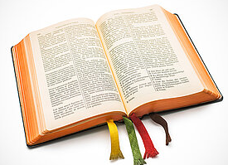
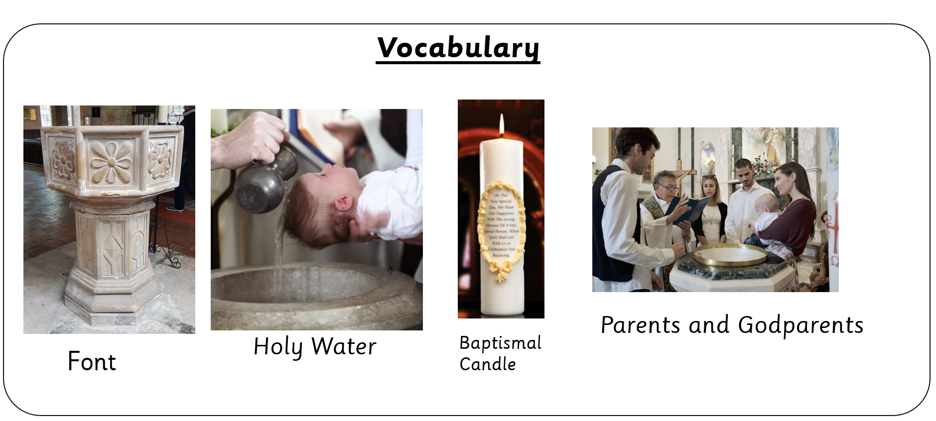
Year 1 – Summer B
Christianity – Church: How might some people show that they ‘belong’ to God?

