Slide 1

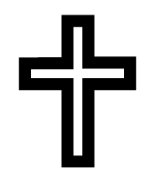
Year 6 – Autumn A
How do Christians mark
‘turning points’ on the journey of life?
Prior Knowledge:
A baptism is a Christian rite of passage into the Christian Church.
A ceremony is a formal religious or public occasion.
Christians believe Baptism is a right of passage that you must go through before you are welcomed fully into the Christian faith.
The First Baptism…
Jesus was the first person to be baptised by John the Baptist; these events are recorded in the Bible (Matthew 3: 11-17).
John the Baptist encouraged people to repent their sins and to be baptised as a sign of repentance.
John tried to refuse to baptise Jesus.
Christians believe that when Jesus was baptised God’s voice was heard and the heavens opened to welcome him.
Infant Baptism | Believer’s Baptism
Baby, godparents and parents are welcomed Readings from the Bible Water poured over the baby’s head Godparents are given a lit candle Baby may be dressed in white | Those wishing to be baptised present themselves Readings from the bible Candidates describe how they became a believer in Jesus Candidate asks for baptism and they and the minister enter a baptismal pool. They are submerged and then change clothes.
Symbol | Meaning
Water | Symbolises that sin has been washed from the body.
White garment | The colour of purity and signifies how the person has a fresh start in the eyes of God.
Candle | To remind Christians of their belief that Christ is the ‘light of the world’.
Cross | The sign of the cross ensures the person will be protected by God.
Dove | Symbolises peace between God and human beings.
Christianity - God
Key Vocabulary

Slide 2
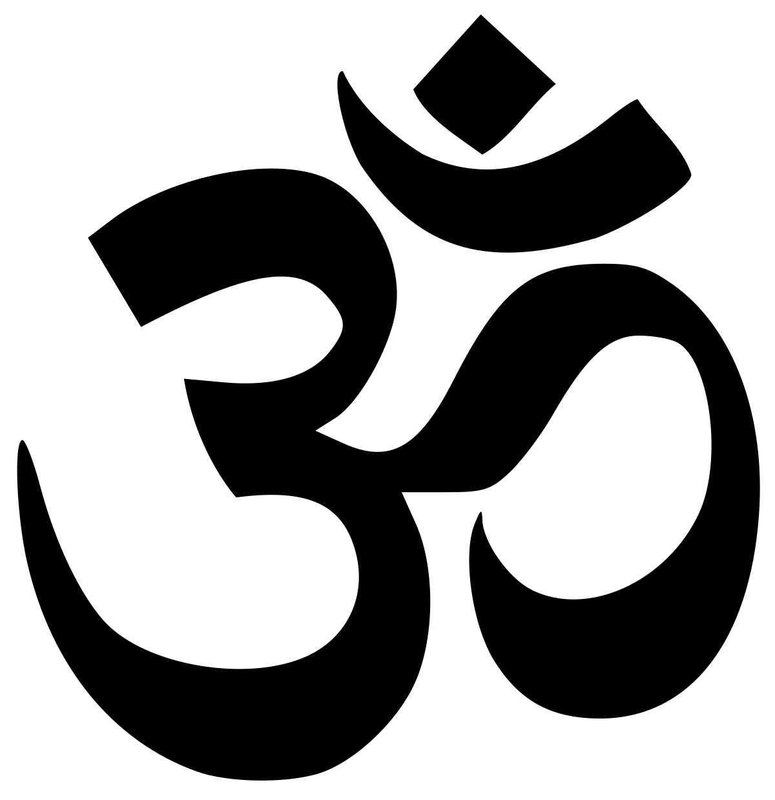
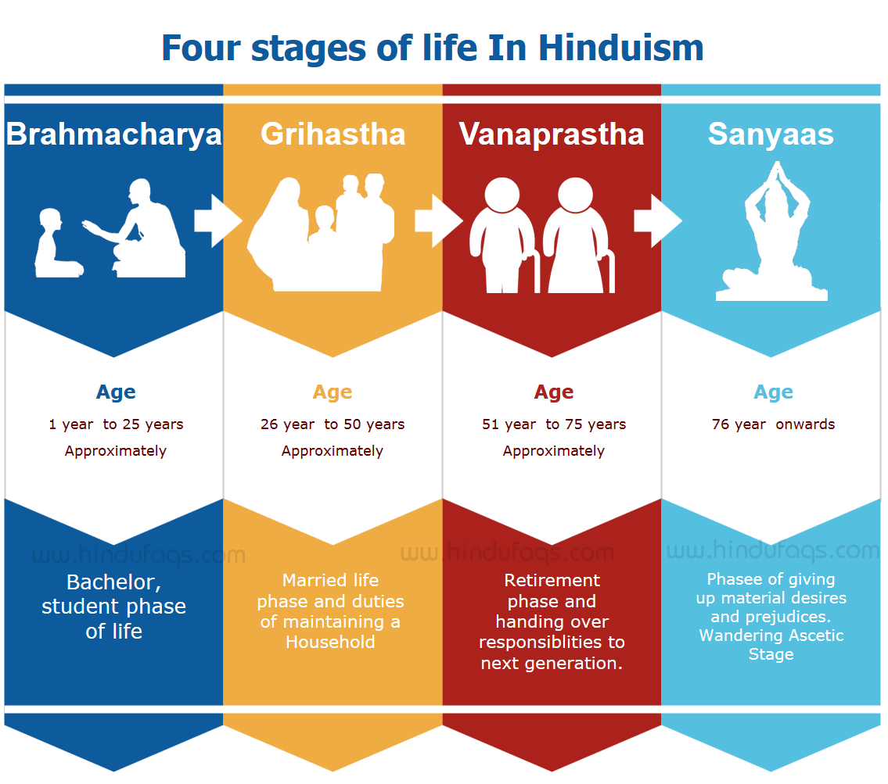
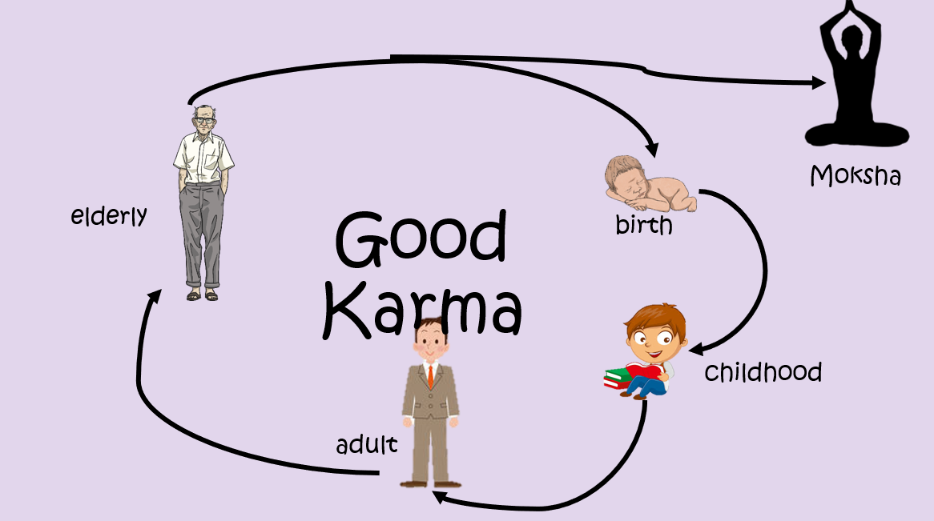
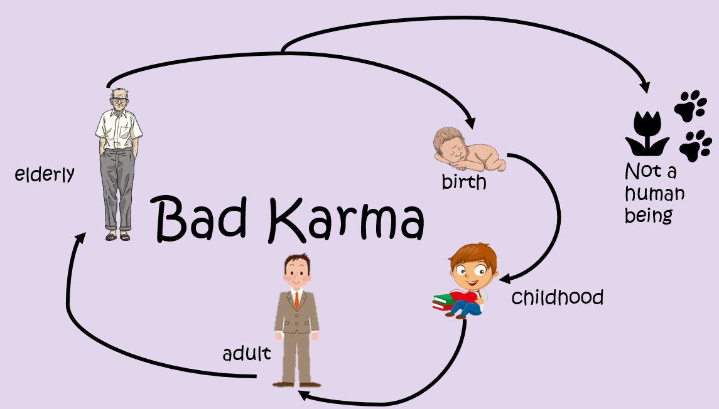
Year 6 – Autumn B
Is there one journey
or many?
Prior Knowledge:
Holi is a Hindu festival that celebrates Spring, love and new life.
Krishna is believed to be an incarnation of the God Vishnu.
Scriptures are sacred writings of a religion.
Samsara is the circle of life.
Karma is the fate of a person decided by their actions.
Hindu’s believe people are born, live and die. They are reincarnated and born again.
A Hindu’s ultimate goal is to achieve Moksha – this is the freedom of Samsara and is believed to then be at one with God.
Hinduism
Key Vocabulary

Slide 3
Year 6 – Spring A
What is Hajj and why is it important to Muslims?
Prior Knowledge:
The Qur’an is the Holy Book for Islam.
The Qur’an is a source of guidance to all Muslims.
The Qur’an was revealed to Prophet Muhammad (pbuh) on the Night of Power.
The Five Pillars of Islam
Shahadah
Faith
Salah
Prayer
Zakat
Charity
Saum
Fasting
Hajj
Pilgrimage
The Five Pillars are also five duties which are expected of every Muslim.
Hajj
Hajj is a pilgrimage to the Holy City of Mecca in Saudi Arabia.
Muslims believe that the 5 Pillars are to support and guide them to live their life in the correct way.
Ummah is important to Muslims and helps them support each other in times of difficulty. It gives a feeling of community and togetherness.
Every Muslim who is physically and financially able must make the pilgrimage. It begins on the 8th day of the Islamic year and ends on the 13^{th.}
The Hajj is the 5th Pillar of Islam.
Pilgrims walk around the sacred shrine called the Ka’ba seven times in the Great Mosque.
Islam
Key Vocabulary

Slide 4
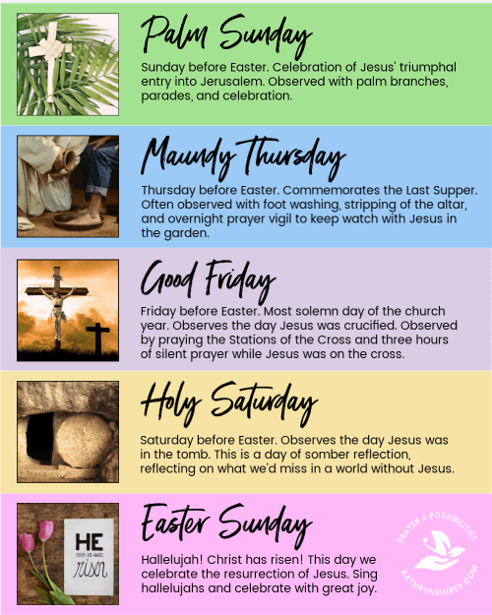
Year 6 – Spring B
Why do Christians believe
Good Friday is ‘good’?
Prior Knowledge:
Christians are expected to make sacrifices as Jesus did.
Lent is the name given to the 40 days and nights before Easter – this is the amount of time Jesus spent in the wilderness.
The bible is split into two books: the Old Testament and the New Testament.
Christians use many different symbols to help them remember the sacrifices made during Holy Week.
Easter Eggs are used as a reminder that Jesus emerged from the tomb and was resurrected.
The New Testament is split into 4 Gospels: Matthew, Mark, Luke & John. Luke 23 tells us the story of Good Friday. Matthew 21 tells us the story of Palm Sunday.
Easter Traditions
The Events of Easter
Christians use Easter as a time to remember that Jesus was crucified on a cross in Golgotha on Good Friday.
Rolling Easter Eggs is to remind Christians that the stone which blocked the tomb was rolled away.
The Eucharist takes place during most Church Services and allows Christians to remember the events of the Last Supper.
Christianity - Jesus
Key Vocabulary

Slide 5

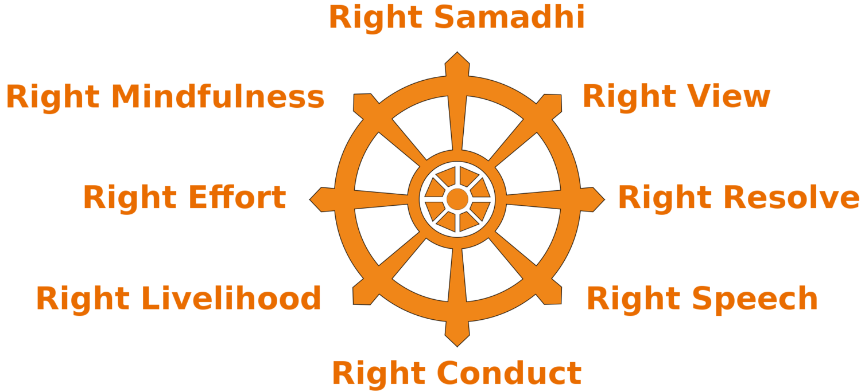
Year 6 – Summer A
What do we mean by a
‘good life’?
Prior Knowledge:
Knowledge about ‘Eastern’ and ‘Western’ religions.
Knowledge of journeys through life.
The Four Noble Truths
All lives are filled with suffering.
Suffering is caused by craving for worldly things.
Suffering will stop when people are free of their desires.
To eliminate desire and achieve Nirvana: follow the Eight Fold Path.
Prince Siddhartha
Grew up near the border of India and Nepal in a life of luxury, shielded from sickness, aging and death.
When he grew up he left the palace to travel the world. He saw a dead man, an old man and a sick man.
He saw a monk who was peaceful, despite being near this suffering.
He aimed to be like this monk. One day whilst meditating, he became enlightened (free from desire and suffering).
Ultimately, he became the Buddha – the enlightened one!
The Eightfold Path teaches people to live in a positive way and share their happiness and contentment with others.
The Eight- Fold Path
A Buddhists aim is to reach Nirvana. The way to do this is to follow the teachings of the Eight-fold path.
Buddhism
Key Vocabulary

Slide 6
Year 6 – Summer B
If life is like a journey,
what’s the destination?
Prior Knowledge:
The Trinity is made up of the Father, Son & Holy Spirit.
There is one worldwide Christian Church with many branches (also known as denominations).
Creed is a formal summary of the principles of the Christian Faith.
God will raise everyone and judge them.
The soul is immortal.
Life
after
Death
Those who have sinned and not repented will go to Hell.
Physical death is just the beginning of new life.
Christians whose sins are forgiven will go to Heaven.
The resurrection of Jesus proves that there is life after death.
Forgiveness
Confession
Christians believe there are stages to forgiveness.
In Catholic Churches, this is known as the Sacrament of Reconciliation
The Sacrament of Reconciliation
Confession of sin | Saying what you have done
Penance is given | Priest gives you something to do that will make up for the sin that was committed
Prayer of pardon | Showing remorse- also known as the Act of Contrition
Absolution | Sin is forgiven by God
Contrition Show sorrow or repentance
Confession Saying the sin aloud and requesting forgiveness
Absolution Receiving the healing power of Jesus
Christianity - Church
Key Vocabulary

