Slide 1

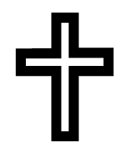
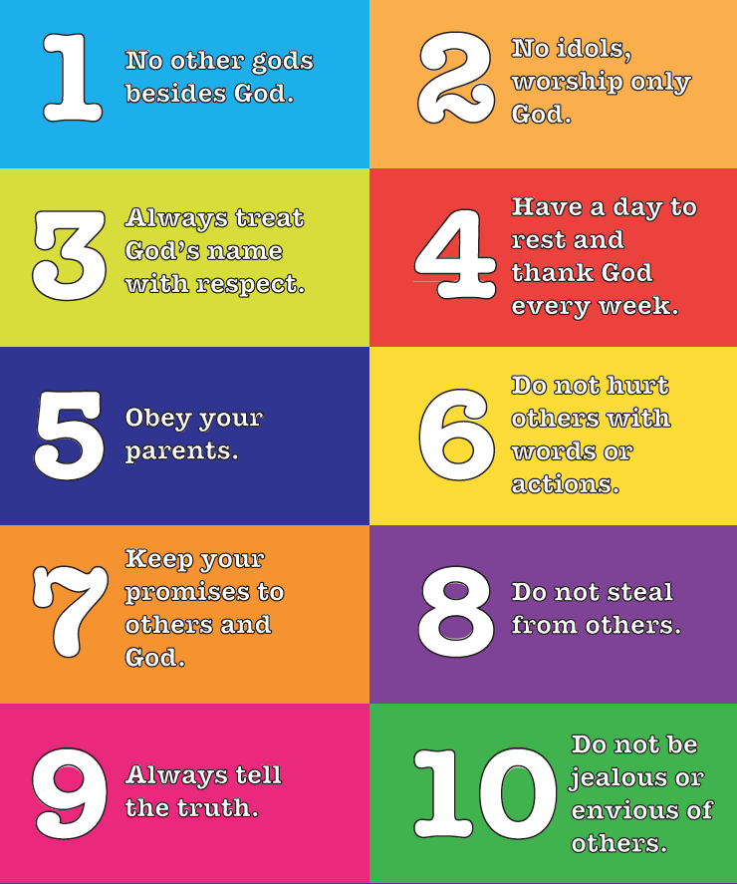
Year 5 – Autumn A
Why is it sometimes difficult
to do the right thing?
Prior Knowledge:
The Bible is a collection of books written by different authors at different times.
It is made up of 55 books in two sections. There are 39 books in the Old Testament and 27 in the New Testament.
The New Testament is the second part of the Christian Bible that shows Jesus’ life and teachings.
Forgiveness in the Bible:
One of the most important parts of Christianity.
It does not mean that people ‘get away’ with things, but they make more of an effort to forgive people.
Christianity teaches about sin and temptation and acknowledges that it is sometimes difficult to do the right thing. Through prayer, forgiveness can be found.
Forgiveness is a theme which can be found in many Bible stories.
Avoiding Evil & Temptation
The Ten Commandments
The Lords Prayer
…Forgive us our sins, as we forgive them those who sin against us. And lead us not into temptation, but deliver us from evil…
Bible Story | Where can I find it? | What does it teach Christians?
Creation | Genesis 1 | That God created everything to work together in harmony.
Adam & Eve | Genesis 3 | When people give into temptation and the wrong thing. They have to face consequences of their actions.
Parable of the Lost Son | Luke 15: 11-32 | God will forgive them if they are willing to be humble and own up to their mistakes.
Christians say this prayer often when they ask for forgiveness. They ask God to protect them from temptation and evil.
To help them avoid evil and temptation, Christians follow the rules as set out in the 10 commandments.
These are the 10 rules, from God, designed to guide people in their lives.
Christianity - God
Key Vocabulary

Slide 2


Year 5 – Autumn B
Why is the Qur’an so
important to Muslims?
Prior Knowledge:
Underpinned by the five pillars of Islam.
Muslims give charity to those in need.
It is a source of guidance and authority.
The Night of Power is celebrated during Ramadan.
It is remembered on the 27th day.
Muslims study the Qur’an to learn all they can.
The Qur’an
The Night of Power
It is also known as the festival of Laylat al Qadr.
This is the Holy Book for Islam.
It is written and read in Arabic.
It is believed to be the holiest night of the year.
The Qur’an was revealed to Prophet Muhammad (pbuh) on the Night of Power.
For Muslims, the Qur’an is the direct word of God as revealed to the Prophet Muhammad (pbuh).
Muslims celebrate by attending the mosque, praying and studying the Qur’an.
Islam
Key Vocabulary

Slide 3
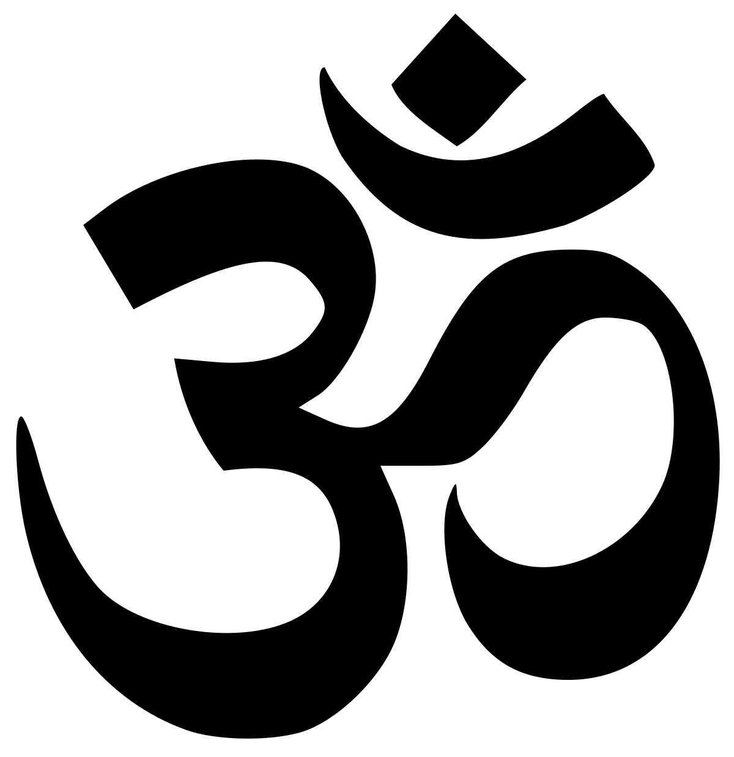
Year 5 – Spring A
What might Hindus learn from stories about Krishna?
Prior Knowledge:
Hindus believe in one God called Brahman which is made up of three parts: Brahma, who creates the universe; Vishnu, who preserves the universe; and Shiva, who destroys the universe.
An avatar is an animal or human form of a God.
A moral is a lesson that can be found in a story.
Krishna is believed to be an incarnation of the God Vishnu.
In stories about Krishna, there are many universal morals and truths to be found.
Story | Universal Truth
The Divine Prophecy | Never disrespect your parents.
Krishna’s Foster Home | Where there is a will, there is a way.
Krishna’s love for butter | Focus on the solution, not the problem.
Nalakuvara and Manigriva | Believe in miracles; they do happen.
The festival of Holi celebrates the Hindu god Krishna and the legend of Holika and Prahlad.
Holi
At Holi, distinctions between people are forgotten. Everyone looks the same when covered in coloured powder.
It is a reminder of equality and that all people are believed to contain the energy of Brahman.
It is known as the festival of colours.
For many, Holi is a time for fun. It involves dancing, singing and throwing powder paint and coloured water.
Hinduism
Key Vocabulary

Slide 4
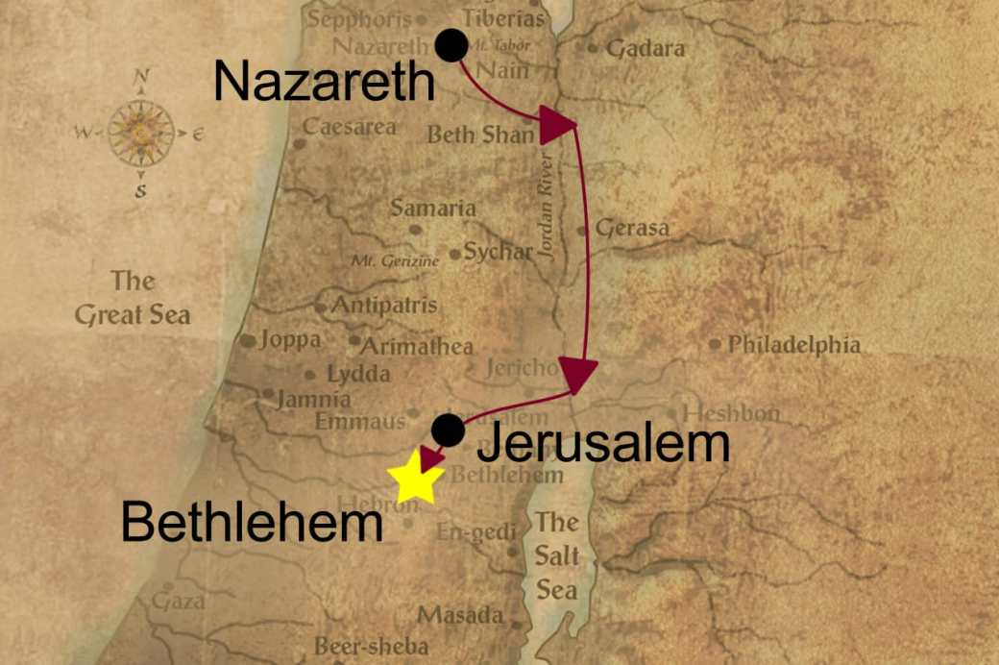
Year 5 – Spring B
What do we mean by a
miracle?
Prior Knowledge:
Christians are expected to make sacrifices, as Jesus did.
Temptation is the desire to do something – usually something wrong.
The Miracles of Jesus
Christians believe that Jesus conducted many miracles whilst alive. They believe they showed the compassion Jesus had for his people.
Miracle | What happened | Where is the story?
Feeding of the 5000 | Using only 5 loaves of bread and 2 fish, Jesus fed thousand of people. | Matthew 14:13-21
Jesus walks on water | The disciples were on a boat struggling to row against the wind, Jesus walked across the water to meet them. | Matthew 14: 22-23
Jesus heals a blind man | Jesus saw a blind man begging. He spat on the ground, made a mud and rubbed in on the man’s eyes. When the man washed, he was able to see. | John 9: 1-12
Miracles demonstrate that Jesus is divine as Christians believe these actions are Godly. It is believed that Jesus can perform miracles because he is God come down to earth. However, he also lives half his life as a human.
Christians believe that the ultimate miracle of Jesus was his resurrection.
Pilgrimage
Some Christians choose to go on a pilgrimage to the Holy Land. This is where it was believed Jesus was born and lived.
Some people go on a pilgrimage when they are looking for a miracle. It can help them overcome something in their life that is difficult.
The ability to rise from the dead three days after being crucified is proof that he was divine as only God has power over life & death.
Pilgrimage is not compulsory. Many people choose to do it to feel connected to the worldwide community.
Christianity - Jesus
Key Vocabulary

Slide 5
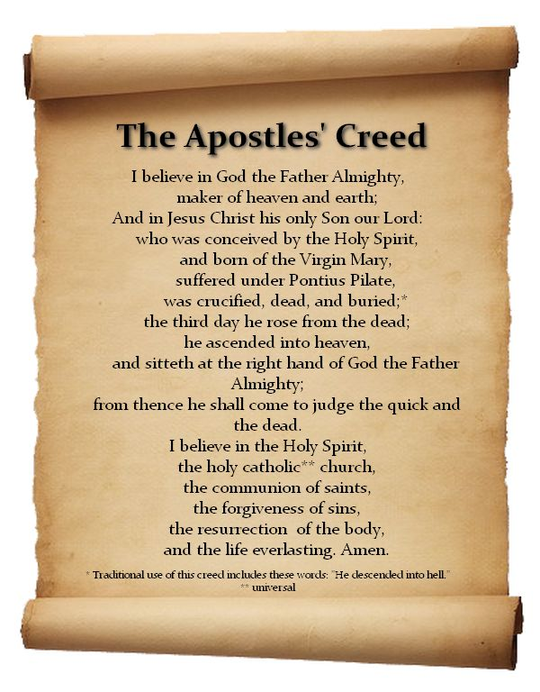
Year 5 – Summer A
How do people decide
what to believe?
Prior Knowledge:
Churches are a place of worship. Many of them have features that represent Christianity including crosses and bells.
The Apostle’s Creed
Denominations
Creed comes from the Latin word ‘credo’ which means I believe and trust.
Christians believe that the creed unifies them.
It includes the teachings of Jesus’ earliest followers (the disciples).
Having a creed meant that people couldn’t cause trouble by teaching things that went against what Jesus himself said.
The creed is still used today.
This is a summary of what the Church teaches including the beliefs of Christians.
There is one worldwide Christian Church with many branches (denominations).
They all share the same basic beliefs; God the creator, Jesus Christ & the Holy Spirit.
There are slight differences in how the Churches understand the teachings and how they should live a Christian life; some are stricter than others.
The differences are clear to see when exploring how they worship. Some focus on certain elements of The Trinity.
The Trinity
Some communities are ecumenical.
They bring together different denominations.
Christianity – Church
Key Vocabulary

Slide 6
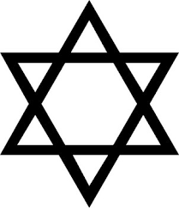
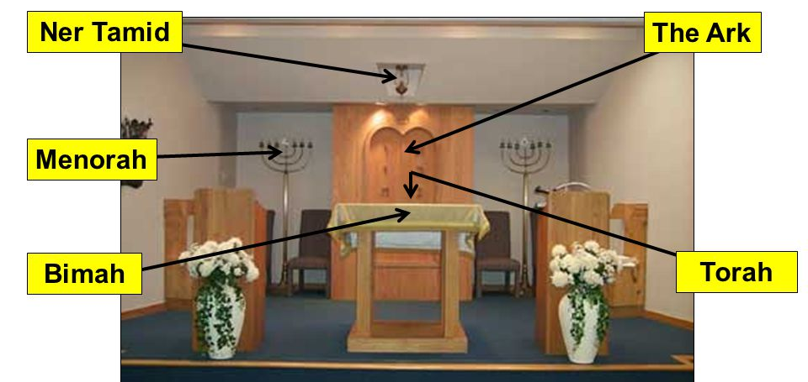
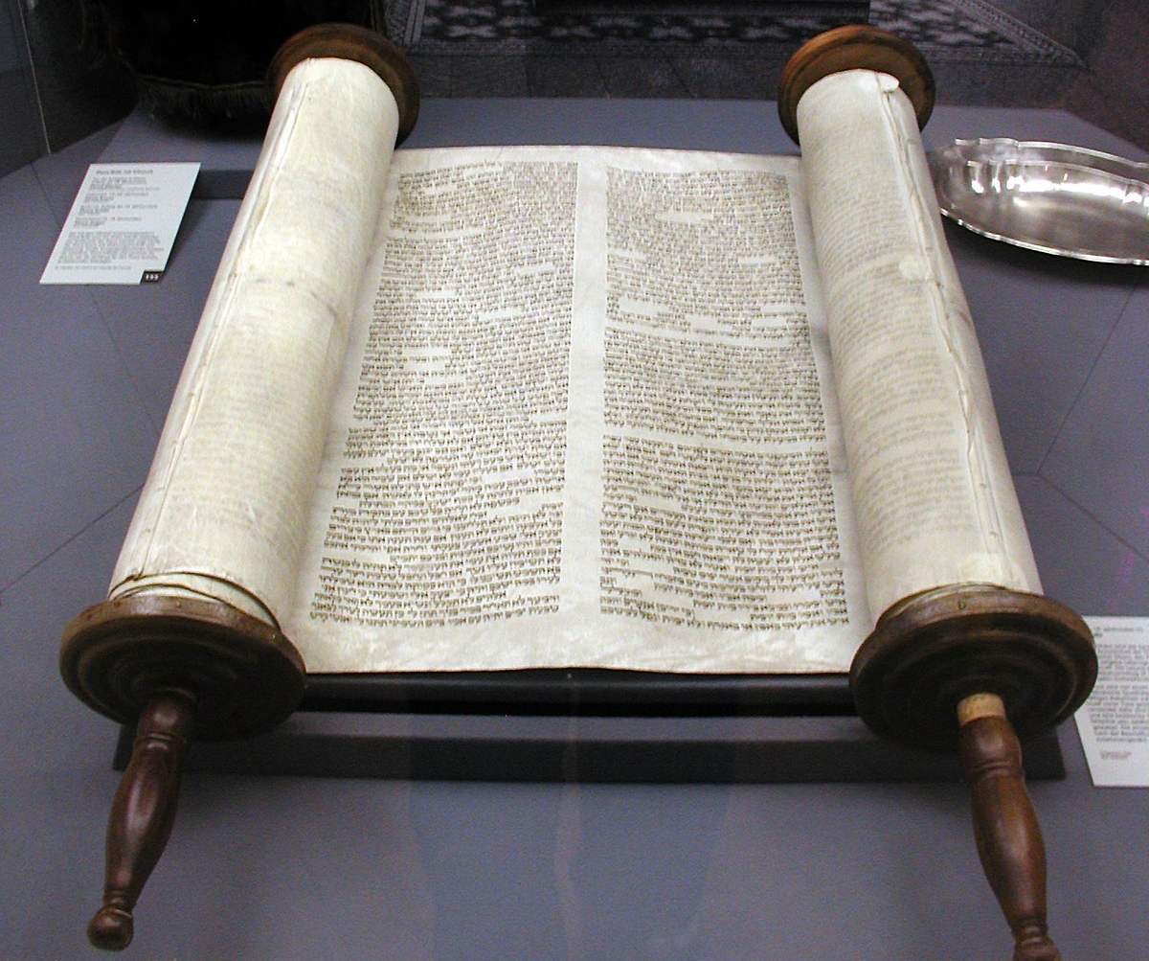
Year 5 – Summer B
Do people need laws to
guide them?
Prior Knowledge:
The Shabbat is the Holy Day. The Torah is the Holy Book.
Sabbath is a day of religious observance and abstinence from work – Jewish people observe from Friday evening to Saturday evening.
Life lessons | The Torah | Worship
Stories from the Torah have lessons for Jews and help to guide them. The Torah is the foundation of how to live as people of God. The stories in the Torah teach Jews how to be obedient to God. The story of Abraham teaches us to put faith in God. | The Torah is the Jewish holy book. The Torah was given to Moses when God made a promise with the Jewish people. The Torah contains 613 rules that teach people how to live. Moses and Abraham are both prophets of Judaism and their stories are shared in the Torah. Jewish people learn from and study the Torah throughout their lives. | Jewish people worship in the synagogue. The services are run by a Rabbi. Men and women sit separately during worship. Worship is important – it brings the community together. Attending the service gives Jews time to focus on God. Moral and religious teachings are passed to the people. Main features: Bimah, Ark and Yad. The home is often regarded as the most important place of worship and includes prayers, observing Shabbat & Sabbath and studying the Torah.
Judaism
Key Vocabulary

