Slide 1

BLEAK HILL PRIMARY SCHOOL
Year Ahead Information
Year 1 - September 2025

Slide 2
Welcome to Year 1
Miss Malone - 1MA
Mrs McDowell & Mrs Rimmer – 1MR
Miss Mercer – 1ME
Miss Moorcroft – 1MA
Mrs Fairhurst – 1MR
Mrs Ashcroft & Another – 1ME
Future Gym – Mr Mason
PPA staff – Miss Tickle, Miss Lang and Mrs Marsden
Notes:
Kim

Slide 3
Start/End of the Day
Year 1 arrive at the classroom doors between 8:45am-9:00am.
Year 1 go home via the classroom doors at 3:20pm.
Notes:
Kim

Slide 4

Curriculum Subjects
Maths
English
Art
Geography
Music
DT
History
PHSE
PE
Computing
Science
RE
Notes:
Sue

Slide 5
Subject Coverage
Within Geography, we study:
Our school area, the UK and weather patterns.
Within History, we study:
Famous Queens, toys from the past and changes in transport.
Within Science, we study:
Everyday materials, seasonal change, plants, animals, including humans and significant scientists.
Notes:
Bern

Slide 6
Subject Coverage
Linked to our curriculum we will be going on some exciting trips.
In Autumn we will be visiting The Blue Planet Aquarium
Spring term will be visiting a local church.
Summer term will be going to Martin Mere.
Dates to be confirmed.
Notes:
Bern

Slide 7
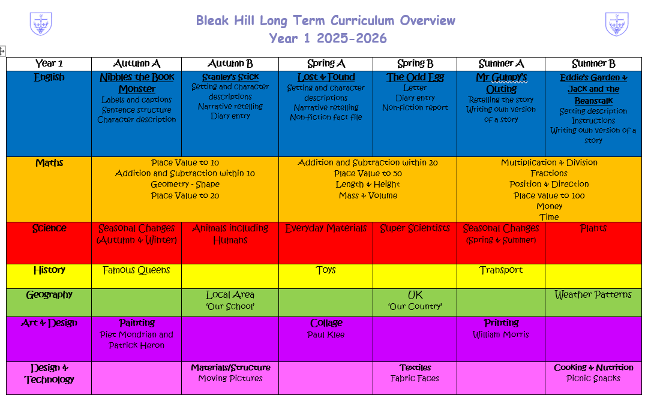

Curriculum Overview 2025/26
All other subject coverage is detailed on this Year 1 Curriculum Overview document.
This will be on the Year 1 class page on the school website.
Notes:
Laura

Slide 8




Knowledge Organisers
We use knowledge organisers to present the children with key information or ‘sticky facts.’
These will also be available on the Year 1 class page on the school website.
Notes:
Kim

Slide 9


Behaviour
As part of our PSHCE and Jigsaw lessons, we have created our Class Charter to make the classroom a safe and happy place to learn. We celebrate learning and achievements using our app: Marvellous me
Rewards
1. Positive Praise
2. Thumbs up/Badges (Marvellous Me)
Stickers/Certificates
Merit Awards
Share work with Leadership Team
Notes:
Bern

Slide 10
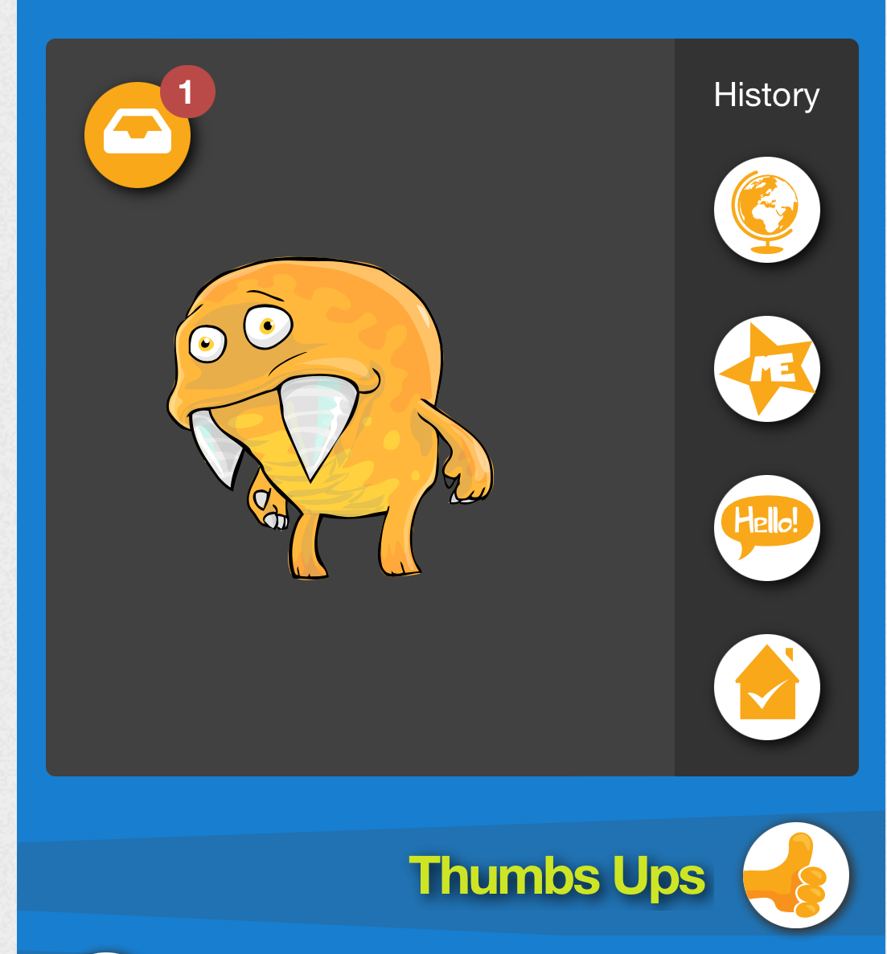
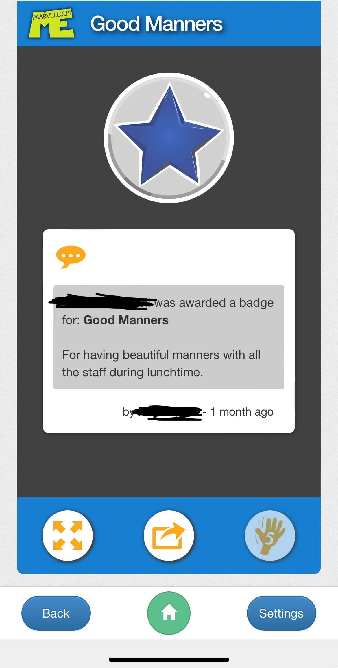
Marvellous Me App
The children will receive ‘Thumbs up’ and ‘Badges’.
Teachers will also send activity images and messages.
Please acknowledge that you have seen the badge, activity or message by clicking on the ‘high 5’ button.
Notes:
Laura

Slide 11
Reading in Year 1
During the first week of school the children will be taught reading in class. We will recap and consolidate the phonic sounds they already know.
With effect from week 2, the children will be bringing home a decodable reading book and a home share book from within school.
Reading books must be brought into school every day as children will be reading daily in class.
Notes:
Sue

Slide 12
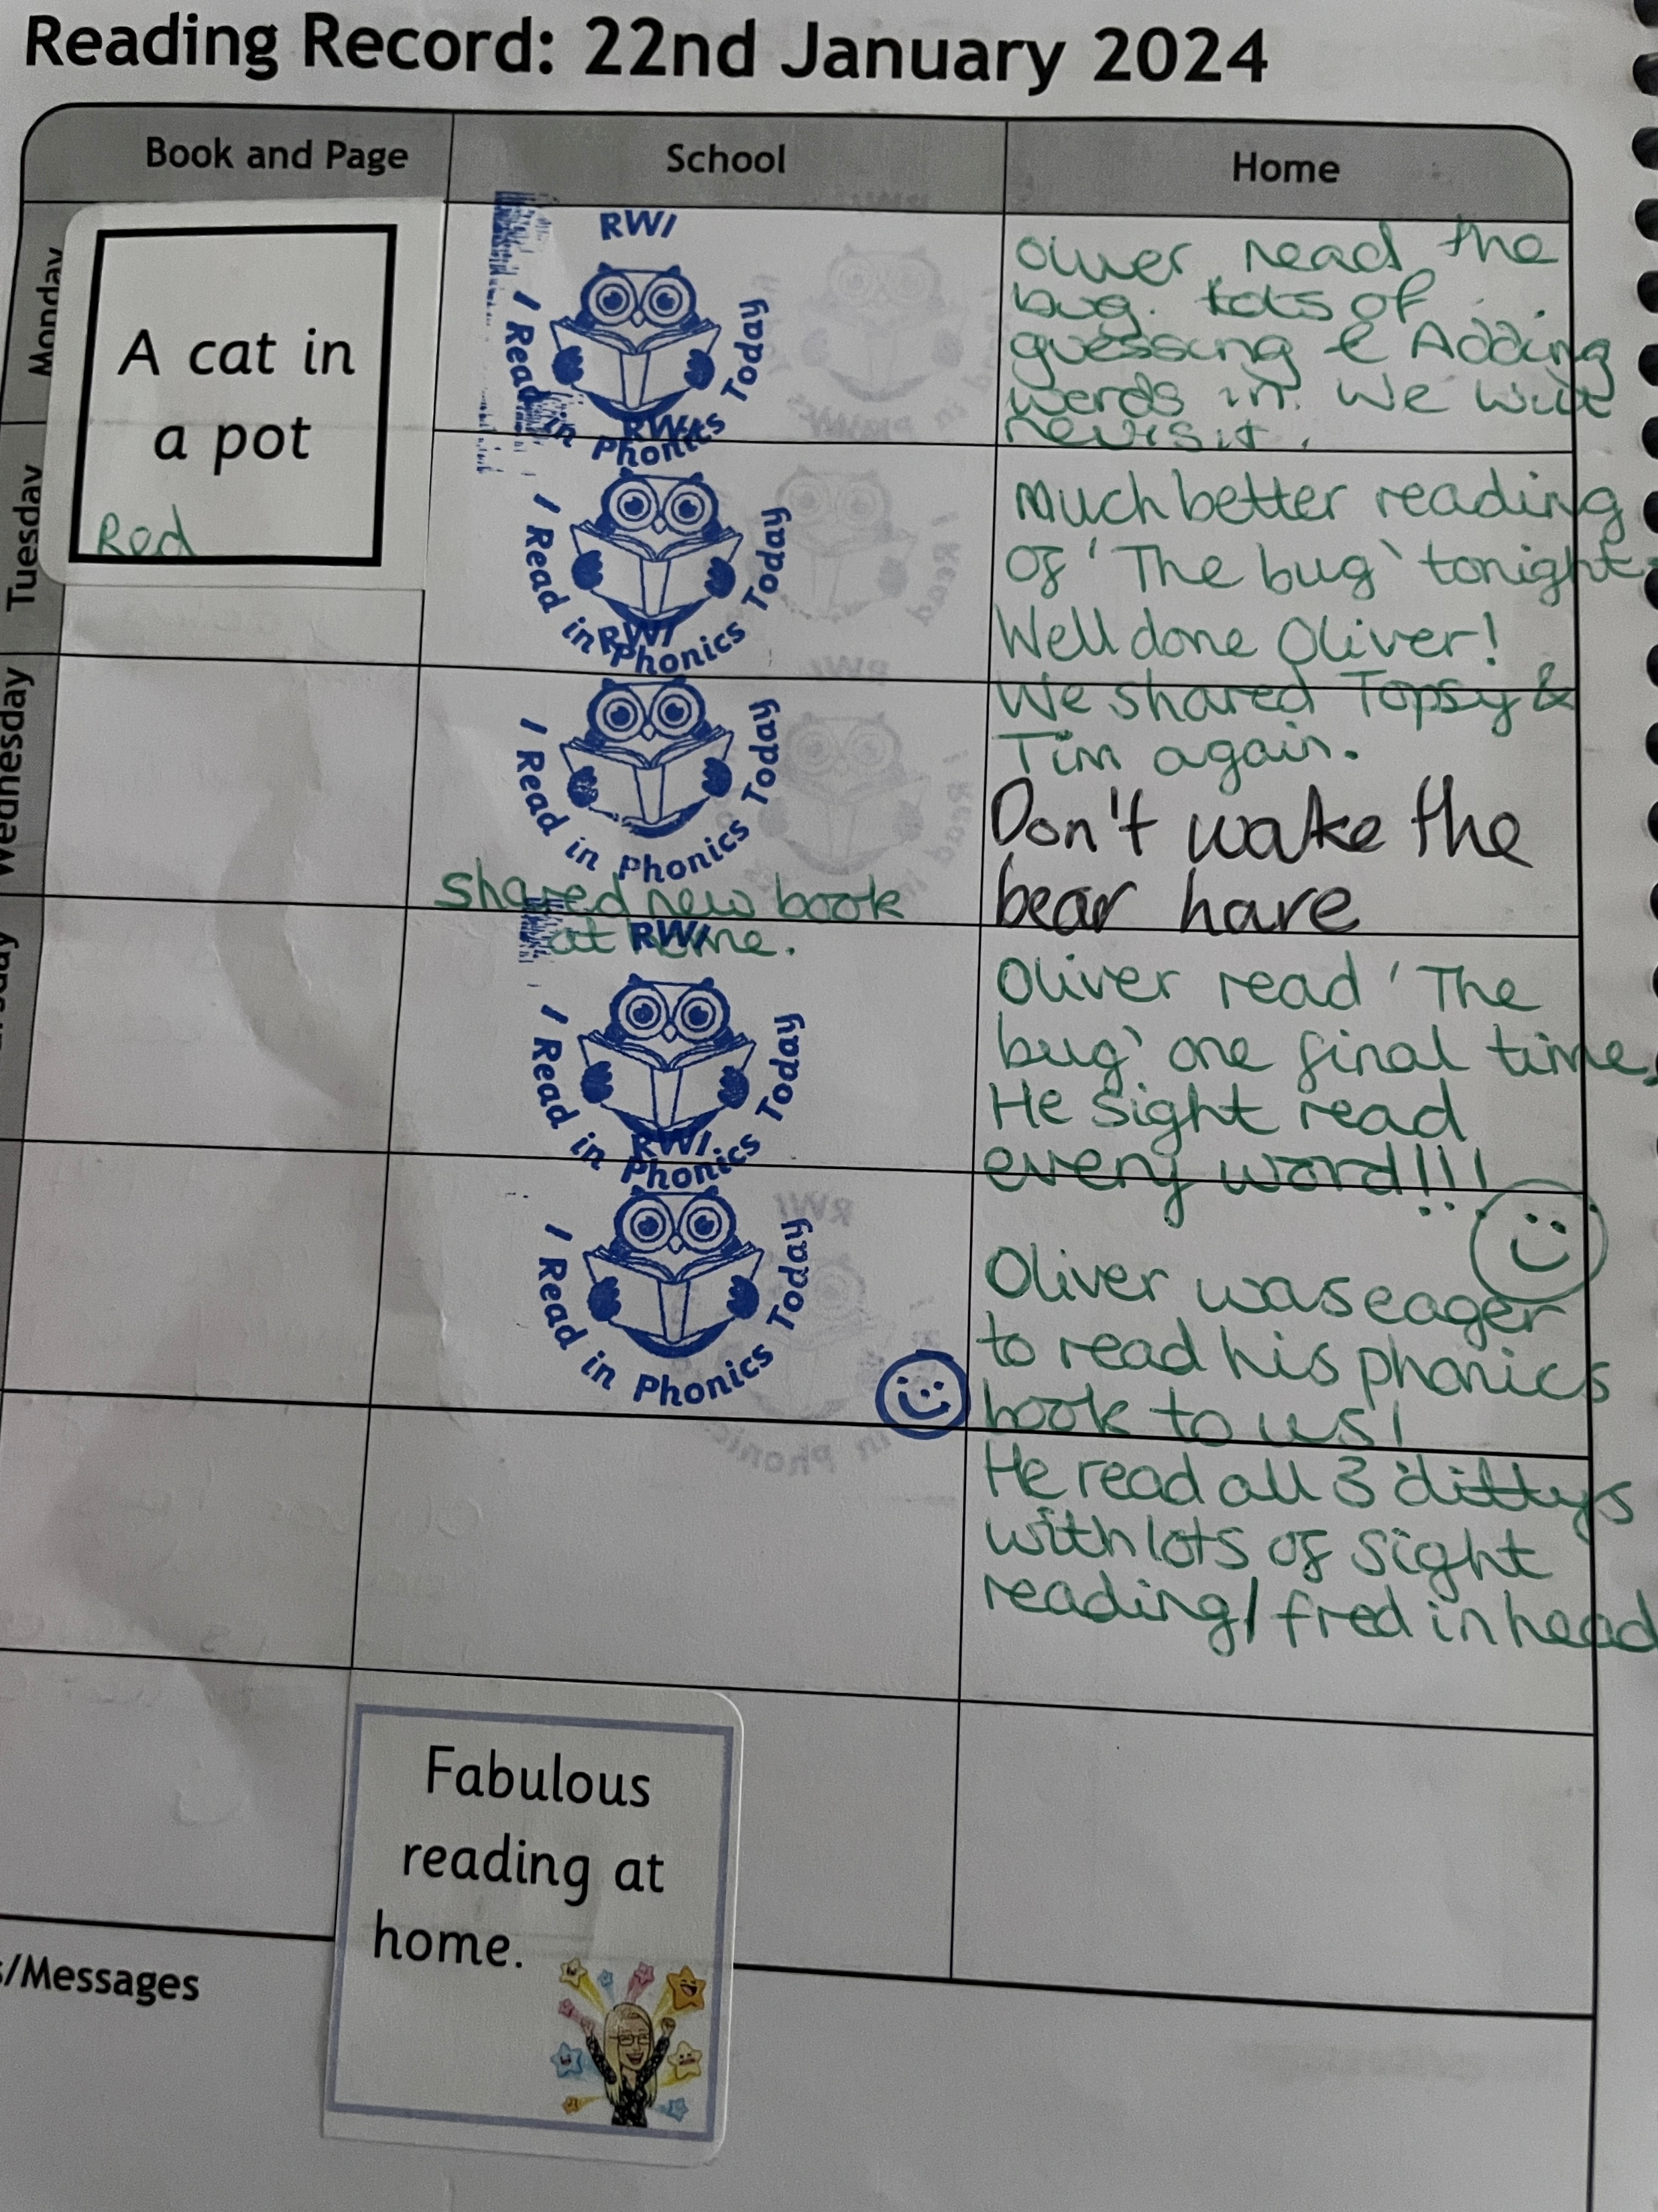
Reading in Year 1
Reading diaries are used and we ask that you comment on the books you have shared with your child at home each day.
Notes:
Sue

Slide 13

Homework
Homework will be set weekly.
This year homework has consisted of:
Daily reading
A weekly maths task
A weekly phonics/spelling task

Slide 14
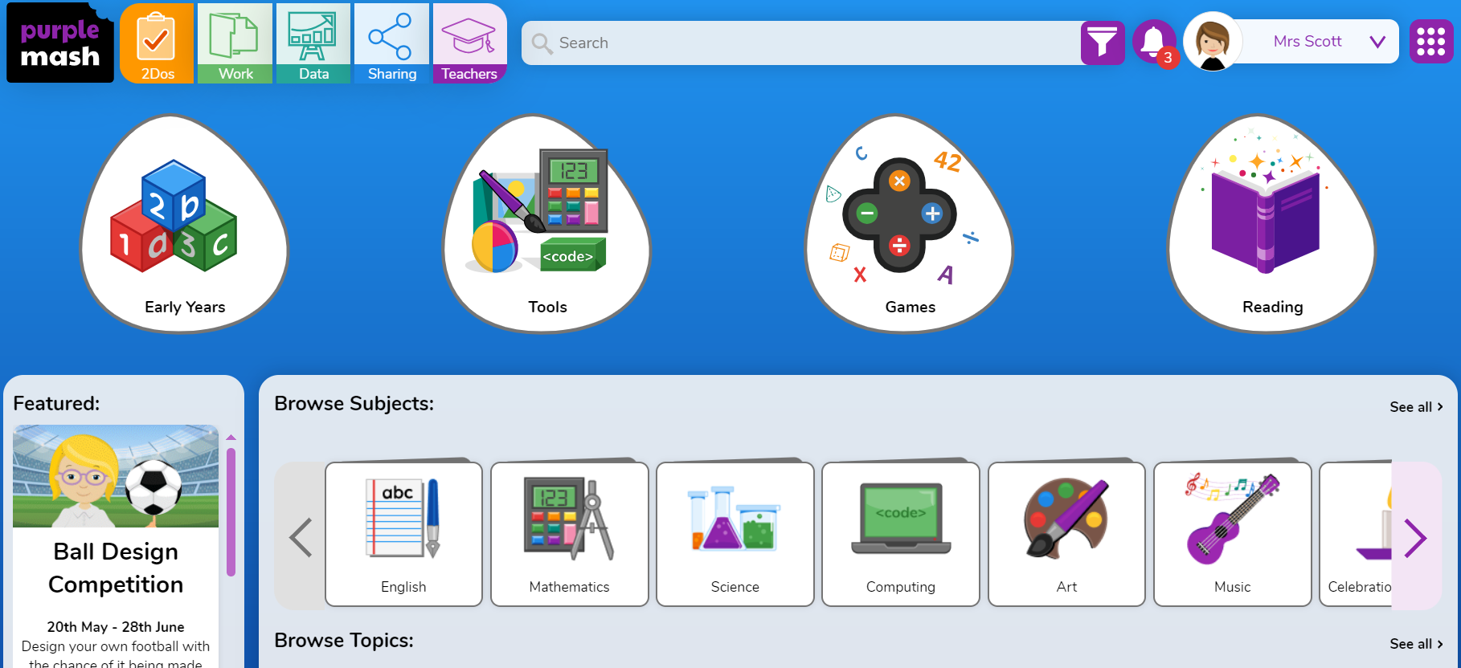
Homework
Some of the tasks for homework may be set as a 2Do task on Purple Mash.
Login details are in Reading diaries.

Slide 15
P.E.
P.E. in Year 1 will be on two different days.
These days will be confirmed via email.
The children must arrive in their P.E. kit.
P.E. Kit
P.E. t-shirt in their house colour team.
Plain navy blue tracksuit or shorts.
Trainers – Velcro preferably please.
Notes:
Laura

Slide 16
Year 1 Assessment
On-going teacher assessments will take place in Reading, Writing and Maths.
Formal assessments will take place once a term- commencing in Spring.
Phonics Screening will take place in June 2026 - date TBC.
Notes:
Bern

Slide 17
Year 1 Class Assembly
The Year 1 class assembly will be in the Autumn Term, date TBC.
Notes:
Sue

Slide 18
Any Other Information
Named Water Bottles - sports cap and water only.
Please put your child’s name in all clothing/ belongings brought into school.
No jewellery (including any earrings) to be worn.
Please keep us up to date on any changes in your contact details.
Notes:
Kim

Slide 19

Any Other Information
Snacks- children can either have toast (which is ordered & paid for via School Money) or bring in their own healthy snack. Children also have a variety of fresh fruit available to them each day.
Please remember we are a nut-free school.
We have a number of children in school
with serious nut allergies.
Notes:
Kim

Slide 20
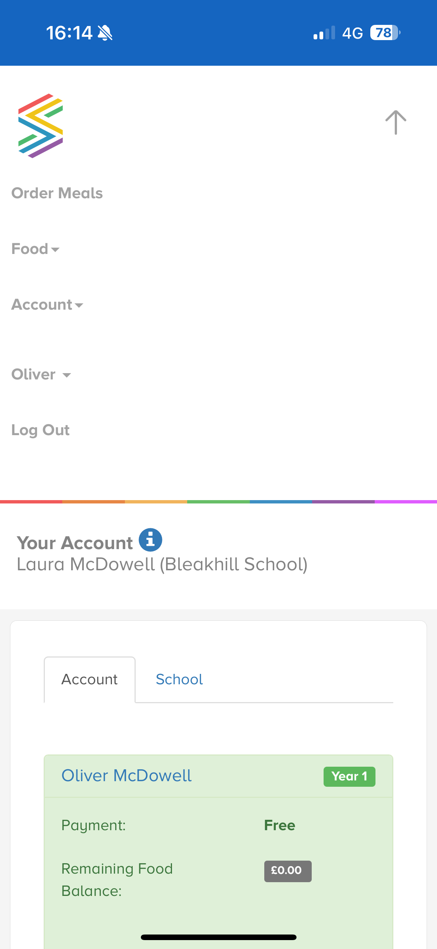
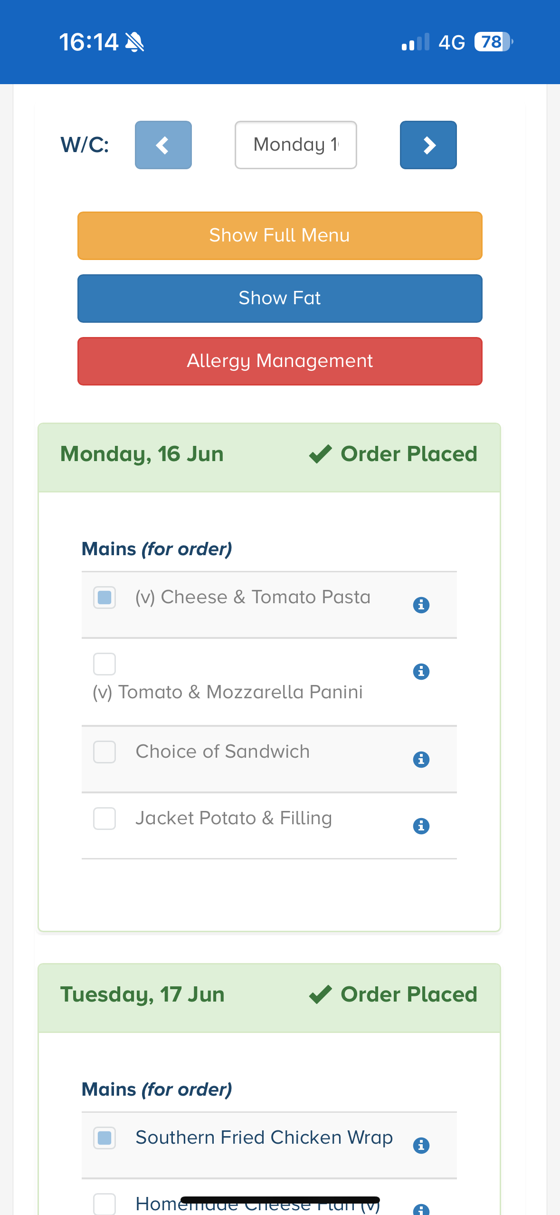
School Lunches
Please remember to order your child’s school lunch in advance via the School Grid App.
Notes:
Laura

Slide 21
Transition Day
Friday 4th July
Your child will be entering school at the usual time via their current classroom door.
Your child will be spending the day with their Year 1 teacher/s in their new Year 1 classroom. They will complete a range of activities during the day.
Your child needs to be collected from their new Year 1 classroom door – at 3.20pm
Notes:
Sue

Slide 22
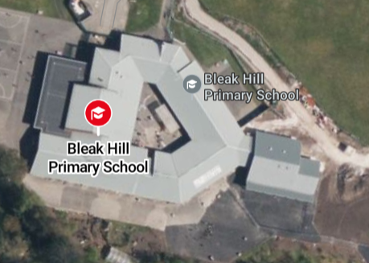
Transition Day
Your child will be collected from their new year 1 classroom door – this is in the courtyard.
The Year 1 classrooms are accessed via the courtyard.
1MA
1MR
Current
Reception
Classrooms
1ME

Slide 23
Contacting School
If you wish to contact staff, please do so via the Bleak Hill email.
bleakhillparents@sthelens.org.uk
Notes:
Bern

Slide 24
Thank you
We look forward to welcoming your child to Year 1 in September and working with you all for a successful year.

