Slide 1

Welcome to Year 5

Slide 2
Welcome to Year 5 2026!
Ms. Hudson Mrs. Brown
Mrs Maiden Mrs Fitzsimons

Slide 3

Values at St John’s
At St. John’s Church of England Primary School our Christian values are at the heart of everything we do. Our whole school community work together to create JOY in living and learning.
Our school values are:
• Respect
• Thankfulness
• Compassion
• Truthfulness
• Trust
• Responsibility

Slide 4
Values at St John’s
Our school motto is:
‘The JOY of the Lord is Your Strength’ (Nehemiah 8:10)
JOY represents JESUS, OTHERS, YOURSELF
• Give your heart to JESUS and follow his example
• Build positive relationships with OTHERS
• Be proud of YOURSELF

Slide 5
Curriculum
English – writing, reading, SPAG (Spelling, Punctuation and Grammar)
History
You can see the Year 5 curriculum overview in detail on the school website. This PowerPoint will also be available on our class page.
Geography
Maths
Art and Design
Design and Technology
Science
Music
PSHE/RSE
Physical Education
RE
French
Computing

Slide 6
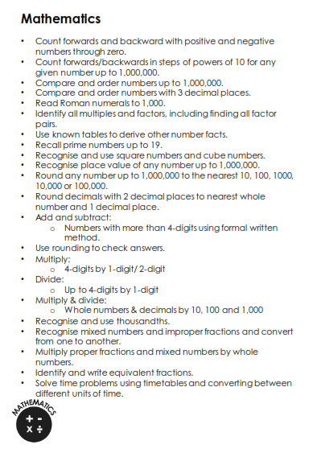
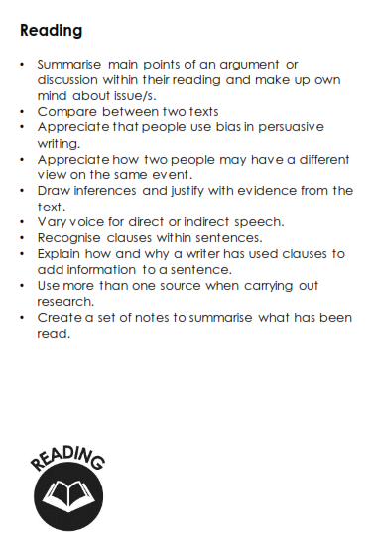
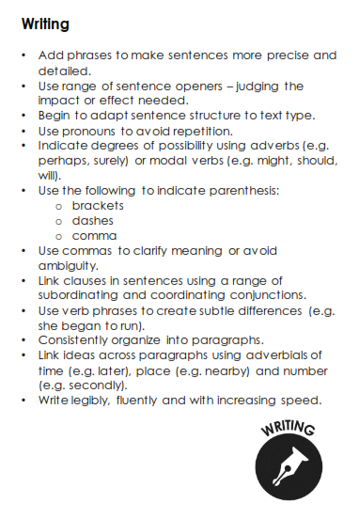
Year 5 End of Year Expectations

Slide 7
Home Learning
The following are non-negotiables and are an expectation of all Year 5 pupils:
Spellings will be tested on a Friday.
Children are expected to read at least three times a week. Reading records need to be in school every day but they will only be checked on a Friday. Logs must be signed by an adult.
Please practise times tables regularly. TT Rockstars is now available via the app.
Homework mats will be sent home termly and you should receive Autumn’s mat by Friday.

Slide 8

Spellings
We practise all our spellings daily in school
Year 5 Common Exception words will be tested half-termly in addition to weekly spelling tests. This is in preparation for KS2 SATS. Some children, dependent on their individual needs, may learn CEW spellings from an earlier year group.
These will be taught in school but it would be beneficial if they could be practised at home. They will be sent home and are available online.
National Curriculum spellings will be introduced on a Friday and expected to be practised at home. Some children may receive different spellings dependent on their individual needs.

Slide 9

Reading
Three key areas: fluency, accuracy and comprehension.
These skills are taught in school but need to be reinforced at home.
Fluency and accuracy – regular (daily) practise and correction.
Comprehension – questioning your child about their understanding of the text.
If your child loses their reading record, a new one can be purchased from the office for £1.

Slide 10
This font will be used to model to the children within lessons. Teachers will also model joined handwriting expectations.
Handwriting in St John’s
Handwriting is a skill that affects written communication across the curriculum. Our aim is that children are able to write with ease, speed and legibility.
In Years 4, 5 and 6, children will be expected to use cursive handwriting in all areas of the curriculum.
Those children whose writing is neat and legible may be encouraged to use handwriting pens.
Children will have dedicated time during the week to practice their handwriting.
For children to achieve the expected standard in writing in Year 6, they HAVE to show they can write joined up for a sustained amount of time / longer piece of writing consistently.
Remember we always start ALL letters on the line.
We have tall letters and small letters.
We have letters that sit on the line.
We have letters that go under the line.
We have letters that woosh…. (curved)
We have letters that reach… (straight)
Have a go and do your best… Don’t give up…

Slide 11
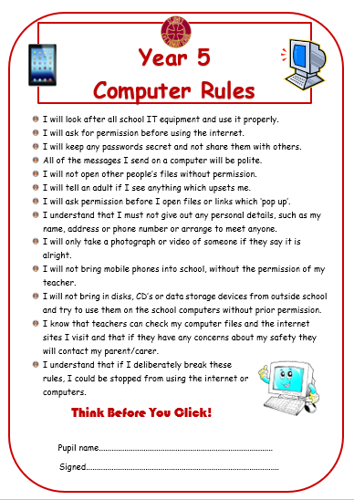
Computing and Online Safety
MOBILE PHONES: Letter to come….
All children are taught Online Safety regularly throughout the year.
Please familiarise yourself with the Year 5 computer rules on the school website.
If you are concerned about anything ICT based, please see a member of staff at school.
Useful Websites:
https://www.thinkuknow.co.uk/parents/
https://www.nspcc.org.uk/preventing-abuse/keeping-children-safe/online-safety/
http://www.safeguardingchildren.co.uk/parents-carers/e-safety-for-parents
https://www.saferinternet.org.uk/advice-centre/parents-and-carers
https://www.childnet.com/resources/know-it-all-for-parents
MOBILE PHONES: Letter to come….

Slide 12
Behaviour
“Pupils behave well and show positive attitudes to learning.” - OFSTED
Our Positive Behaviour Policy is based upon our school values and can be found on our school website.
Rewards – certificates; stickers; Dojos; Headteacher Awards; golden tickets awarded to the 2 highest Dojo winners in a class for that half term (who have not already won that year); reading prizes; attendance awards; 10 dojo’s for completed homework; in year 5 we have a weekly dojo winner who can have 15 minutes of craft a day for the whole of the following week.
“Bullying is rare and dealt with quickly and effectively.” – Pupil feedback to OFSTED.
Should you be concerned over any aspect, please speak to:
Class teachers
Miss Bishop – our pastoral support advisor
Mr Thomson
A positive home-school partnership is vital in ensuring that children fulfill their potential in school. We have adopted a parent and teacher code of conduct policy as a guide to establishing and maintaining these relationships.
A home school behaviour agreement will be sent home to sign and return.

Slide 13

Class Dojo
  This is our main form of communication so please check regularly / enable notifications if needed. It is intended for parent – not pupil use.
  Please check the main school story page as well as class pages for all your children. Our weekly newsletter is always shared on the main Dojo page and includes key upcoming dates
  We celebrate the work of children / classes / school on Dojo so it is a brilliant way of finding out about your child’s education.
  Please feel free to message at any time BUT…
  Teachers will check for any messages whenever they can between the hours of 8 and 4 on weekdays and get back to you as soon as they can. Please be patient as they will be teaching during the day and may not see the message immediately or have time to deal with any matters. Outside of 8-4, they are instructed to have notifications turned off.
  If you require an urgent response please ring the main office.

Slide 14
Please use Dojo for… | Please do not use Dojo for…
Checking regularly for updates and news on the main school page and on class pages - Ensure notifications are switched on if needed Making positive comments and celebrate JOY in school Sharing achievements from home Asking non-urgent questions – maybe regarding aspects of class organisation Arranging a time for a meeting or phone call should it be required. | Reporting absence to teachers – contact the office please Questions regarding school dinners – these should go via the office Complaints. Mr Thomson is always around and – should there be an issue – it is always better to chat than attempt to solve using a keyboard. If he is out then a member of the Senior Leadership Team is always available.
Ensuring ALL children in our care reach their FULL potential is a TEAM effort. Positive relationships between home and school ensure our whole school community works together to create JOY in living and learning.

Slide 15
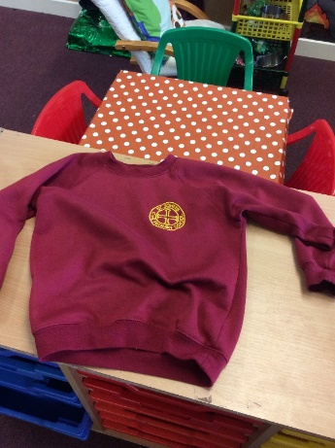
Uniform
Boys
Grey trousers or shorts
White polo shirt
Sweatshirt with school crest on
Grey socks and black school shoes (not black trainers)
Girls
Winter
Grey skirt, pinafore dress or grey trousers
White polo shirt
School sweatshirt or cardigan with school crest
White/ grey socks or grey tights and black shoes
Summer
Red and white checked dress
White socks and black shoes
Trainers may be brought into school to change into at lunchtime. If there is a problem with schools shoes, trainers can be worn to school then change into PE pumps.
PLEASE ENSURE ALL UNIFORM AND LUNCHBOXES ARE CLEARLY LABELLED.

Slide 16
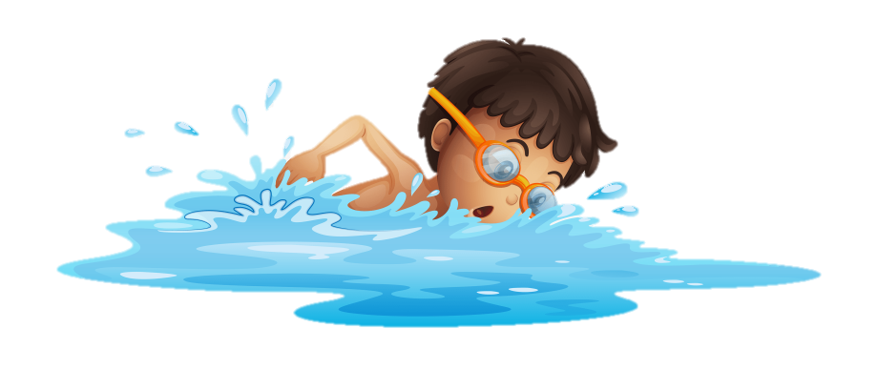
PE
Swimming lessons will begin after the October half term on a Thursday for approximately 10 weeks. A letter will be sent home prior to sessions staring. Please remember girls need a one piece costume and boys trunks/shorts must not be baggy.
All jewellery, including earrings must be removed due to the regulations at Dunes.
Swimming caps can be purchased from the school office for £2.
Plain white T-Shirt
Black shorts
Pumps
School Jumper is fine if cold outside
Plain tracksuit or leggings (black) may be worn for outdoor lessons during winter.
Please ensure your child comes into school in their PE kit on a FRIDAY.

Slide 17

Attendance Matters
Every child has a legal entitlement to attend school regularly.
Good attendance and punctuality are vital, as it not only impacts academic progress, but also your child’s general wellbeing.
We continually monitor attendance and punctuality at St. John’s and want to make sure that parents are well informed if there are concerns. You will be informed each term if your child’s attendance is of concern.

Slide 18
Attendance Matters
96% and above = good attendance
Between 90-95% = some improvement required. You will receive a Class Dojo message to notify you and an attendance plan may be required as a supportive measure.
Below 90%- persistent absence. A support plan will be required to work in partnership with you to improve the attendance figure.

Slide 19
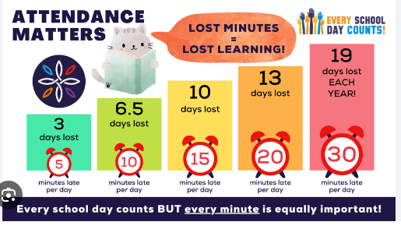
Attendance Matters
Every school day counts BUT every minute is equally important.

Slide 20
Attendance Rewards
Throughout the year we celebrate attendance successes whether that is excellent overall attendance or improved attendance!
Attendance challenges will be set periodically as reminders for the children of how important good attendance is.
Each week the class with the highest attendance percentage will earn extra playtime as a reward.
At the end of the year those with attendance above 96%, as well as children who have 100% attendance for the year, will be celebrated.
If you have any questions about your child’s attendance please speak to Mrs Thomas or Miss Bishop.

Slide 21


Please be aware that we are a NUT FREE SCHOOL!
We have children and members of staff with severe nut allergies who have epi pens in school. It is as severe as if any nuts are in the air, it can cause a reaction.
Please check any packaging of snacks / pack lunch items are nut free.
Remember that Nutella contains nuts!

Slide 22

General Information & Reminders
No eccentric hair styles/hair accessories/jewellery. No earrings P.E. – please provide plasters if these cannot be removed. No jewellery at all when swimming.
Children are encouraged to bring in water bottles and a piece of fruit for snack.
School equipment is provided.
Please call Mrs Bond in the school office before 9:30am if your child is ill.
The gate will open at 8:40 ready for teachers to collect their class at 8:45. The register is taken at 9am. A late mark will be given after this time.
Holidays – requests to Mr Thomson. These will be unauthorised absences unless there are exceptional circumstances.
    Mobile phones are not encouraged. If it is absolutely
    necessary for your child to have one, it will need to be switched off before they come through the gate and will be kept in the
    class stock cupboard for the duration of the school day.

Slide 23
General Information & Reminders cont.
Asthma inhalers – please ensure you send in an in-date inhaler, clearly labelled.
Medication must be signed in before it can administered. This should be clearly labelled with name and year group.
Class Dojo is our main method of communication. Please check in regularly for important updates and news. You can also send in messages/photos to share your child’s achievements.
Any changes to permissions for media and local visits must be provided in writing. Please ensure these are updated for this academic year.

Slide 24

Handle with Care
At St John’s we are here for your child, for you, and your family.
If your family is having a difficult time at home, we would like to provide additional support at school.
We understand family situations can be sensitive; you do not need to share the details with us.
After a difficult night, morning, or weekend, please just message your child’s class teacher on dojo and say, “Handle with care.”
We won’t ask any other questions. But we will give your child the extra time, patience, help, and care they might need that day. If you wish to talk through anything then we are always here – reach out to our pastoral team!
As always, we are a TEAM and we want to help your child thrive - always.

Slide 25
How can I support my child?
Websites | Apps | Books
BBC Bitesize Top Marks – Hit the Button is particularly good for times tables! www.spellingframe.co.uk www.sumdog.co.uk (Maths) www.onceuponapicture.co.uk (comprehension) www.primarygamesarena.com www.gridclub.com NRICH (Maths) | Spelling Shed (£2.99) 10 minutes a day times tables A+ Spelling Word Beach: Fun Spelling Games Hit the Button 9-10 Mental Maths (£3.99) King of Maths | KS2 English Comprehension: Year 5 – CGP KS2 Maths Targeted Study Book: Year 5 – CGP Practise and Learn: Spelling (10-11) – CGP KS2 Grammar and Punctuation Age 9-11 – Letts Handwriting Workbook Ages 7-9 – Collins Easy Learning
PLEASE NOTE: It is NOT an expectation for your child to complete additional work at home other than set homework, reading and spellings. Your child will be appropriately challenged/supported at school. This will be discussed at parents’ evening or feel free to arrange a meeting with me to discuss your child’s individual needs.

Slide 26

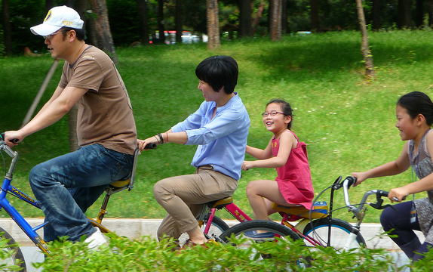
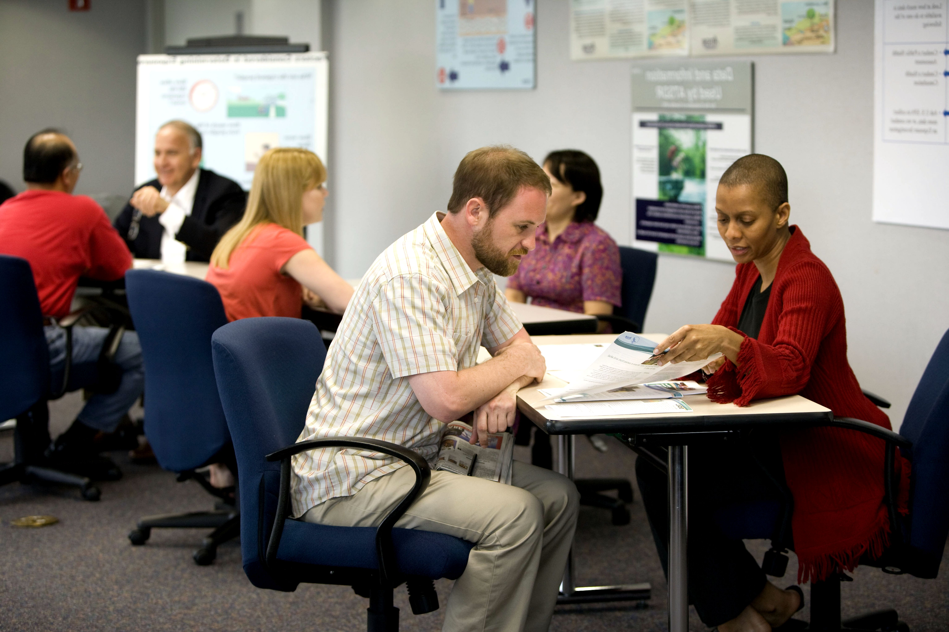
Read with your child!
Novels, newspapers, comics, graphic novels…anything with words!
Enjoy precious family time!
Home- school communication
50 things to do before you’re 11
https://www.nationaltrust.org.uk/features/50-things-to-do-before-youre-11--activity-list
Notes:
NOTE: To change images on this slide, select a picture and delete it. Then click the Insert Picture icon in the placeholder to insert your own image.

