Slide 1
Welcome to Year 2 ☺
Miss Klaassen
Mrs Lawson
Tuesday pm-
Mrs Lawson & Mrs Brant
Thursday pm-
Mrs Lawson & Mrs Pattell

Slide 2

Values at St John’s
At St. John’s Church of England Primary School our Christian values are at the heart of everything we do. Our whole school community work together to create JOY in living and learning.
Our school values are:
• Respect
• Thankfulness
• Compassion
• Truthfulness
• Trust
• Responsibility

Slide 3
Values at St John’s
Our school motto is:
‘The JOY of the Lord is Your Strength’ (Nehemiah 8:10)
JOY represents JESUS, OTHERS, YOURSELF
• Give your heart to JESUS and follow his example
• Build positive relationships with OTHERS
• Be proud of YOURSELF

Slide 4
Curriculum
English – writing, reading, SPAG (Spelling, Punctuation and Grammar)
History
Geography
You can see the Year 2 curriculum overview in detail on the school website on our class page.
Please note that this document may change as we go through the year!
Maths
Art and Design
Design and Technology
Science
Music
PSHE
Physical Education
RE
Computing

Slide 5
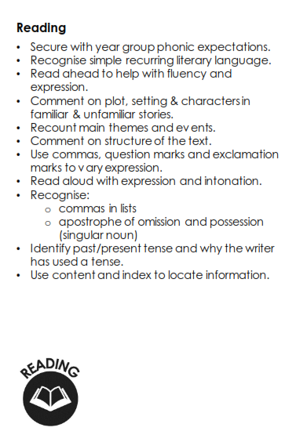
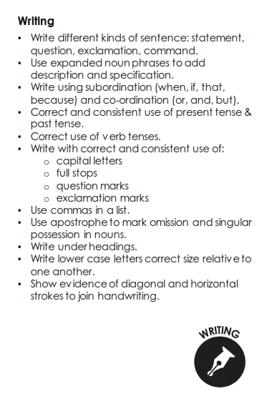
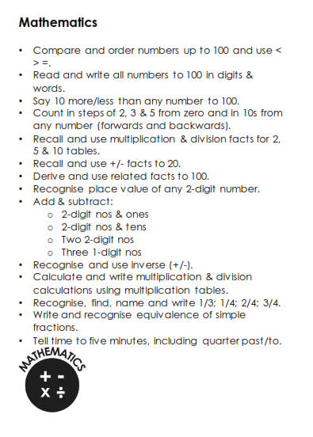
Year 2 End of Year Expectations

Slide 6
Busy Time
We understand that Year 2 is a step up from Year 1 and St John’s is trying to provide a bit more continuous provision style learning across KS1.
Our ‘Busy Time’ will allow the children to access focused activities and tasks around our topics to help develop their knowledge and understanding, whilst increasing their independence.

Slide 7
Home Learning
The following are non-negotiables and are an expectation of all Year 2 pupils:
Spellings will be tested on a Wednesday.
Children are expected to read at least three times a week. Reading records need to be in school every day but they will only be checked on a Wednesday. Logs must be signed by an adult.
Please practice times tables regularly. Numbots is now available via the app.

Slide 8
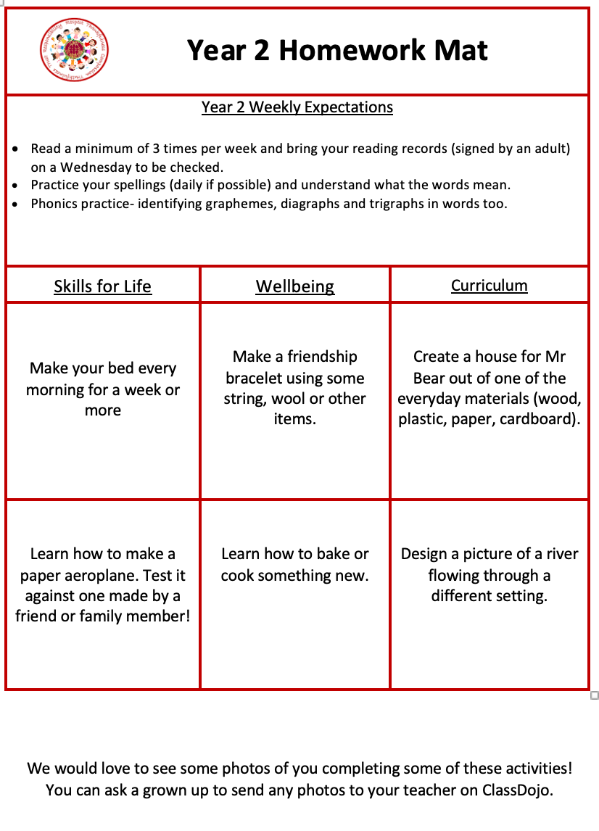
Homework mats

Slide 9
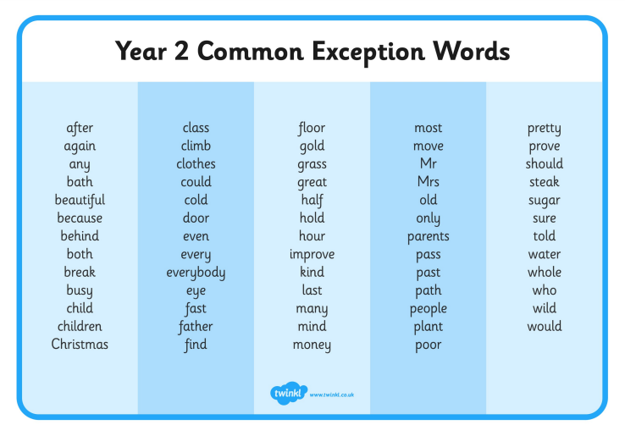
Spellings
Year 2 Common Exception words will be tested half-termly in addition to weekly spelling. Some children will continue to practice and consolidate their Year 1 Common Exception words before moving onto the Year 2 words.
We will try to teach the weekly test words in class but it would be really beneficial if they could be practised at home. (Being able to read and understand them first.) They will be sent home as a half termly list and also available on our class page on the website.

Slide 10

Reading
Three key areas: fluency, accuracy and comprehension.
These skills are taught in school but need to be reinforced at home.
Fluency and accuracy – regular (daily) practise and correction.
Comprehension – questioning your child about their understanding of the text.
If your child loses their reading record, a new one can be purchased from the office for £1.

Slide 11
This font will be used to model to the children within lessons. Teachers will also model handwriting expectations.
Handwriting in St John’s
Handwriting is a skill that affects written communication across the curriculum. Our aim is that children are able to write with ease, speed and legibility.
In Year 2, adults will model cursive writing from the beginning of the year as children will already be familiar with cursive.
The children will be encouraged to continue the development of basic joins which they should transfer into all their independent writing. They will also continue to link their handwriting to their phonic development as they learn to write new sounds using a cursive writing style.
Errors in pencil grip and letter formation will be immediately addressed, modelled and corrected.
Remember we always start ALL letters on the line.
We have tall letters and small letters.
We have letters that sit on the line.
We have letters that go under the line.
We have letters that woosh…. (curved)
We have letters that reach… (straight)
Have a go and do your best… Don’t give up…

Slide 12
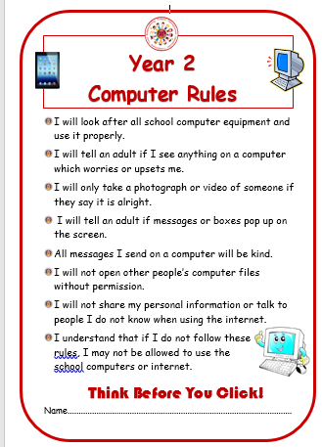
ICT and E-Safety
All children are taught E-Safety regularly throughout the year.
Please familiarise yourself with the Year 2 computer rules on the school website.
If you are concerned about anything ICT based, please see a member of staff at school.
Useful Websites:
https://www.thinkuknow.co.uk/parents/
https://www.nspcc.org.uk/preventing-abuse/keeping-children-safe/online-safety/
http://www.safeguardingchildren.co.uk/parents-carers/e-safety-for-parents
https://www.saferinternet.org.uk/advice-centre/parents-and-carers
https://www.childnet.com/resources/know-it-all-for-parents

Slide 13

Class Dojo
  It is our main form of communication so please check regularly / enable notifications if needed.
  We celebrate the work of children / classes / school on Dojo so it is a brilliant way of finding out about your child’s education.
  Teachers will check any messages whenever they can between the hours of 8 and 4 on weekdays and get back to you as soon as they can.
  It’s great for quick questions / notify us of pupil absence but if you require a more detailed discussion, please feel free to give us a ring (or request a call through Dojo)

Slide 14
Rewards
For following our school rules linked very closely to our values, children will receive dojo points.
Lots of points and praise for manners, presentation, effort.
Children can be awarded dojo points by any member of staff around school.
Golden tickets for outstanding pieces of work will be given out
– a trip to share work with Mr Thomson and a treat from the prize box!
Weekly certificates celebrating achievements and values.
A copy of our behaviour policy is on our website.

Slide 15
Please use Dojo for… | Please do not use Dojo for…
Checking regularly for updates and news on the main school page and on class pages - Ensure notifications are switched on if needed Making positive comments and celebrate JOY in school Sharing achievements from home Asking non-urgent questions – maybe regarding aspects of class organisation Arranging a time for a meeting or phone call should it be required. | Reporting absence to teachers – contact the office please Questions regarding school dinners – these should go via the office Complaints. Mr Thomson is always around and – should there be an issue – it is always better to chat than attempt to solve using a keyboard. If he is out then a member of the Senior Leadership Team is always available.
Ensuring ALL children in our care reach their FULL potential is a TEAM effort. Positive relationships between home and school ensure our whole school community works together to create JOY in living and learning.

Slide 16

Handle with Care
At St John’s we are here for your child, for you, and your family.
If your family is having a difficult time at home, we would like to provide additional support at school.
We understand family situations can be sensitive; you do not need to share the details with us.
After a difficult night, morning, or weekend, please just message your child’s class teacher on dojo and say, “Handle with care.”
We won’t ask any other questions. But we will give your child the extra time, patience, help, and care they might need that day. If you wish to talk through anything then we are always here – reach out to our pastoral team!
As always, we are a TEAM and we want to help your child thrive - always.

Slide 17


Please be aware that we are a NUT FREE SCHOOL!
We have children and members of staff with severe nut allergies who have epi pens in school. It is as severe as if any nuts are in the air, it can cause a reaction.
Please check any packaging of snacks / pack lunch items are nut free.
Remember that Nutella contains nuts!

Slide 18
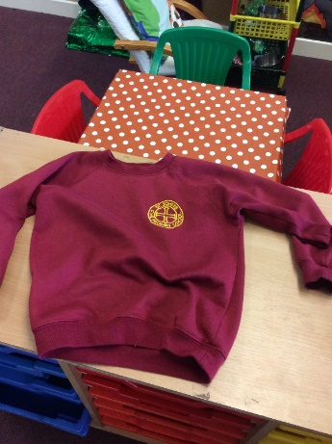
Uniform
Boys
Grey trousers or shorts
White polo shirt
Sweatshirt with school crest on
Grey socks and black school shoes (not black trainers)
Girls
Winter
Grey skirt, pinafore dress or grey trousers
White polo shirt
School sweatshirt or cardigan with school crest
White/ grey socks or grey tights and black shoes
Summer
Red and white checked dress
White socks and black shoes
Trainers may be brought into school to change into at lunchtime. If there is a problem with schools shoes, trainers can be worn to school then change into PE pumps.
PLEASE ENSURE ALL UNIFORM AND LUNCHBOXES ARE CLEARLY LABELLED.

Slide 19
PE
Plain white T-Shirt
Black shorts
Pumps
School Jumper is fine if cold outside
Plain tracksuit or leggings (black) may be worn for outdoor lessons during winter.
Please ensure your child comes into school in their PE kit on a Thursday.

Slide 20

Attendance Matters
Every child has a legal entitlement to attend school regularly.
Good attendance and punctuality are vital, as it not only impacts academic progress, but also your child’s general wellbeing.
We continually monitor attendance and punctuality at St. John’s and want to make sure that parents are well informed if there are concerns. You will be informed each term if your child’s attendance is of concern.

Slide 21
Attendance Matters
96% and above = good attendance
Between 90-95% = some improvement required. You will receive a Class Dojo message to notify you and an attendance plan may be required as a supportive measure.
Below 90%- persistent absence. A support plan will be required to work in partnership with you to improve the attendance figure.

Slide 22
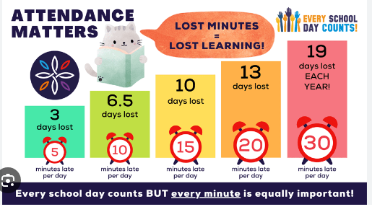
Attendance Matters
Every school day counts BUT every minute is equally important.

Slide 23
Attendance Rewards
Throughout the year we celebrate attendance successes whether that is excellent overall attendance or improved attendance!
Attendance challenges will be set periodically as reminders for the children of how important good attendance is.
Each week the class with the highest attendance percentage will earn extra playtime as a reward.
At the end of the year those with attendance above 96%, as well as children who have 100% attendance for the year, will be celebrated.
If you have any questions about your child’s attendance please speak to Mrs Thomas or Miss Bishop.

Slide 24
Forms
Medical
Photographs
Local trips

Slide 25

General Information & Reminders
No eccentric hair styles/hair accessories/jewellery. No earrings for swimming – please provide plasters if these cannot be removed.
Children are encouraged to bring in water bottles and a piece of fruit for snack.
School equipment is provided.
Please call Mrs Bond in the school office before 9:30am if your child is ill.
The gate will open at 8:40 ready for teachers to collect their class at 8:45. The register is taken at 9am. A late mark will be given after this time.
Holidays – requests to Mr Thomson. These will be unauthorised absences unless there are exceptional circumstances.
    Mobile phones are not encouraged. If it is absolutely
    necessary for your child to have one, it will be kept in the
    office for the duration of the school day.

Slide 26
General Information & Reminders cont.
Asthma inhalers – please ensure you send in an in-date inhaler, clearly labelled.
Medication must be signed in before it can administered. This should be clearly labelled with name and year group.
Class Dojo is our main method of communication. Please check in regularly for important updates and news. You can also send in messages/photos to share your child’s achievements.
Any changes to permissions for media and local visits must be provided in writing. Please ensure these are updated for this academic year.

Slide 27
How can I support my child?
Websites | Apps | Books
BBC Bitesize Crickweb (all subjects) Top Marks (Maths) Phonics Tracker Phonics Play Sumdog (Maths) | Spooky spellings Numbots (log ins will be sent out) | https://www.booksfortopics.com/year-2 Check out this link for recommended stories for 6 and 7 year olds
PLEASE NOTE: It is NOT an expectation for your child to complete additional work at home other than set homework, reading and spellings. Your child will be appropriately challenged/supported at school. This will be discussed at parents’ evening or feel free to arrange a meeting with me to discuss your child’s individual needs.

